Slide 1


Cambridge Rocky Worlds
Ariel
Quentin Changeat
Jan 2020
Notes:
Quentin. Talk was supposed to be Given by Gio. PhD student UCL work on Exoplanet atm: analysis of current data HST… And Simulations for the Ariel Space telescope
Present the Ariel Space Telescope from ESA and put it into the context of this conf

Slide 2
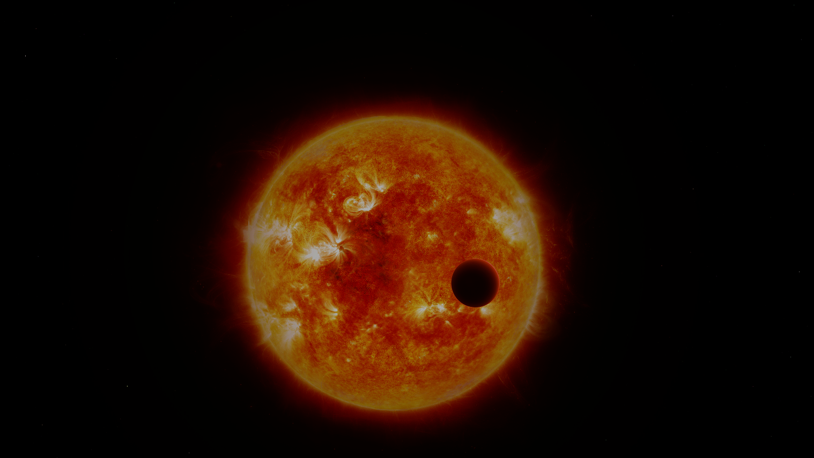
Plan
Agenda
ESA Ariel Space Telescope Presentation
Ariel targets
Ariel Simulations
Notes:
Plan for today is
Generic info about ARIEL and target selection
Simulations of Rocky exoplanets

Slide 3
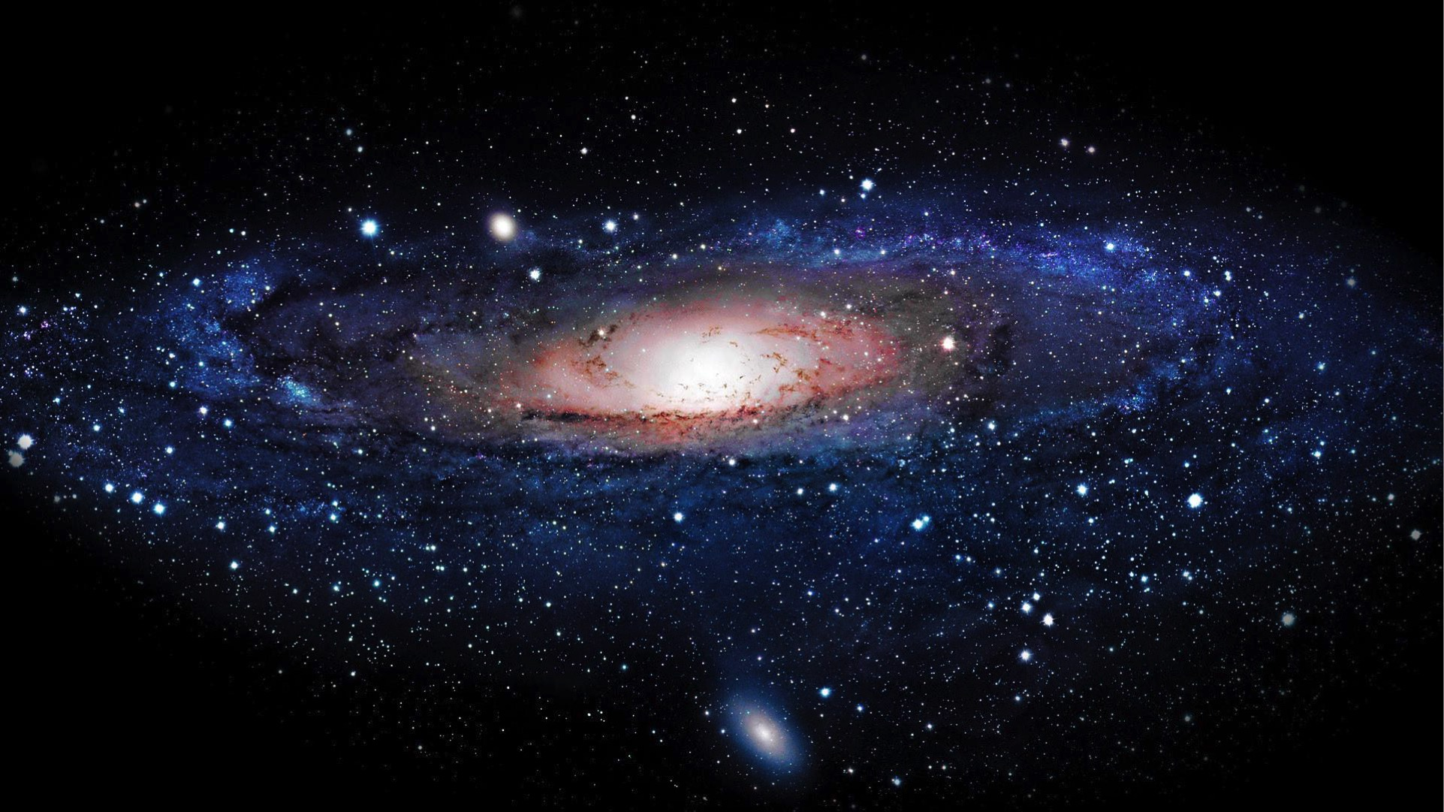
PLANETS ARE UBIQUITOUS
ESA ARIEL Space Telescope
https://arielmission.space/
AT LEAST AS MANY PLANETS AS STARS IN OUR GALAXY
Notes:
First, Generic statement and what we know about exo. We know that planets are everywhere. At least a planer per star in our galaxy

Slide 4
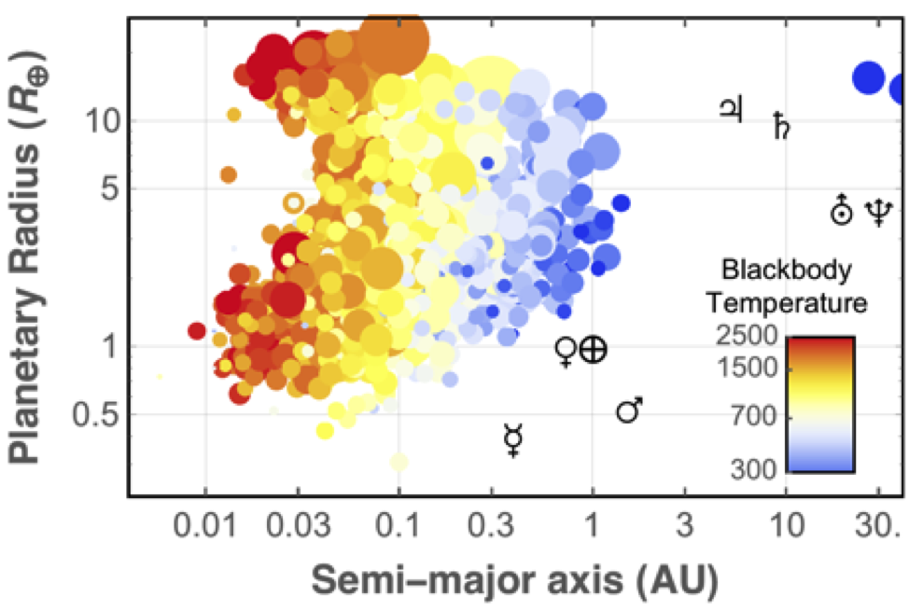
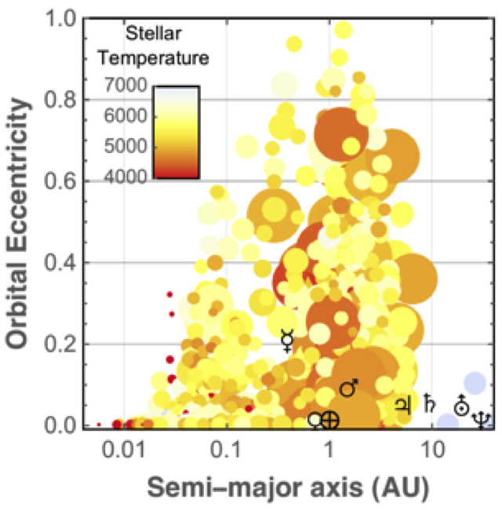
Around 4000 planets found -> Diverse population
ESA ARIEL Space Telescope
https://arielmission.space/
Exoplanets Today
Notes:
We also observe a very diverse pop of exoplanet. In the 4000 planets we know.. They range a very wide param space in rad, temp and position to the star.
Here is just a graph of radius and semi major axis.
We discovered new type of planets like super hot gas giants. Planets with molten surface, probably ice or water worlds…

Slide 5
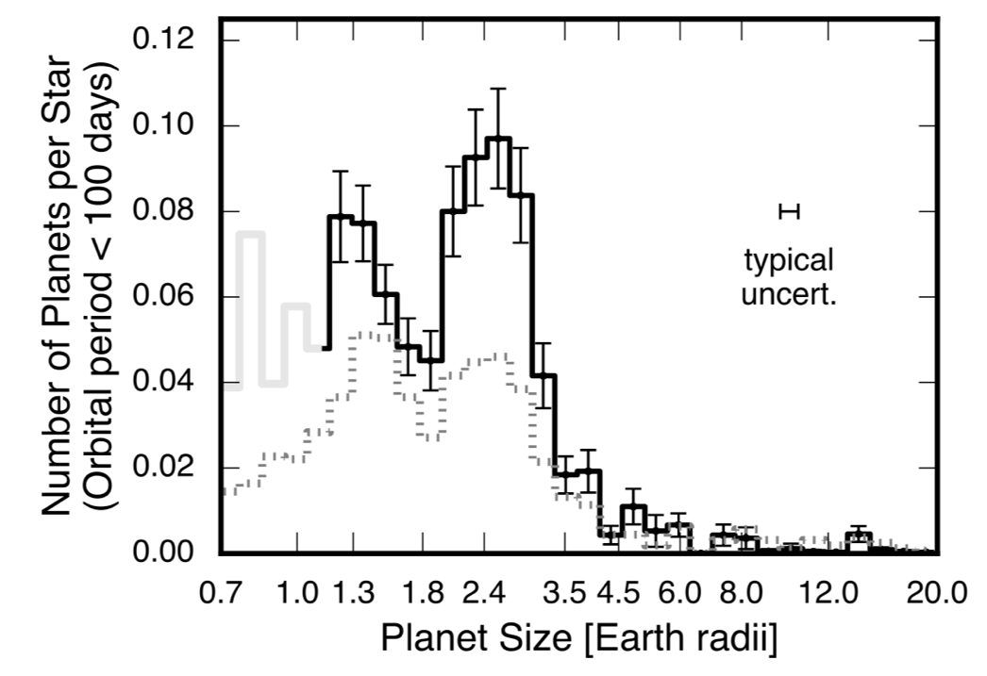
Around 4000 planets found -> Diverse population
ESA ARIEL Space Telescope
https://arielmission.space/
Exoplanets Today
Fulton et al.
Rocky planets
Gaseous planets
Notes:
This was possible because of the large sample of planets we detected. One of the great discovery I like is the Fulton gap: lack of planets around 1.8 Rp. Postulated that the planets below are rocky and can’t sustain light atm. The planets above are gaseous and more Neptune.
This is based on a limited amount of data. Namely 2 params Rp and sma. We also have mass for these planets.

Slide 6
Key exoplanet questions
ESA ARIEL Space Telescope
https://arielmission.space/
How do planets form and evolve?
How chemically diverse are exoplanets?
How does chemistry correlate with other parameters?
Have smaller planets retained H2/He envelope?
Need to study the atmospheres of a large number of planets!
Notes:
Other Key exoplanet questions/ answering the reasons:
How planets forms and evolve? Helping to answer migration processes, atmosphere evolution, primary/secondary, atmospheric loss
chemical diversity? Large diversity of exoplanets like magma, ocean, dry, TiO regimes..
chemistry and parameters? Can we link this diversity to classes
Small planet envelope? Escape processes, close in planets, H2/He sub Neptune to super earth

Slide 7
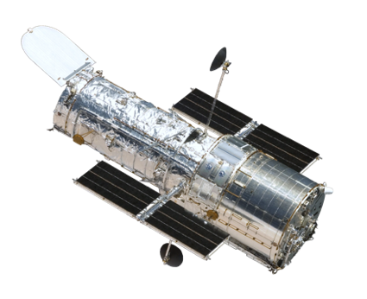
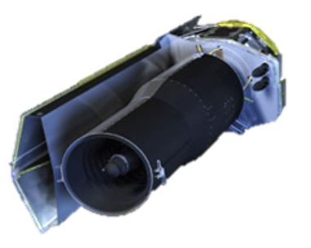
Current Observations
ESA ARIEL Space Telescope
https://arielmission.space/
HST
Low resolution and SNR
Limited wavelength coverage (and not
simultaneous)
Instrument systematics difficult to disentangle
Spitzer
Notes:
However, current observations are very limiting. Most of the instruments were not designed for exoplanet studies. So not particularly adapted. Low wl coverage and SNR. Resolution is limited. And the telescopes are subject to systematics. Do not take the obs simultaneously.

Slide 8
Answering the key questions
ESA ARIEL Space Telescope
https://arielmission.space/
We need:
  To observe hundreds of exoplanet atmospheres
We require:
  Specifically designed instruments
  Broad wavelength coverage
  Dedicated mission
Notes:
To answer these questions:
observe 1000 exoplanets with dedicated instrument:
broad w coverage, adapted SNR and resolution, 100% time for the mission (not like JWST)

Slide 9
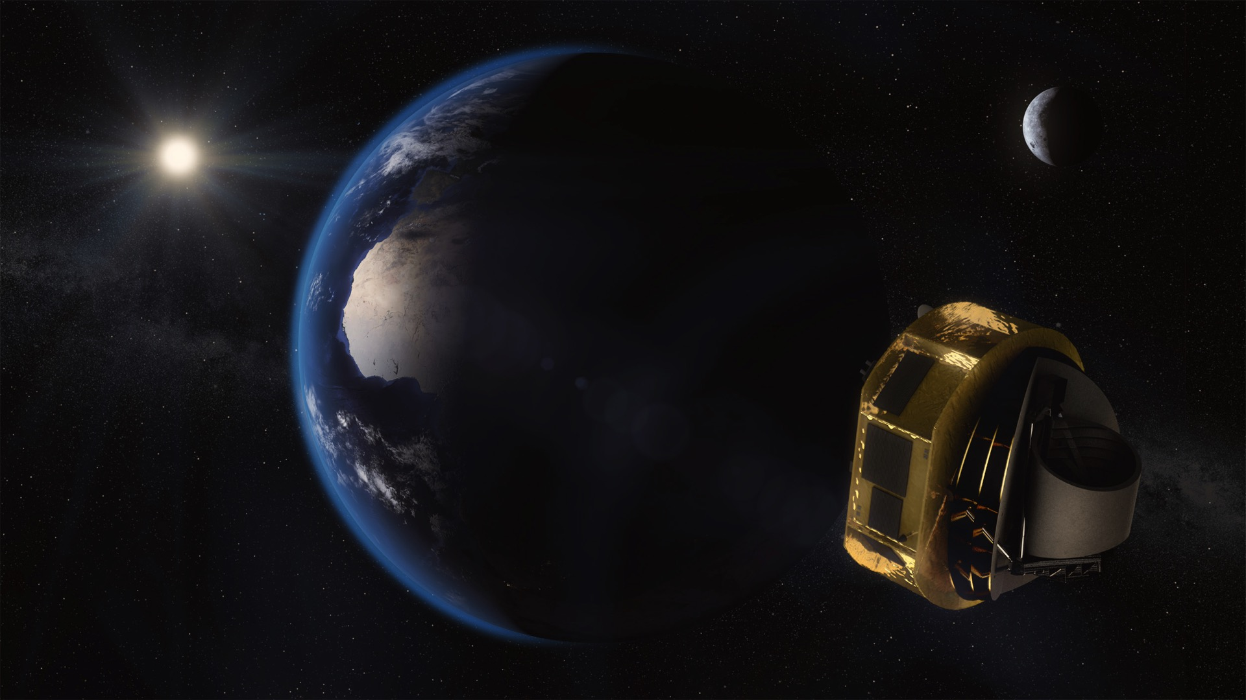
The Mission
ESA ARIEL Space Telescope
https://arielmission.space/
ESA medium (M4) mission: Launch 2028
Telescope aperture: 1m
Wavelength coverage: 0.5 - 7.8µm
Key science question:
  How chemically diverse are exoplanets?
Science goal:
  Observe ~1000 exoplanet atmospheres
Notes:
This is where ARIEL comes in
Launch 2028
1m telescope
Large w coverage
Observe a large sample of exoplanets

Slide 10
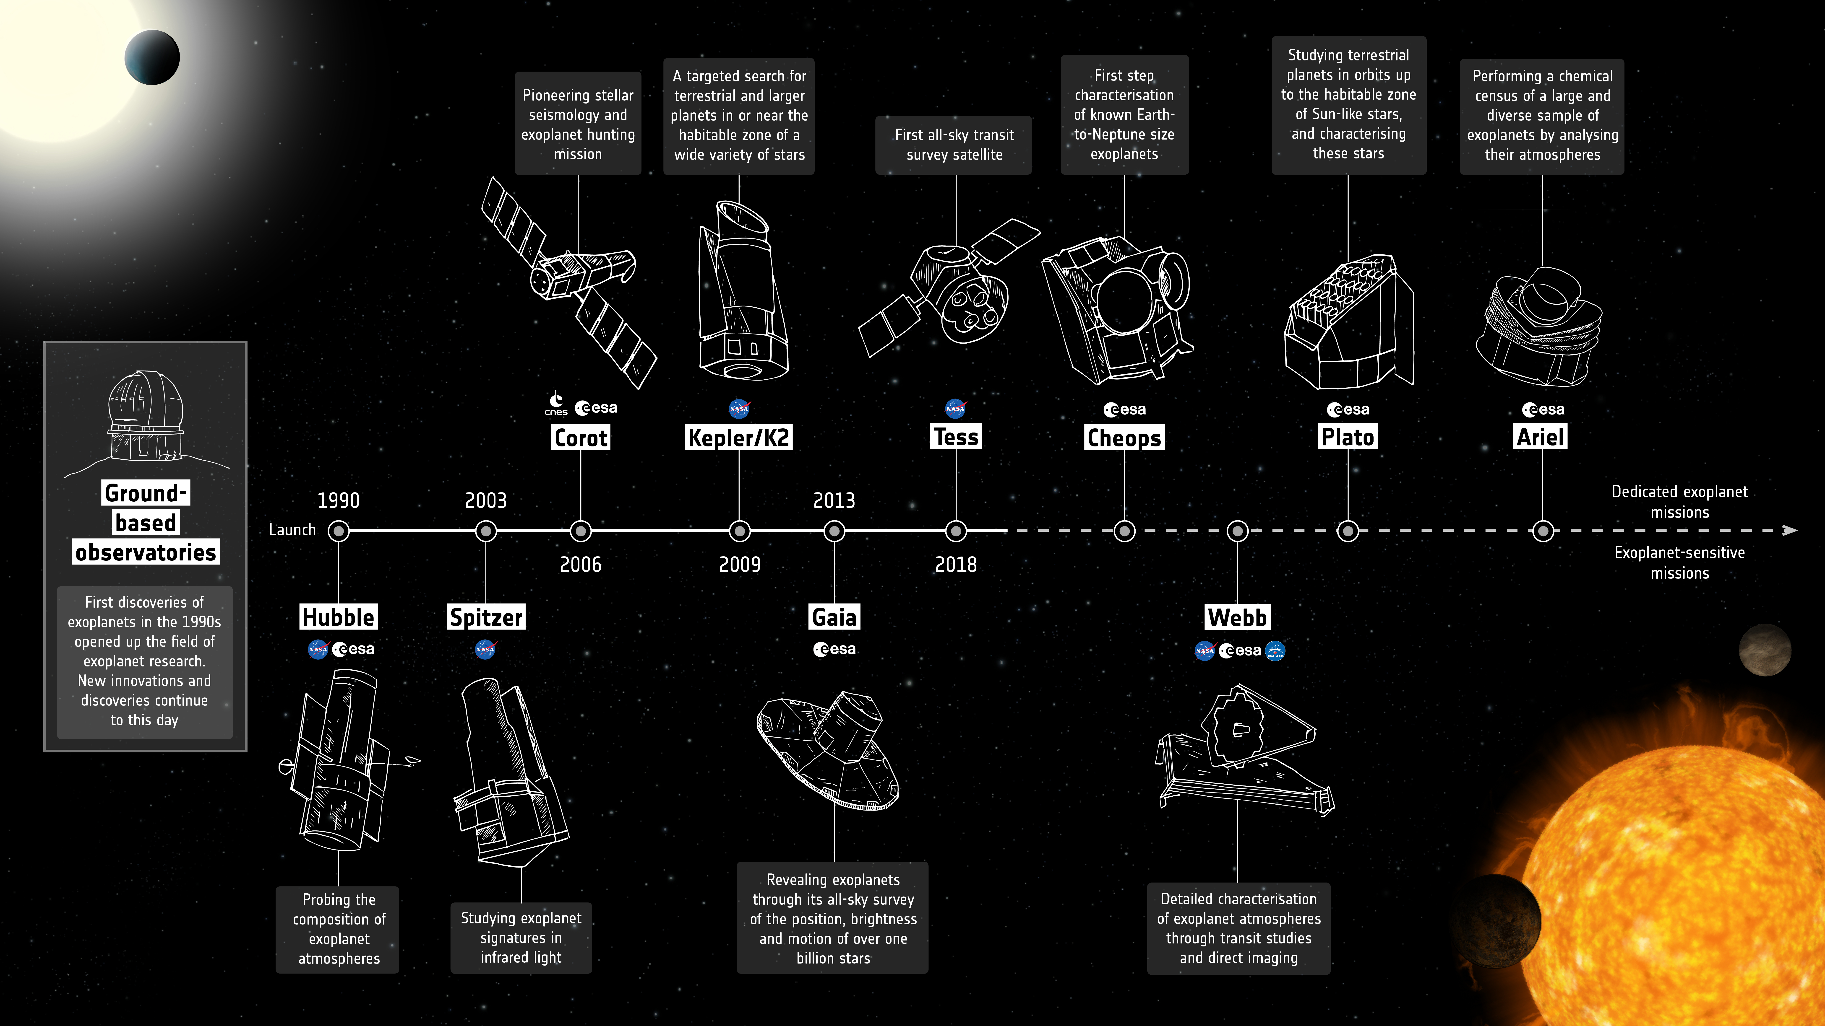
ESA ARIEL Space Telescope
https://arielmission.space/
WFIRST
Ariel
PLATO
TESS
JWST
CHEOPS
Notes:
An idea of the timeframe:
CHEOPS: characterize bulk parameters for MN and SE (gap characterisation)
PLATO: Exoplanet hunter: Finding terrestrial planets
JWST precise characterization of a limited amount of targets (transit + DI)
Ariel: first large scale study of atmospheres (1000 exoplanets in transit)

Slide 11
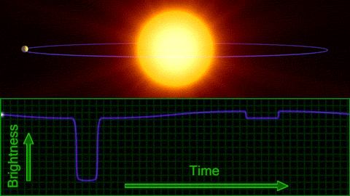
Observation Techniques
ESA ARIEL Space Telescope
https://arielmission.space/
Notes:
Ariel will use both transit and eclipse methods to constrain day and terminator of the planets.

Slide 12
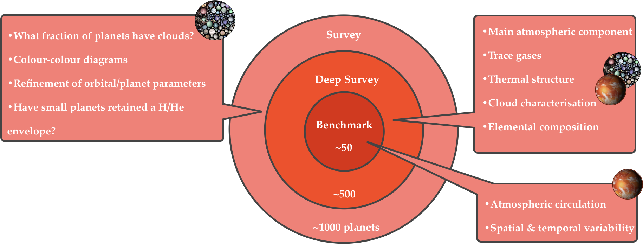
Observational Strategy
ESA ARIEL Space Telescope
https://arielmission.space/
Additional time for alternative science cases (ex phase curves)
Notes:
Observation plan divided in 3 categories:
Survey
Deep Survey
Benchmark
Survey:
Low resolution fast characterization: clouds? Simple params(H2O, radius, T)? Orbital params? Type of atm for small planets
Deep Survey:
Good targets in depth characterization: Atm components and trace gases, thermal profiles, cloud characterization, elemental comp (C/O ratio, metallicity…)
Benchmark:
Best targets: temporal spatial variations, atm circulation, phase curve

Slide 13
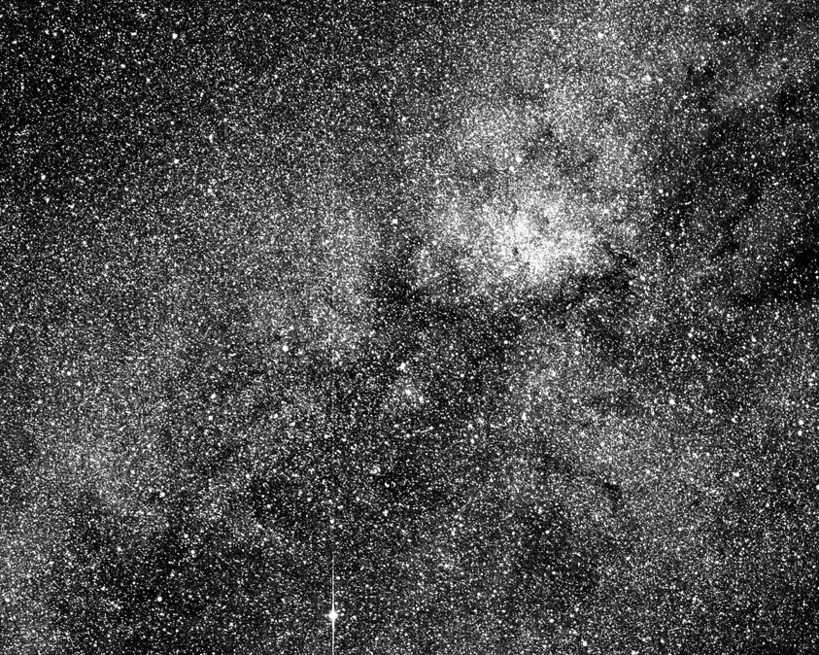
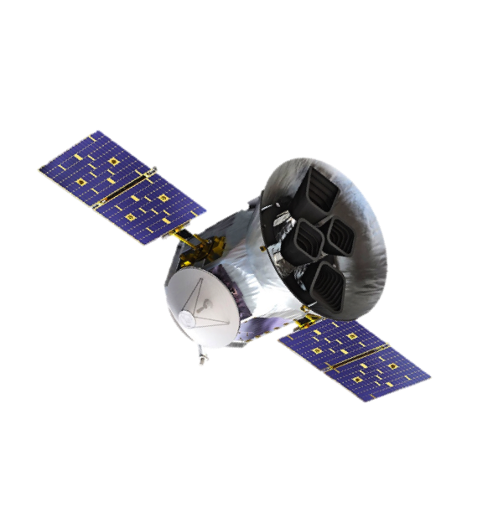
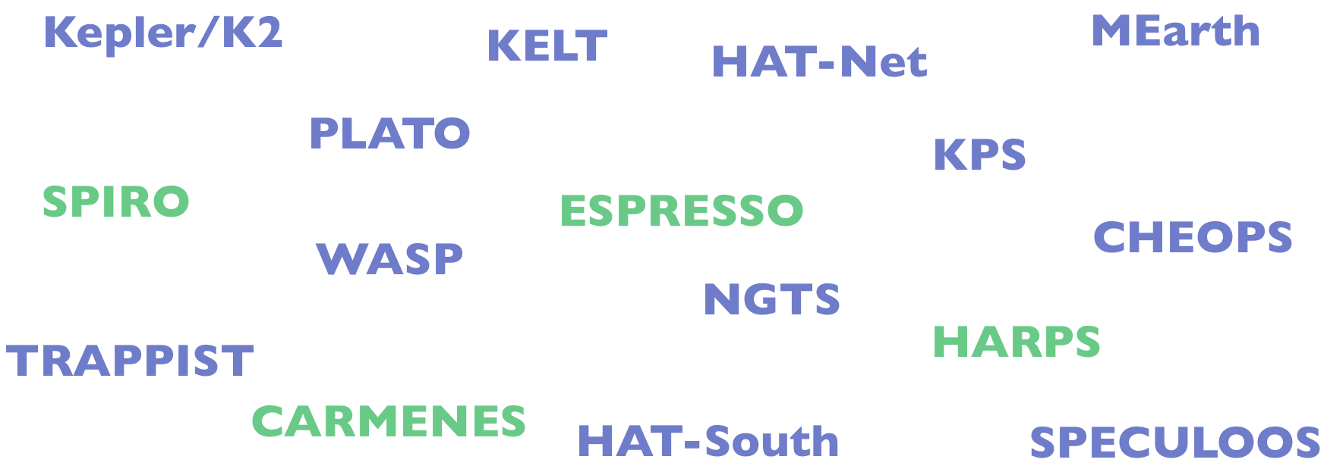
Sinergy with survey missions
ESA ARIEL Space Telescope
https://arielmission.space/
TESS
Launched in April 2018
Aim: Find transiting exoplanets
Notes:
But how where do we get our targets? Using already known targets and synergy with other missions like tess, we can build a catalogue of expected targets for when Ariel launches

Slide 14


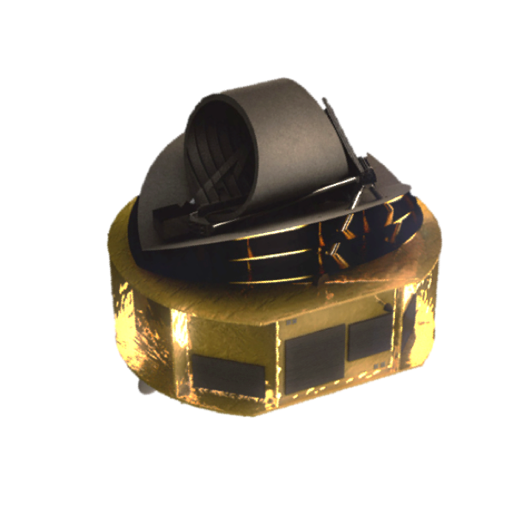
Current potential targets
ESA ARIEL Space Telescope
https://arielmission.space/
Master Catalogue
NASA Exoplanet Catalogue
Tier 1:
  ~2000 planets in ≤ 5 observations
Tier 2:
  ~1000 planets in ≤ 20 observations
Tier 3:
  ~150 planets in ≤ 2 observations
Supplementary Catalogues
Exoplanet.eu
Open Exoplanet Catalogue
TEPCat
Edwards et al. 2019
Notes:
This is what we get. The key point being that we already have enough targets for the mission.

Slide 15
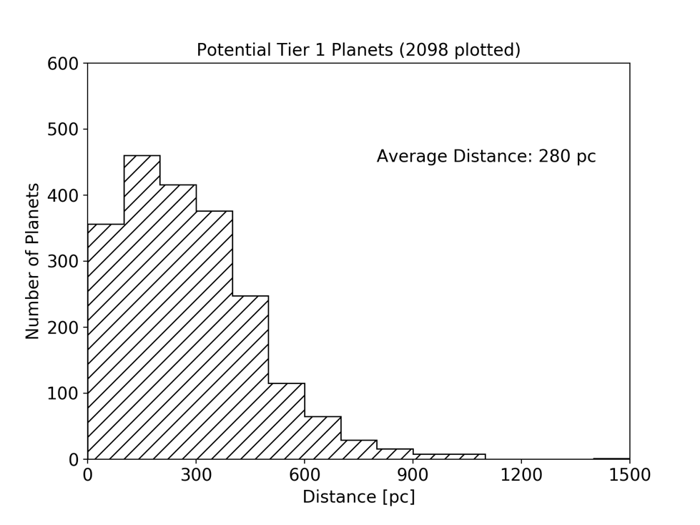
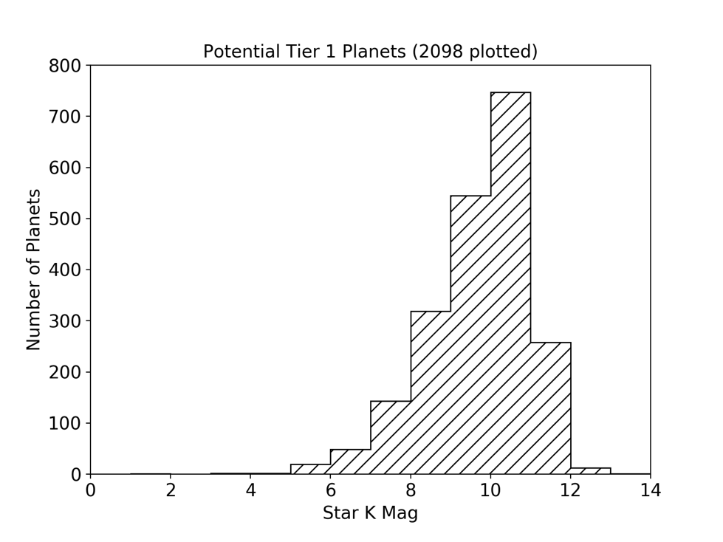
Simulated targets for Ariel
ESA ARIEL Space Telescope
https://arielmission.space/
Planets are around bright, nearby stars
Edwards et al. 2019
Notes:
An example of the distribution of the planets we want to observe.
Distance in pc and number of planets. So relatively close starss
The magnitude. Rtelatively bright stars.

Slide 16
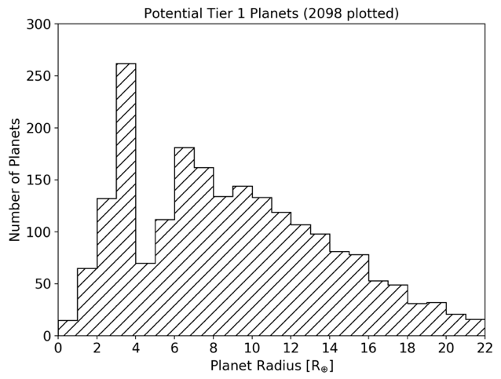
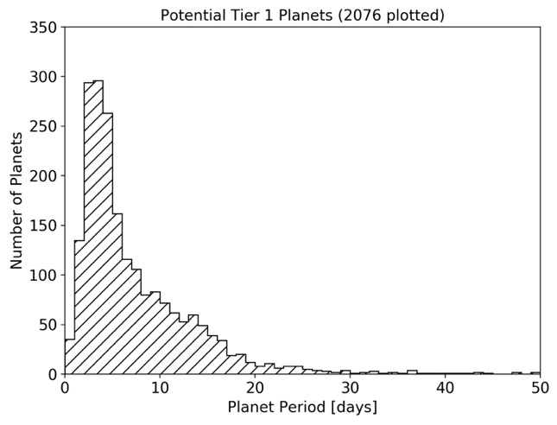
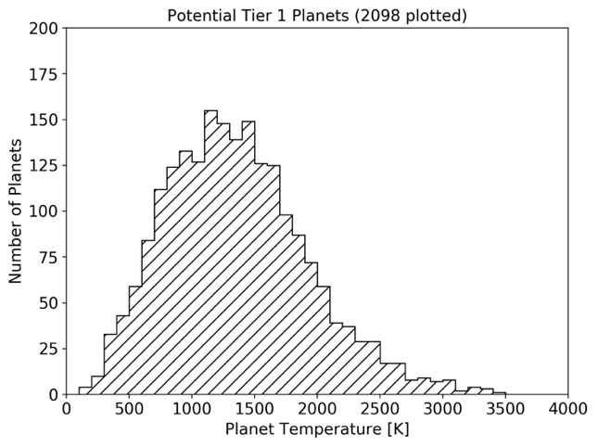
Simulated targets for Ariel
ESA ARIEL Space Telescope
https://arielmission.space/
The entire parameter space is explored
Edwards et al. 2019
Notes:
In terms of the category of planets. These are everywhere. And that’s where u should be interested: A good number of targets may be in the super earth regime.

Slide 17
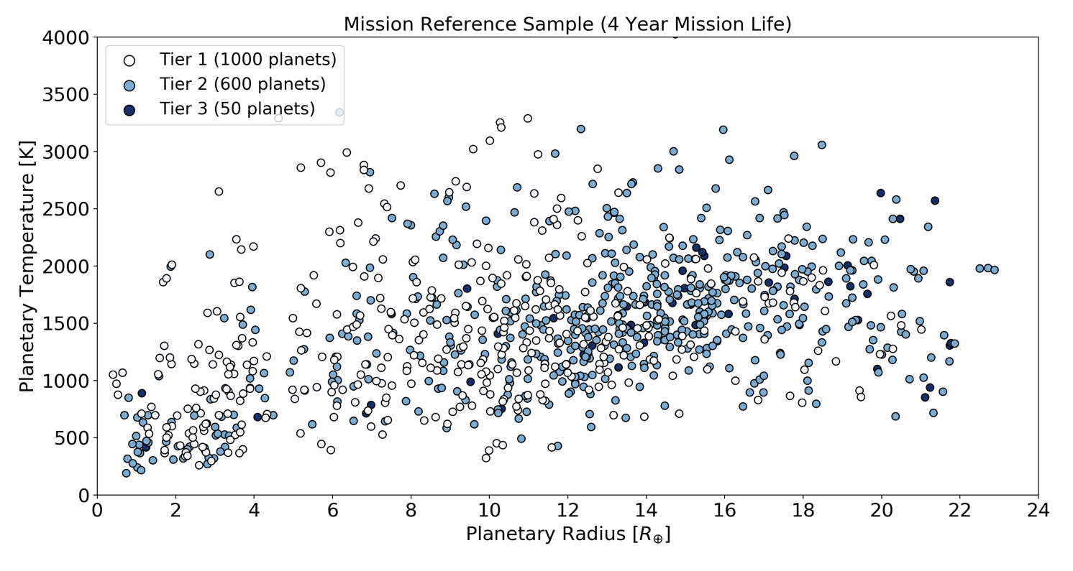
Mission Reference Sample
ESA ARIEL Space Telescope
https://arielmission.space/
Simulated from TESS expected yield Barclay, Pepper & Quintana, 2018
Notes:
If we decompose a particular simulation of the targets observed by Ariel, this is what we get. Quite a good amount in the terrestrial regime, which have high enough signal to be observed.

Slide 18
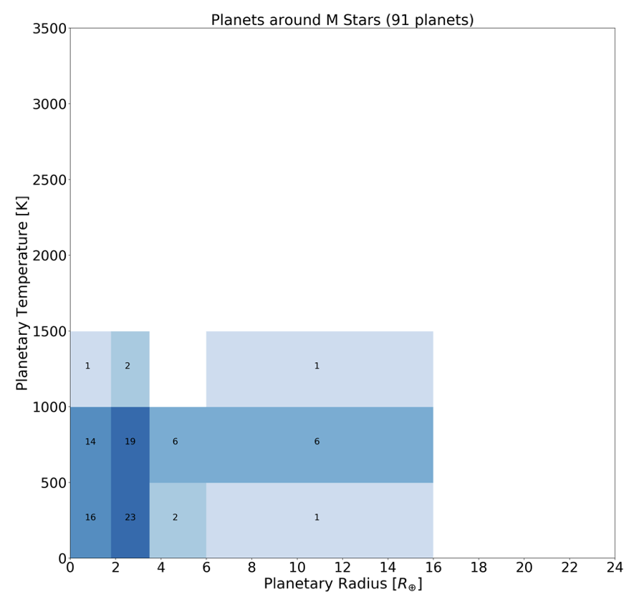
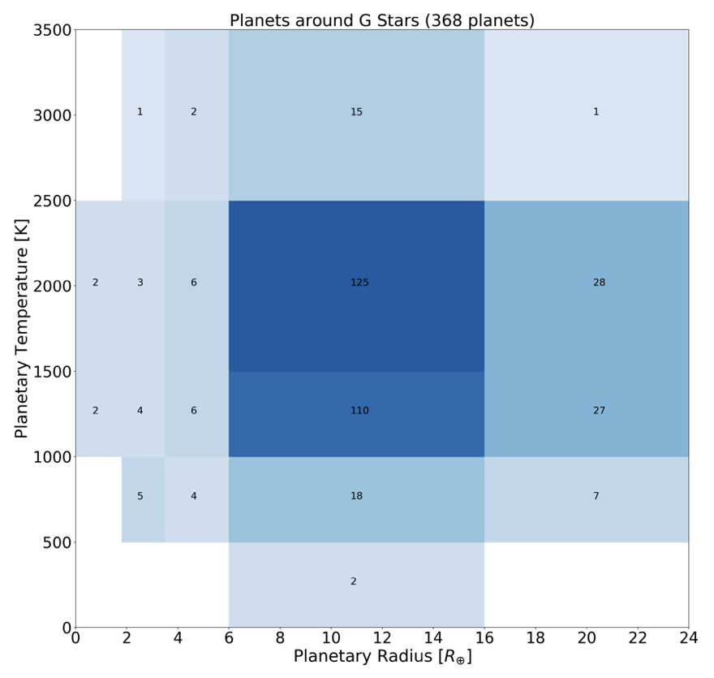
Mission Reference Sample
ESA ARIEL Space Telescope
https://arielmission.space/
Simulated from TESS expected yield Barclay, Pepper & Quintana, 2018
Notes:
Another way to say it span the entire parameter space.

Slide 19
ARIEL Simulations for rocky worlds
ESA ARIEL Space Telescope
https://arielmission.space/
Notes:
Now let’s look at examples of planets we could observe with Ariel

Slide 20

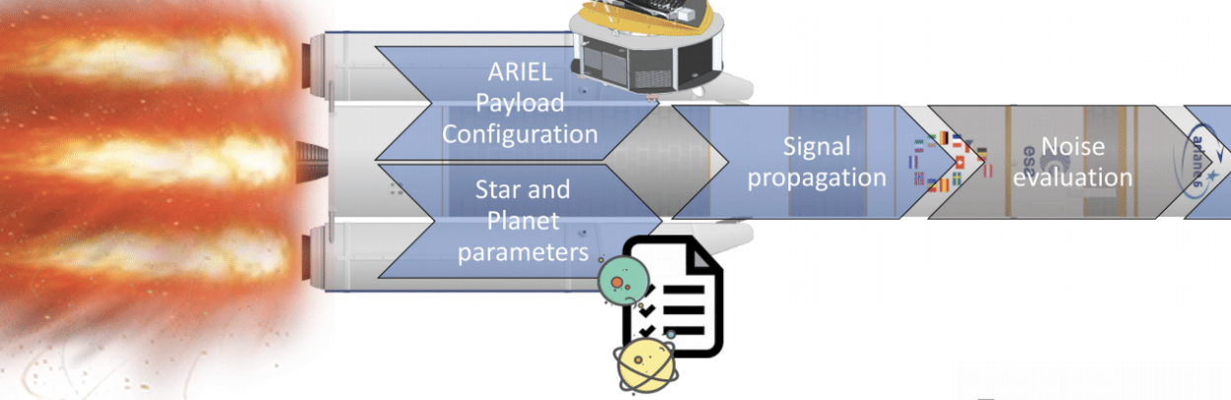
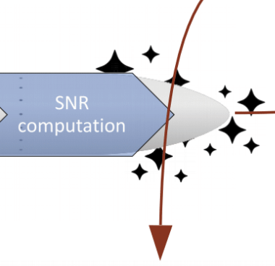
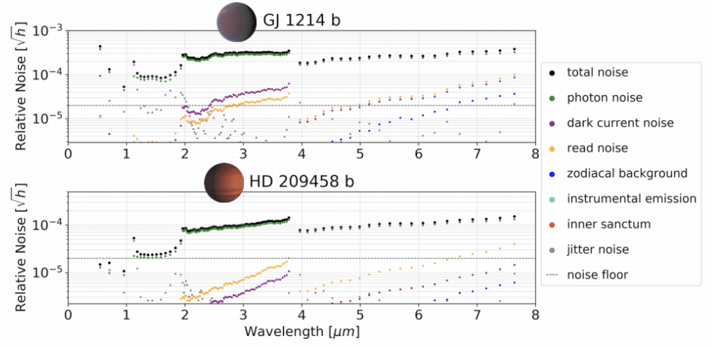
ArielRad
ESA ARIEL Space Telescope
https://arielmission.space/
This simulator, starting from a parametrization of ARIEL Payload and a list of planets to observe, makes use of a Physically motivated noise model to evaluate ARIEL performance.
Mugnai L., Edwards B., Papageorgiou A., Pascale E. and Sarkar S. (2019)
Notes:
This is simulations of course and we use our noise simulator ArielRad which takes the telescope config and the system parameters as input to return the noise in the observation

Slide 21
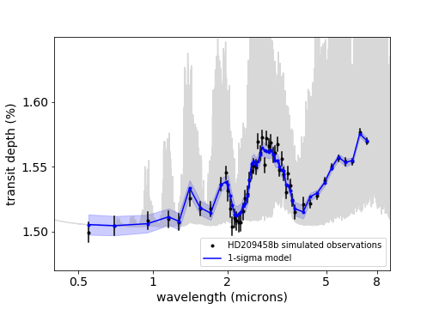
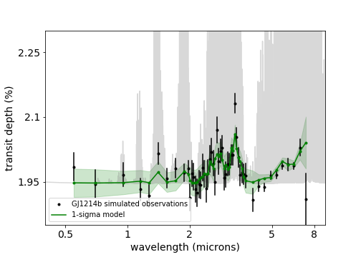
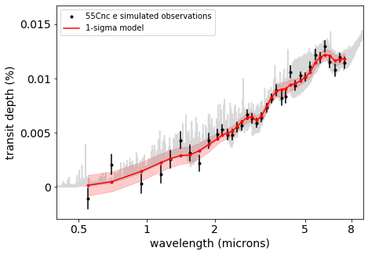
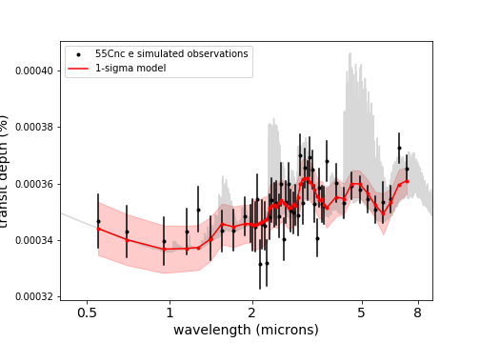
Simulated Ariel Observations
ESA ARIEL Space Telescope
https://arielmission.space/
TauREx 3 (Al-Refaie et al. 2019)
ArielRad (Mugnai et al. 2019)
1 obs
5 obs
40 obs
40 obs
Notes:
When applied this is what we have for 3 different planets
HD209:
H2, He
0.17
CH4 1e-6
CO 1e-6
H2O 1e-4
NH3 1e-6
GJ1214
CH4 1e-5
CO 1e-12
H2O 1e-4
NH3 1e-12
55Cnc:
H2, He, N2
0.17, 0.5
CH4 1e-6
CO 1e-3
H2O 1e-7
HCN 1e-5

Slide 22
55 Cancri e
ESA ARIEL Space Telescope
https://arielmission.space/
Few facts:
1.9 Re
Tidally locked
2300 K to 1300K
Magma ocean on day side
Atmosphere with some H2
Day side mineral atmosphere
Notes:
This type of planet is particularly interesting as depending on what is detected in the atm, we can trace back to the magma composition and maybe formation. The nature is still poorly understood (why do we see the H2, can we say anything abou the magma from the atm). Also constraints from modelers can help to understand this planets and future obs

Slide 23
55 Cnc e: Mineral atmosphere
ESA ARIEL Space Telescope
https://arielmission.space/
(i) Ito et al. (2020) – in prep)
(ii) Hu et al. (2014)
(i)
(ii)
(ii)
SiO feature
Notes:
The nature of the atm is still controversial/ poorly understood. Multiple interpretation of current data exist.
3 different types drawn here:
- Hydrogen rich
Water rich
Mineral rich
SiO feature could be detectable in Ariel even though we can’t get the 10um feature.

Slide 24
Mineral atmosphere detections
ESA ARIEL Space Telescope
https://arielmission.space/
Ito et al. (2020) – in prep)
1 Ariel observation
10 Ariel observation
Notes:
Currently extending this work to other planets to find the parameter space where the planets are detectable. The two main params are temperature and distance and we show in color the strength of the SiO signal. We see that with 1 obs its hard. But potentially with 10 obs we can reach very good detection maps within 50pc.

Slide 25
K2-18b
ESA ARIEL Space Telescope
https://arielmission.space/
Few facts:
2.3 Re
9 Me
Eq temp: 270K
Unknown nature (rocky, icy, water world?)
H2 and H2O in the atmosphere
Notes:
Another planet we could be interested about if K2-18b, which is a planet in the habitable zone. It’s been found to have an atm with water.
The exact nature is not completely known but we found water and H2.

Slide 26
K2-18b
ESA ARIEL Space Telescope
https://arielmission.space/
The data does not allow to constrain the atmosphere:
Rich hydrogen + clouds
Hydrogen + N2
Hydrogen + H2O
Current HST data (Tsiaras et al. 2019)
Notes:
In fact the solutions from Tsiaras et al are degenerated and points at 3 different scenarios.

Slide 27
K2-18b: temperate super-Earth
ESA ARIEL Space Telescope
https://arielmission.space/
TauREx 3 (Al-Refaie et al. 2019)
ArielRad (Mugnai et al. 2019)
K2 – 18b for 3 different scenarios
Forward models from Tsiaras et al. 2019
Notes:
Reproduced these scenarios in Ariel. The features are now distinguishable and potentially Ariel could inform on which one is the most likely

Slide 28
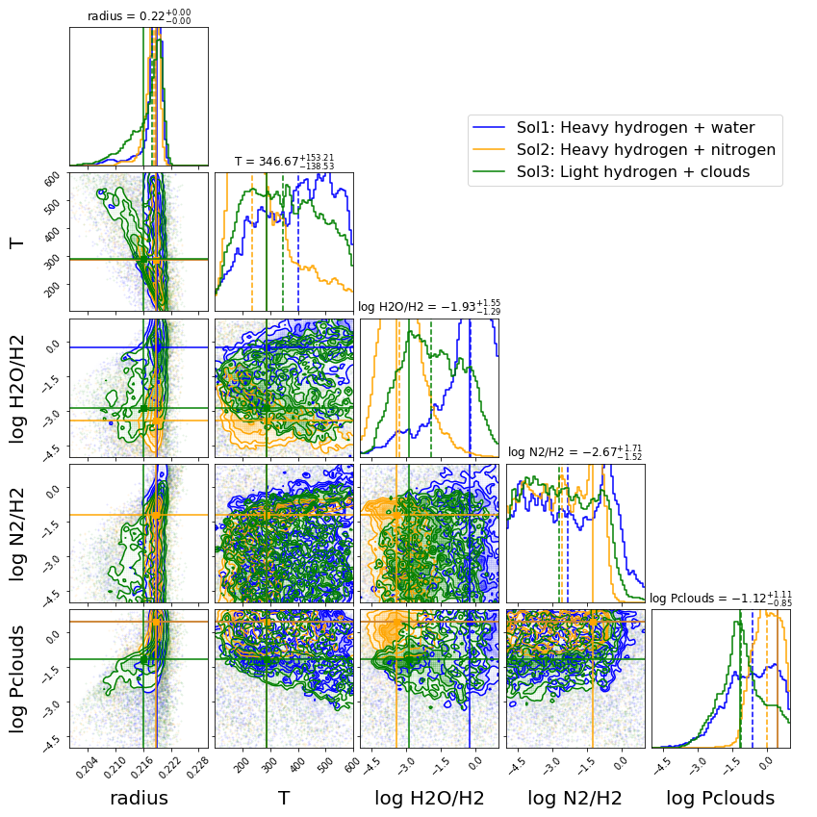
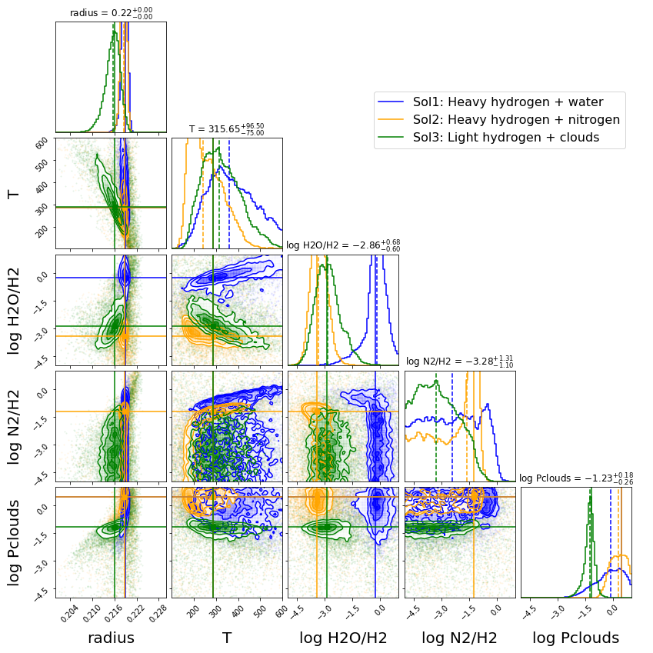
Retrievals on Ariel observations
ESA ARIEL Space Telescope
https://arielmission.space/
TauREx 3 (Al-Refaie et al. 2019)
ArielRad (Mugnai et al. 2019)
K2 – 18b for 3 different scenarios
10 obs
50 obs
Notes:
Retrievals and show here the coorelation maps. The 3 solutions are represented and left is 10 obs, right is 50.
We see that 10 cant allow to fully distinguish the solutions (posteriors are very close and still unconstrained) but we start seeing the differences (h2O/H2). But with 50 obs, the difference is very evident and the 3 cases can be distinguished!

Slide 29
Conclusion
ESA ARIEL Space Telescope
https://arielmission.space/
Ariel will observe around 1000 exoplanet atmospheres
To answer key exoplanet questions
The targets will cover a large parameter space and we will use knowledge from other facilities (e.g. TESS, JWST, E-ELT, Twinkle)
Some small exoplanets will be interesting targets (55 Cnc, K2-18b). Potentially Ariel has the capability to do good science for these targets too!
Input from the whole community
Ariel Public Conference: 14-16 January 2020, ESA ESTEC in Nederland

Slide 30
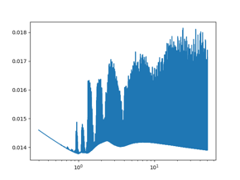
Retrieval Framework (forward model)
TauREx
https://exoai.github.io/software/taurex/
Input Parameters
Forward Model
Output Spectrum
Star radius
Planet radius, mass
Temperature
Chemistry
Notes:
First the forward model (what we control)
From Input params to HR spectrum

Slide 31
Retrieval Framework (inverse model)
TauREx
https://exoai.github.io/software/taurex/
Assumptions
Observed spectrum
Retrieved Parameters and Posteriors
Input Parameters
Forward Model
Output Spectrum
Fitting
Update
Parameter Bounds
Retrieval code
Input
Output
Notes:
Retrieval encapsules the FM in a statistical loop.
Spectrum to get the Input params.
Give physical assumptions (Like type of model to use), Param bounds and a spectrum
Fit for it
Recover the params and their uncertainty map

