Slide 1

‘Fe-eling sensitive? The effect of planetary accretion on the development of complex life”
Jon Wade

Slide 2


James D P Moore,
Anthony B. Watts,
Richard M. Palin,
Brendan Dyck,
Andrew J. Smye,
Tim Lichtenberg,
Jun Muto.
Hal Drakesmith

Slide 3
In the beginning…..

Slide 4
Planets accrete….and form metallic cores
Planetary differentiation happens quickly - body reaches few kms, heat from short lived radioactive decay (e.g. Al²⁶)
Body melts, Iron segregates and sinks - core formation.
Fe (metal) + 1/2 O₂ → FeO (mantle)

Slide 5
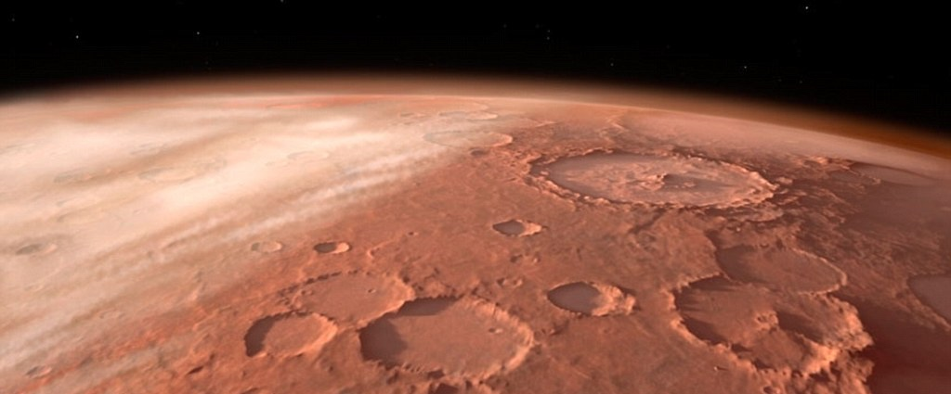
The terrestrial planets - Mars, Earth, Mercury (Venus?)
all broadly chondritic in major element chemistry
The big difference?
Mercury, <2wt% FeO
Earth, 8wt% FeO
Mars, ~18wt% FeO
Fe (metal) + 1/2 O₂ → FeO (mantle)
Is core formation the key to planetary habitability?

Slide 6
Where does this all fit in with water? Mars – a quick geology recap
Notes:
Mars, the red planet, is small, about 11% mass of the Earth

Slide 7
The Northern basin – little topography, 3km+ lower
Notes:
Its low gravity, a third of the Earth’s means it can sustain the solar systems tallest known volcano (22km). The Norther third of Mars is 3 to 5km lower than the southern. This is known as the Northern dichotomy and has been proposed, controversially, to have once been an ocean basin.

Slide 8
The South is old
Notes:
Importantly, the southern half, covered in basalts and meteorite craters, is old, with areas in excess of 3.5_billion years old.

Slide 9
Lots of evidence of water – hydration & remnant mag field

Slide 10
The Moons of Mars – related to the Northern basin?

Slide 11
The Northern basin (caused by impact?)
p.s. Happy New Year!

Slide 12
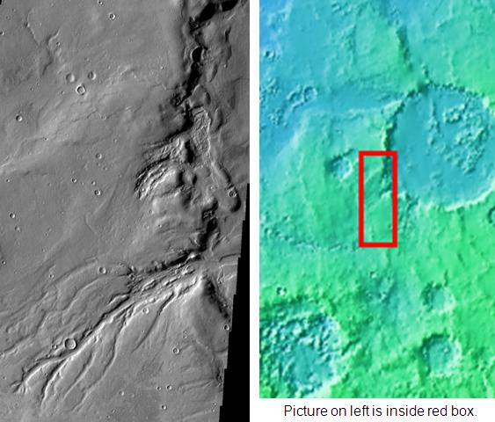
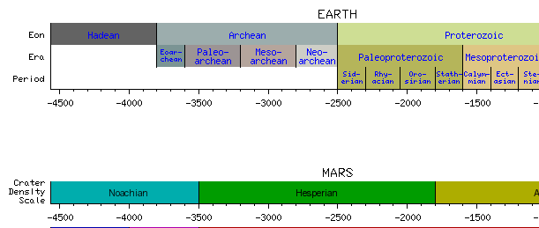
Like Earth , Mars once possessed surface water:
Surface evidence includes:
Sedimentary features
River channels
Substantial water

Slide 13
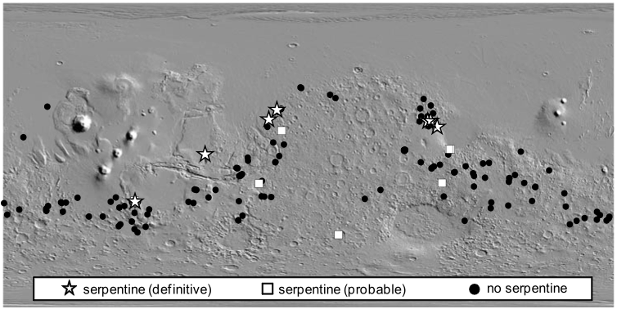
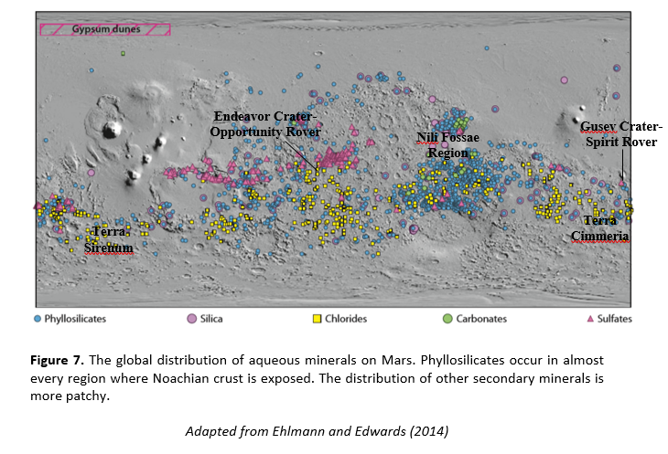
Early Mars, like Earth surface once had water: evidence rock data

Slide 14
So – Old Martian rocks show signs of water
So the obvious question…..
Why does Earth still have surface oceans and Mars does not?
Water lost to space from upper atmosphere
Increased efficiency after loss of magnetic field.
And some is still present (?) as sub surface ice
But all of it? And early? Why?

Slide 15
What of the iron?
What if some water had reacted with the Martian rocks?
The Earth now has plate tectonics – active water
Transport mechanisms. But surface water volumes appear constant (?) thru Phanerozoic
Why did Mars dry out?
And why is it still raining outside??!

Slide 16

Which allows a fair amount of arm waving*…..
What would happen if martian rocks were erupted in the presence of water?
*a.k.a modelling

Slide 17
SNC meteorites indicate that the rate of secular cooling on Mars was at least three-times faster than that of Earth
  Smaller planet = loses heat faster
Estimate radiogenic heat production on each planet, and use a plate cooling model to calculate geotherms and aerotherms for Earth and Mars
  Predict petrological changes along these P–T paths for primitive (Fastball) and evolved (Backstay) Martian basalts, and high-MgO Archean basalt and a modern-day MORB on Earth
End-members: minimal fluid saturation (“wet”) and nominally anhydrous (“dry”)

Slide 18
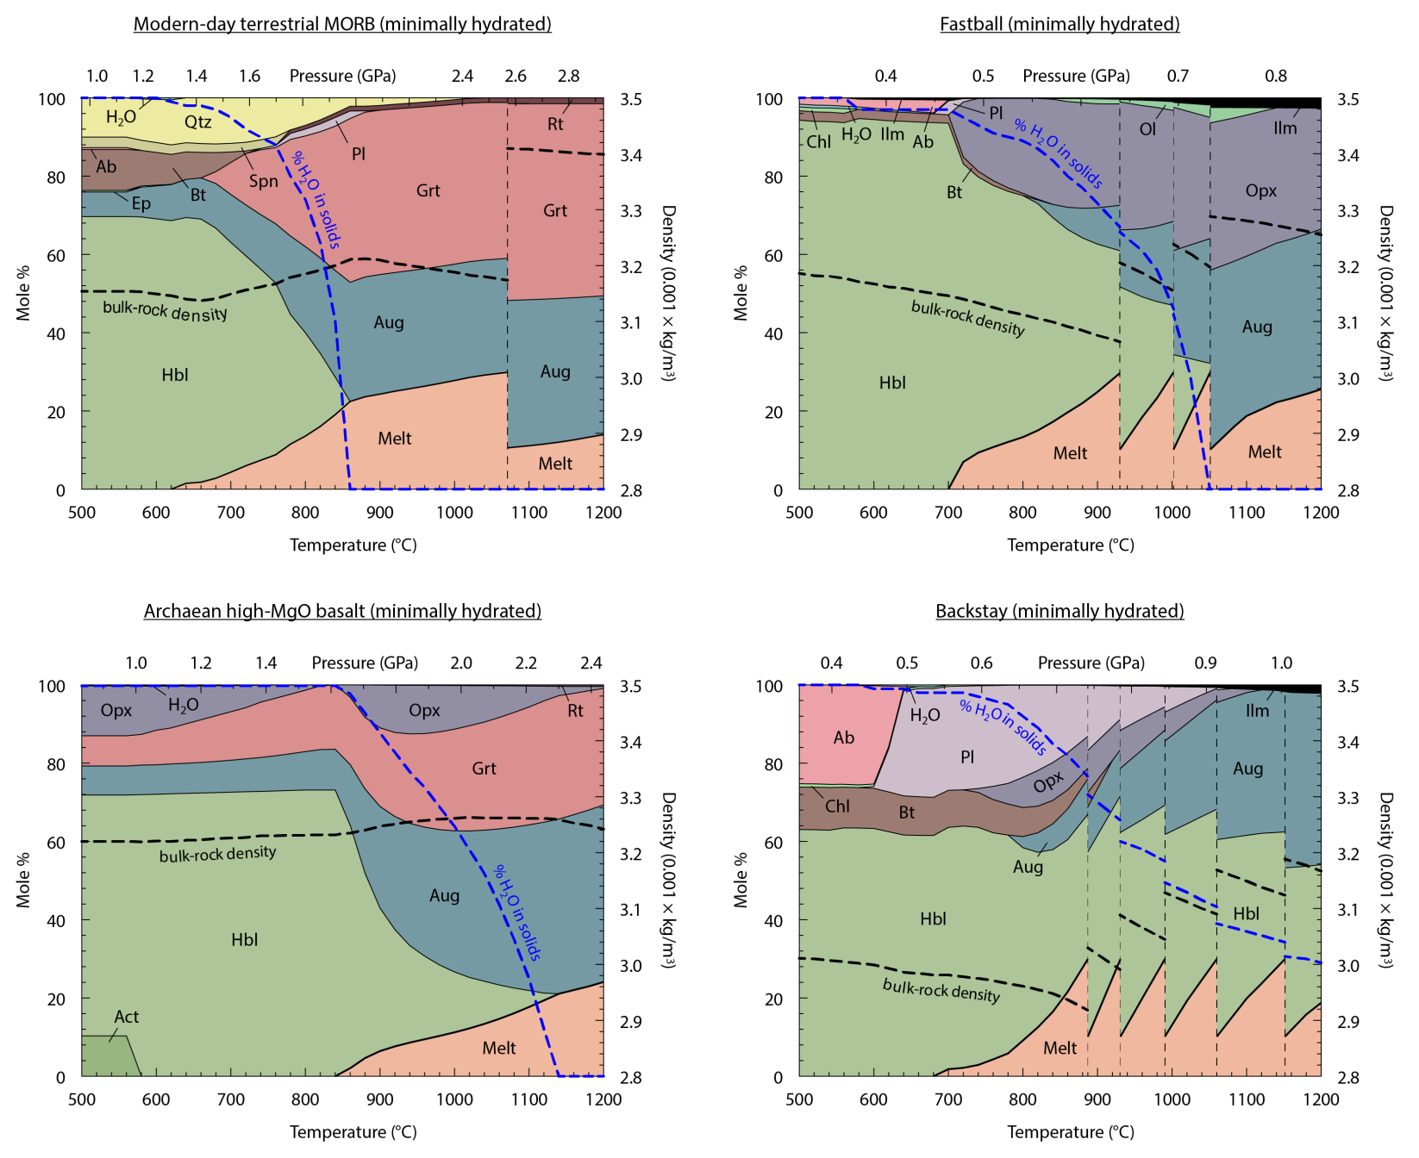
‘Wet’

Slide 19
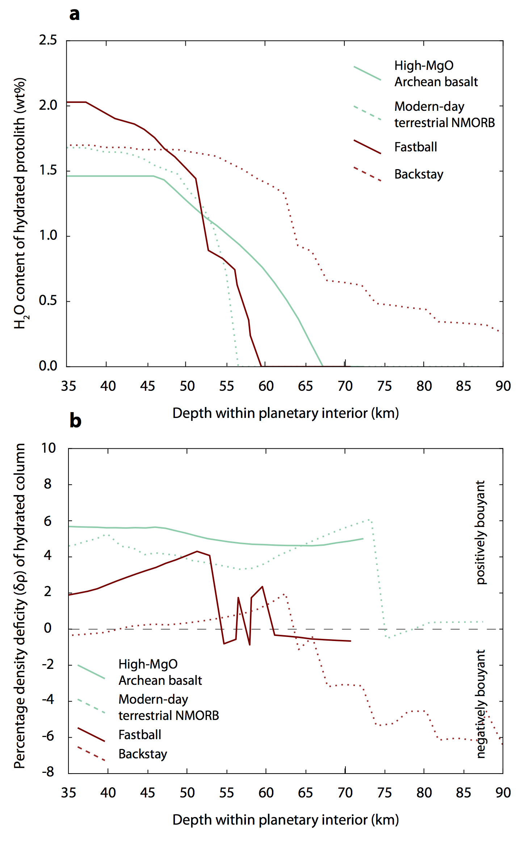
(Arrow - ‘old’ to ‘younger’ rocks)
Mars rocks soak up MORE water
than Earth rocks
Wet, hydrated Mars rocks are dense and sink
Wet Earth rocks float keeping water near the surface

Slide 20
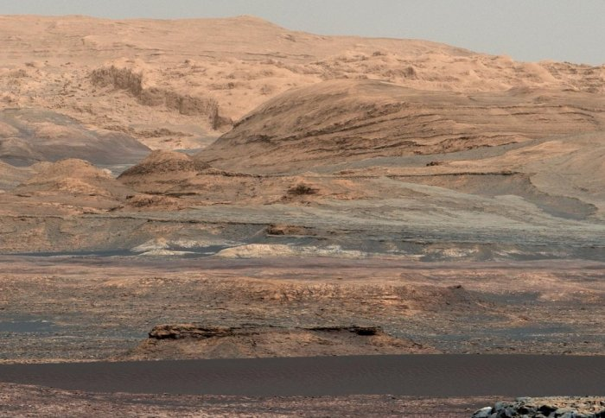
Martian surface could consume a global water layer ~ 3km thick.
        (More than enough to fill Northern basin)
Mars ‘rusted’, top down, and ‘drank’ its water very early on.

Slide 21
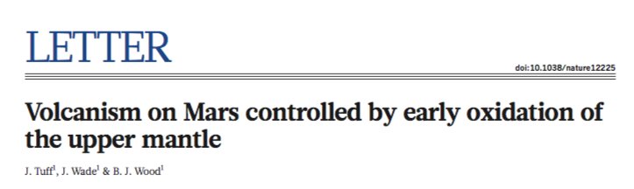
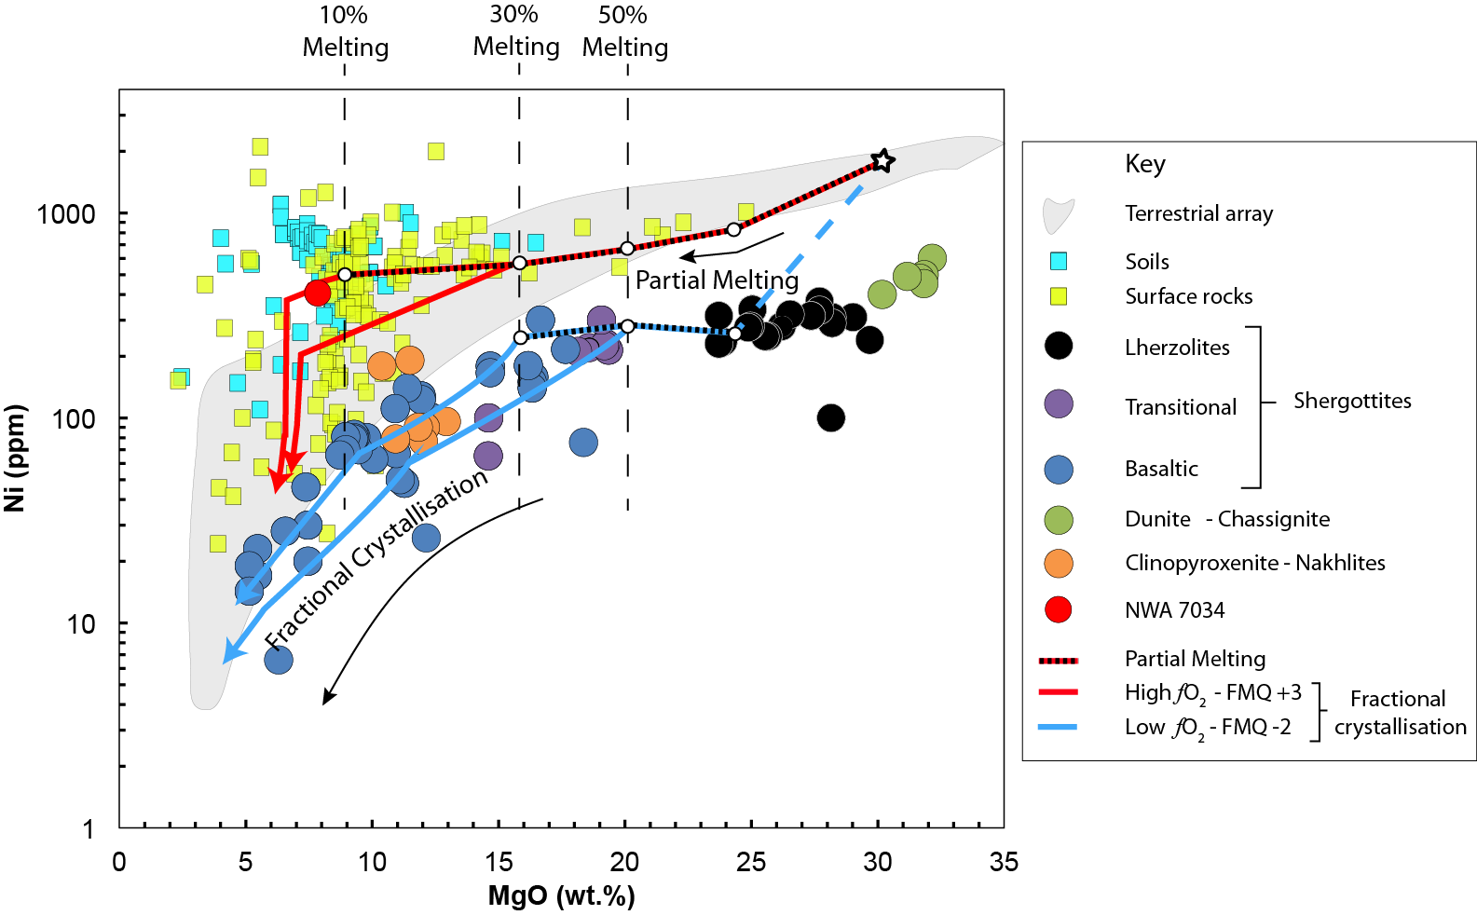
Evidence?
maybe….Martian meteorites aren’t very oxidised….
…unlike surface rocks.
water sequestration is a viable oxidation mechanism

Slide 22
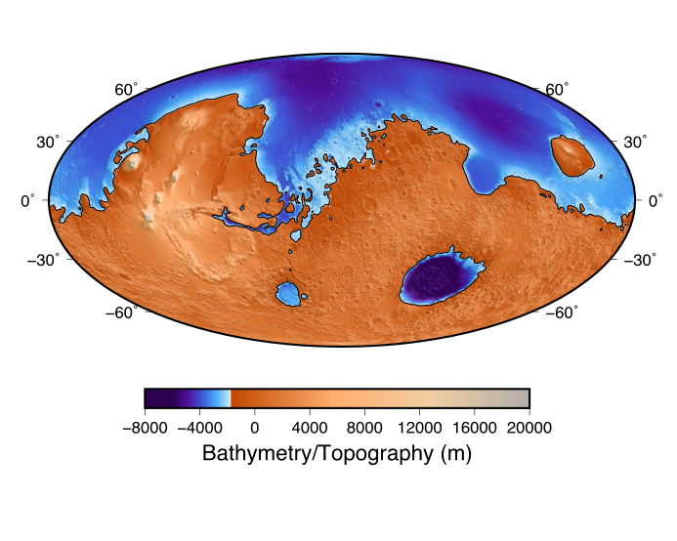
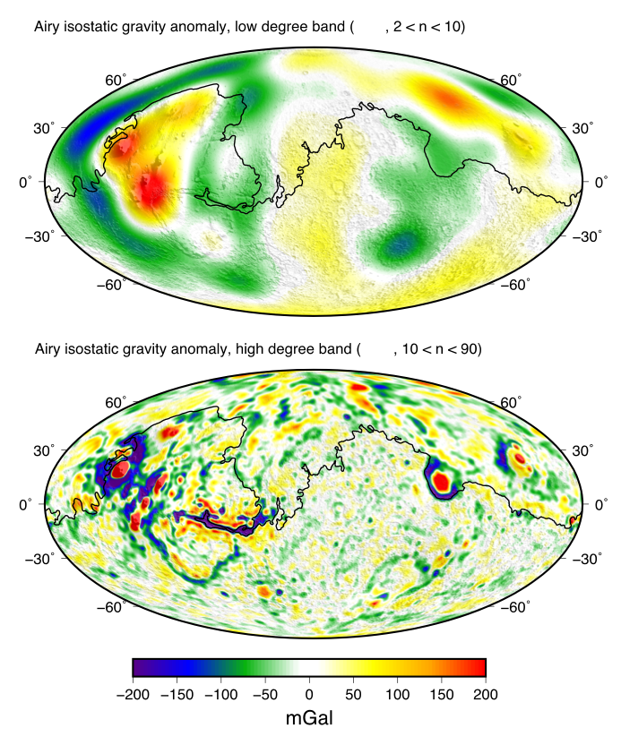
Evidence
J.P. Moore et al.
Viscoelastic flexural modelling with flow laws suggests that up to 30% of the crust may be hydrated.
This suggests that ~2km of equivalent global surface water may have been sequestered into the Martian crust.
  Comparable with the higher end assessments of early Martian oceans.

Slide 23
Why does this matter?
The iron content of the mantle affects the composition of a planet’s surface rocks and the ability of a planet to retain surface water for times long enough to develop complex life.
But to ’keep’ water on a planets surface for long enough for complex life to evolve requires many processes to coincide (chemistry, accretion history….)
Implications for extra-Solar planets
- life doesn’t *just* require water and the right distance from star

Slide 24
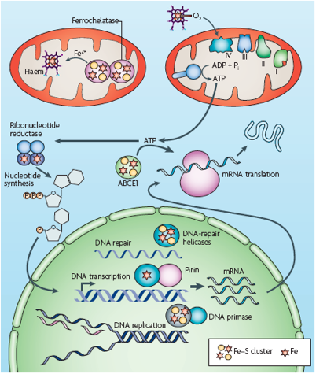
Iron is central to
fundamental cellular processes such as oxygen transport, energy generation, and DNA synthesis
Life requires iron
Iron deficiency is the leading cause of ‘years lived with disability'
why?

Slide 25

Life learnt its trade in a iron rich world…
Basic metabolic reactions in cells represent the
prevailing geochemical conditions ~4Gya
Functions of genes that are shared across *ALL* life
Iron is highly abundant, and ‘bioavailable’
Iron easily donates and receives
one electron - catalysis
Iron atoms form bonds with
many other elements

Slide 26
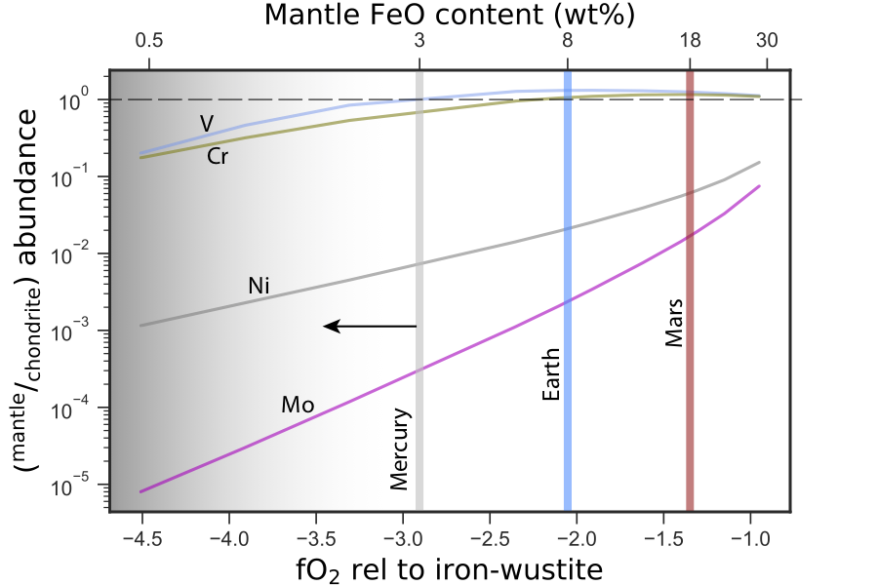
What’s all this got to do with us geochemists?
Core formation ‘sets’ the mantle abundance of iron

Slide 27
The geochemical conditions for ‘life’ may be very narrow:-
Mercury –reduced mantle depleted in transition elements.
Fe - appears in the metabolic pathways of all life (bar two bacteria).
No transition elements – problematic for life (e.g.Wachtershauser 1988)
Mars – high Fe surface basalts, higher water sequestration via e.g. amphibole production than Earth. Unlike Earth, crust/upper mantle easy to hydrate, and water lost.

Slide 28
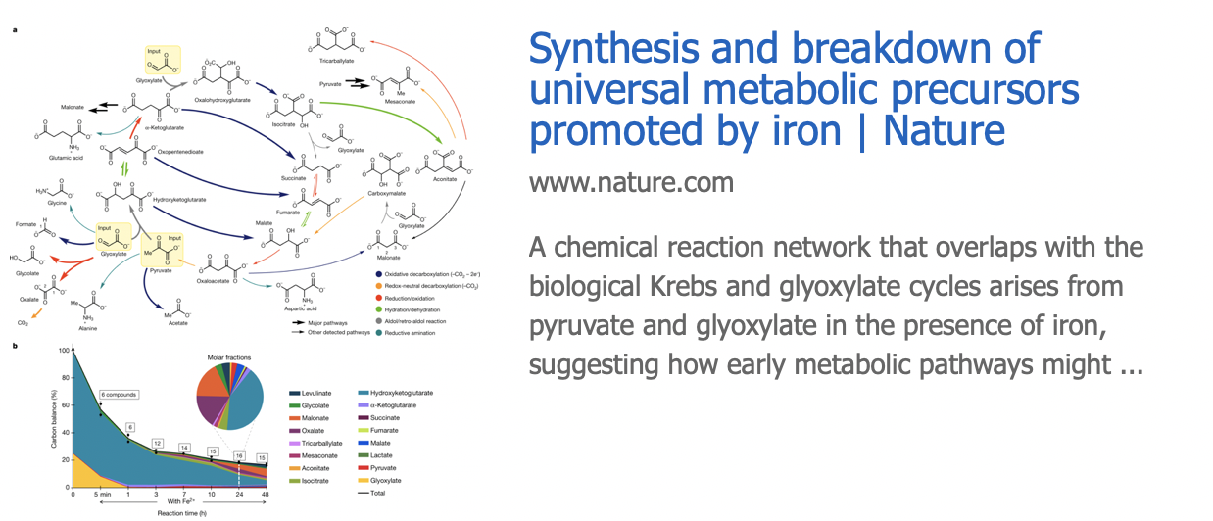
What’s all this got to do with us geochemists?
Life may place independent constraints on our estimates
of the redox state of the early atmosphere
…. in the presence of hydroxylamine (NH₂OH) and metallic iron, their chemical network can be extended to include the formation of four kinds of amino acid, the building blocks of proteins. Both hydroxylamine and metallic iron could have been available on early Earth: hydroxylamine would probably have formed as a result of the rich, abiotic nitrogen chemistry that is known to have occurred early in the planet’s existence, whereas metallic iron is abundant in certain meteorites that peppered our planet.

Slide 29
Iron became integrated into basic metabolism and physiology, but this all came to an abrupt end….
Selection pressure
Adaptation behaviours emerge

Slide 30
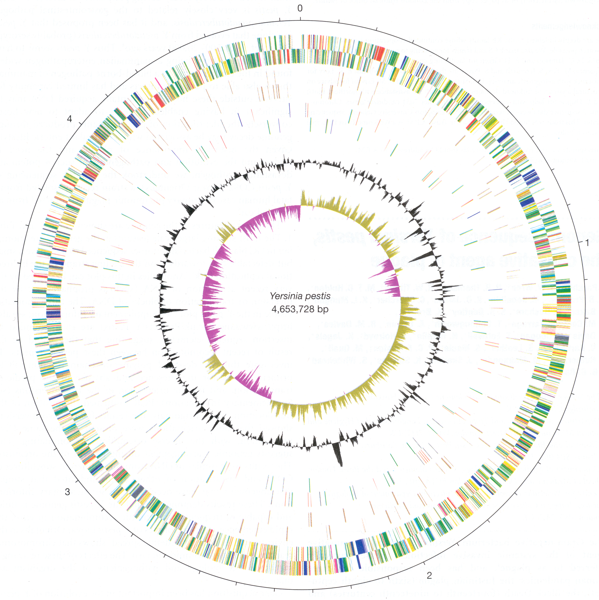
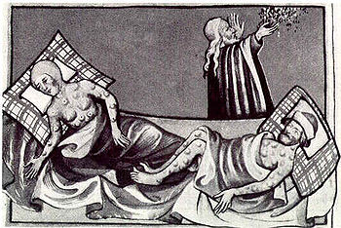


Genome sequence for Yersinia pestis, the causative agent
of plague ” Parkhill et al (2001)
A large chunk of the genome is given over to encode mechanisms of iron acquisition from the host
Iron acquisition is critical for virulence of pathogenic microorganisms

Slide 31
Iron became integrated into basic metabolism and physiology, but this all came to an abrupt end….
Selection pressure
Adaptation behaviours emerge
Steal iron (infection, predation)
Share iron (symbiosis - mitochondria)
Utilize and recycle iron more efficiently (multicellularity)

Slide 32
Mercury –reduced mantle depleted in transition elements.
Fe - appears in the metabolic pathways of all life (bar two bacteria).
No transition elements – problematic for life (e.g.Wachtershauser 1988)
Mars – high Fe surface basalts, higher water sequestration via e.g. amphibole production than Earth. Unlike Earth, crust/upper mantle easy to hydrate, and water lost.
Core formation:
Plays the dominant role in setting mantle chemistry
Q? How sensitive are mantle processes to Fe content? (e.g volatile transport to mantle)
Stochastic events during accretion may have a disproportionate effect on planetary development.
Habitability – not just a case of ‘right place, right bulk chemistry’
  But also the right ‘recipe’ – is the Earth ‘lucky’?

Slide 33

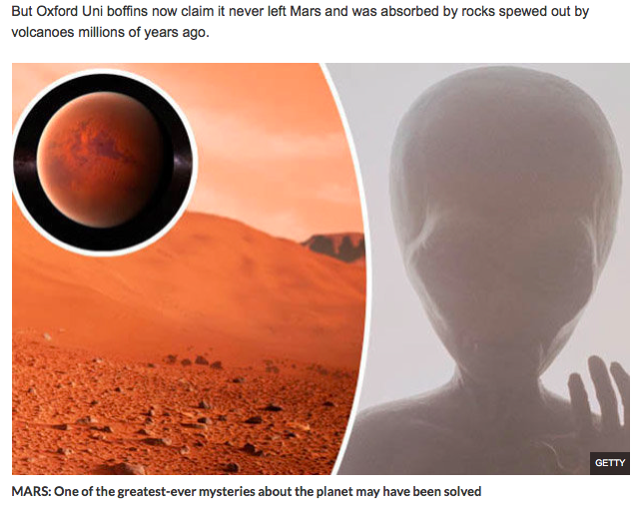
In Summary
Mars is now dry, cold and lacks atmosphere.
Random events during accretion may have a disproportionate effect on habitability.
Or?
Metamorphic geology
is important

Slide 34
Thank you!
Mars 3.5 Ga
Mars present

Slide 35
Something else to think about....
Not a lot happened on Earth for 2.5 Ga – the ‘boring billions’

Slide 36
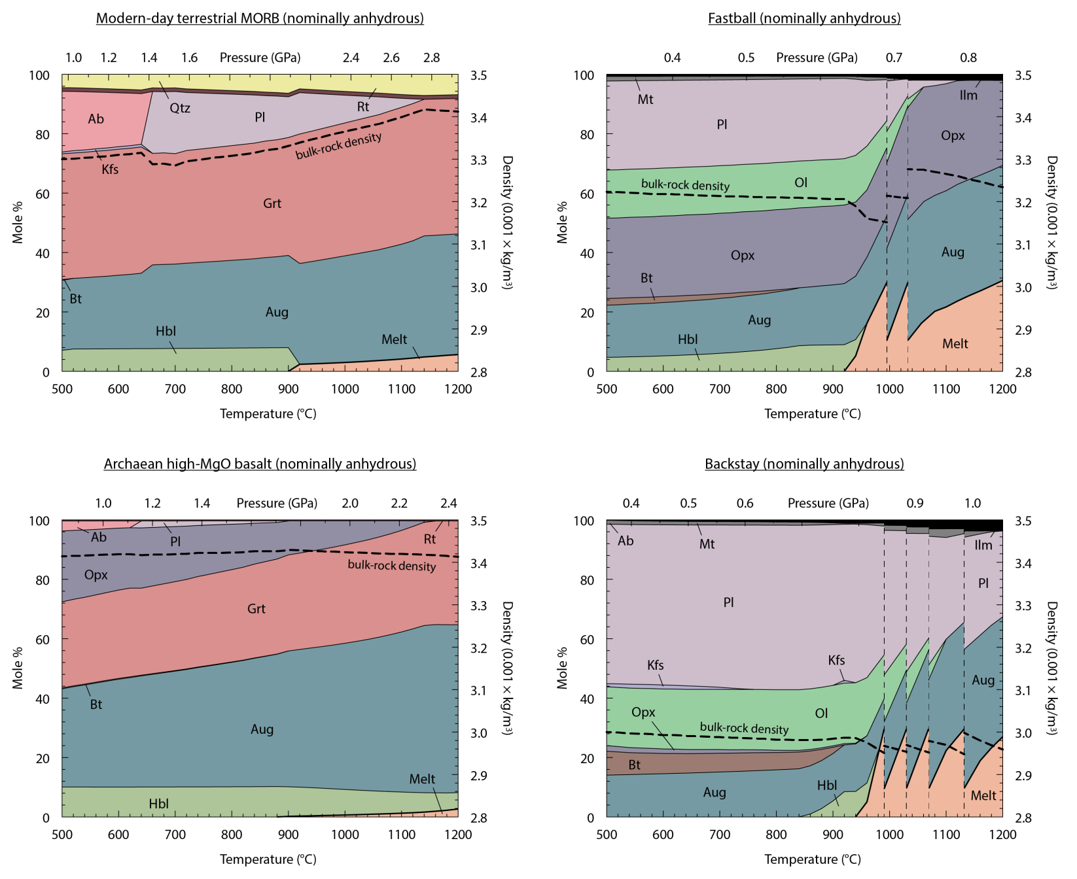
Nominally anhydrous - ‘dry’

Slide 37
Sun is getting brighter as it gets older.
In ~500Ma increased luminosity means a run-away greenhouse. Ouch.
If the life on Earth took any longer to get its act together we would not be around for long!

Slide 38
Viscoelastic flexural modelling with flow laws suggests that up to 30% of the crust may be hydrated.
This suggests that ~2km of equivalent global surface water may have been sequestered into the Martian crust.
  Comparable with the higher end assessments of early Martian oceans.
James Moore

