Slide 1
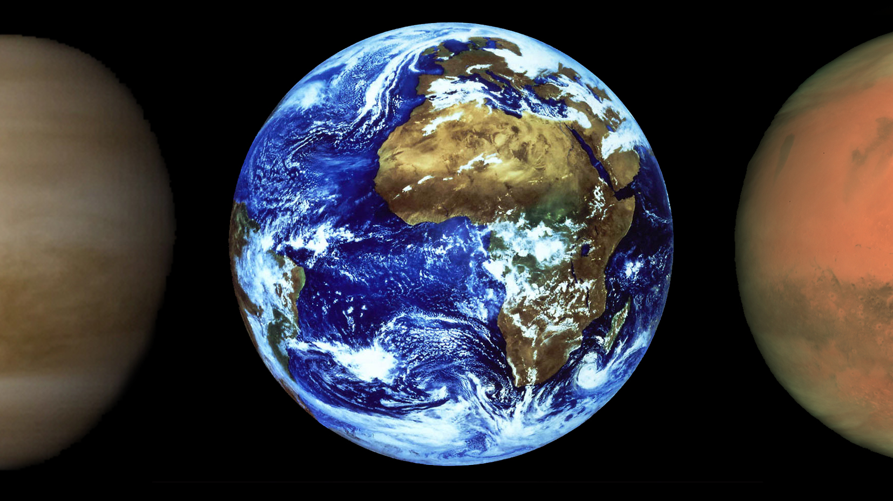

A numerical code to model terrestrial planet atmosphere evolution Due to bombardment
Catriona Sinclair
Supervisors: Mark Wyatt, Oliver Shorttle
Credit: ESA
Notes:
Hello everyone, thank you for having me to speak today.
My name is Catriona Sinclair and I’m going to tell you a bit about the work I’ve been doing during my PhD with Mark Wyatt at the institute of astronomy in Cambridge on the effect of impacts on terrestrial planet atmospheres.

Slide 2
OUTLINE
Intro: Terrestrial Planet Atmospheres
The Outcome of an Impact
The Numerical Code
Application to the Earth
What next…
Credit: ESA
Notes:
I will be talking today about the numerical code we have developed that models this process, and what we hope to do with it as well as presenting some very preliminary results for the evolution of Earths atmosphere during the accretion of the late veneer, after the Moon forming impact.

Slide 3
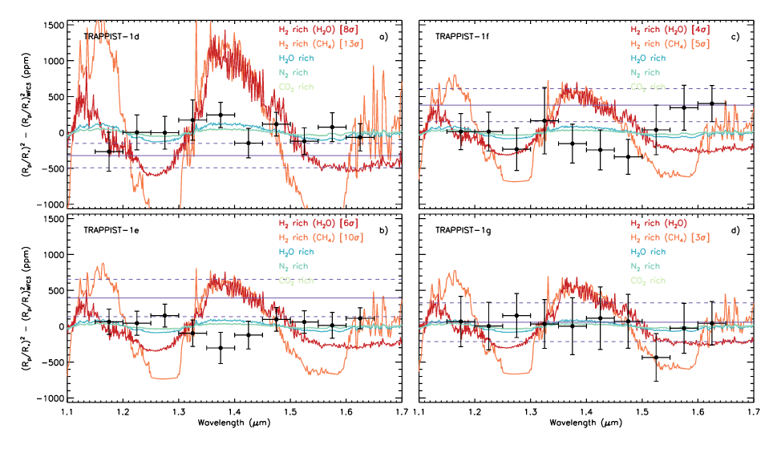
Terrestrial Planet Atmospheres:
Current and Future Prospects
Atmospheric characterisation of planets around low mass is currently feasible
DeWit (2018)
Notes:
We have now reached a stage where atmospheric characterisation of planets around low mass stars is just about possible, for example these spectra from the four TRAPPIST-1 planets. in the habitable zone.
Characterisation of the atmospheres of terrestrial planets around sun like stars is likely to become possible in the not too distant future.
It is therefore vital that we improve our understanding of how these kinds of atmosphere form and evolve.

Slide 4
Terrestrial Planet Atmospheres: formation and evolution
Many processes determine the evolution of terrestrial planet atmospheres:
  Stellar Irradiation
  Mantle – Atmosphere exchange
  Geological cycles
  Climate / Oceans / Ice caps
  Biological processes
  Impacts
Notes:
There are a huge number of processes that can all contribute to the further evolution of a terrestrial planet atmosphere, some of which I have listed here.
While all of these effects are important, we know from the cratering record on various solar system bodies and the overabundance of iron loving highly siderophile elements in the Earth’s mantle that the Earth underwent a period of bombardment after the last giant impact, which formed the moon.
This bombardment resulted in the accretion of what is known as the late veneer mass, roughly 0.5% of the Earths present mass in a relatively short period of time.
During which the evolution of the atmosphere was likely dominated by the effects of impacts.

Slide 5
OUTLINE
Intro: Terrestrial Planet Atmospheres
The Outcome of an Impact
  Cratering
  Polar Cap Limit
  Giant Impact Effects
The Numerical Code
Application to the Earth
What next…
Credit: ESA
Notes:
I'm now going to talk about impacts in more detail, specifically, what effect does an impact have on an atmosphere?
That depends, obviously, on the impact itself, how fast the object is moving, and what it and the planet are made of.
The code we have developed is designed to be modular, so the choice of impact prescription can easily be changed, but we are choosing to use a slightly modified version of the prescription from Shuvalov 2009, combined with the prescriptions from Schlichting 2015.
These prescriptions parameterise the atmosphere loss and volatile delivery resulting from a single impact, in terms of the impactor, planet and atmosphere properties.

Slide 6
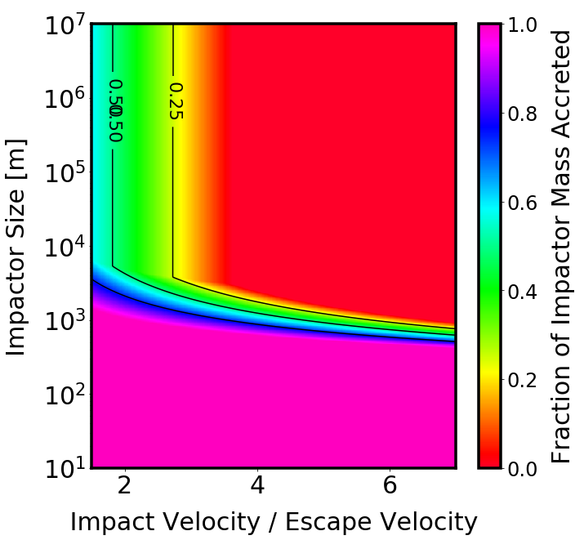
The Outcome of an Impact
Sinclair et al. (in prep)
Shuvalov (2009)
Notes:
Here is an example of what these prescriptions give for an impactor with asteroid like density impacting an Earth like atmosphere, firstly for the fraction of the impactor mass that is retained during an impact.
The x axis is the ratio of impact velocity to planet escape velocity, and the y axis is impactor size, while the colour and the contour lines shows the fraction of the impactor mass retained.

Slide 7
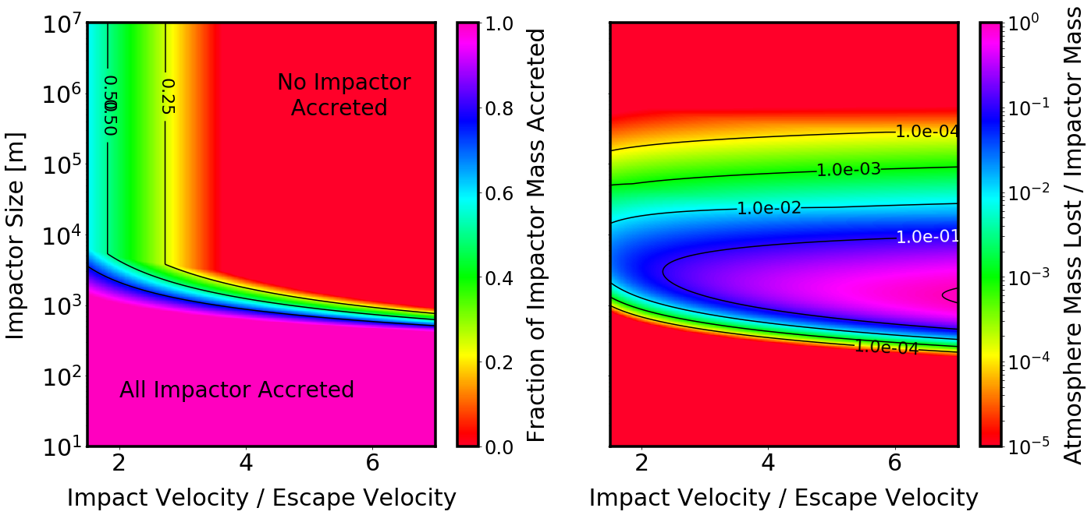
The Outcome of an Impact
Sinclair et al. (in prep)
Shuvalov (2009)
Notes:
We can see that for large and fast impactors, in the top right corner, none of the impactor mass is accreted by the planet, while small impactors with diameter less than roughly one kilometre are completely accreted.
In between there is a transition, and we can see here that even the largest impactors can be partially accreted if they are slow enough.

Slide 8
The Outcome of an Impact
Sinclair et al. (in prep)
Shuvalov (2009)
Notes:
Now for the atmosphere mass removed by such an impact, shown here as a fraction of the impactor mass, with contours showing 10%, 1% and 0.1%, we can see that faster impactors tend to remove more atmosphere mass.
Also, we see that small impactors remove very little atmosphere mass, while the most efficient impactors are those around 1-10km in size.
The largest impactors do remove more mass than the smaller impactors, but are not very efficient, because they are limited by the polar cap mass

Slide 9
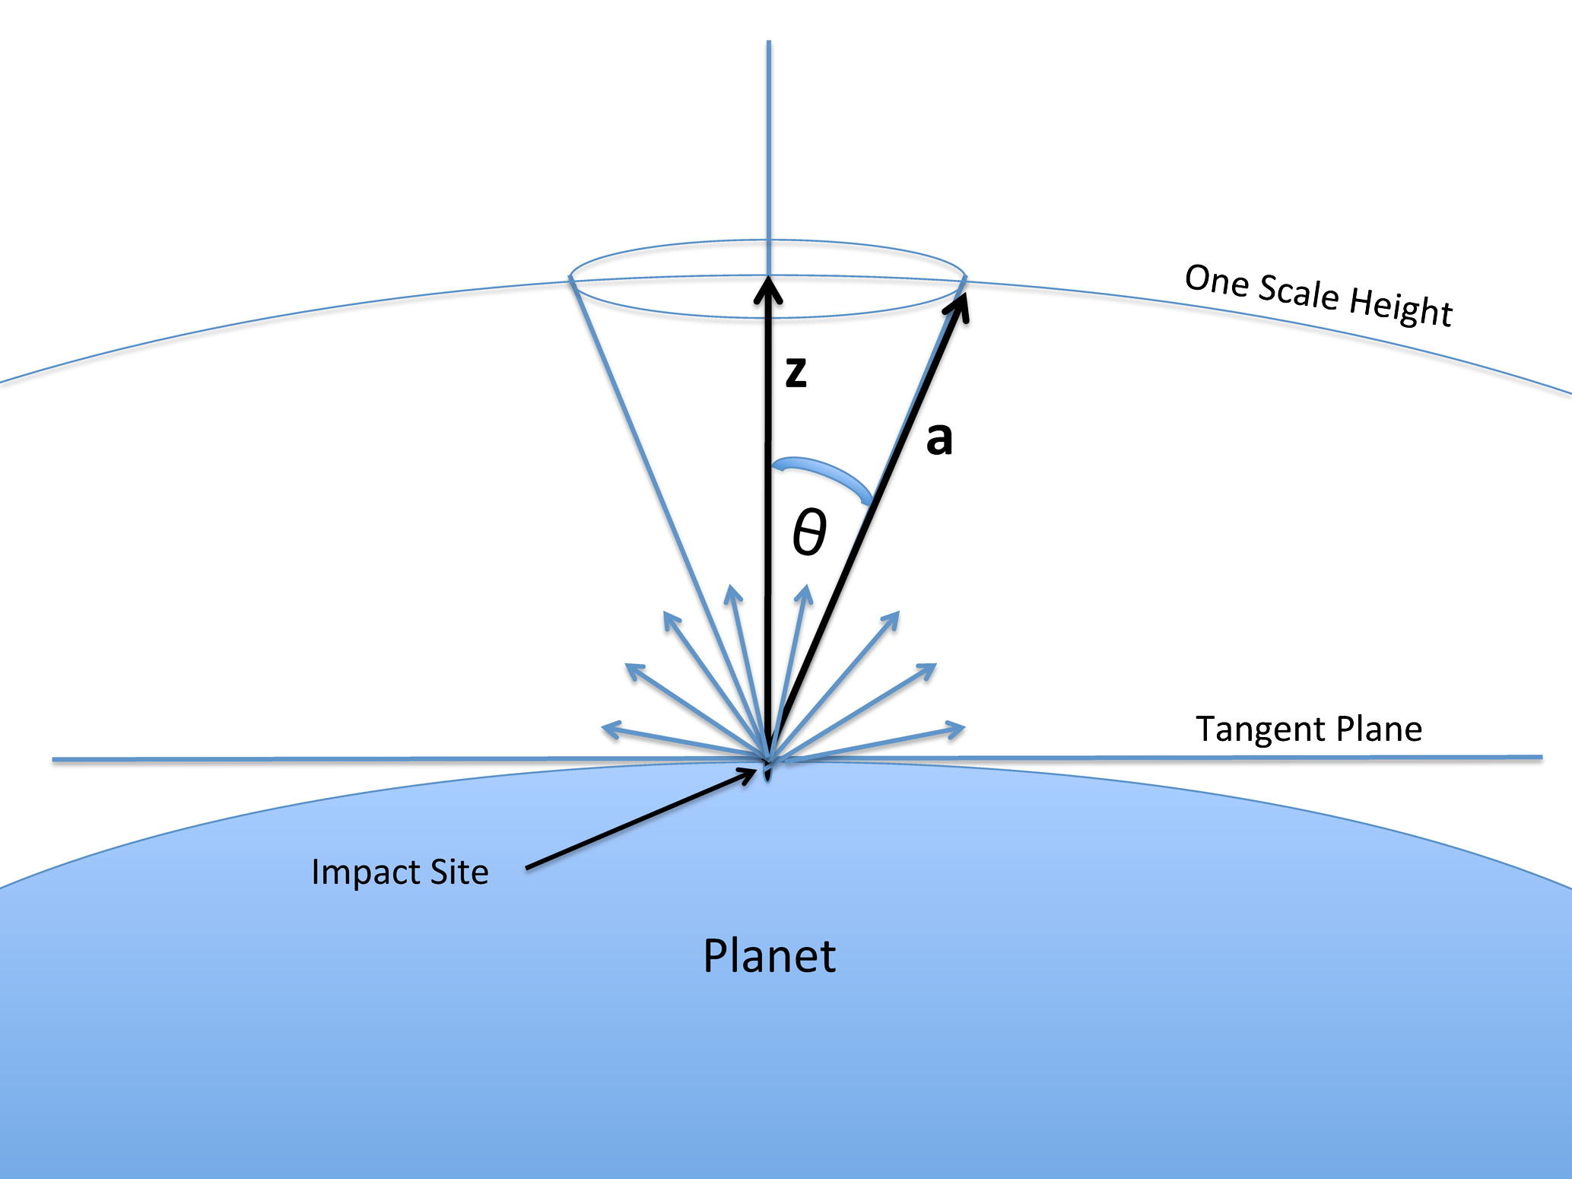
The Outcome of an Impact
Shuvalov (2009)
Schlichting (2015)
  Polar Cap Limit
Schlichting (2015)
Notes:
this is a limit which we adopt from Schlichting 2015, which states that a single cratering impact can’t remove more atmosphere than that contained above the tangent plane at the impact site

Slide 10
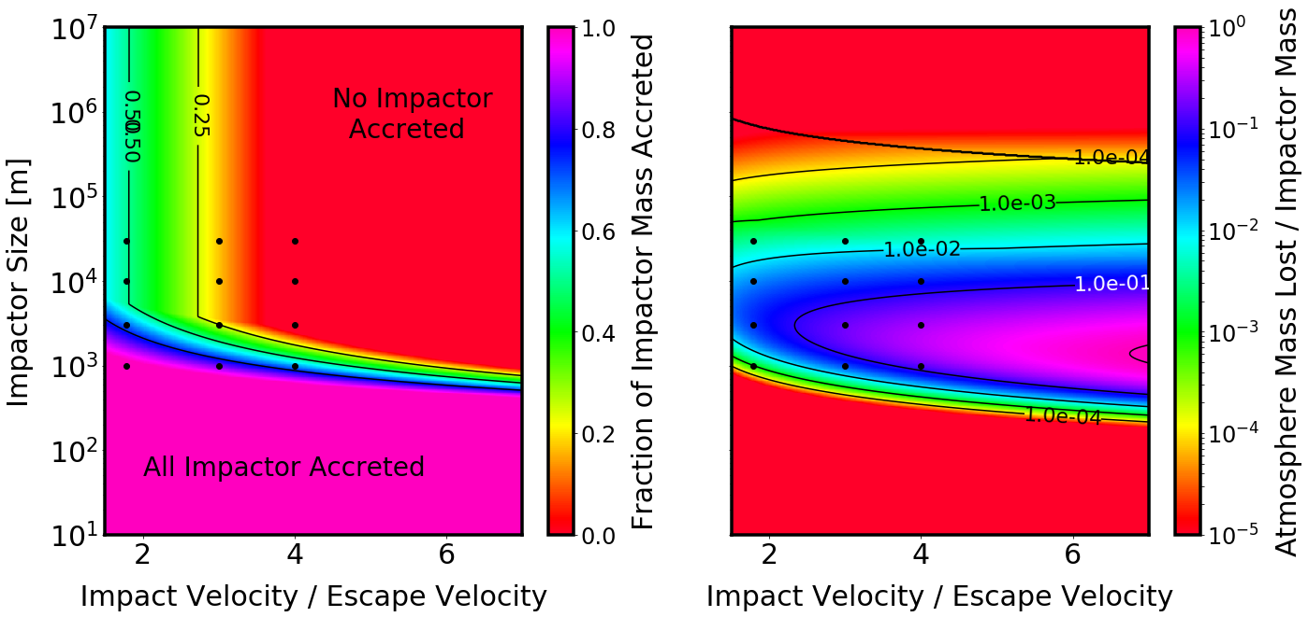
The Outcome of an Impact
Sinclair et al. (in prep)
Shuvalov (2009)
Schlichting (2015)
  Polar Cap Limit
Notes:
The region where this effect becomes important is shown here by this black line, so we can see it is relevant for only the largest objects, with diameters of at least several hundred kilometres.
However as the atmosphere mass decreases, this limit becomes significant for smaller impactors.

Slide 11
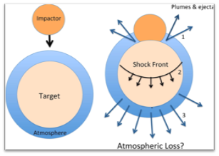
The Outcome of an Impact
Shuvalov (2009)
Schlichting (2015)
  Polar Cap Limit
  Giant Impacts
Schlichting (2015)
Notes:
We also include the effect of giant impacts, using the prescription from Schlichting 2015.
by a giant impact we mean an impact large enough and fast enough that when it impacts the planet it not only causes atmosphere loss through the cratering impact, but also sends a shock wave through the planet, which can accelerate regions of the atmosphere on the opposite side of the planet beyond the planet's escape velocity, causing non local atmosphere loss.
This effect is negligible for the atmosphere mass shown here, but scales with the atmosphere mass, so becomes significant when considering atmospheres that grow significantly during their evolution.

Slide 12
OUTLINE
Intro: Terrestrial Planet Atmospheres
The Outcome of an Impact
The Numerical Code
  What inputs it takes
  How it works
Application to the Earth
What next…
Credit: ESA
Notes:
So now we not what a single impactor does to the atmosphere, I’m going to describe the code we have developed.

Slide 13
The code
Notes:
How does it work?

Slide 14
The code
Initial Atmosphere
Notes:
It allows you to specify the initial conditions for your atmosphere

Slide 15
The code
mass
mean molecular weight
Initial Atmosphere
Notes:
specifically the total atmosphere mass and mean molecular weight

Slide 16
The code
mass
mean molecular weight
Initial Atmosphere
Planet Properties
Notes:
the initial properties of the planet

Slide 17
The code
planet mass
planet density
semi-major axis
stellar luminosity
stellar mass
mass
mean molecular weight
Initial Atmosphere
Planet Properties
Notes:
its mass, density, semi major axis and the luminosity and mass of the host star

Slide 18
The code
planet mass
planet density
semi-major axis
stellar luminosity
stellar mass
mass
mean molecular weight
Initial Atmosphere
Planet Properties
Impactor Populations
Notes:
and any number of individual impactor populations,

Slide 19
The code
planet mass
planet density
semi-major axis
stellar luminosity
stellar mass
Composition
Size Distribution
mass
mean molecular weight
Initial Atmosphere
Planet Properties
Impactor Populations
Impact Velocities
Impact Rate
Notes:
each of which can have a time dependent composition, size distribution, impact velocity distribution and impact rate.

Slide 20
The code
planet mass
planet density
semi-major axis
stellar luminosity
stellar mass
Composition
Size Distribution
mass
mean molecular weight
Initial Atmosphere
Planet Properties
Impactor Populations
Impact Velocities
Stochastic sampling of impactors
Impact Rate
Notes:
The code then stochastically samples the impactors from these distributions

Slide 21
The code
planet mass
planet density
semi-major axis
stellar luminosity
stellar mass
Composition
Size Distribution
mass
mean molecular weight
Initial Atmosphere
Planet Properties
Impactor Populations
Impact Velocities
Stochastic sampling of impactors
Impact Rate
Impact Prescription
Notes:
and based on a prescription for the outcome of an impact

Slide 22
The code
planet mass
planet density
semi-major axis
stellar luminosity
stellar mass
Composition
Size Distribution
mass
mean molecular weight
Initial Atmosphere
Planet Properties
Impactor Populations
Impact Velocities
Stochastic sampling of impactors
Impact Rate
Impact Prescription
mass gain and mass loss
Notes:
calculates the mass gain and mass loss caused by those impactors

Slide 23
The code
planet mass
planet density
semi-major axis
stellar luminosity
stellar mass
Composition
Size Distribution
mass
mean molecular weight
Initial Atmosphere
Planet Properties
Impactor Populations
Impact Velocities
Stochastic sampling of impactors
Impact Rate
Impact Prescription
Adaptive time step
Time evolution of planet properties
Notes:
The code then uses an adaptive time step, to evolve the atmosphere and planet properties in time as a result of these impacts

Slide 24
The code
planet mass
planet density
semi-major axis
stellar luminosity
stellar mass
Composition
Size Distribution
mass
mean molecular weight
Initial Atmosphere
Planet Properties
Impactor Populations
Impact Velocities
Stochastic sampling of impactors
Impact Rate
Impact Prescription
Adaptive time step
Time evolution of planet properties
Atmosphere Evolution
Planet mass
Notes:
This gives us results in the form of the planet mass and atmosphere properties as a function of time.

Slide 25
The code
planet mass
planet density
semi-major axis
stellar luminosity
stellar mass
Composition
Size Distribution
mass
mean molecular weight
Initial Atmosphere
Planet Properties
Impactor Populations
Impact Velocities
Stochastic sampling of impactors
Impact Rate
Impact Prescription
Adaptive time step
Time evolution of planet properties
Atmosphere Evolution
Planet mass
Mass
Mean molecular weight
Source Fraction
Notes:
For the atmosphere, we track the mean molecular weight, total mass, and the proportions of the atmosphere mass that are delivered by each impactor population.

Slide 26
OUTLINE
Intro: Terrestrial Planet Atmospheres
The Outcome of an Impact
The Numerical Code
Application to the Earth
  Impactor populations
  Impactor properties
  Results
What next…
Credit: ESA
Notes:
I’m now going to discuss the results we obtain from applying this code to some recent dynamical results regarding bombardment of our own planet.
I will take you through the inputs we use for the impactors and the Earth, and show you how the stochastic nature of impacts can lead to markedly different atmosphere outcomes for the same impacts.
Finally I will map out where we intend to go next, both short and long term.

Slide 27
Bombardment History
Nice Model
Grand Tack
Asteroids (Nesvorny (2017))
Comets (Nesvorny (2013))
Left-over planetesimals (Morbidelli (2018))
Notes:
We consider three populations of impactors: asteroids, comets and planetesimals left over after terrestrial planet formation.
The dynamics of these impactors we get from dynamical modelling based on the Nice and Grand Tack models.
For the asteroids we use the results from Nesvorny 2017, for the comets Nesvorny 2013 and planetesimals Morbidelli 2018, considering a time period of 500Myrs following the moon forming impact.

Slide 28
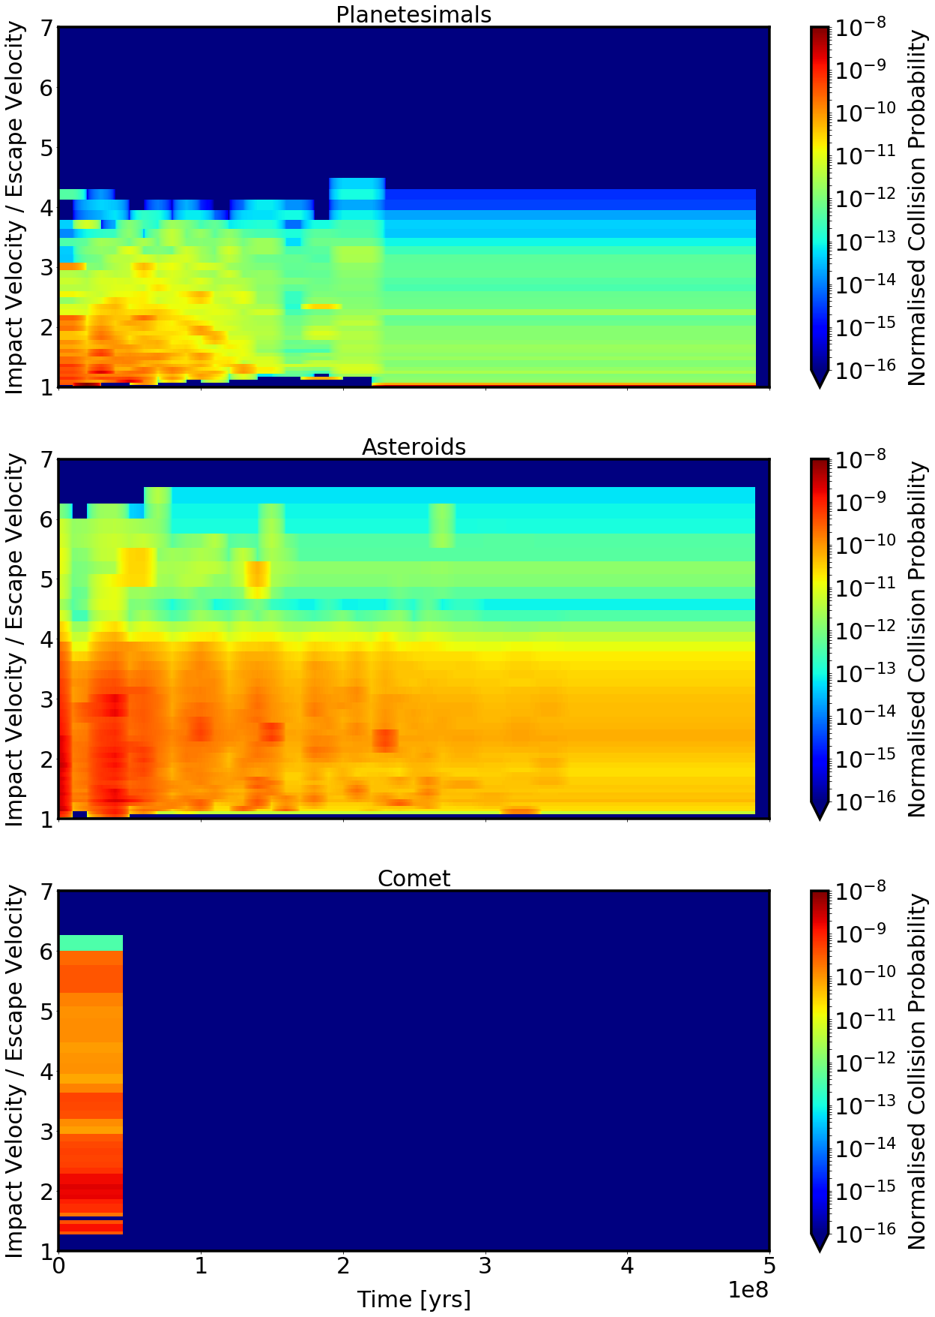
Impact velocities and Impact rates
For each particle
  Orbital Elements → Impact Probability
Combine to get time, velocity dependence
Sinclair et al. (in prep)
Notes:
From these we take the information about the orbits of Earth-crossing test particles in the simulations, and use these to calculate distributions for the impact flux as a function of time and impact velocity for a time period covering a period of 500 million years, beginning shortly after the Moon forming impact.
For each population, we combine these distributions from all the particles present at each time, (to give a distribution of the the flux of impacts onto the Earth as a function of time, on the x axis, and velocity, on the y axis.
To avoid biasing the distribution of velocities due to small numbers of particles from the simulations we combine multiple time steps if we need to, which is why the comet flux is essentially constant for 50 million years before dropping to zero.

Slide 29
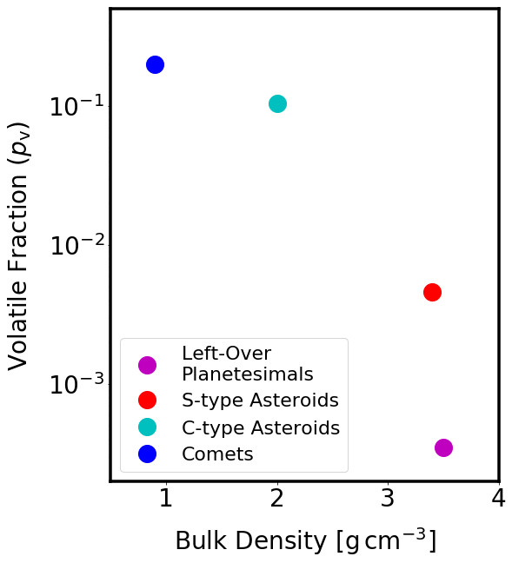
Impact Compositions and volatile content
Volatile Fraction = fraction of mass contributing to the atmosphere
Sinclair et al. (in prep)
Notes:
For each impactor population we assign a density, a volatile fraction (defined to be the percentage by mass of the impactor mass that goes into the atmosphere, either immediately on impact or through later outgassing) as well as a mean molecular weight associated with these volatiles.
The comets are volatile rich, and not dense at all.
The planetesimals are likely most similar to enstatite chondrites, which are dense and relatively dry.

Slide 30
Impact Compositions and volatile content
Volatile Fraction = fraction of mass contributing to the atmosphere
Two asteroid populations
  C-Type / S-Type
Split by initial location
Sinclair et al. (in prep)
Notes:
We split the asteroid population in two, into dryer S-Type asteroids, similar to ordinary chondrites, and more volatile rich C-type asteroids, similar to carbonaceous chondrites.

Slide 31
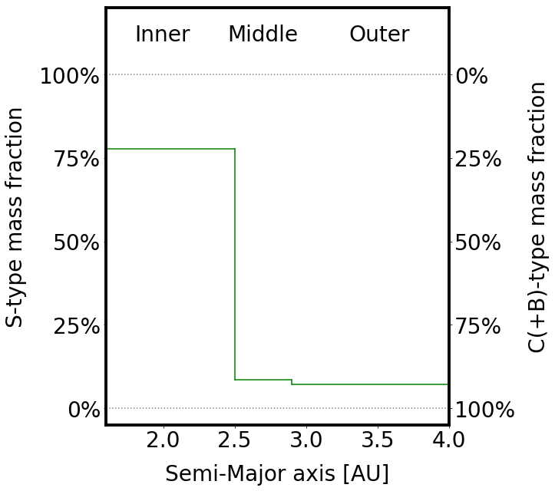
Impact Compositions and volatile content
Volatile Fraction = fraction of mass contributing to the atmosphere
Two asteroid populations
  C-Type / S-Type
Split by initial location
Sinclair et al. (in prep)
Notes:
The asteroid populations from the dynamical simulations is split based on their initial semi-major axes, according to a simplified version of the observed distribution from DeMeo 2014, with S-types dominating in the inner regions and C-types dominating in the outer regions.

Slide 32
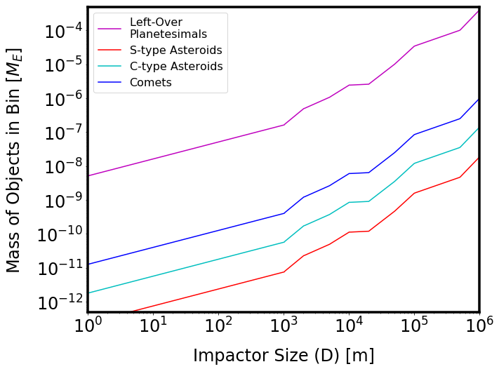

Impact size distributions
Asteroid Main Belt Distribution
Assume $α = 3.5$below 1km
Mass Normalisation
  Comets – Jupiter Trojan
  Asteroids – Number in belt today
  Planetesimals – Late Veneer Mass
Sinclair et al. (in prep)
Notes:
We assume that all out populations have a size distribution the same as the main belt asteroids. Shown here for each population, normalised to it’s total mass in the nominal case.
For asteroids, we normalise the number of mass of impactors by the number in the asteroid belt today, for comets by the capture fraction of Jupiter Trojan’s and for planetesimals we use an iterative approach such that the total mass accreted by the Earth during the simulation is on average equal to the late veneer mass.

Slide 33

Earth initial conditions
Poorly constrained by observation
To be explored…
For now:
  $m_{0} = 0.85 x {10}^{−6} M_{⊕}$ (current atmosphere mass)
  $μ_{0}= 29$ (Nitrogen dominated)
Notes:
The initial conditions for the Earth are not well constrained, and so we treat them as another free parameter.
For the representative result I’m about to show, we assume that the earth starts a nitrogen dominated atmosphere, with the same mass as it currently has.
The Earth starts with a mass of 0.995 it’s present value, allowing the accretion of the late veneer mass.

Slide 34
Representative evolution
– All three populations
500 Runs
Identical initial conditions
Identical impactor populations
Notes:
With all this in mind, what happens to the atmosphere?
We run our code a total of 500 times, with identical initial conditions, and identical populations of impactors

Slide 35
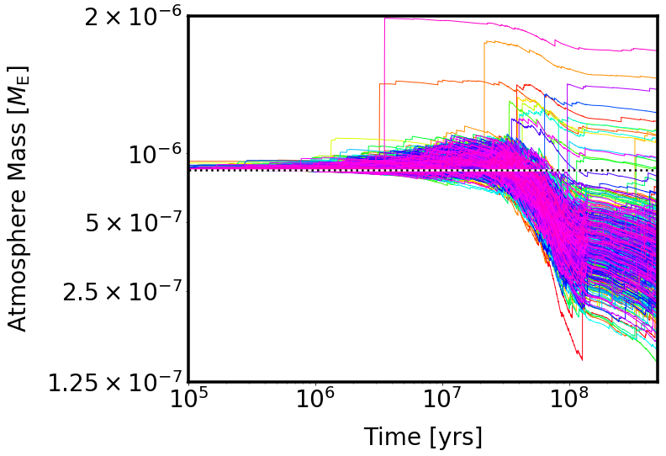
Representative evolution
– All three populations
Atmosphere Mass
Sinclair et al. (in prep)
Notes:
From this plot of atmosphere mass as a function of time, we see that the majority of the runs, ignoring the outliers for now, follow a similar evolution, with an early period of growth until around 50Myr, and then a period of depletion until the end of the runs.

Slide 36
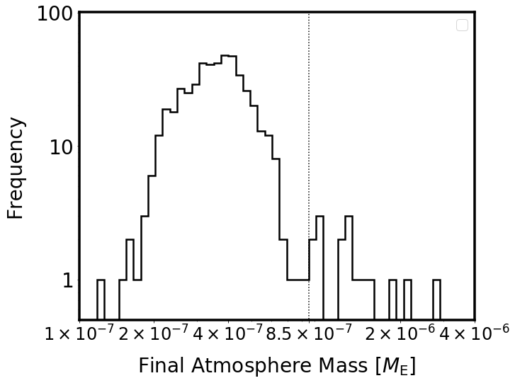

Representative evolution
– All three populations
Sinclair et al. (in prep)
Atmosphere Mass
$m_{fin}=(3.7 ±1.2)×{10}^{−7}M_{⊕}$
Notes:
This plot shows a histogram of the final atmosphere masses, ignoring for the moment the obvious outliers, the final atmosphere mass is on average around 43% of the initial atmosphere mass.

Slide 37
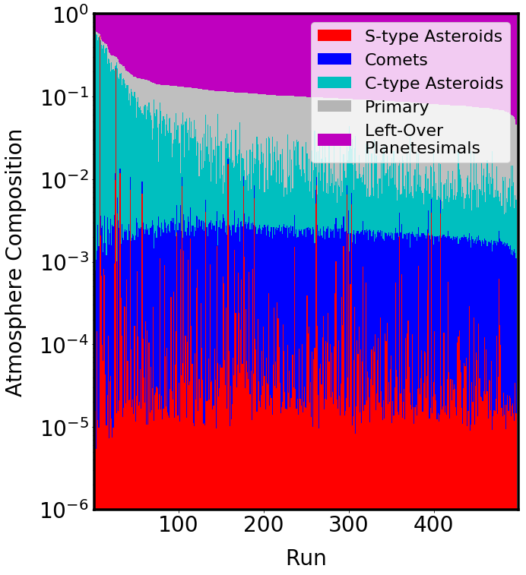

Representative evolution
– All three populations
Atmosphere Mass
$m_{fin}=(3.7 ±1.2)×{10}^{−7}M_{⊕}$
~88% Left over planetesimal
+ 5% Primary
+ 10⁻⁴ S-type asteroids,
+ 0.2% comets
+ 3.4% C-type asteroids
Sinclair et al. (in prep)
Notes:
Looking at the same plot on a log scale, we can see there is a small contribution from C-type asteroids, and even smaller contributions from comets and S-Type asteroids.

Slide 38

Representative evolution
– All three populations
Atmosphere Mass
$m_{fin}=(10.7−28.2)×{10}^{−7} M_{⊕}$
13/500 runs
Single (large) asteroid impacts
Notes:
Now looking at these outliers, these have much larger final masses, which are the result of single impacts, which seem able to occur at any time.
This occurs in roughly 3% of our runs, and results in atmospheres that grow by up to an order of magnitude.

Slide 39
Representative evolution
– All three populations
Atmosphere Mass
$m_{fin}=(10.7−28.2)×{10}^{−7} M_{⊕}$
19 – 74% Planetesimals
2 – 13% Primary
+ 60% C-Type Asteroid
Single (large) asteroid impacts
Sinclair et al. (in prep)
Notes:
These have different final compositions, dominated by material delivered in an impact by a single large C-Type asteroid, which a much smaller contribution from planetesimals and primary atmosphere.

Slide 40
Initial Conditions
100 Runs
Notes:
Now we look at what happens when we start our atmosphere off with different initial conditions, running the code one hundred times in each case

Slide 41

Initial Conditions
100 Runs
Initial conditions
$m_{0}= \left\{\begin{matrix}0.85 × {10}^{−7} \\ 0.85 × {10}^{−6} \\ 0.85 × {10}^{−5}\end{matrix}\right\} M_{E}$
$$μ=15, 29, 45$$
Notes:
we consider a three by three grid in initial mass and mean moleculae weight to start with

Slide 42
Initial Conditions
100 Runs
Initial conditions
Identical impactor populations
$m_{0}= \left\{\begin{matrix}0.85 × {10}^{−7} \\ 0.85 × {10}^{−6} \\ 0.85 × {10}^{−5}\end{matrix}\right\} M_{E}$
$$μ=15, 29, 45$$
Notes:
And use an identical population of impactors in each case

Slide 43
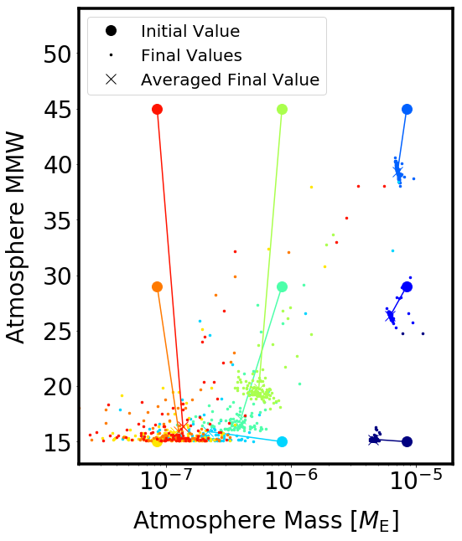
Initial Conditions
100 Runs
Initial conditions
Identical impactor populations
$m_{0}= \left\{\begin{matrix}0.85 × {10}^{−7} \\ 0.85 × {10}^{−6} \\ 0.85 × {10}^{−5}\end{matrix}\right\} M_{E}$
$$μ=15, 29, 45$$
Sinclair et al. (in prep)
Notes:
This plot shows the initial locations of each run in atmosphere mass, atmosphere composition space as large circles, and the final locations as small dots, with the average final composition shown as a cross, connected to the initial value.
From this we can draw a number of tentative conclusions, firstly that for modest initial atmosphere masses, the final mass seems to cluster around a value slightly lower than the current mass, with these atmospheres growing and these depleting.
Secondly the composition of the final atmosphere, with the caveat that we are for now ifnoring any atmospheric chemistry that occurs, is dominated by material delivered by the population of left over planetesimals.
Thirdly, in the absence of any other loss mechanisms, we can rule out a very large initial atmosphere mass, as the accretion of the late veneer is not able to decrease this atmosphere mass to the present day mass.

Slide 44

Conclusions
Wide range of outcomes possible for the same initial conditions
  Due to the stochastic arrival of the impacts that have the largest effects
In general $m_{final}→2 −5 x {10}^{−7}M_{E}$ with compositions determined by the left-over planetesimals
Can rule out large initial atmosphere masses in the absence of alternative loss mechanisms
Notes:
In conclusions, the same initial atmosphere and the same impactor population can result in very different resulting atmospheres due to the stochastica arrival of relatively rare large objects, which have the biggest effect on the atmosphere evolution.
In general the final atmosphere mass is around 2 to 5 times ten to the minus seven, slightly less than the current atmosphere mass.

Slide 45
OUTLINE
Intro: Terrestrial Planet Atmospheres
The Outcome of an Impact
The Numerical Code
Application to the Earth
What next…
Credit: ESA
Notes:
So what next?

Slide 46
How important is…
Uncertainty in the
  impactor dynamics
  impactor composition
  total mass of each population
Notes:
Firstly we are working to understand how varying our inputs affects our conclusions, specifically how important are the assumptions we make about the composition, total masses and dynamics of the impactors, as well as how we split up the asteroid population, and the mass and composition of our starting atmosphere.

Slide 47
Where next?
Venus and Mars
Exoplanets
Chemical modelling
Notes:
Looking further into the future, we want to apply this model to Venus and Mars, as well as some exoplanetary systems, where the different system architecture can cause very different bombardment histories.
We are also looking into using the results from the code as the basis for more detailed chemical modelling of the atmosphere

Slide 48
Questions?
Notes:
Thank you very much for listening, I’ll now take any questions

Slide 49
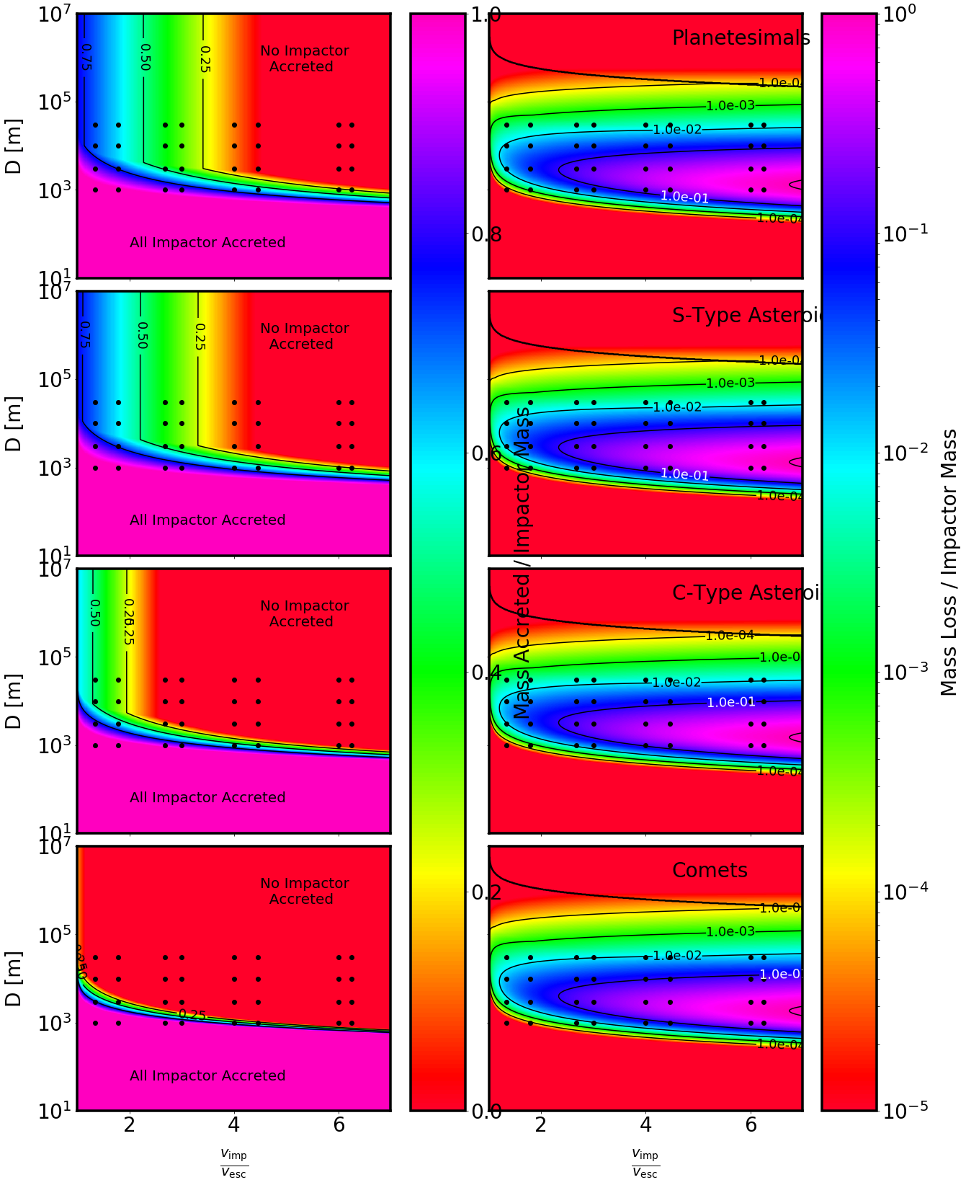
Notes:
Planetesimals - <10^-7 Me
S-types ~ 10^-6
C-types ~ 10^-5
Comets ~10^-6 (but much more rapid drop off to zero with velocity)

Slide 50
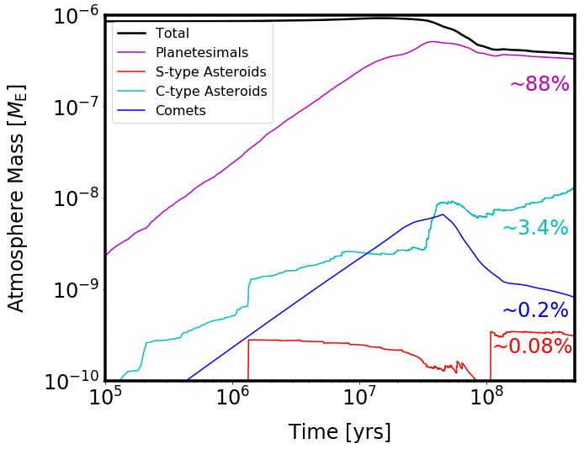
Notes:
Thank you very much for listening, I’ll now take any questions

Slide 51
OUTLINE
Intro: Terrestrial Planet Atmospheres
  Current and Future Prospects
  Formation and Evolution
The Outcome of an Impact
  Cratering
  Polar Cap Limit
  Giant Impact Effects
The Numerical Code
  How it works
  What it needs
Application to the Earth
  Impactor Populations
  Dynamics
  (Preliminary) Results
What next…
Credit: ESA

Slide 52
The code
Composition
Size Distribution
Initial Atmosphere
Planet Properties
Impactor Populations
Impact Velocities
Stochastic sampling of impactors
Impact Rate
Impact Prescription
Adaptive time step
Time evolution of planet properties
Atmosphere Evolution
Planet mass
Mass
Source Fraction
Mean molecular weight
Notes:
So what does this code do? And why is it needed?
In it’s simplest description, it allows you to specify any number of impactor populations, giving them a time dependent flux, and specifying the distribution of impact velocity and size, as well as the impactor composition.
From this population, the code evolves the atmosphere mass through time, using an adaptive timestep, tracking the change in atmosphere mass, atmosphere mean molecular weight and planet mass.
Further properties, which do no effect the outcome of a single impact, can be post processed from the results, which give the atmosphere fraction delivered by each impactor population over time.
The code treats the impactor flux stochastically, so that single rare impacts are accounted for.

Slide 53
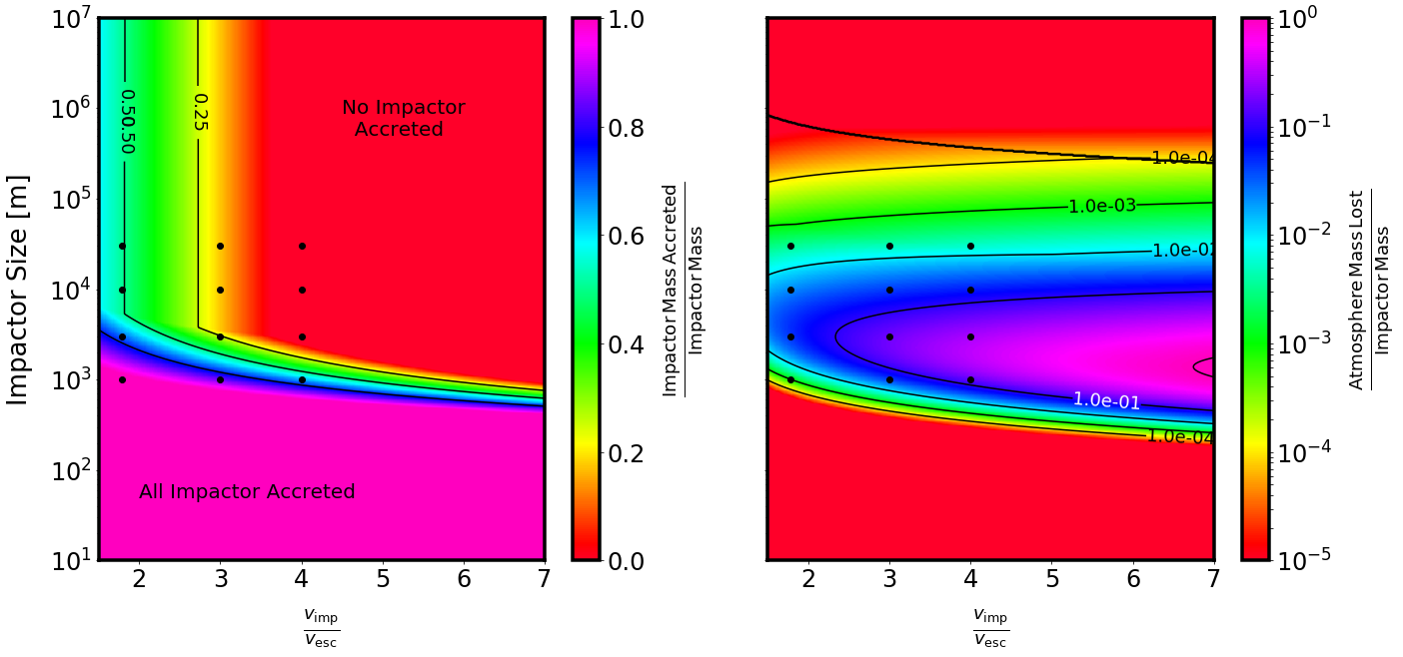
The Outcome of an Impact
Shuvalov (2009)
Schlichting (2015)
  Polar Cap Limit
  Giant Impacts
Sinclair et al. (in prep)
Notes:
So what does a single impact do?
The code is designed to be modular, so the choice of impact prescription can easily be changed, but we are choosing to use a slightly modified version of the prescriptions from Shuvalov 2009.
These give the atmosphere mass ejected, and impactor mass retained after an individual collisions as a function of a dimensionless parameter eta, that depends on the impact velocity, impactor size and composition, and atmosphere scale height.
For an Earth like planet, these prescriptions look like this.
The colour shows the atmosphere mass ejected on the left, and impactor mass accreted on the right, with a column each for dense asteroid like impactors and less dense comet like impactors.
The x axis is the ratio of impact velocity to planet escape velocity, and the y axis is impactor size.
From this we can see several trends, faster impactors remove more atmosphere mass, and less of their mass is retained by the planet.
Impactors with size of 1-100km are the most efficient at removing atmosphere mass, but in absolute terms, the largest impactors remove the most atmosphere.
We modified the prescription such that at high values of eta (large and fast impactors) the absolute atmosphere mass loss does not start to decrease as eta increases.
We also include a polar cap limit, from Schlichting et al 2015, which limits the total mass that can be removed by a single cratering impact to be less than the total atmosphere mass contained in the polar cap above the impact site.
The region where this becomes significant is above the black lines, so for only the largest impactors, however this limit does decrease as atmosphere mass loss increases.
We also include a prescription from Schlichting et al 2015 to account for the non-local atmosphere mass loss that occurs when particularly massive objects impact the planet, and send shock waves through the planet, accelerating regions of the atmosphere on the opposite side to greater than the escape velocity.

