Slide 1
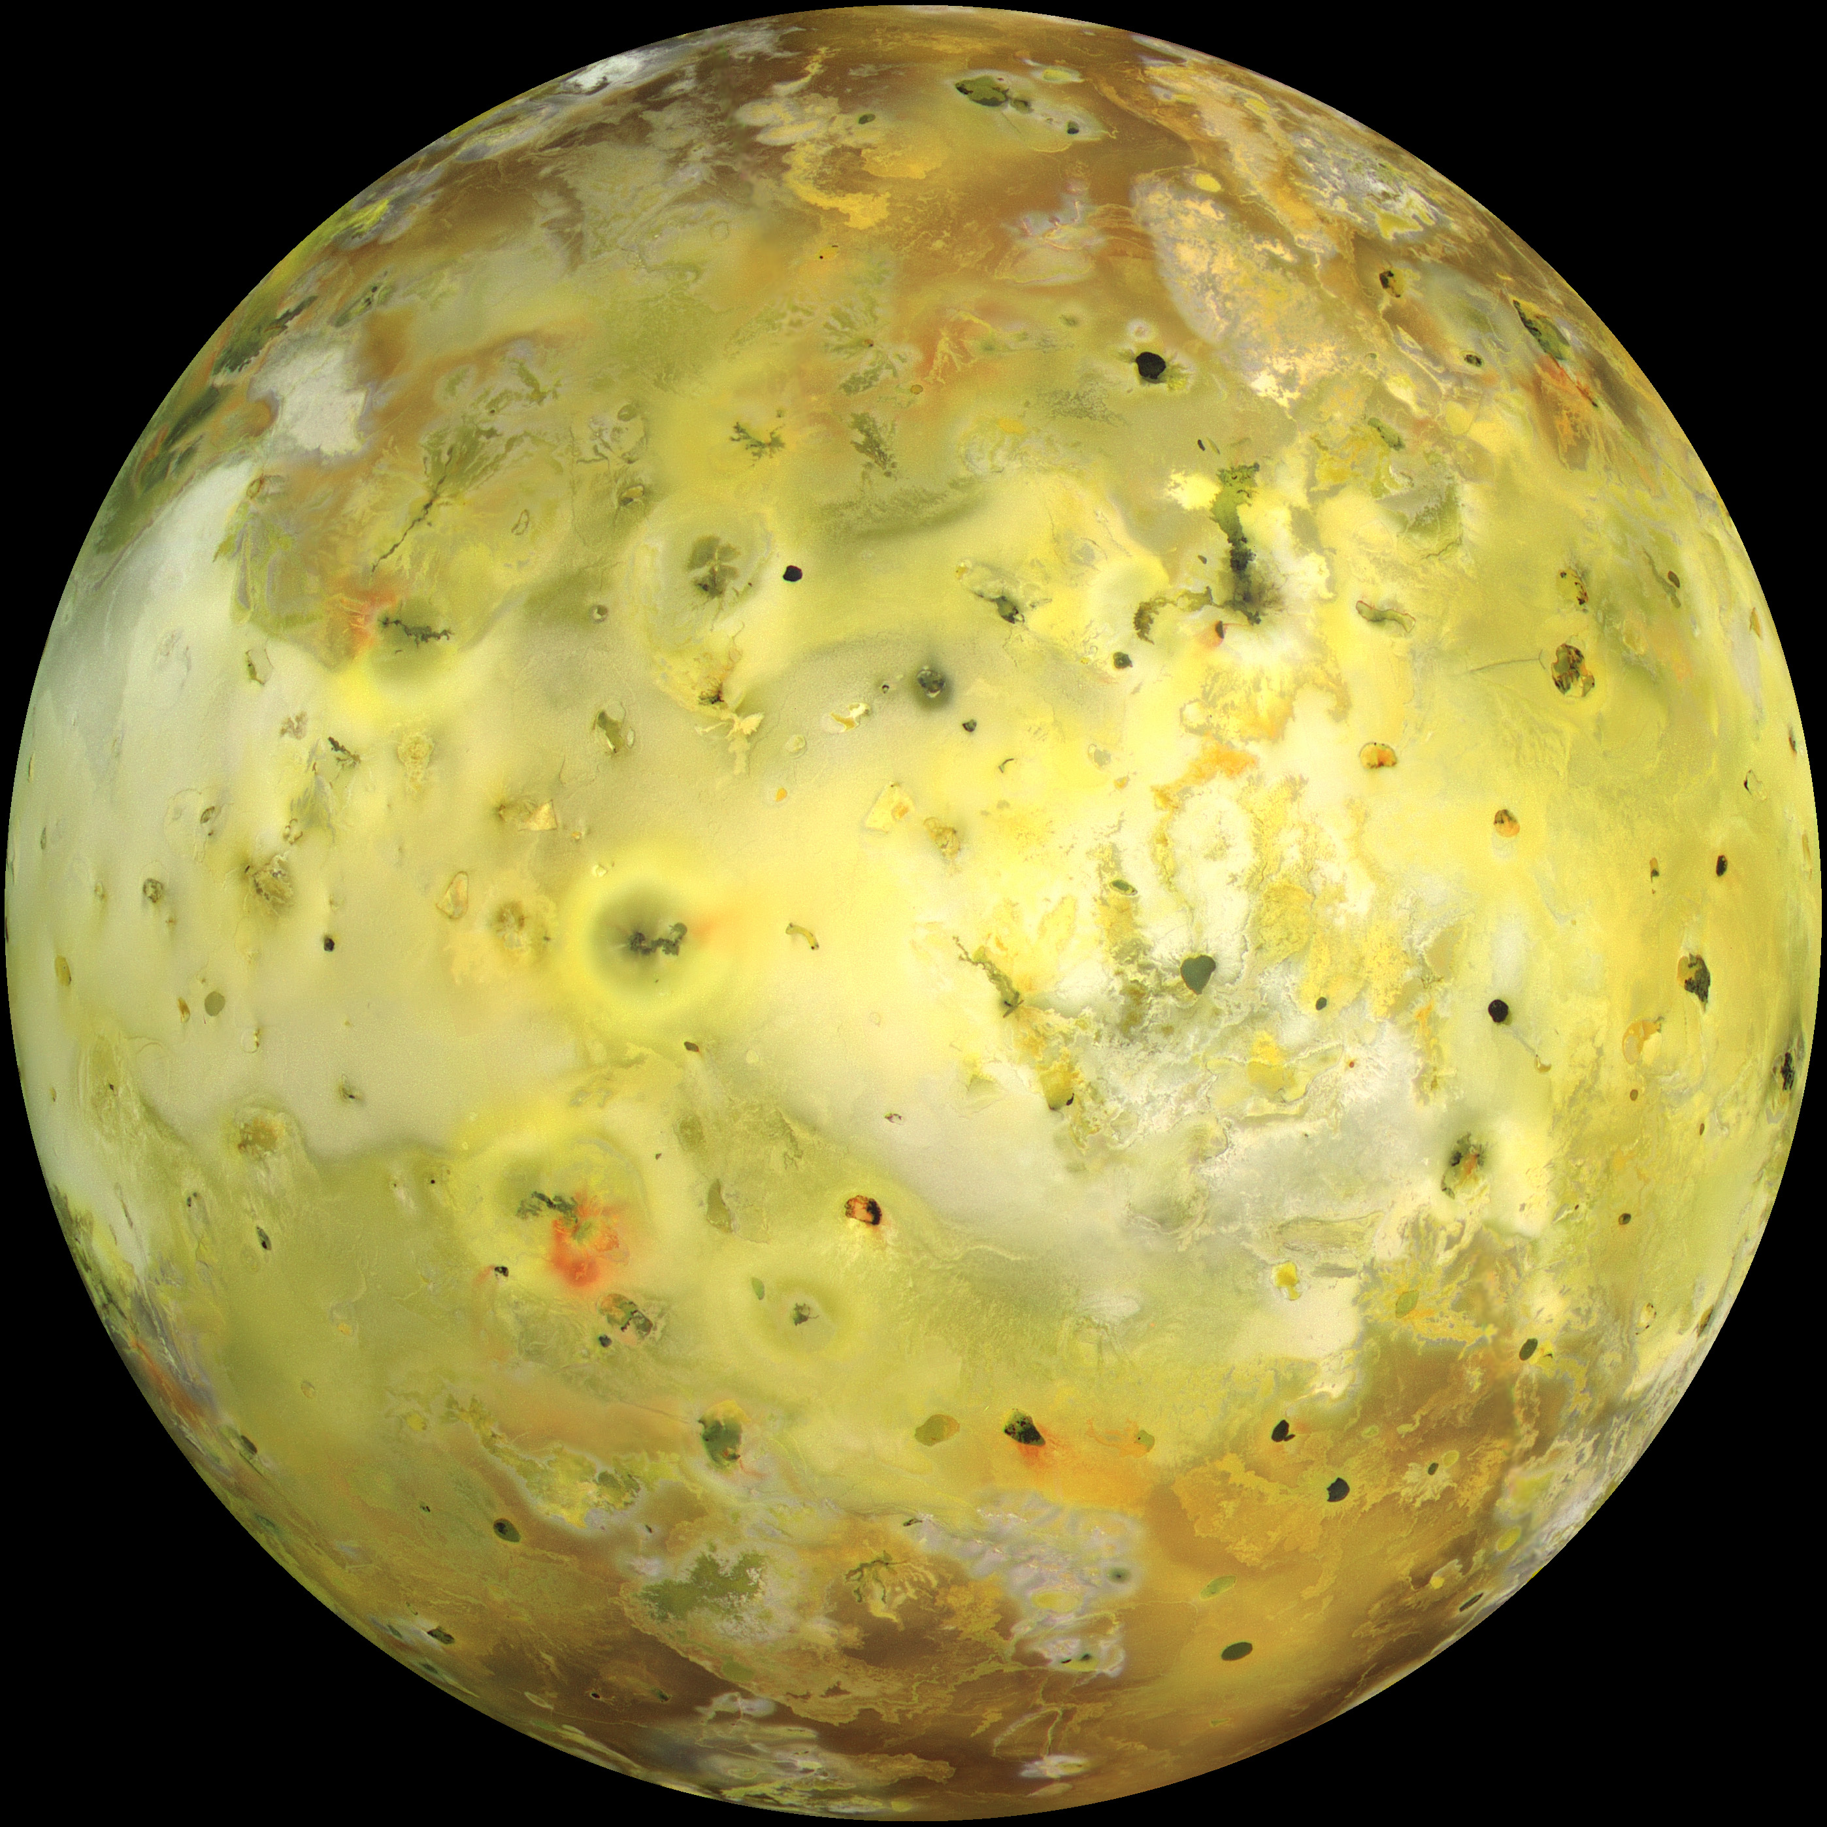
Coupling volcanism and interior dynamics on Io
Dan Spencer¹
Richard F Katz¹ & Ian J Hewitt²
¹ Department of Earth Sciences, Oxford
² Mathematical Institute, Oxford
dan.spencer@earth.ox.ac.uk
Spencer_space

Slide 2
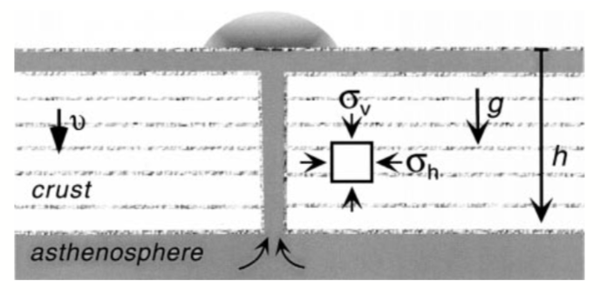
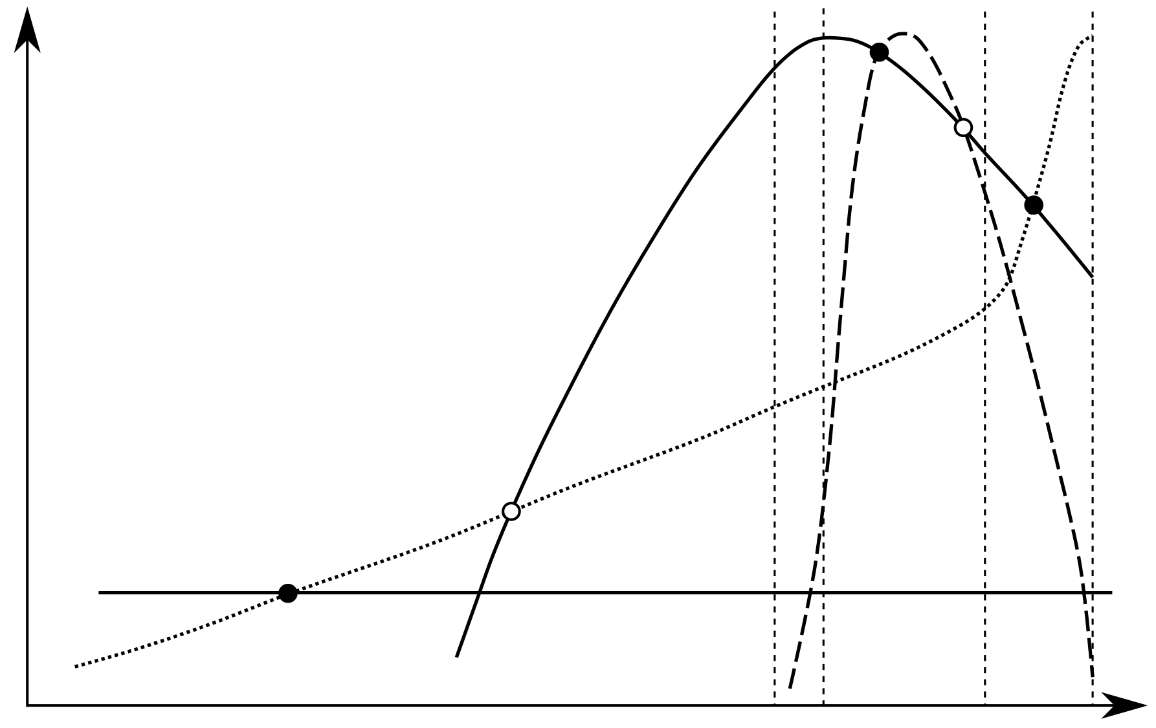
Heat-pipe Io
1800
Lithosphere
Decreasing Darcy flux
1600
O’Reilly and Davies, 1981, McKinnon et al 2001
Radius (km)
Tidal heating
Stable equilibrium
Unstable equilibrium
1400
Heat flux
Convection
Melt
Segregation
Lower mantle
Radioactivity
1200
0
0.1
0.2
Temperature
Ts
Melt fraction $ϕ$
Tc
Td
Tl
Moore 2003, Breuer & Moore 2015
Moore 2001

Slide 3
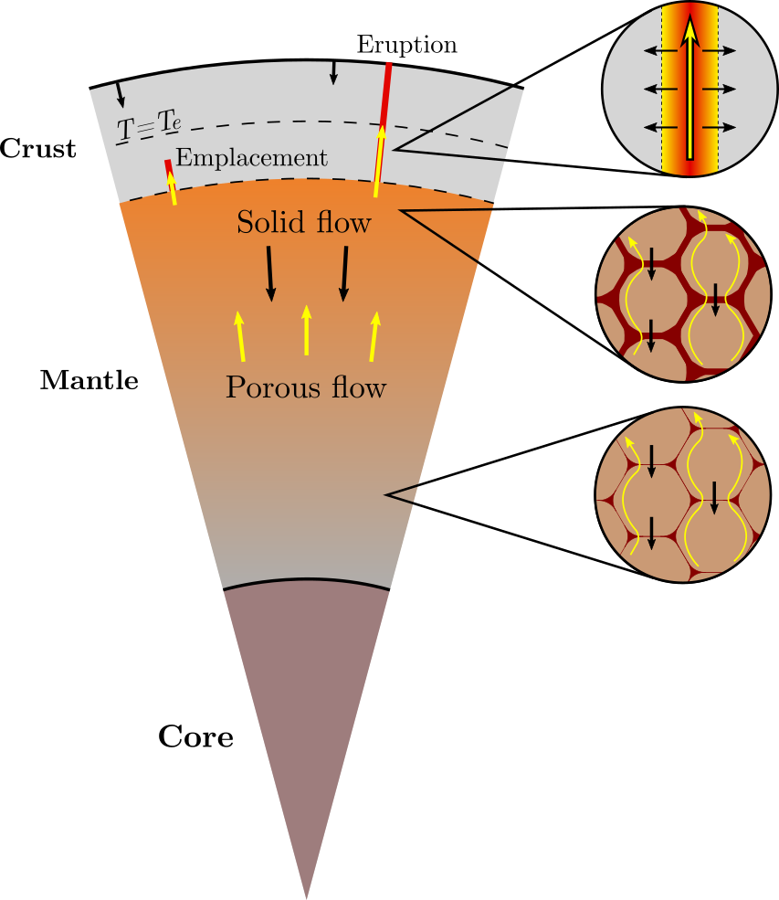
Model Setup
Key model assumptions:
Uniform tidal heating
One-component thermodynamics
Spherical symmetry

Slide 4
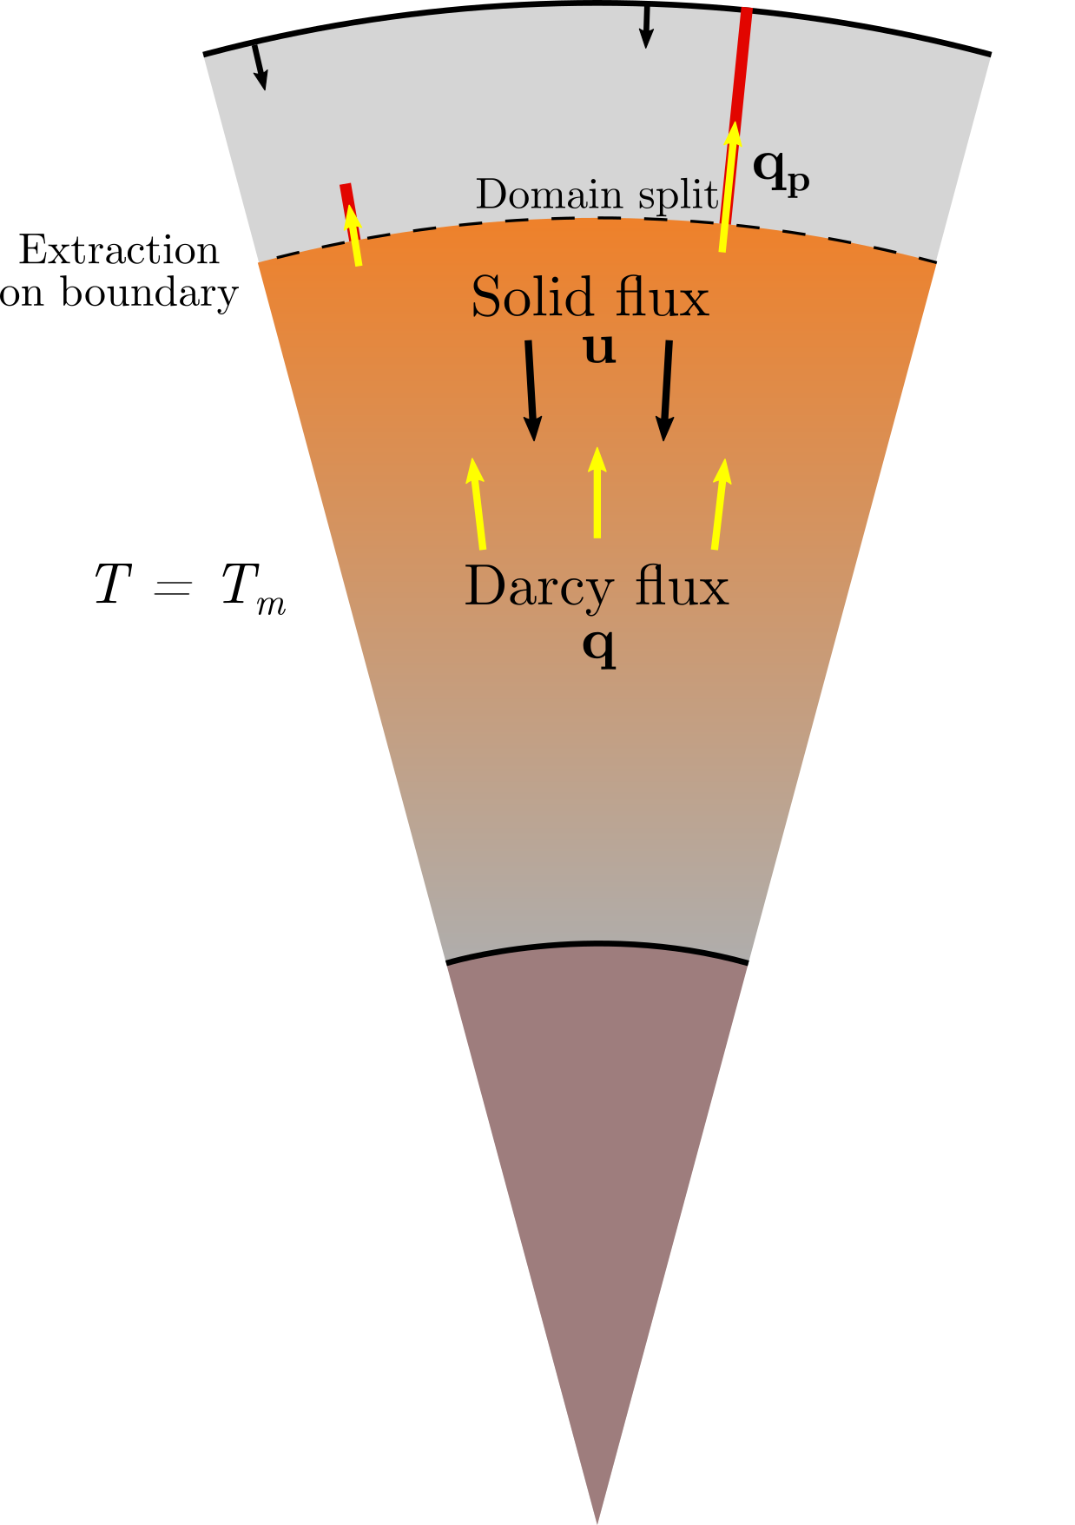
Model Theory
Conservation of mass
$$T=T_{e}$$
Extraction and emplacement
Conservation of energy
Conservation of momentum
Solid velocity | u
Darcy flux | q
Plumbing system flux | qp
Extraction rate | E
Emplacement rate | M
Extraction rate constant
Plumbing system temp. | Tp
Compaction viscosity
Permeability exponent | n
Permeability constant | K0
Liquid viscosity
Density difference
Emplacement rate constant | h
Liquid overpressure | P
Critical liquid overpressure | Pc
Temperature | T
Critical emplacement temp. | Te
Specific heat | ce
Latent heat | L
Porosity
Thermal diffusivity
Volumetric tidal heating
$$ζ$$
$$ϕ$$
$$κ$$
$$η_{l}$$
$$ν$$
$$ψ$$
$$Δρ$$

Slide 5
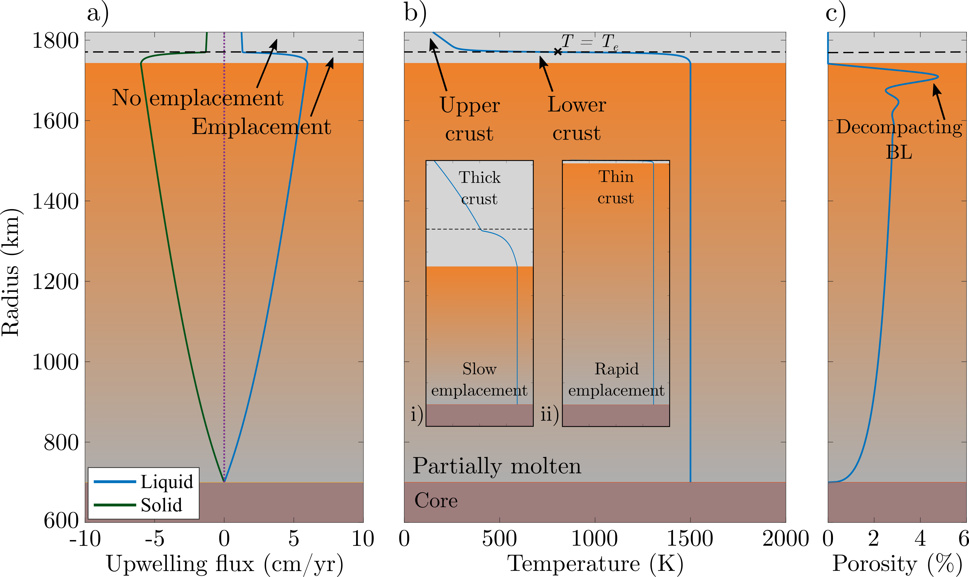
Example solution

Slide 6
Observable model outputs

Slide 7
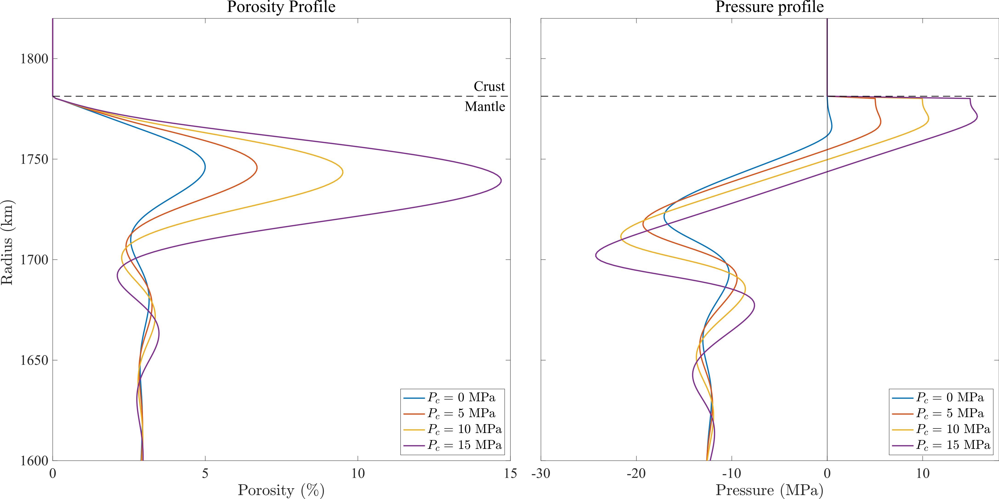
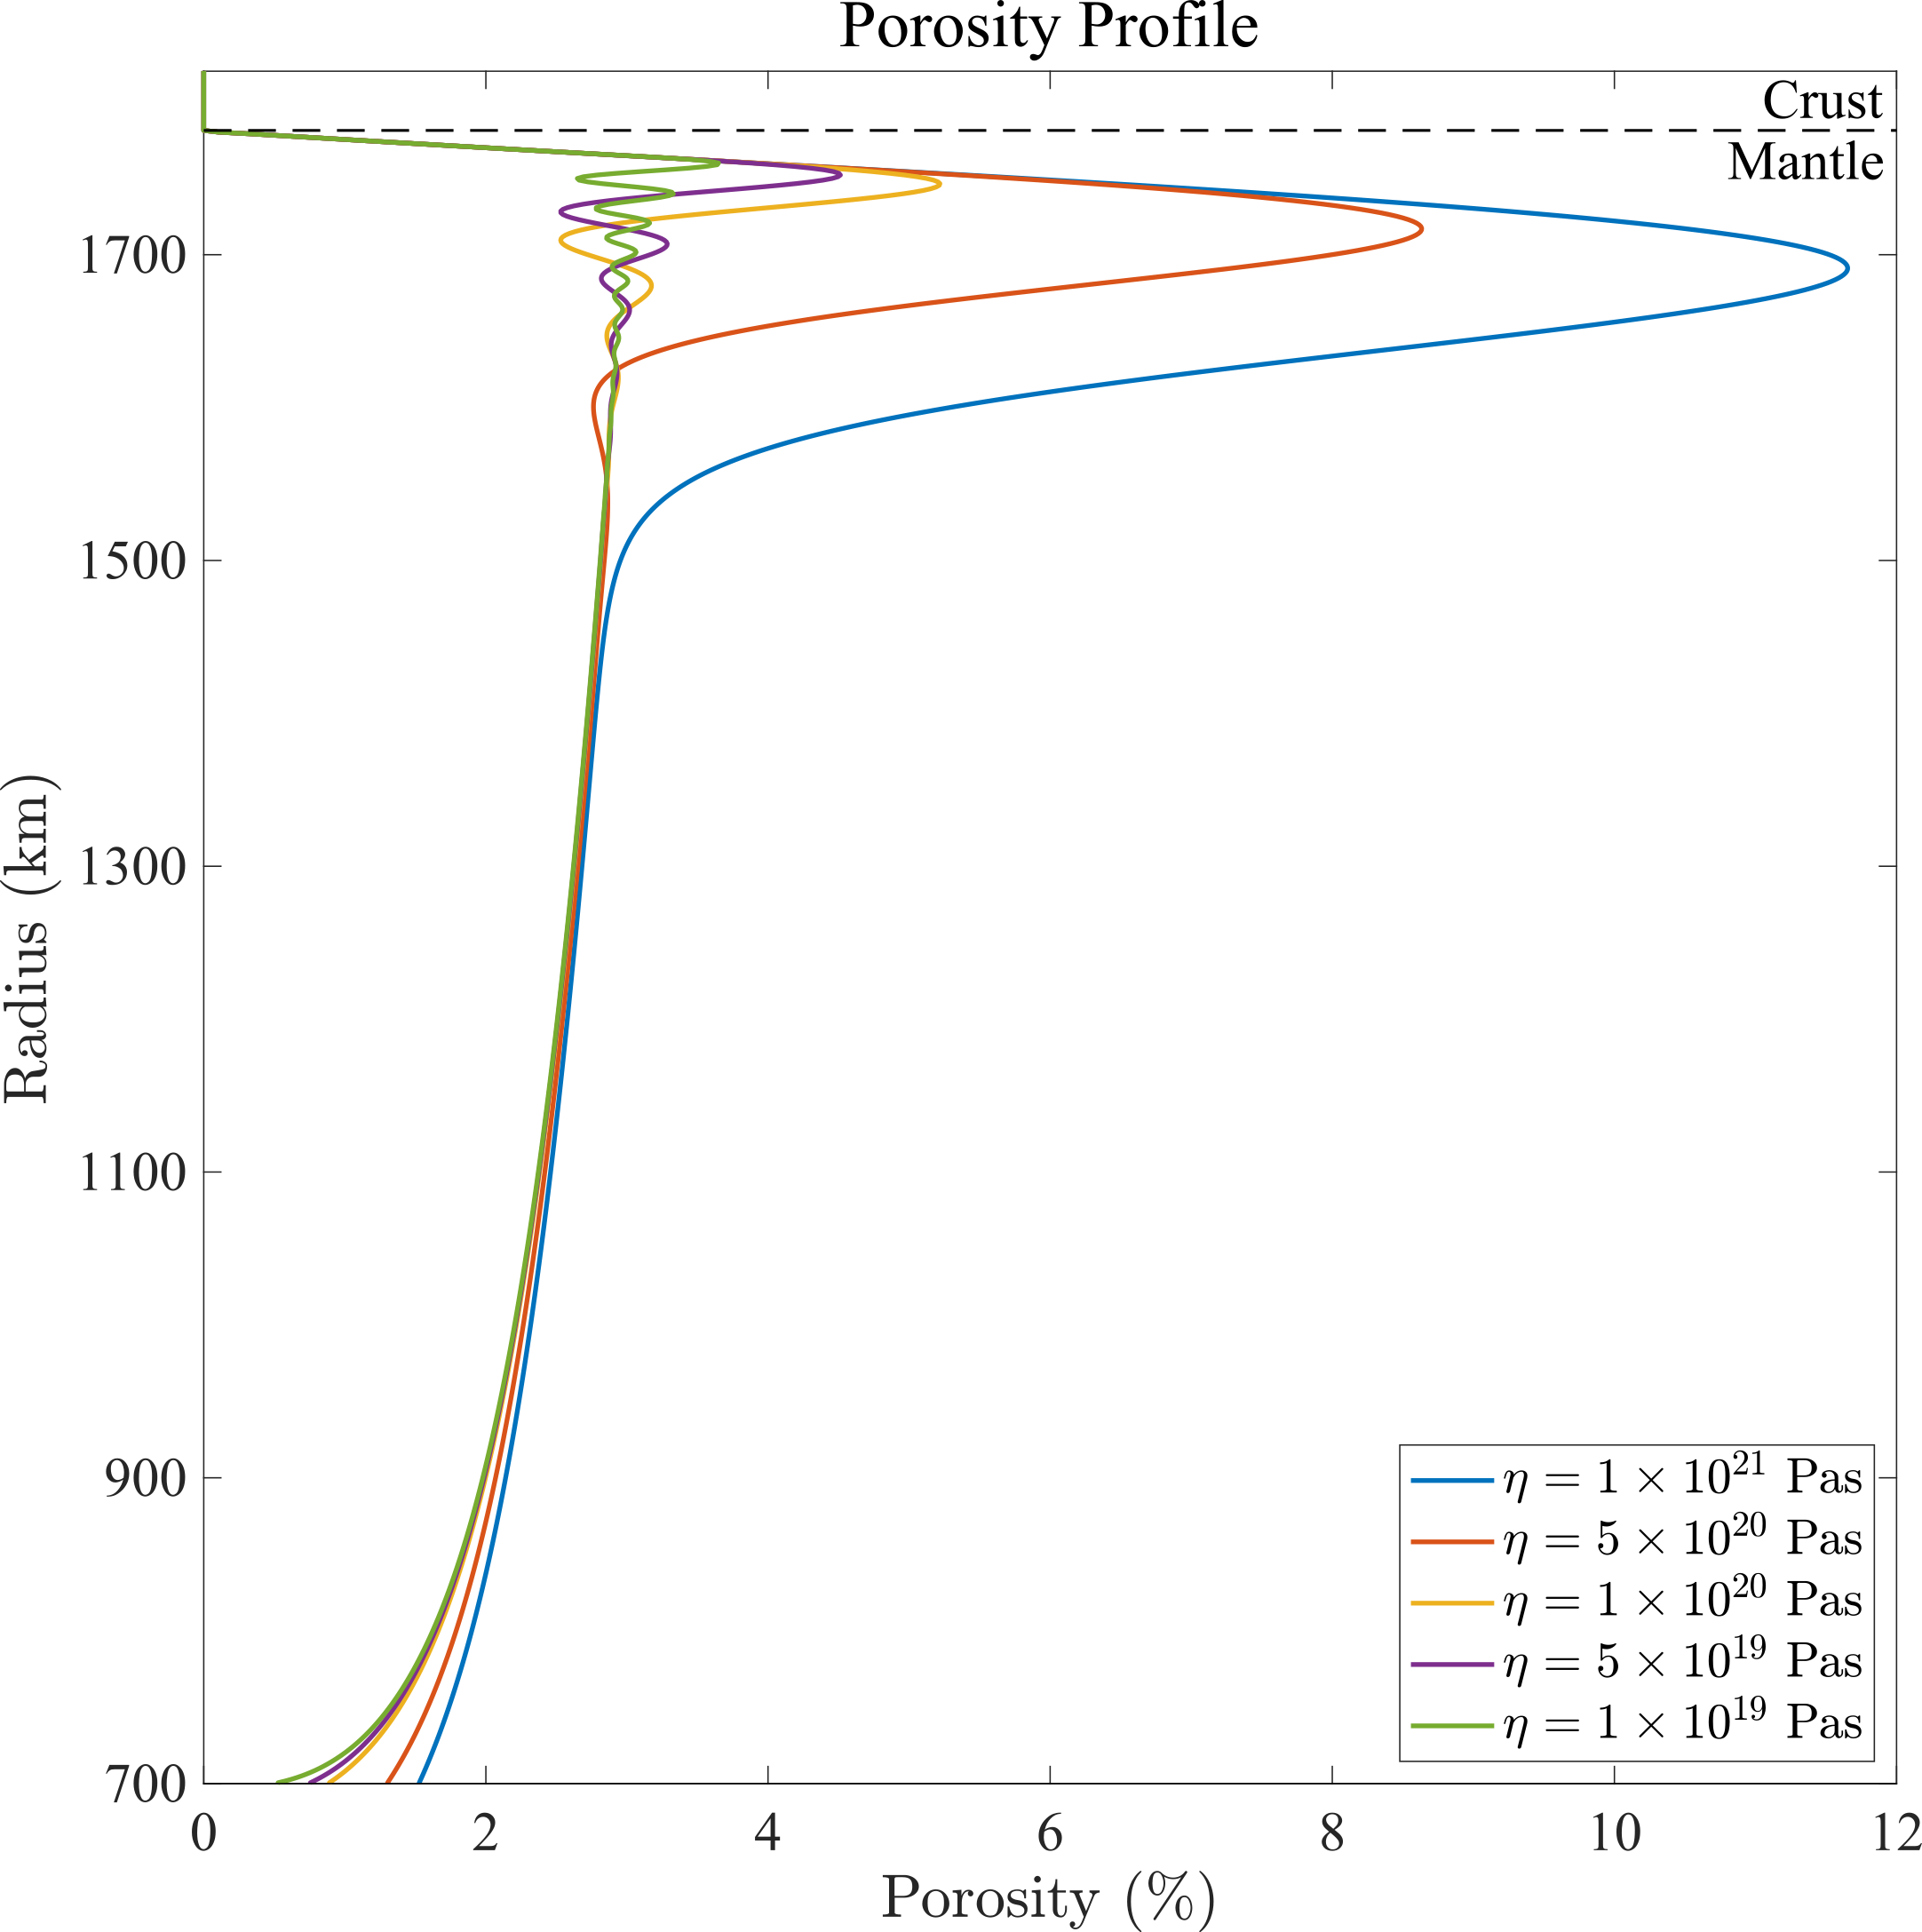
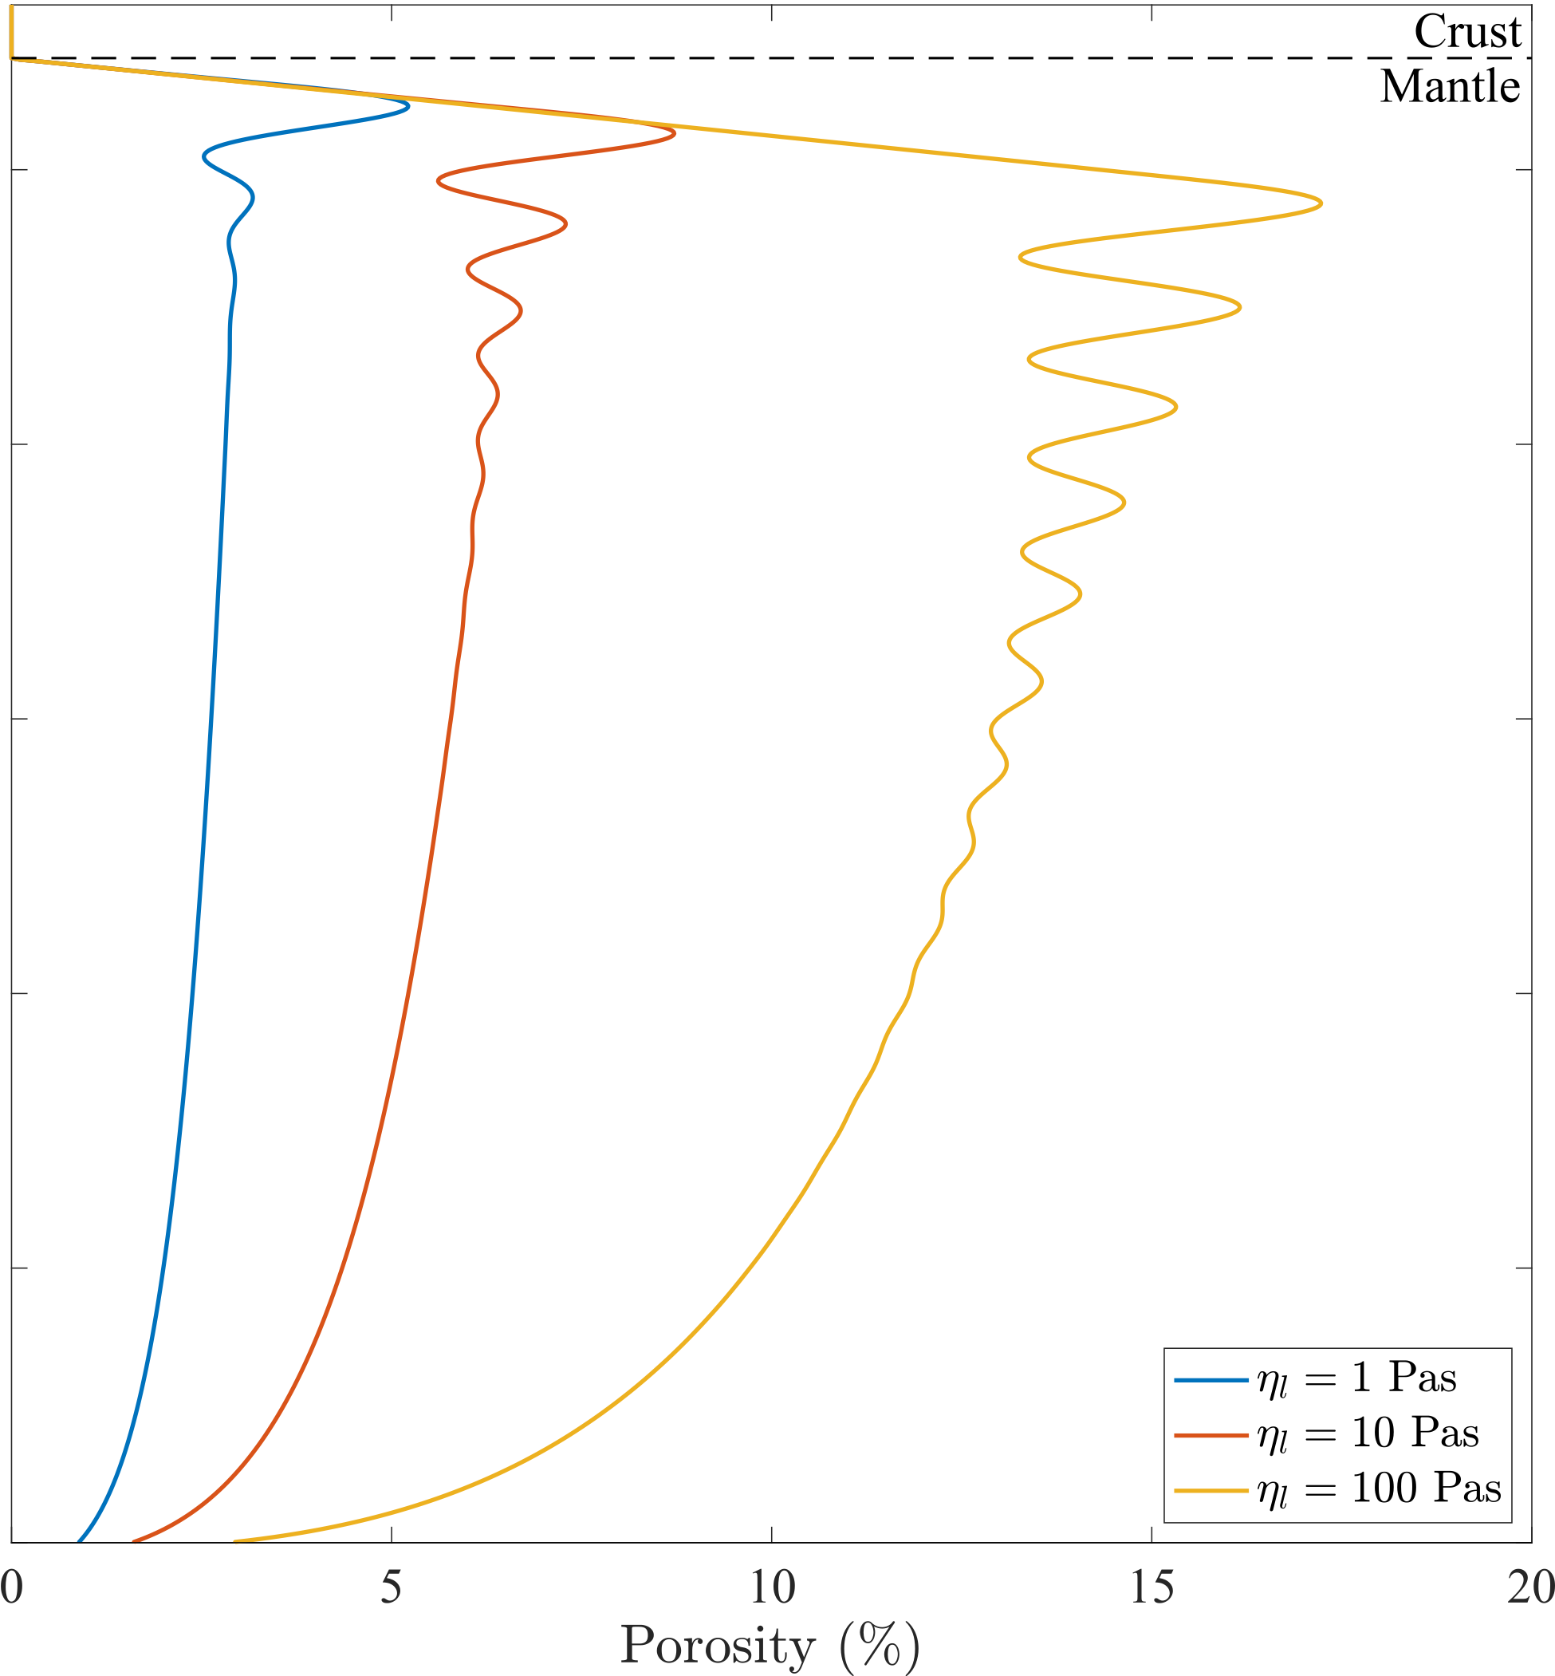
Decompacting boundary layer
a)
b)
Critical extraction pressure
$$P_{c}$$
a)
b)
Shear viscosity
and
melt viscosity
$$ηη_{l}$$

Slide 8
Conclusions
Magmatic emplacement is a fundamental control on Io’s crustal thickness.
A high melt fraction region can form beneath Io’s crust if either i) Io’s shear viscosity and melt viscosities are relatively high, or ii) it is difficult for magma to migrate from Io’s mantle into the crust.
If shear viscosity and melt viscosities are low, and melt can easily pass from Io’s mantle into the crust, a high melt fraction region will not develop.
This would imply a relatively uniform mantle and little drive for radial partitioning of tidal heating.
Future work
Include a compositional model
Does melting in a stratified Io help explain Io’s different eruption styles, crustal thicknesses, and lava temperatures?
Spencer_space
dan.spencer@earth.ox.ac.uk

