Slide 1
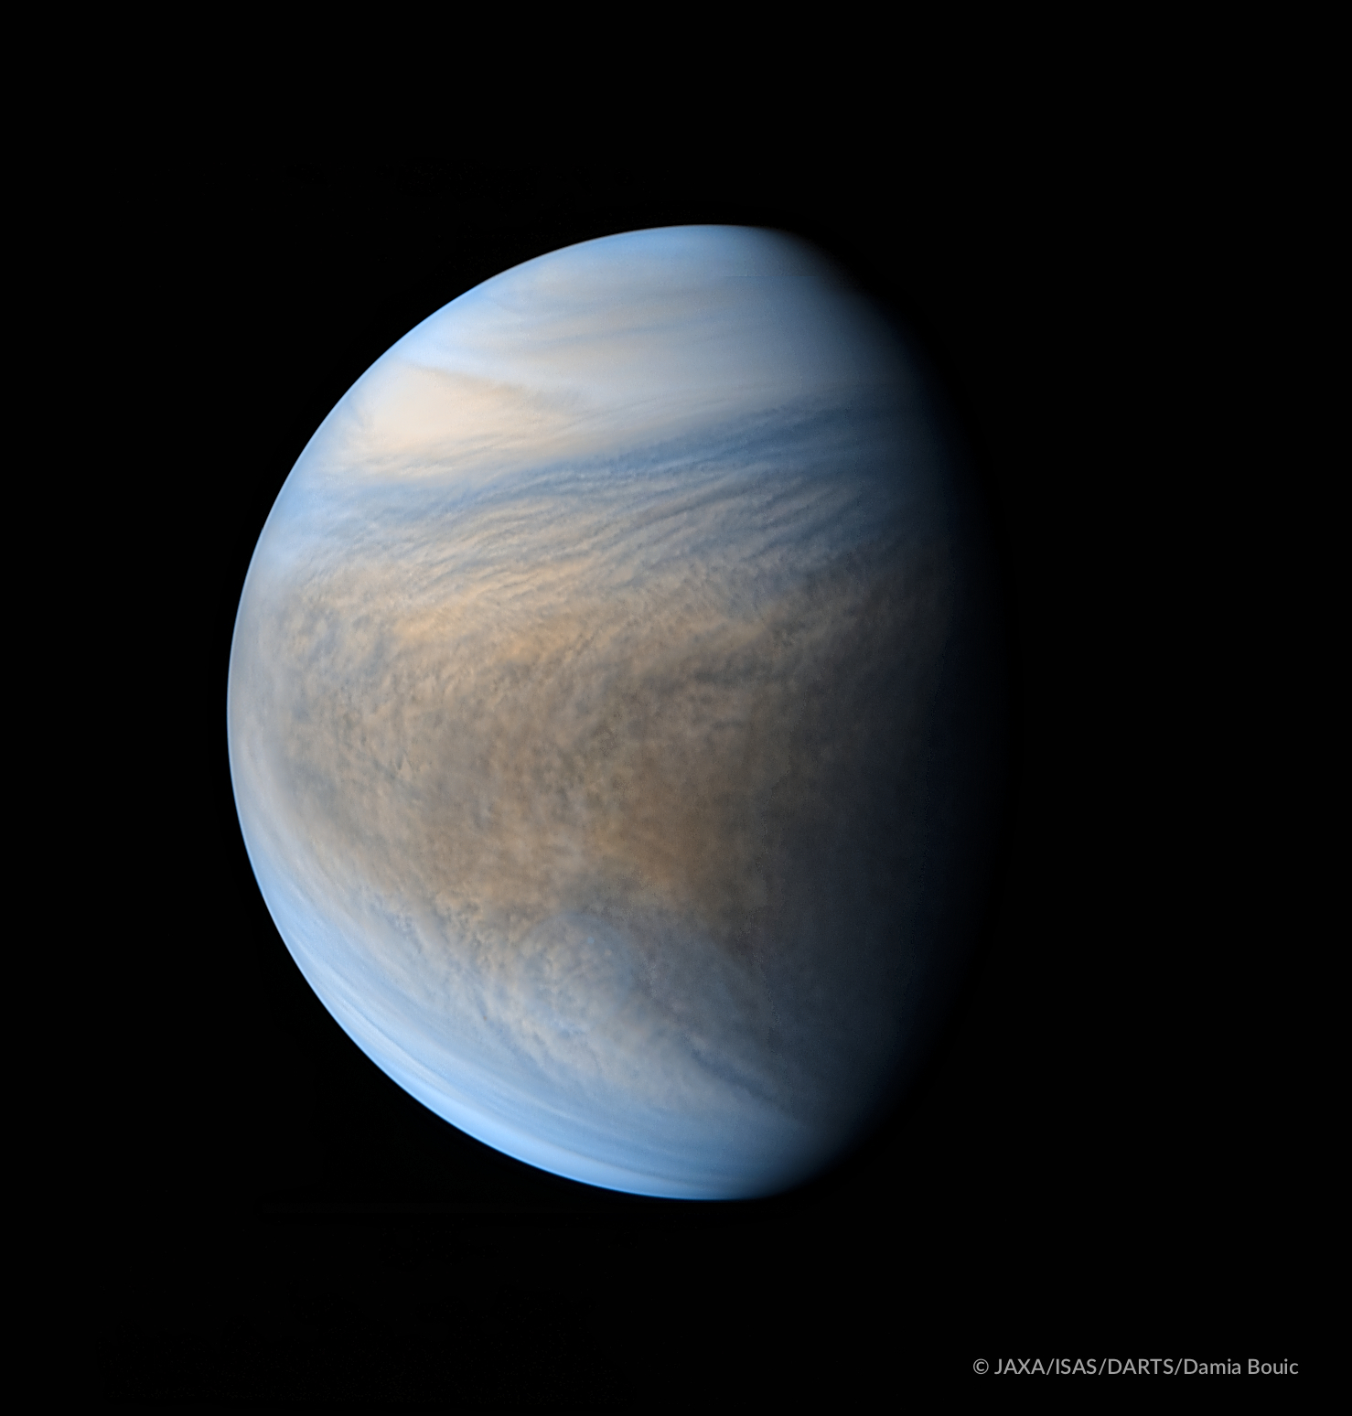

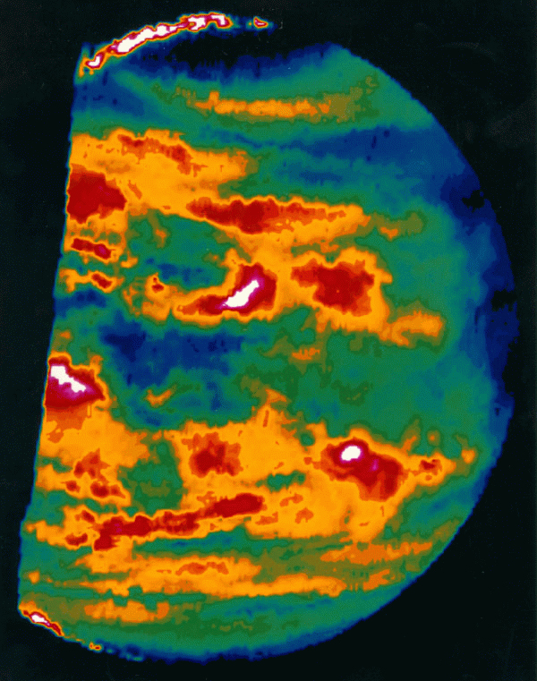
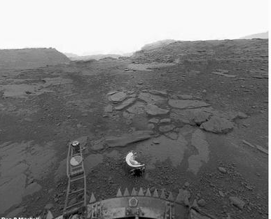
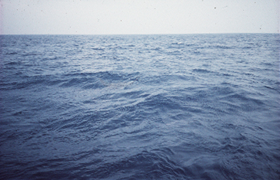
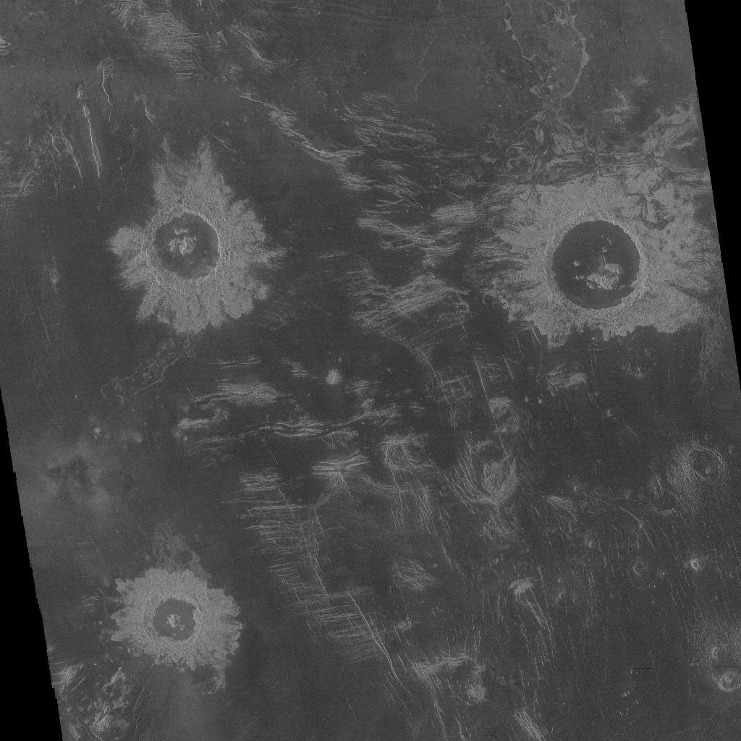
The Evolution of Climate
and a Possible Biosphere on Venus
David Grinspoon
Planetary Science Institute
David@funkyscience.net
@DrFunkySpoon
Rocky Worlds
Kavli Institute
1/8/2020

Slide 2
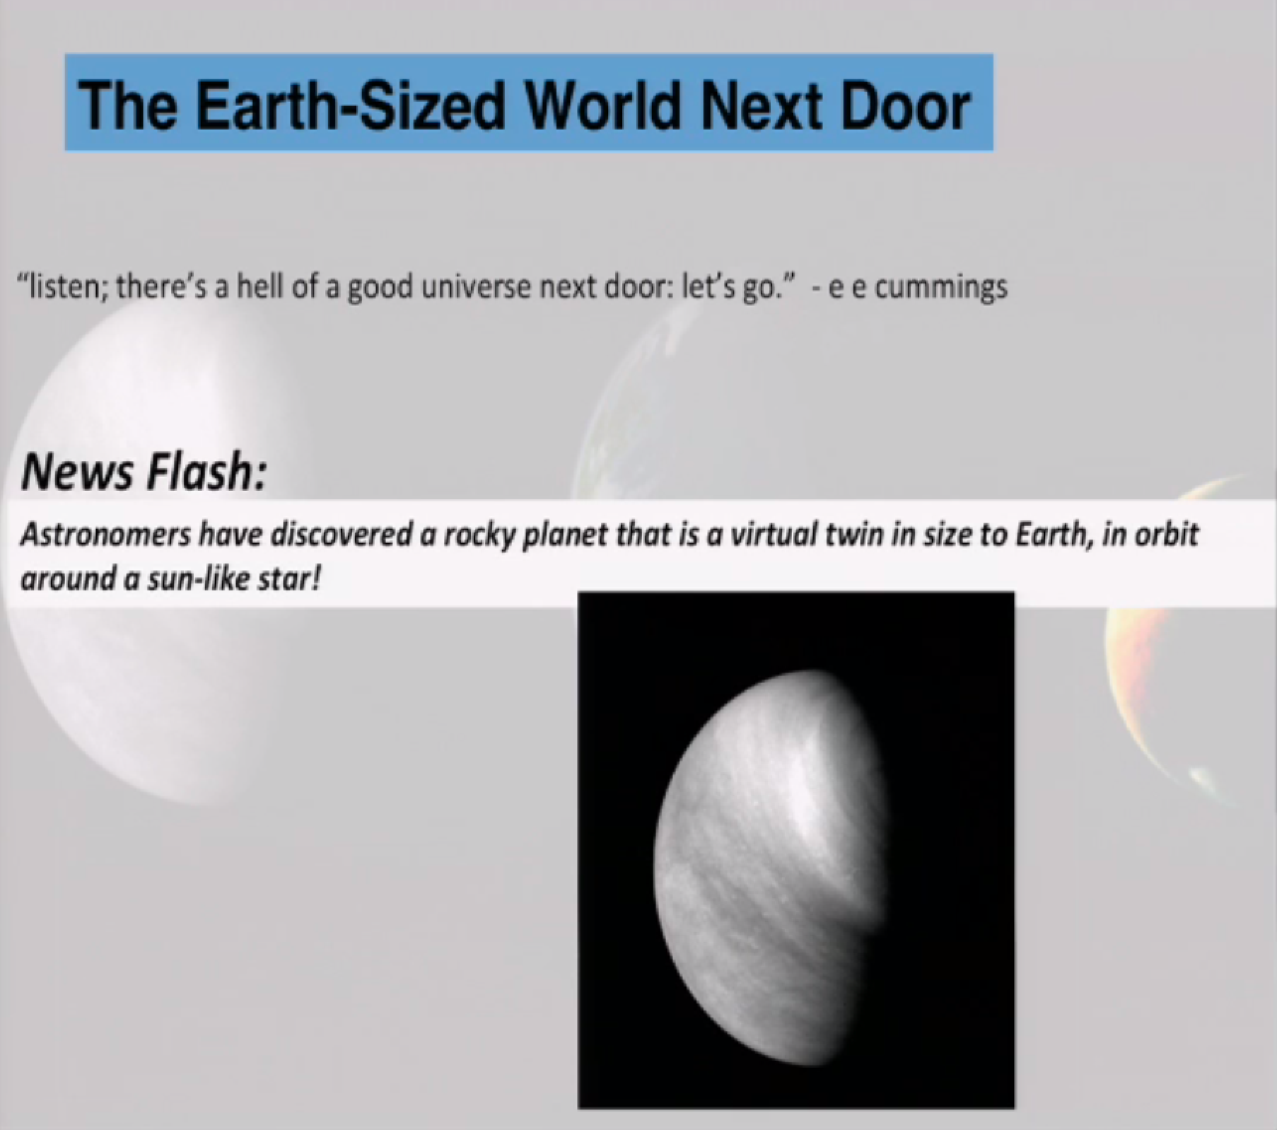

Slide 3
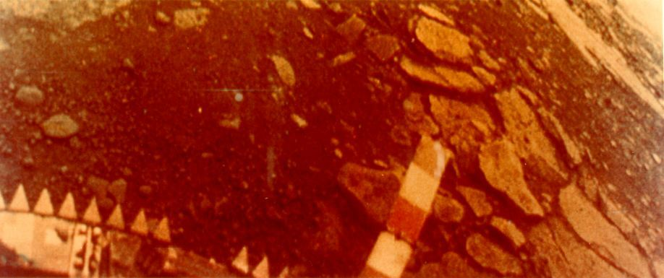
Did Venus experience one great transition or two?
Loss of Oceans.
2) Global resurfacing.

Slide 4
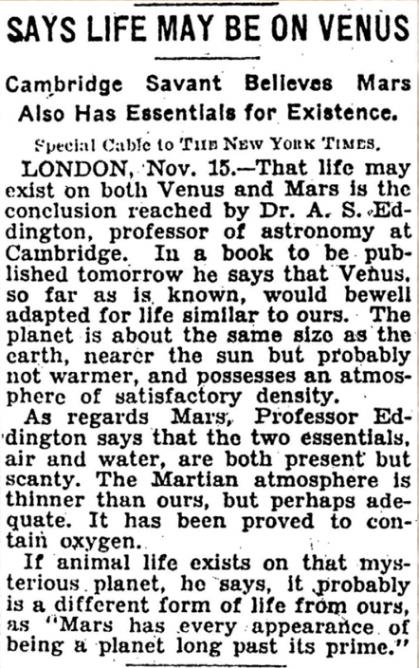

New York Times 11/16/1928

Slide 5
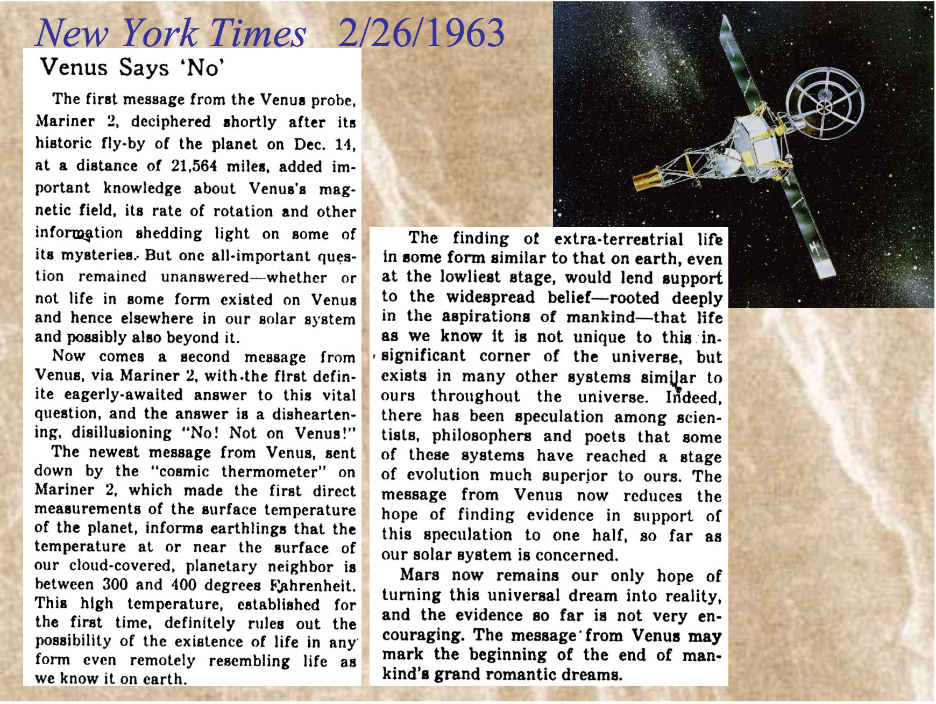

Slide 6
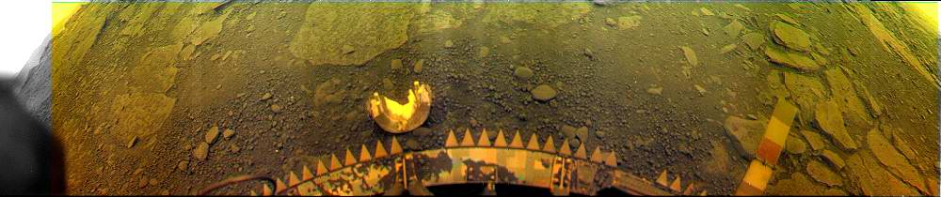
Water on Venus and Earth
VENUS In atmosphere: 3 cm equivalent. On surface: None!
EARTH In atmosphere: 3 cm equivalent. On surface: 3 km.
Earth has 100,000 times as much water as Venus.

Slide 7
Did Venus Have Oceans?
No direct evidence! (a central goal for future missions)
But Venus surely accreted with substantially more water than it has now.
Indirect/circumstantial evidence:
    * D/H ratio > 100 x ⊕. A large fractionation requires a severely depleted reservoir. Requires that most of the water to have ever resided on the surface or in the atmosphere of Venus has escaped. Does not prove there was ever surface water.
    * Formation: Did Venus and Earth accrete with the current factor of 10⁵ difference in water abundance? No formation model predicts, or can account for, this extreme segregation. Nature is not that neat and tidy and not prone to huge, random decreases in entropy. “Occam’s razor”: Venus formed with orders more water.
    * Almost surely all terrestrial planets formed quite wet (Matsui & Abe, Zahnle, Elkins-Tanton, etc.
    * Climate models: with faint young Sun: water would be liquid. (but depends on unknown albedo & cloud/radiation interactions)
However* Caveat: early solar activity may have prevented surface water condensation and removed most hydrogen and water.

Slide 9
(until recently…)

Slide 10
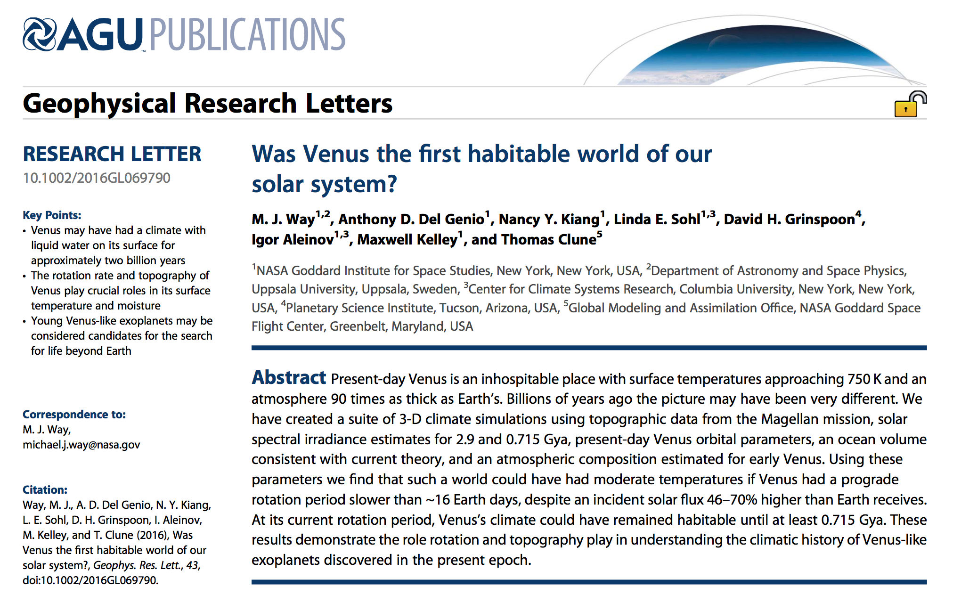

Slide 11
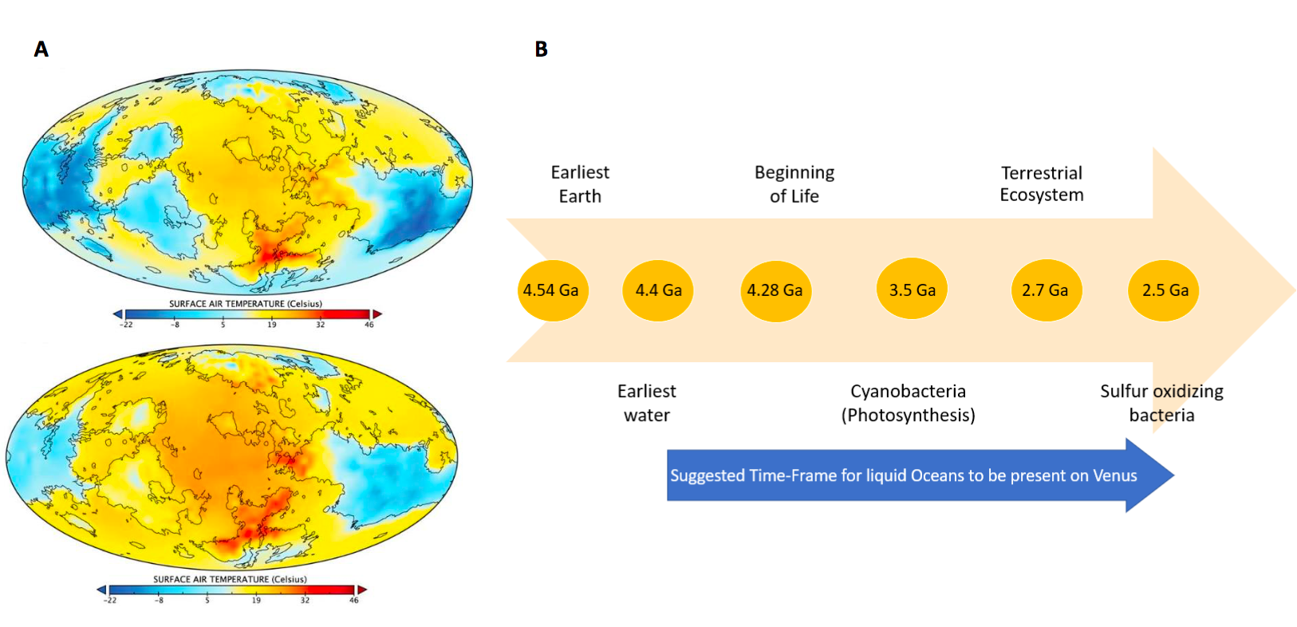
For over two billion years our solar system may have contained
two neighboring terrestrial planets with habitable surface oceans.
Neira et al. 2018
Way et al. 2016

Slide 12
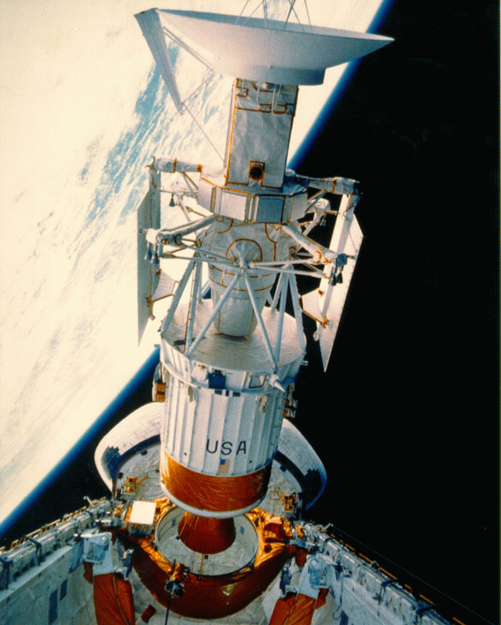
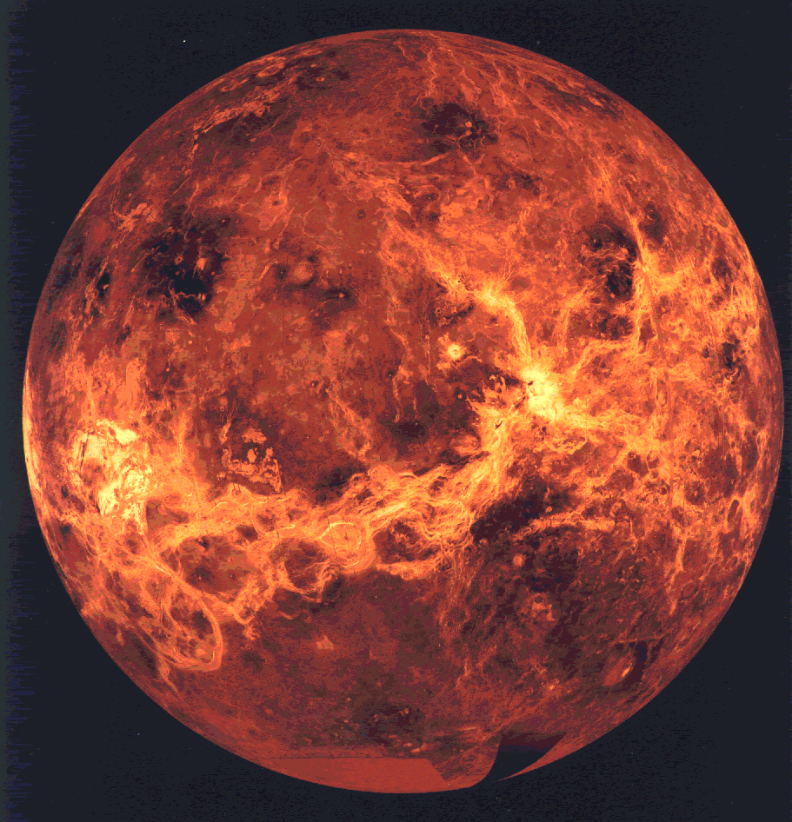
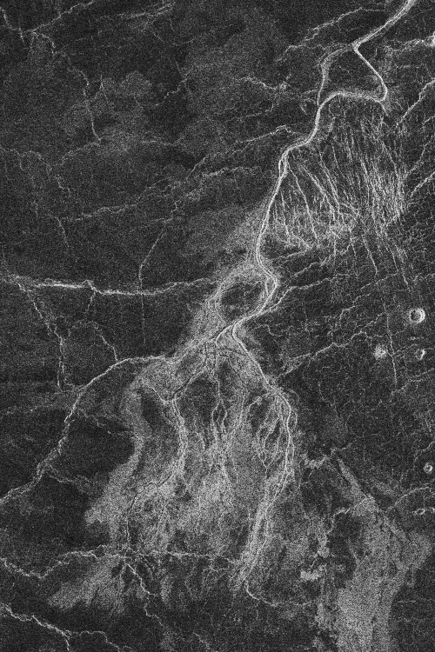
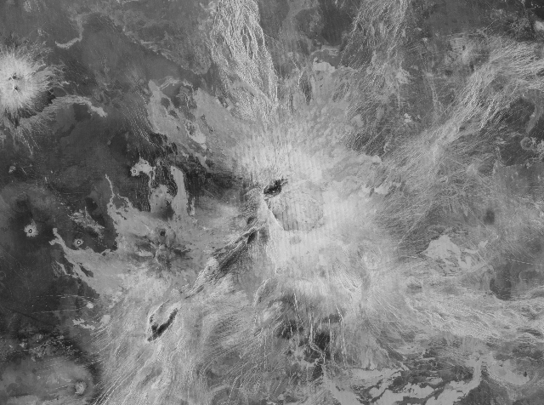
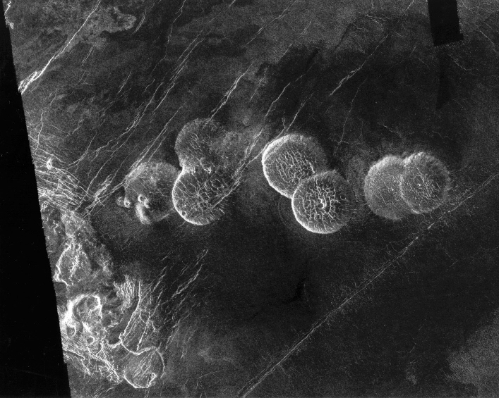

Slide 14
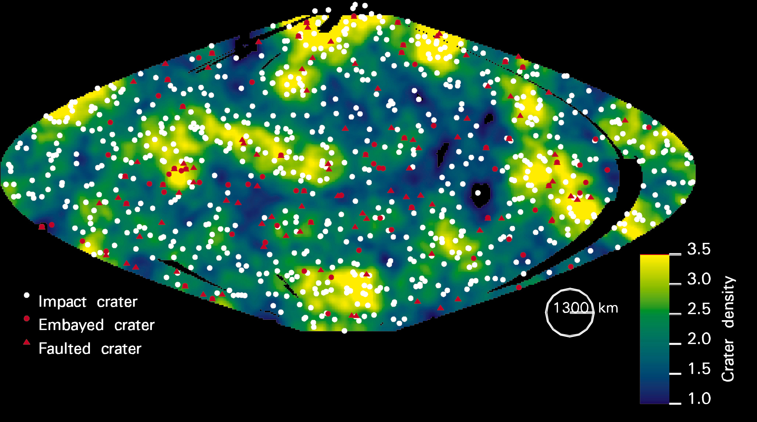

Slide 15
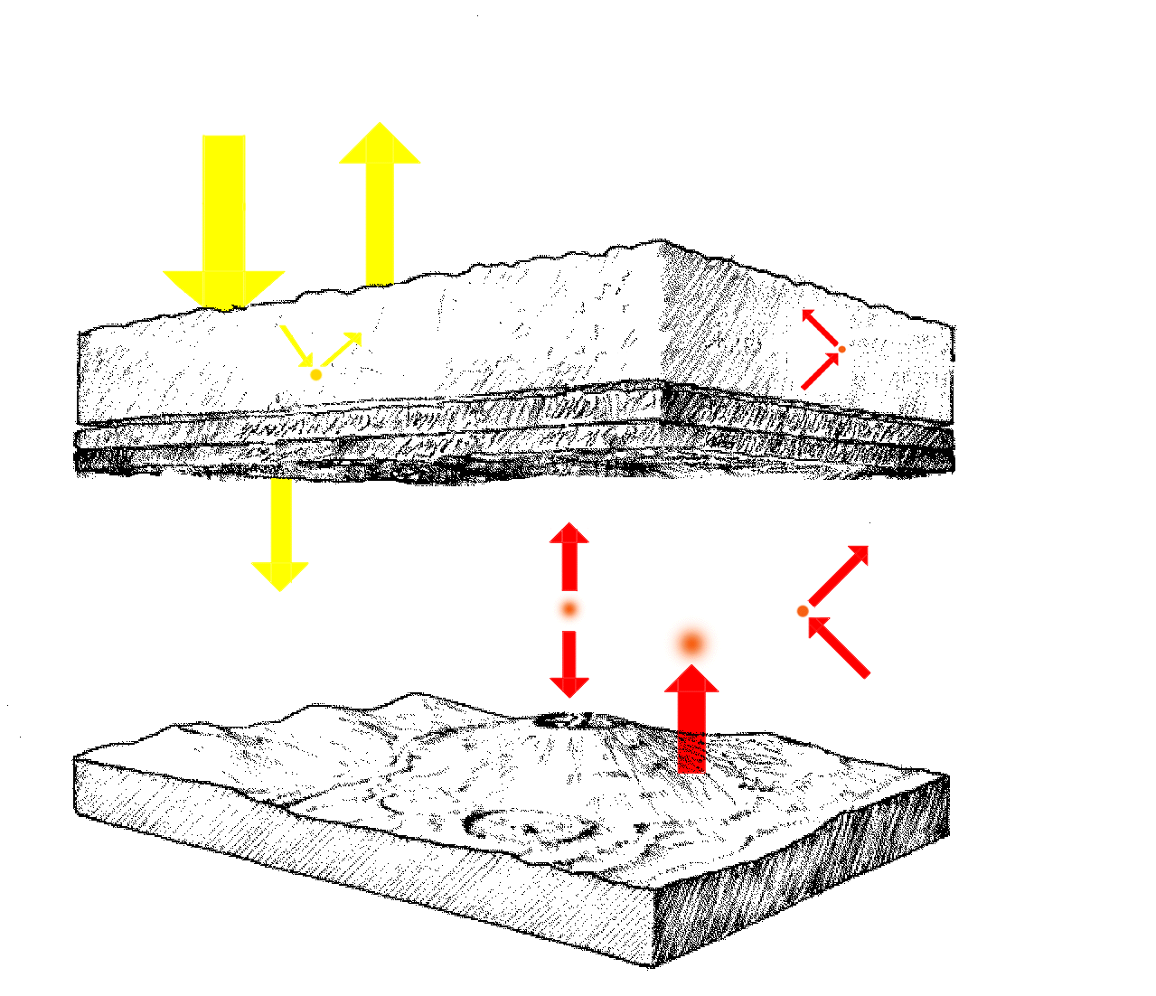
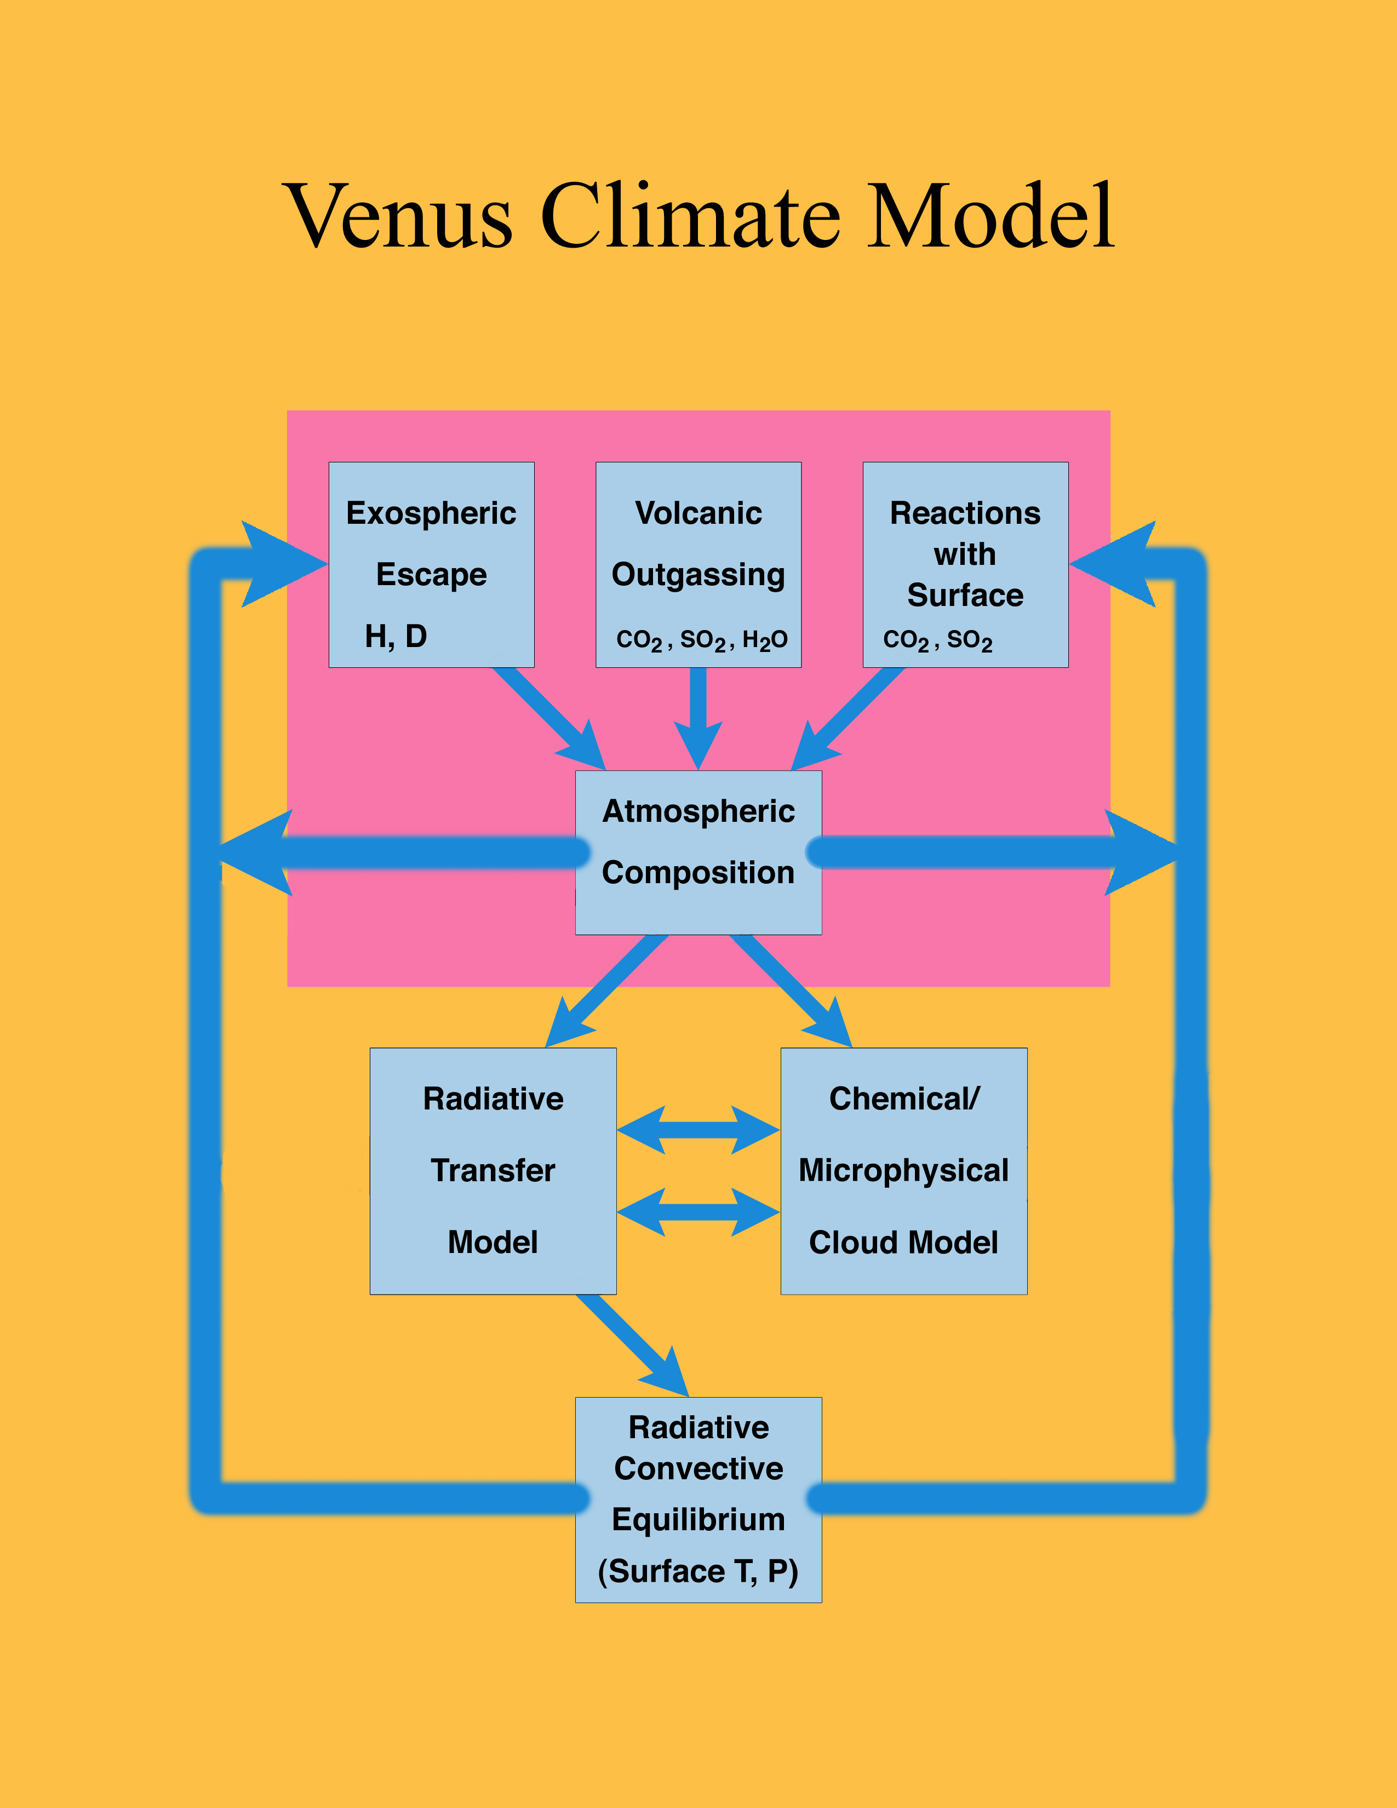
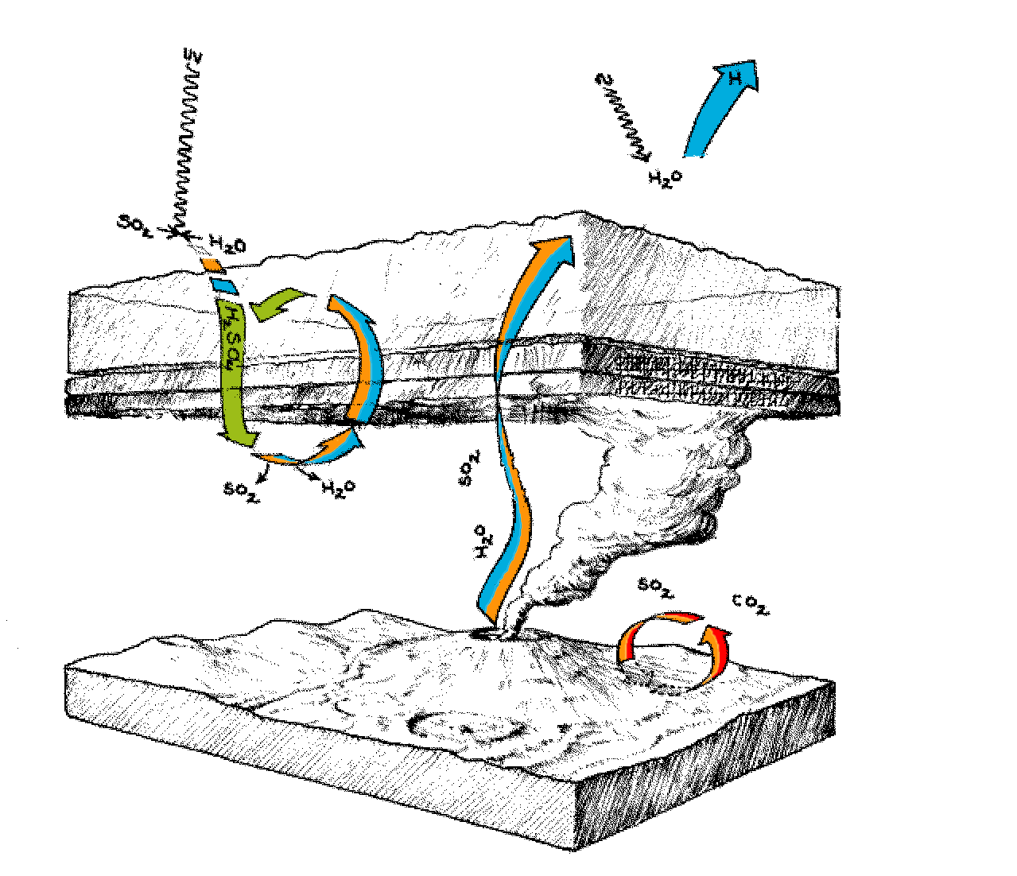

Slide 16
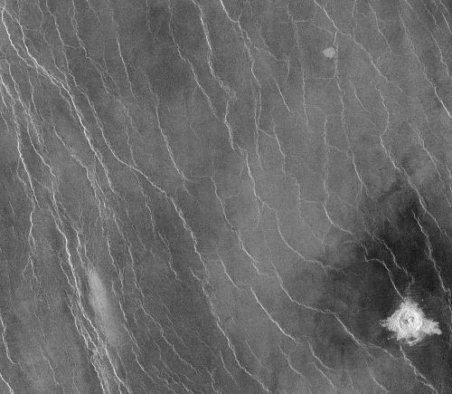
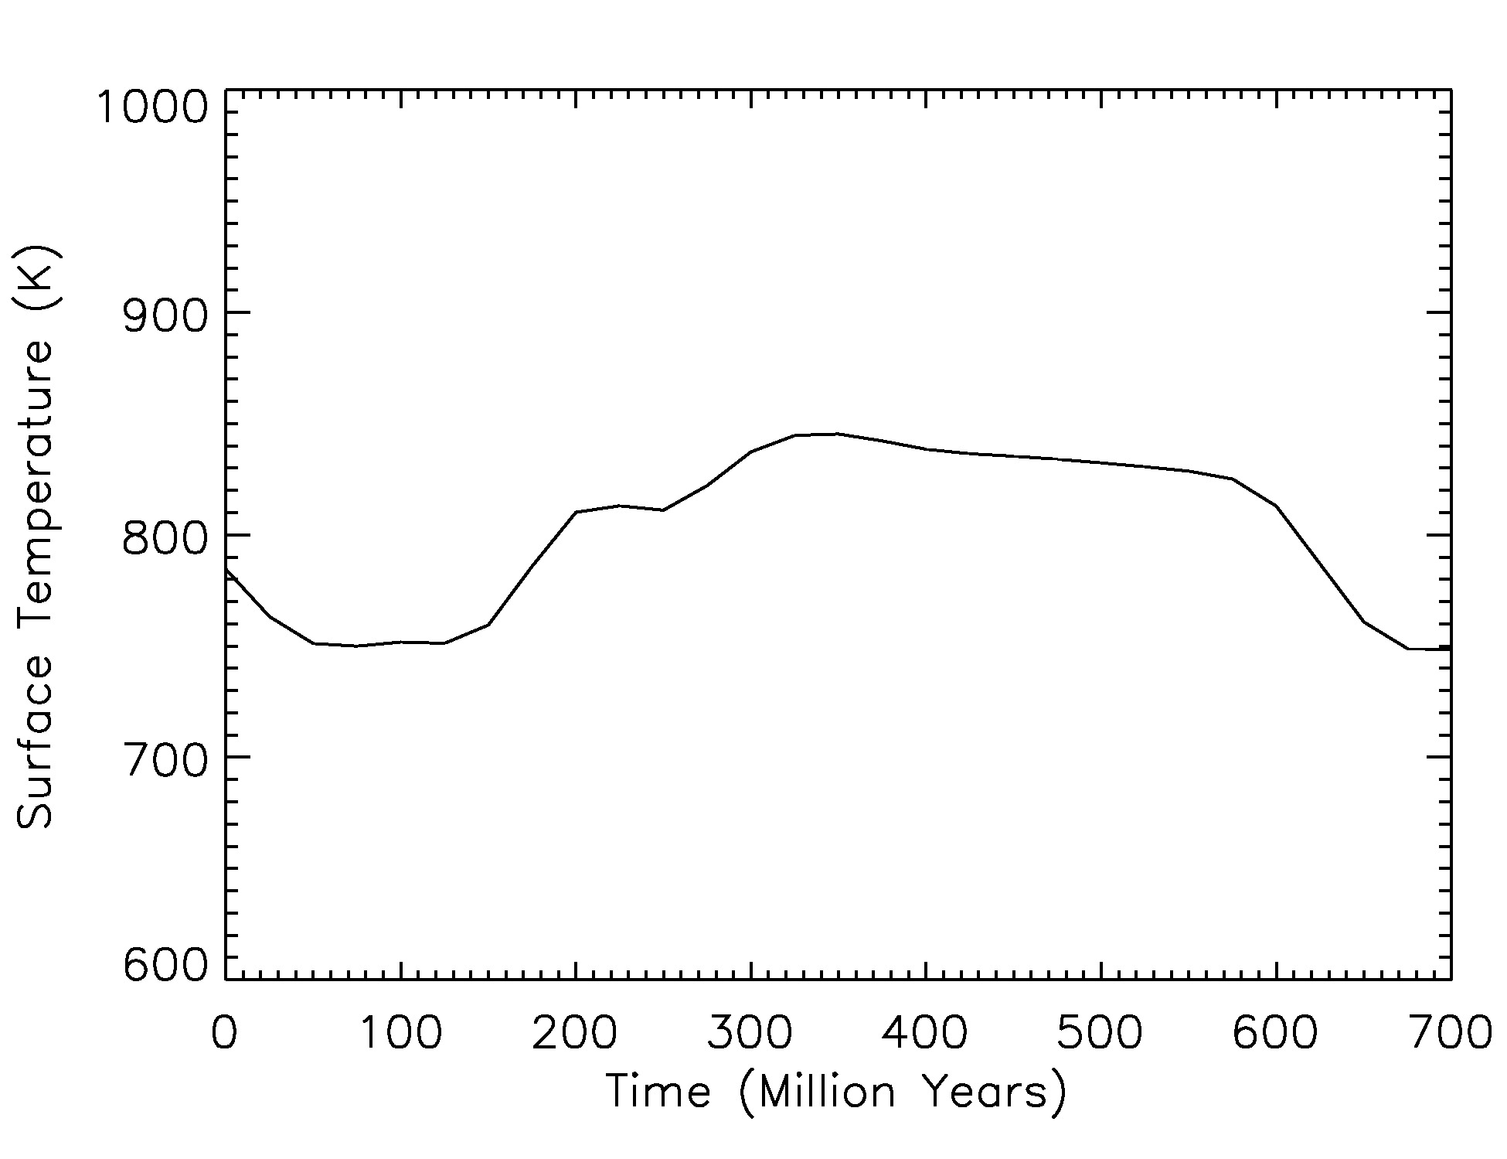
EVOLUTIONARY CLIMATE MODEL:
Changes in outgassing rate associated with the onset and decline of rapid resurfacing can lead to changes in surface temperature on order 100 K.
Bullock and Grinspoon (2001) , The recent history of climate on Venus, Icarus, 150, 19-37
Globally synchronous formation of wrinkle ridged plains. (Solomon, Bullock and Grinspoon, Science, 1999)

Slide 17
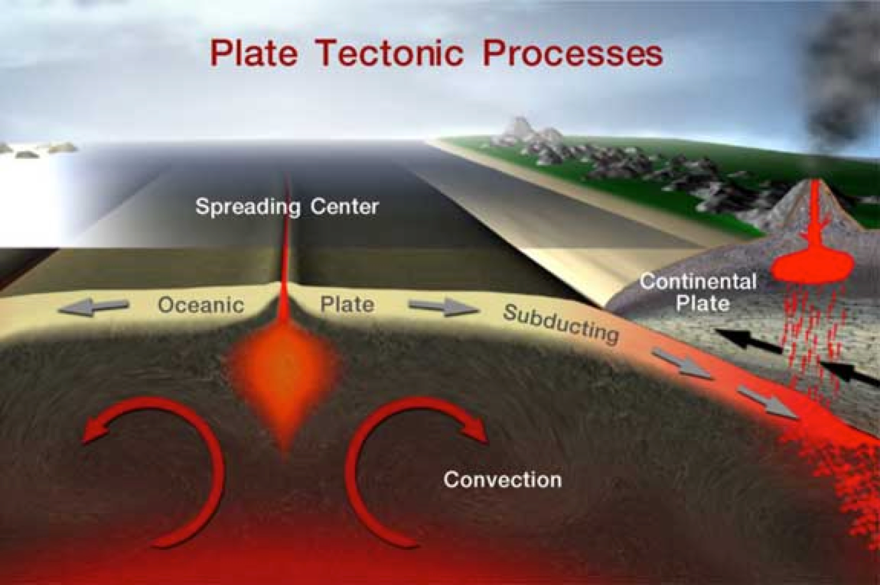
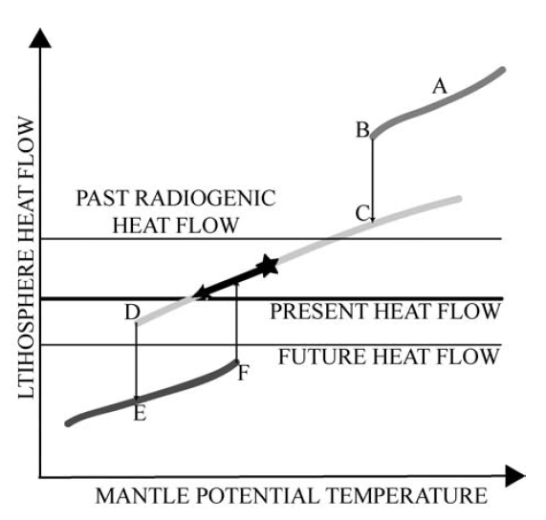
Geological and atmospheric evolution are coupled.
Tectonic style may depend on water content.
(Sleep, 2000)
(Sleep, 2000)
A-B: Magma Ocean
C-D: Plate tectonics
E-F: Stagnant lid

Slide 18
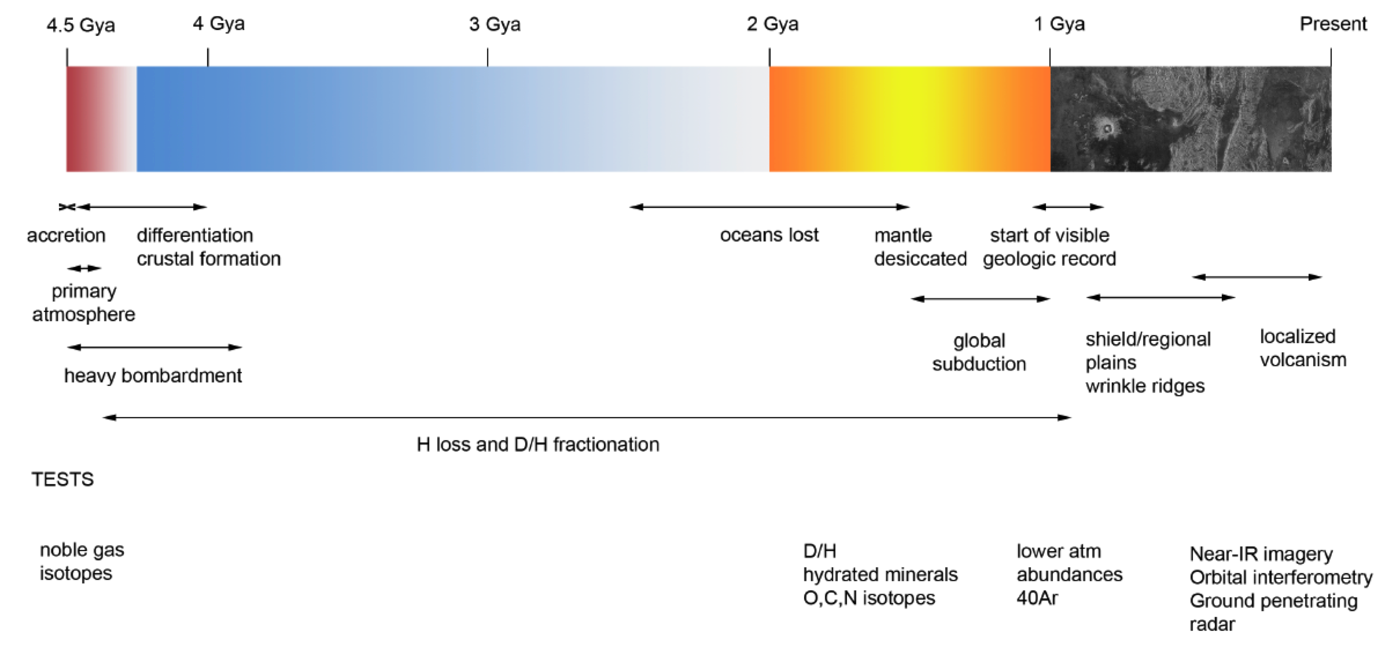
A Unified Scenario: The Great Transition
≈ 2.5 -3 Gy (??) Loss of surface water, subduction of hydrated sediments ceases.
Mantle becomes desiccated, lithosphere thickens
Loss of asthenosphere -> lithosphere tightly coupled to mantle.
Crustal recycling inhibited.
≈ 1 Gy Plate tectonics ceases, Venus becomes “1 plate planet”, mantle cools less effectively
≈ 700 My, global resurfacing
700 My to present: localized volcanism, tectonism, conductive heat release, production population of craters.
  Tessera: remnants of more vigorous past tectonics. (continents?)
  Plains record global resurfacing, or at least epoch of much higher resurfacing rates that ended “suddenly”.
  Venus may have been a habitable planet for much of Solar System history.

Slide 19
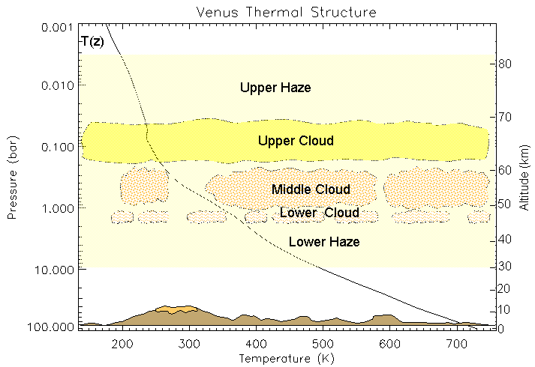

Slide 20
A Sulphur-Based Survival Strategy for Putative Phototrophic Life in the Venusian Atmosphere
D. Schulze-Makuch, D.H. Grinspoon, O. Abbas, L.N. Irwin & M. Bullock (2004) . Astrobiology, 4, 11-18.
Abstract
Several observations indicate that the cloud deck of the Venusian atmosphere may provide a plausible refuge for microbial life (Sagan, 1961; Grinspoon, 1997; Schulze-Makuch and Irwin, 2002; Schulze-Makuch and Irwin, 2004). Having originated in a hot proto-ocean or been brought in by meteorites from Earth (or Mars), early life on Venus could have adapted to a dry, acidic atmospheric niche as the warming planet lost its oceans. The greatest obstacle for the survival of any organism in this niche may be high doses of ultraviolet (UV) radiation. Here we make the argument that such an organism may utilize sulphur allotropes present in the Venusian atmosphere, particularly S₈, as a UV sunscreen, as an energy converting pigment, or as a means for converting UV light to lower frequencies that can be used for photosynthesis. Thus, life could exist today in the clouds of Venus.

Slide 21
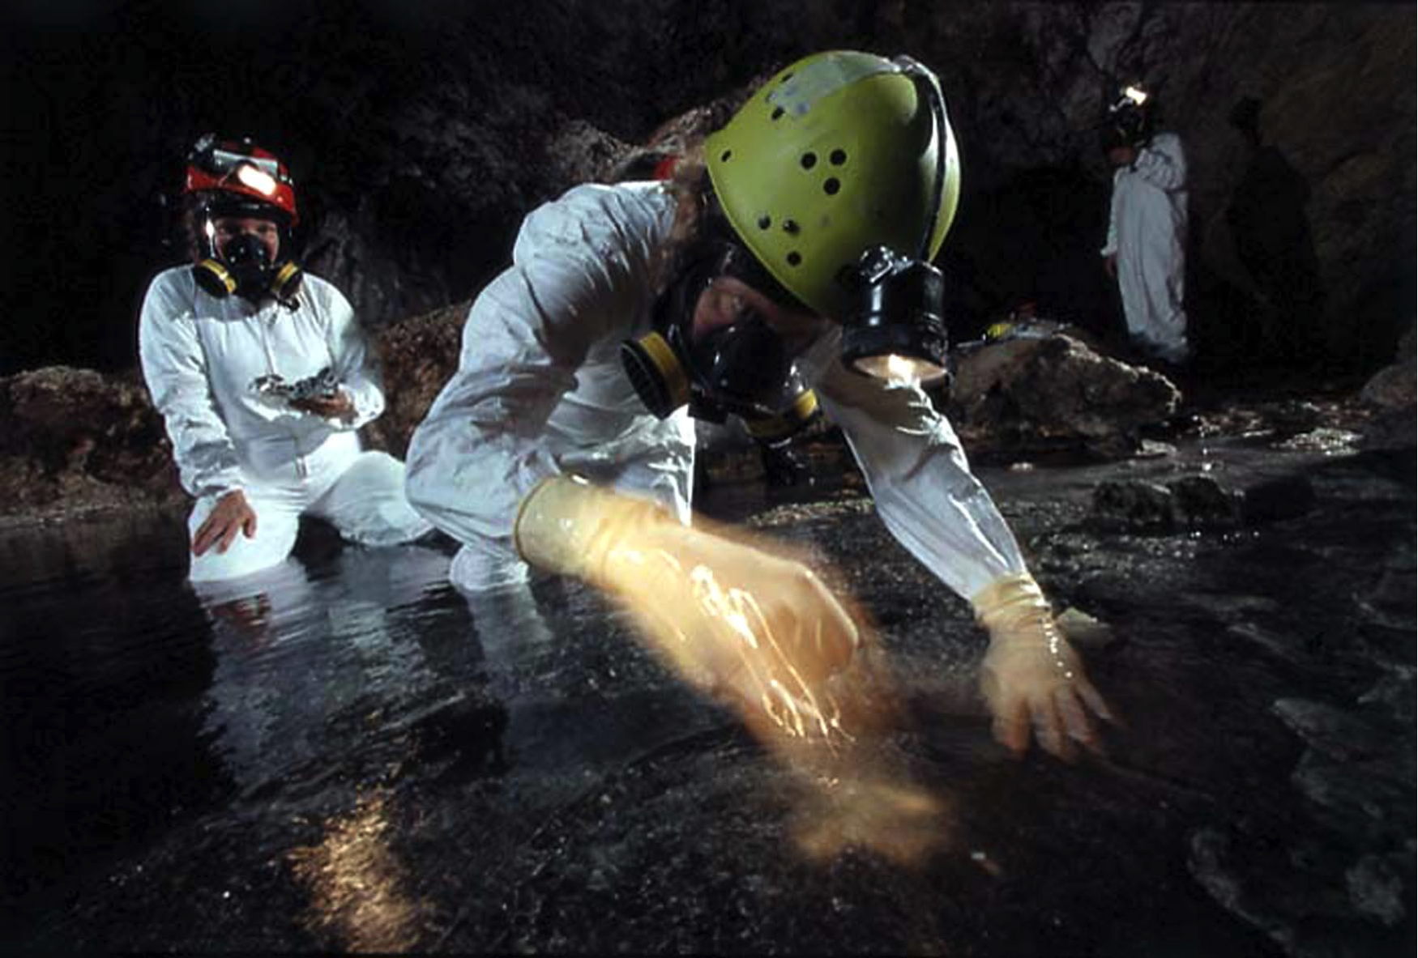
The low pH limit of
Terrestrial life is not known.
Many organisms have now
been discovered that grow at very low pH
For example, the archaeon ferroplasma acidarmanus thrives at pH 0.

Slide 22
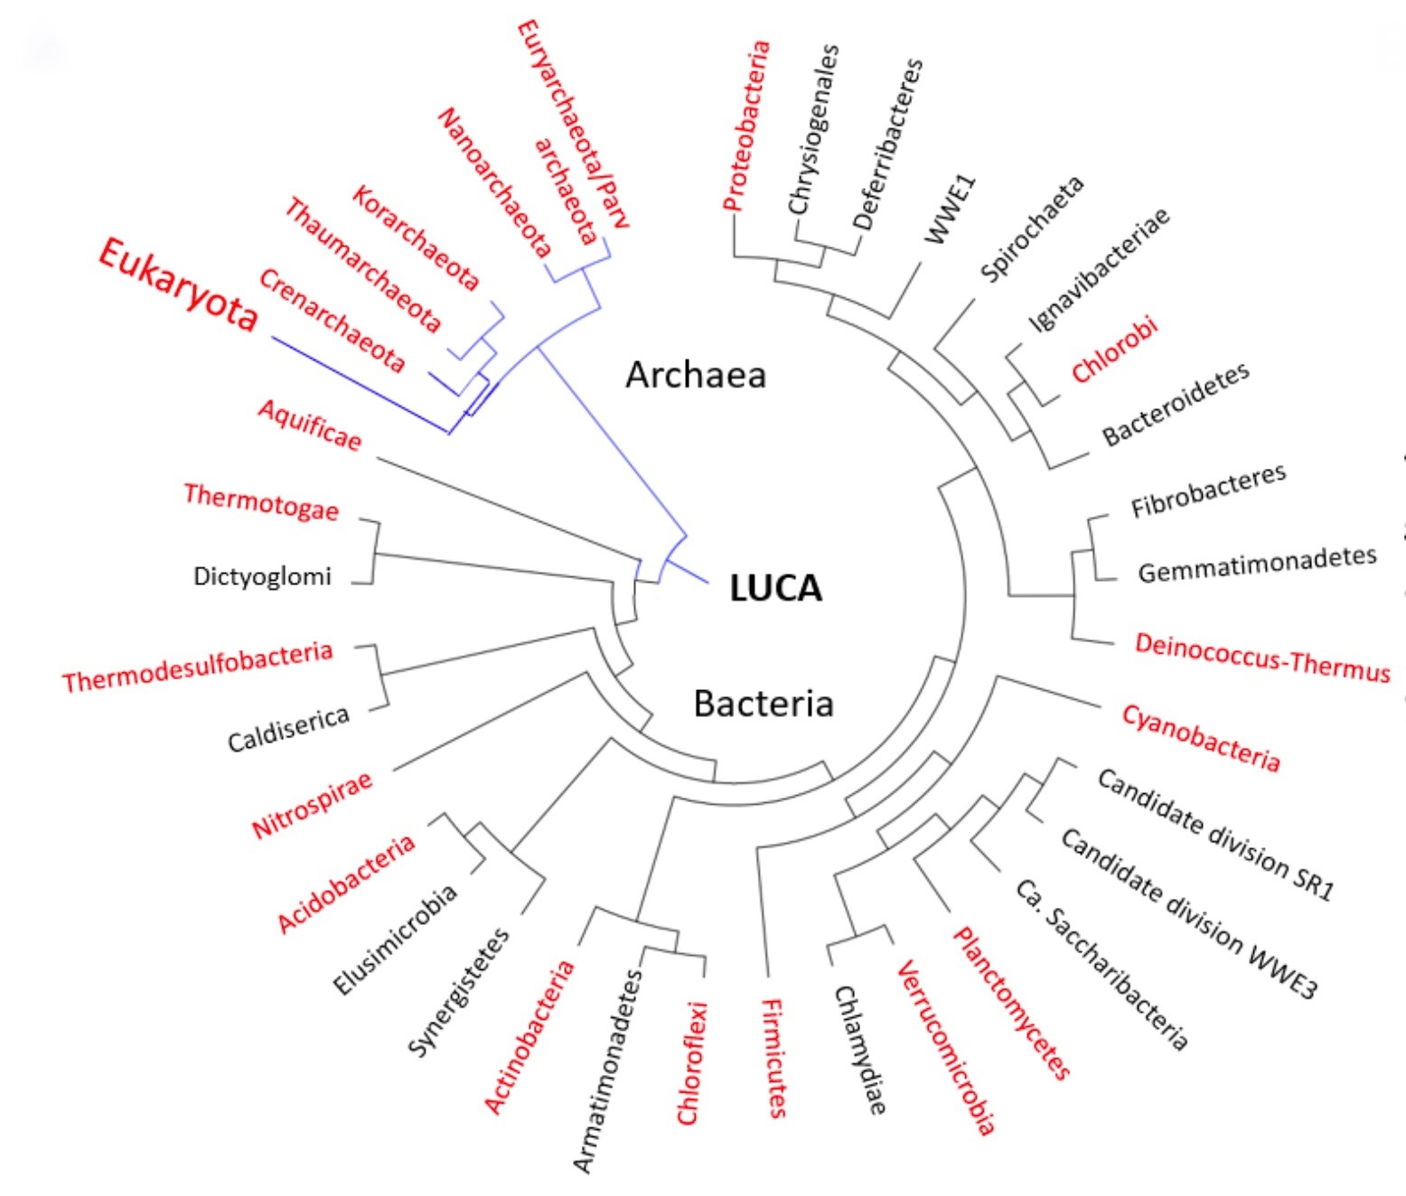
“We posit that low pH does not represent an insurmountable challenge for life. On the contrary, life on Earth is abundant in many low pH environments even in the presence of high temperatures, low temperatures, high salt concentrations, low water activity, anaerobicity, etc. Furthermore, organisms that thrive at low pH are distributed all over the Tree of Life suggesting that the evolution of the ability to live at low pH (acidophilia) is not only plausible but rampant.”
Tree of Life. In red, is shown the distribution of acidophilic microorganisms present in the diverse branches.
Neira et al. 2018

Slide 23
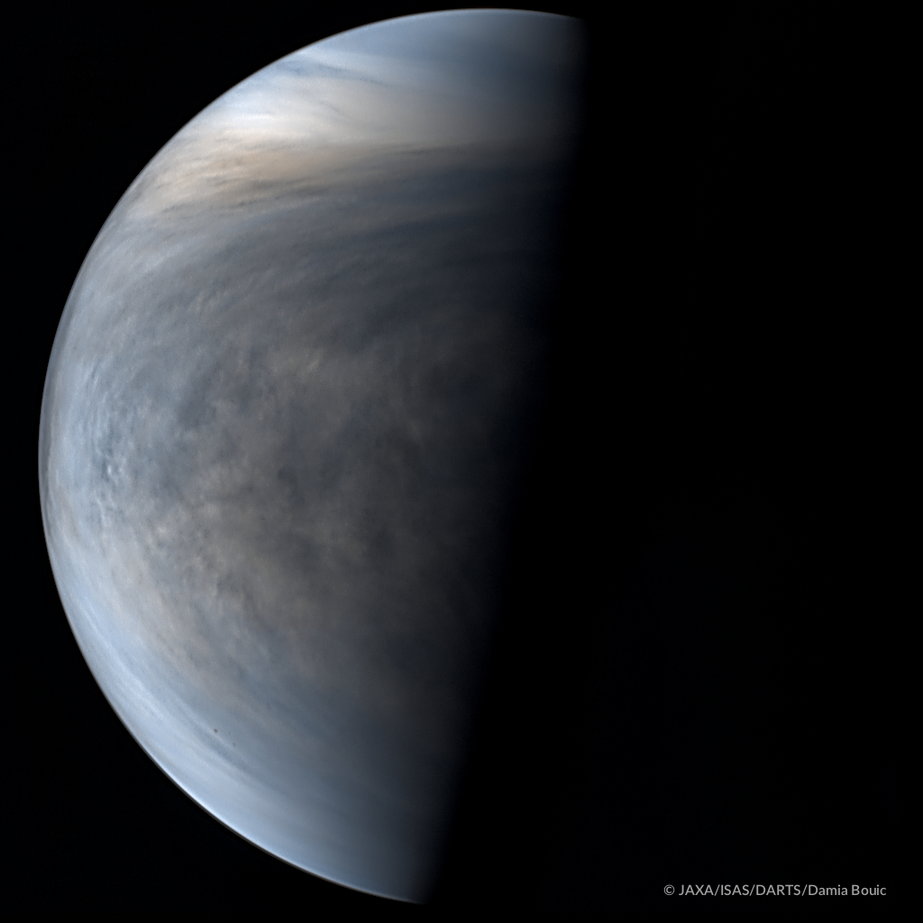
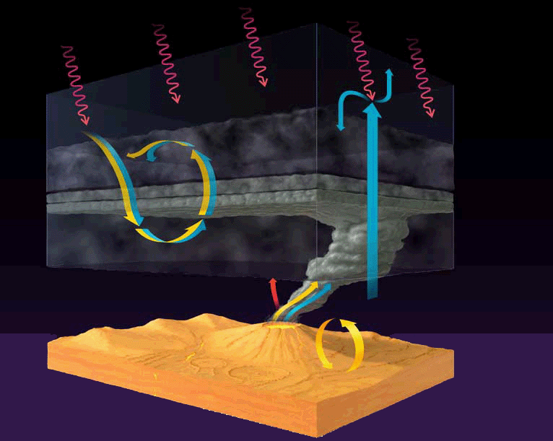
“All is a woven web of guesses” – Xenophanes
All ideas about extraterrestrial biochemistry are extrapolations from a single example. This is necessary, for now, but requires humility. All conclusions as to what is “universal” must be regarded as provisional.
Resist groupthink: some potential locales for life become more acceptable through repetition.
Its plausible that life exists within the ocean of an ice covered world that has never seen sunlight.
Its plausible that life exists underground within a planet that is largely, geologically dead.
And its plausible that life exists within the clouds of a planet with vibrant chemical flows, energy sources, stable aqueous environment etc.
Among the plausible niches for extraterrestrial life in our Solar System, the clouds of Venus are among the most accessible and least well explored.

Slide 24
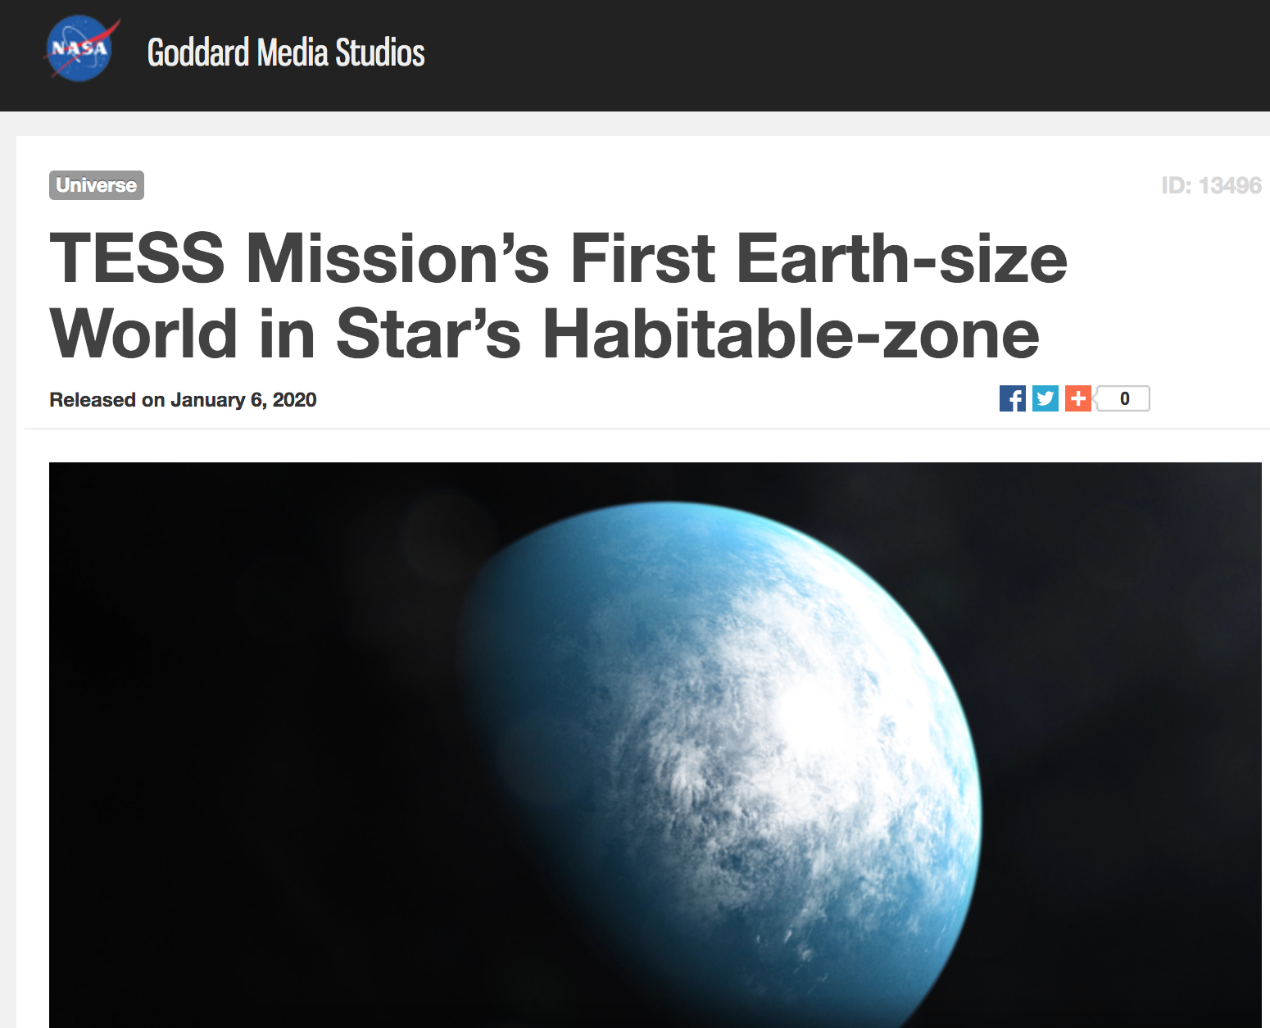
Venus

Slide 26
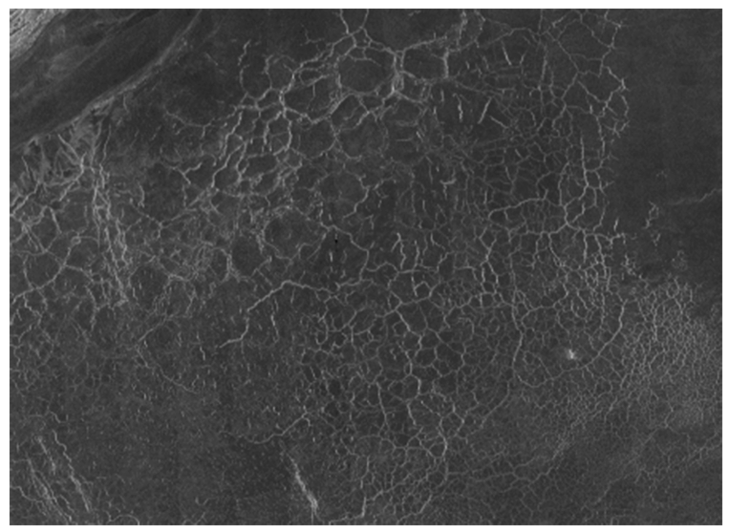
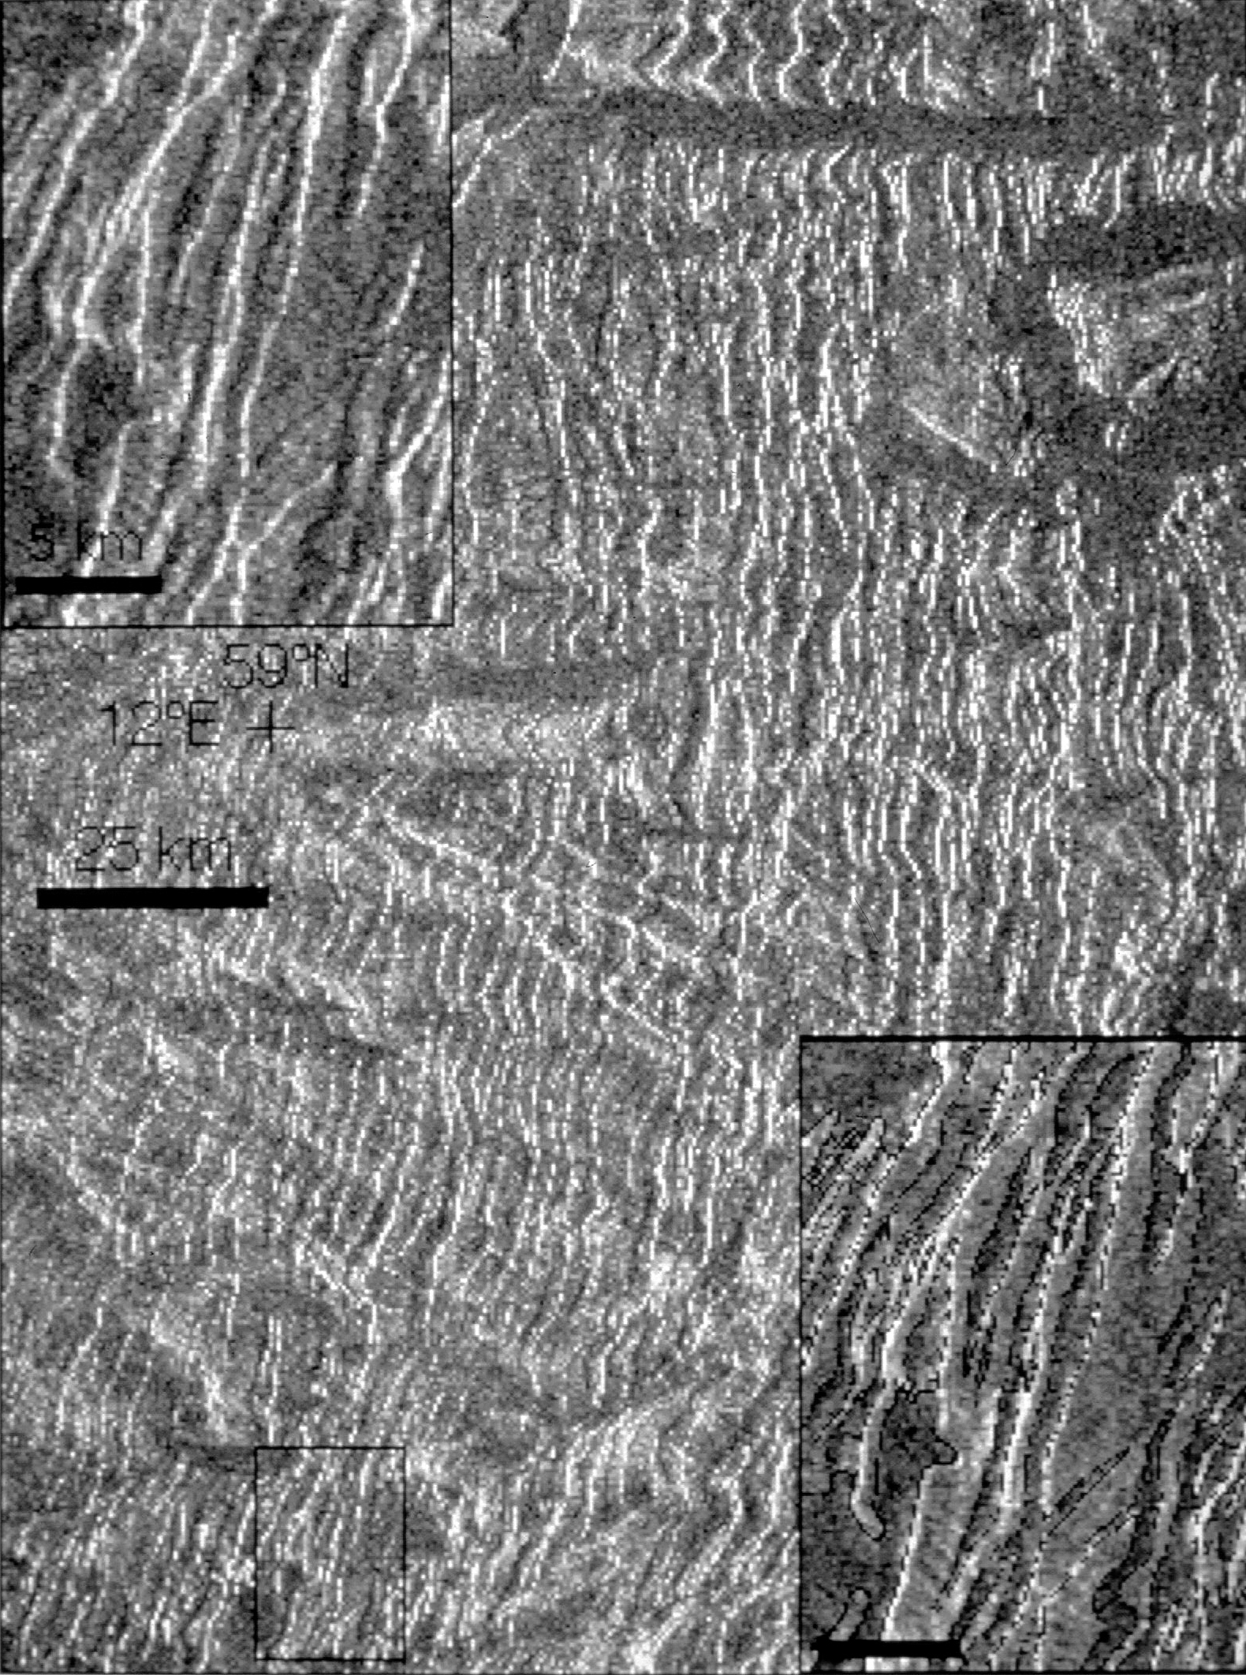
SURFACE OBSERVATIONS ON VENUS THAT MAY INDICATE CLIMATE CHANGE INCLUDE:
polygonal terrain
Anderson and Smrekar, JGR, 1999
ribbon terrain
on tessera.
Phillips & Hansen, Science, 1998
sinuous channels
Kargel et al,
Icarus, 1994
steep sided dome rheology. Stofan et al, JGR, 2000

