Slide 1
The Early Thermal Evolution of Planetesimals during Accretion and Differentiation
Kathryn Dodds¹, James Bryson¹, Jerome Neufeld^{1,2,3} & Rich Harrison¹
¹Department of Earth Sciences, University of Cambridge, UK
²BPI, University of Cambridge, UK
³DAMTP, University of Cambridge, UK
Notes:
Talk about the modelling work we’ve been doing looking at constraining how and when planetesimals generate dynamos and how factors such as accretion timing and duration affects a planetesimal’s ability to generate a magnetic field in its core.

Slide 2
Introduction
The meteorite paleomagnetic record suggests that differentiated planetesimals generated dynamos driven by thermal convection in their cores alone.
The timing and duration of these fields have been used to constrain parent body radii and accretion timing (e.g. Bryson et al., 2019)
We build on these previous studies by considering the effect of gradual accretion and differentiation on a planetesimal’s ability to generate a thermal dynamo.
Notes:
So here’s the outline for my talk. I want to talk about firstly what are planetesimals and why we want to constrain their accretionary histories in terms of the larger picture of planet formation and early solar system processes. Our record of magnetic field generation in planetesimals is then the paleomagnetic record from meteorite which has been growing over the last decade or so and it is this that we’re wanting to use our model to explain. Ill then go through the thermal model we’ve created and how we are linking the thermal evolution of a planetary body to its ability to generate a dynamo field and lastly I’ll present some of the results we’ve obtained.

Slide 3
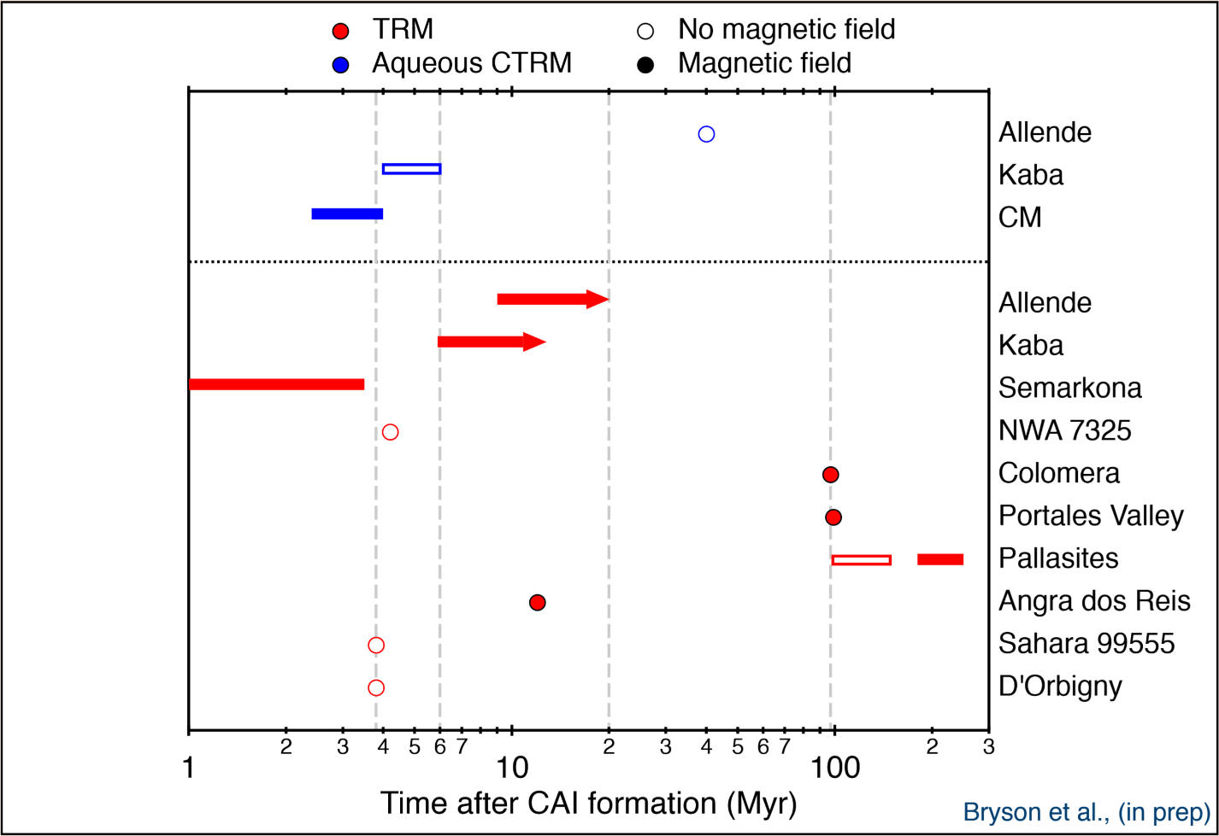
Meteorite Paleomagnetic Record
Bryson et al, (2019)

Slide 4
Meteorite Paleomagnetic Record
Bryson et al, (2019)

Slide 5
Linking Dynamo Field Generation and Thermal Evolution
Require vigorous convection in liquid core to generate dynamo field
Convective speed, u, controlled by how fast planet is cooling
Require supercritical magnetic Reynolds number for dynamo generation
$$Re_{m}=\frac{ul}{λ}$$
$$Re_{m,crit}>10$$
l = convective length scale, λ=magnetic diffusivity of iron
Notes:
Add figure

Slide 6
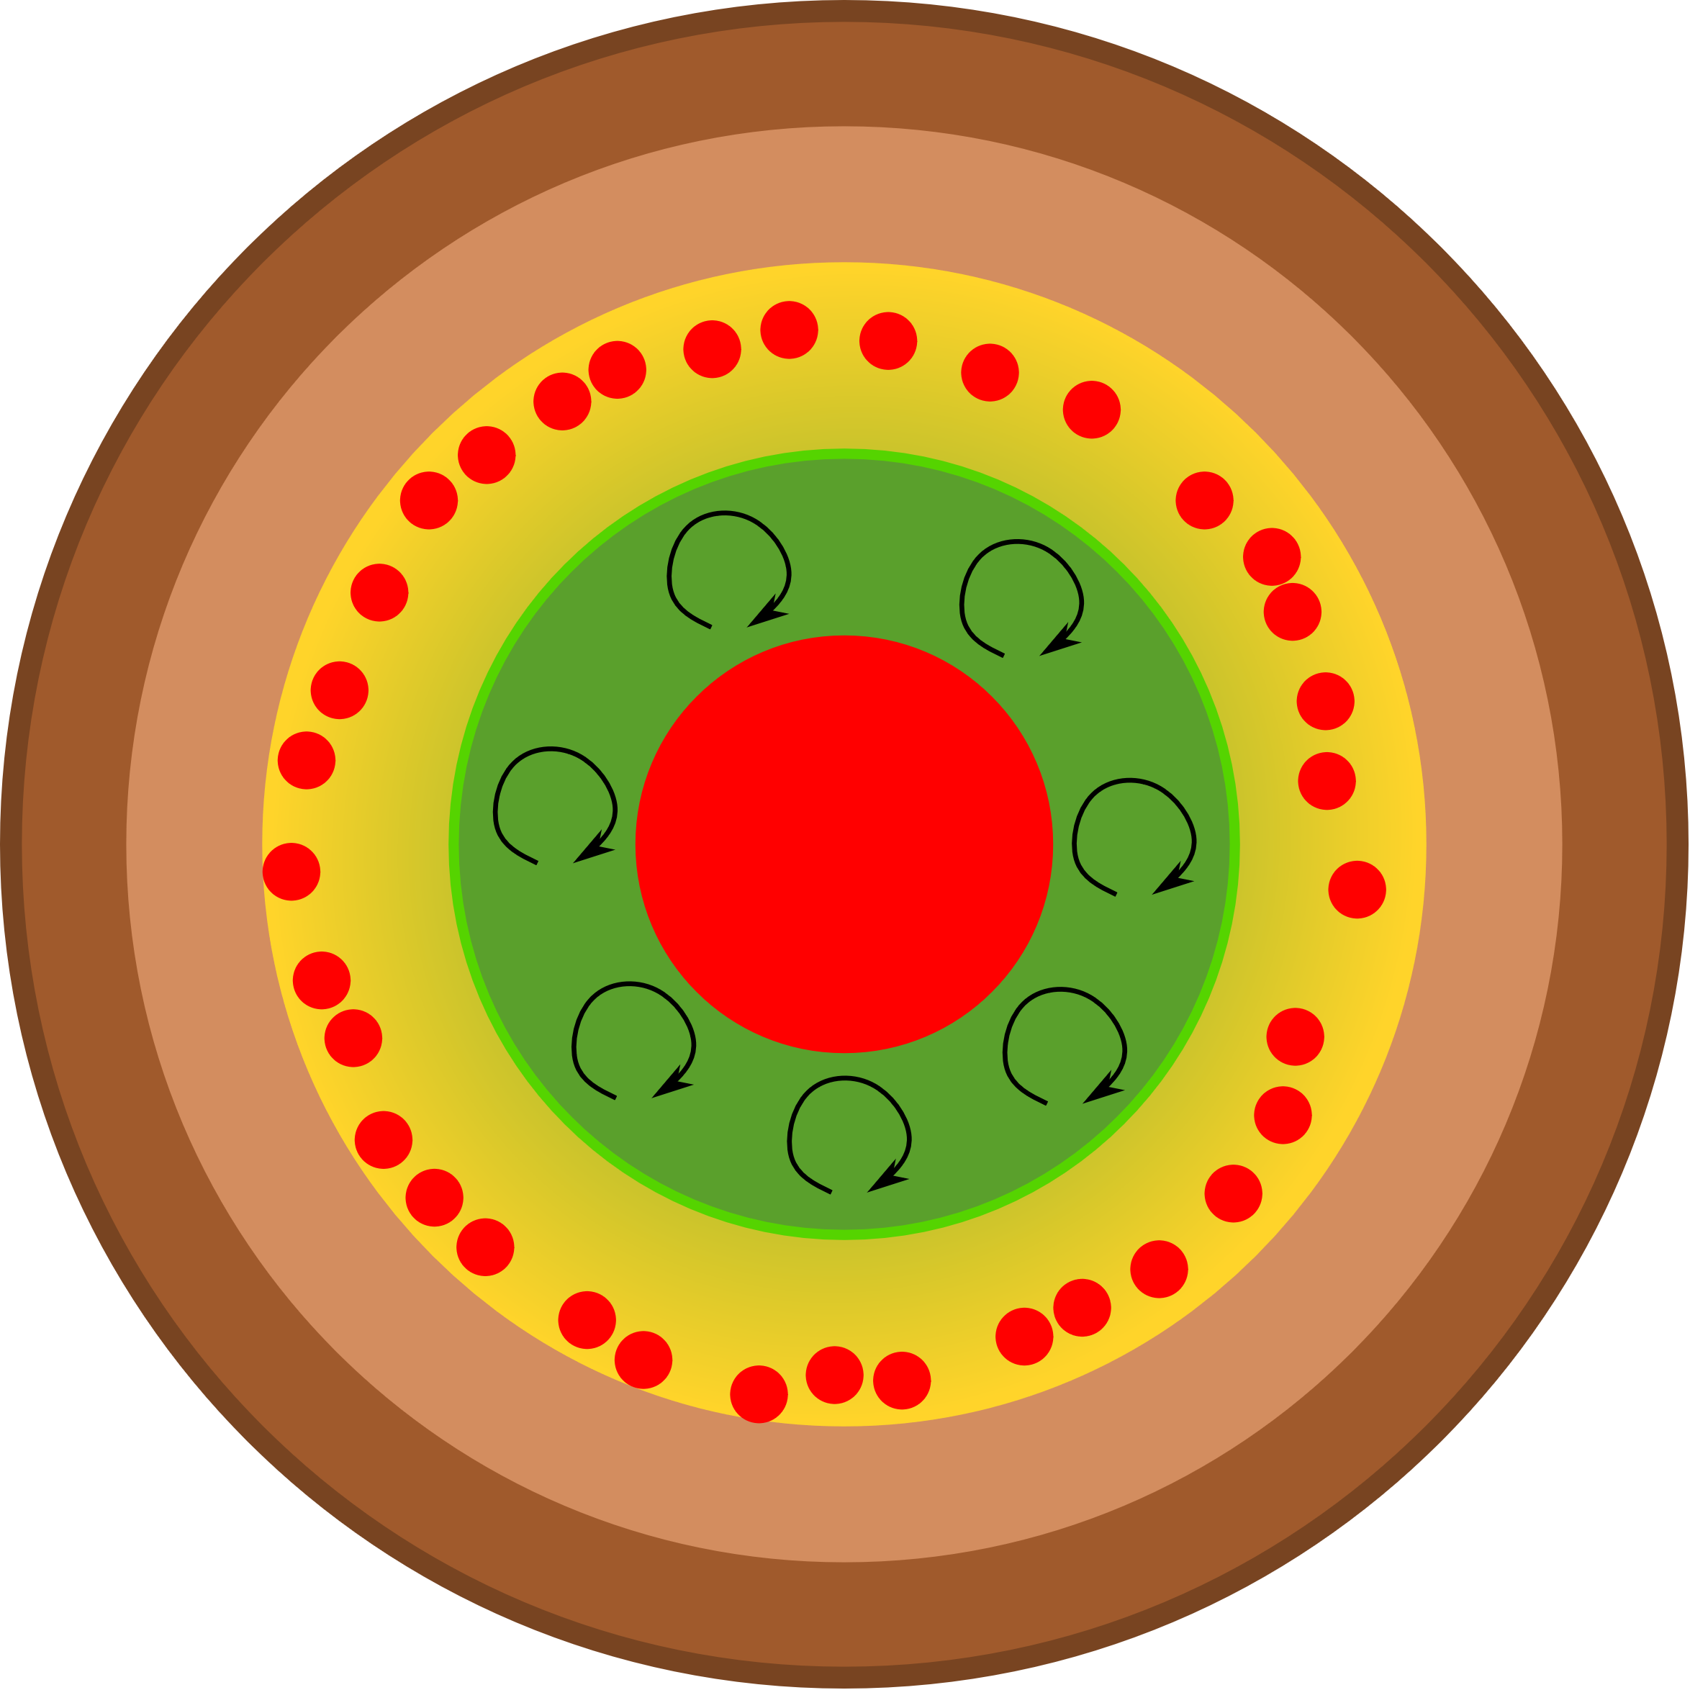
Thermal Evolution of Planetesimals
Differentiation
and Core
Formation
Accretion
Magma Ocean
and Whole Core
Convection
Conductive
Heat Loss from
Mantle
Magma Ocean
stops convecting

Slide 7
Dominant Heat Source for Differentiation?
Short-lived radioisotope ²⁶Al
Half-life=0.717 Myr
Lithophile: partitions into the silicate portion of a planetary body.
Accretes before 2 Myr post-CAIs:
Differentiated bodies
Accretes after 2 Myr post-CAIs:
Undifferentiated bodies
²⁶Al
²⁶Al
²⁶Al
²⁶Al
²⁶Al
²⁶Al
²⁶Al
²⁶Al
²⁶Al
²⁶Al
²⁶Al
²⁶Al
Notes:
Make a graph of this

Slide 8
Accretion
Cold, porous chondritic
material contains ²⁶Al
R₀
Initial seed asteroid
Radius, R₀
Notes:
Cold, porous chondritic material added to the surface of the planetesimal.
Contains ²⁶Al which then heats up body.
Heat lost diffusively from the surface.

Slide 9
Accretion
Cold, porous chondritic
material contains ²⁶Al
R_{p}
R₀
Initial seed asteroid
Radius, R₀
²⁶Al decays, heats interior
Notes:
Cold, porous chondritic material added to the surface of the planetesimal.
Contains ²⁶Al which then heats up body.
Heat lost diffusively from the surface.

Slide 10
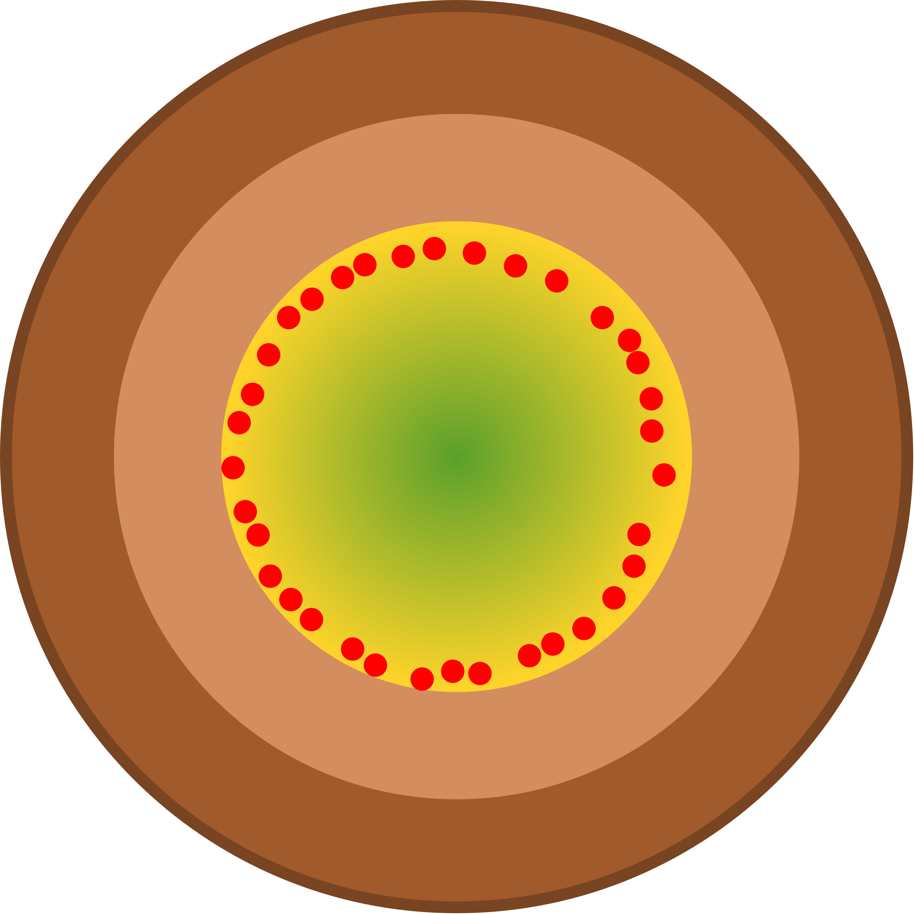
Accretion
Accretion rate increase as R_{p} increases
Cold, porous chondritic
material contains ²⁶Al
R_{p}
R₀
Initial seed asteroid
Radius, R₀
²⁶Al decays, heats interior
Metal then silicates
start to melt
Notes:
Cold, porous chondritic material added to the surface of the planetesimal.
Contains ²⁶Al which then heats up body.
Heat lost diffusively from the surface.

Slide 11
Onset of Differentiation & Core Formation
Redistribution of ²⁶Al
Magma ocean continues to heat up
No heat source in the core; heat passes across the CMB to the top of the core
Continuous core formation can emplace hot iron at the top of the core as the core grows.
Interior starts convecting,
proto-core forms,
²⁶Al into magma ocean
Notes:
²⁶Al heats up planetesimal, causing melting.
Increase in temperature and melt fraction leads to onset of convection in centre of body.
Silicate and metal portions segregate; ²⁶Al partitions into magma ocean.

Slide 12
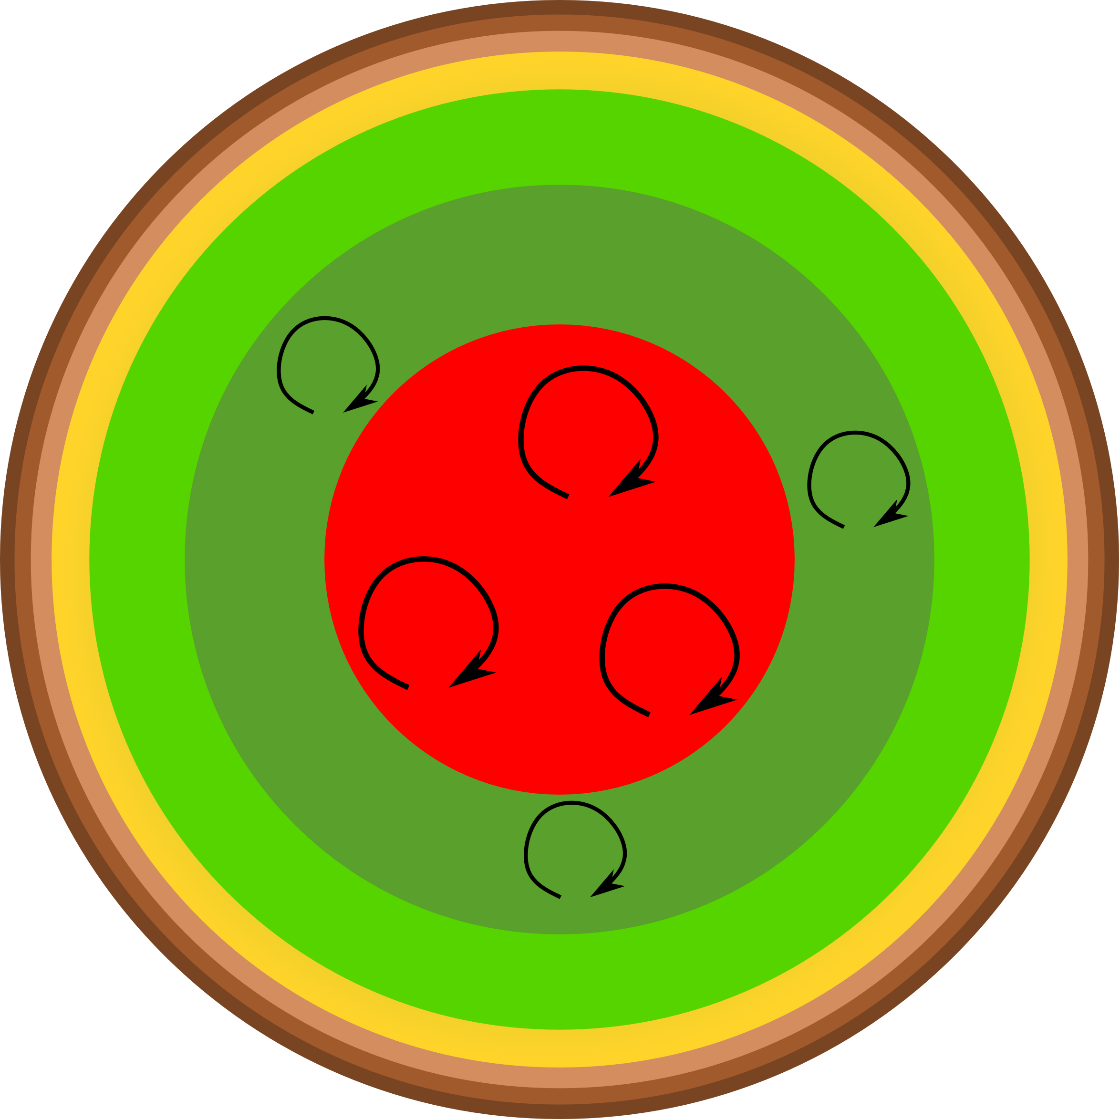
Core Formation Ends
Core cooling driven by secular cooling
Core can start convecting
Dynamo generation possible
Notes:
3-4Myr post-CAI formation, ²⁶Al supply is exhausted. Magma ocean starts to cool, increases CMB heat flux. Core starts to convect. Dynamo generation possible.

Slide 13
‘Instantaneous’ Accretion Example
Accretes from 170km to 504km in radius over 50kyr

Slide 14
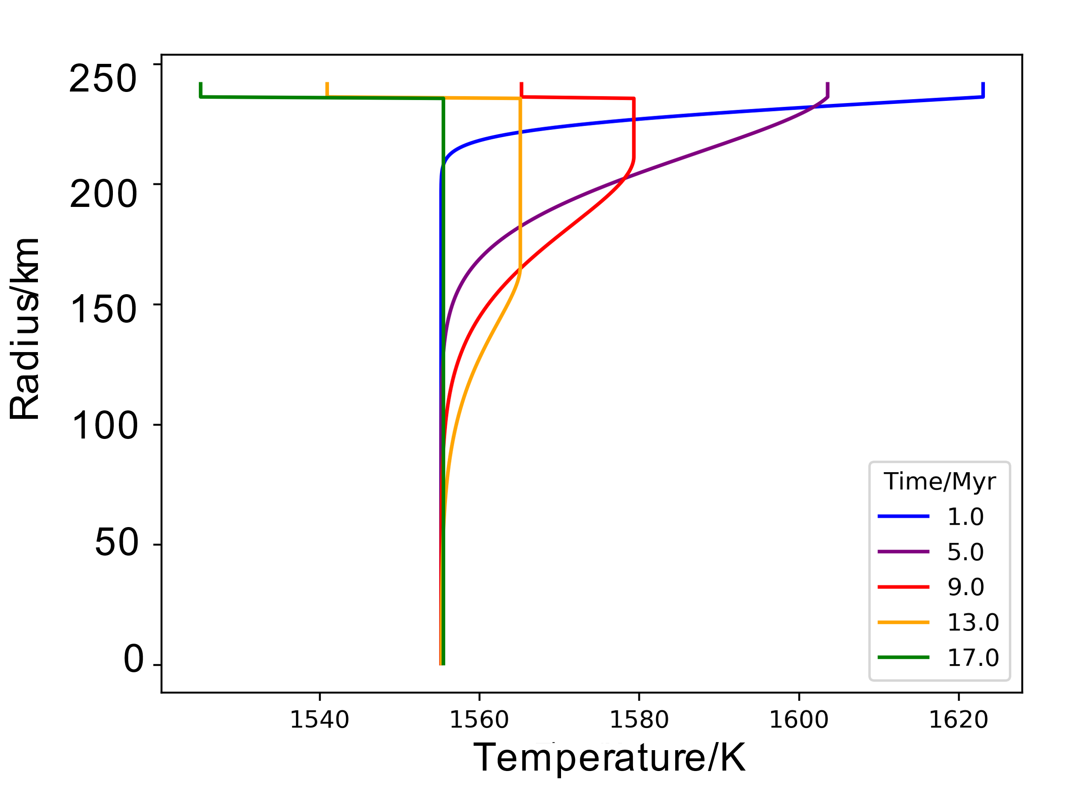
‘Instantaneous’ Accretion Example
Temperature Profiles across the Core

Slide 15
Gradual Accretion Example
Accretes from 170km to 504km in radius over 170kyr

Slide 16
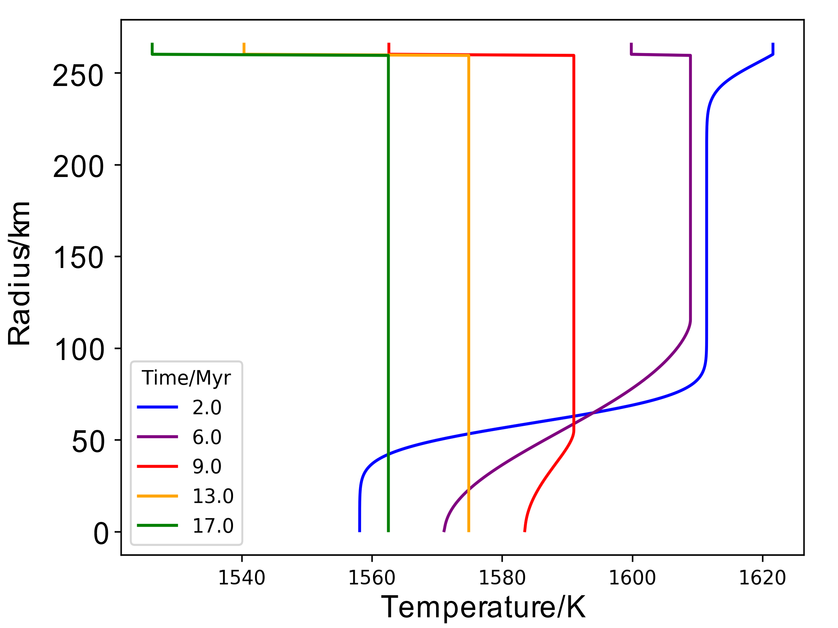
Gradual Accretion Example
Temperature Profiles across the Core
Temperature/K

Slide 17
Summary of Examples
Partitioning of ²⁶Al into the magma ocean leads to growth of a stably stratified layer at the top of the planetesimal’s core.
This inhibits core convection and dynamo generation.
Gradual accretion and core formation reduces the strength of this stratification and leads to early core convection and dynamo generation.
Notes:
Make a graph of this

Slide 18
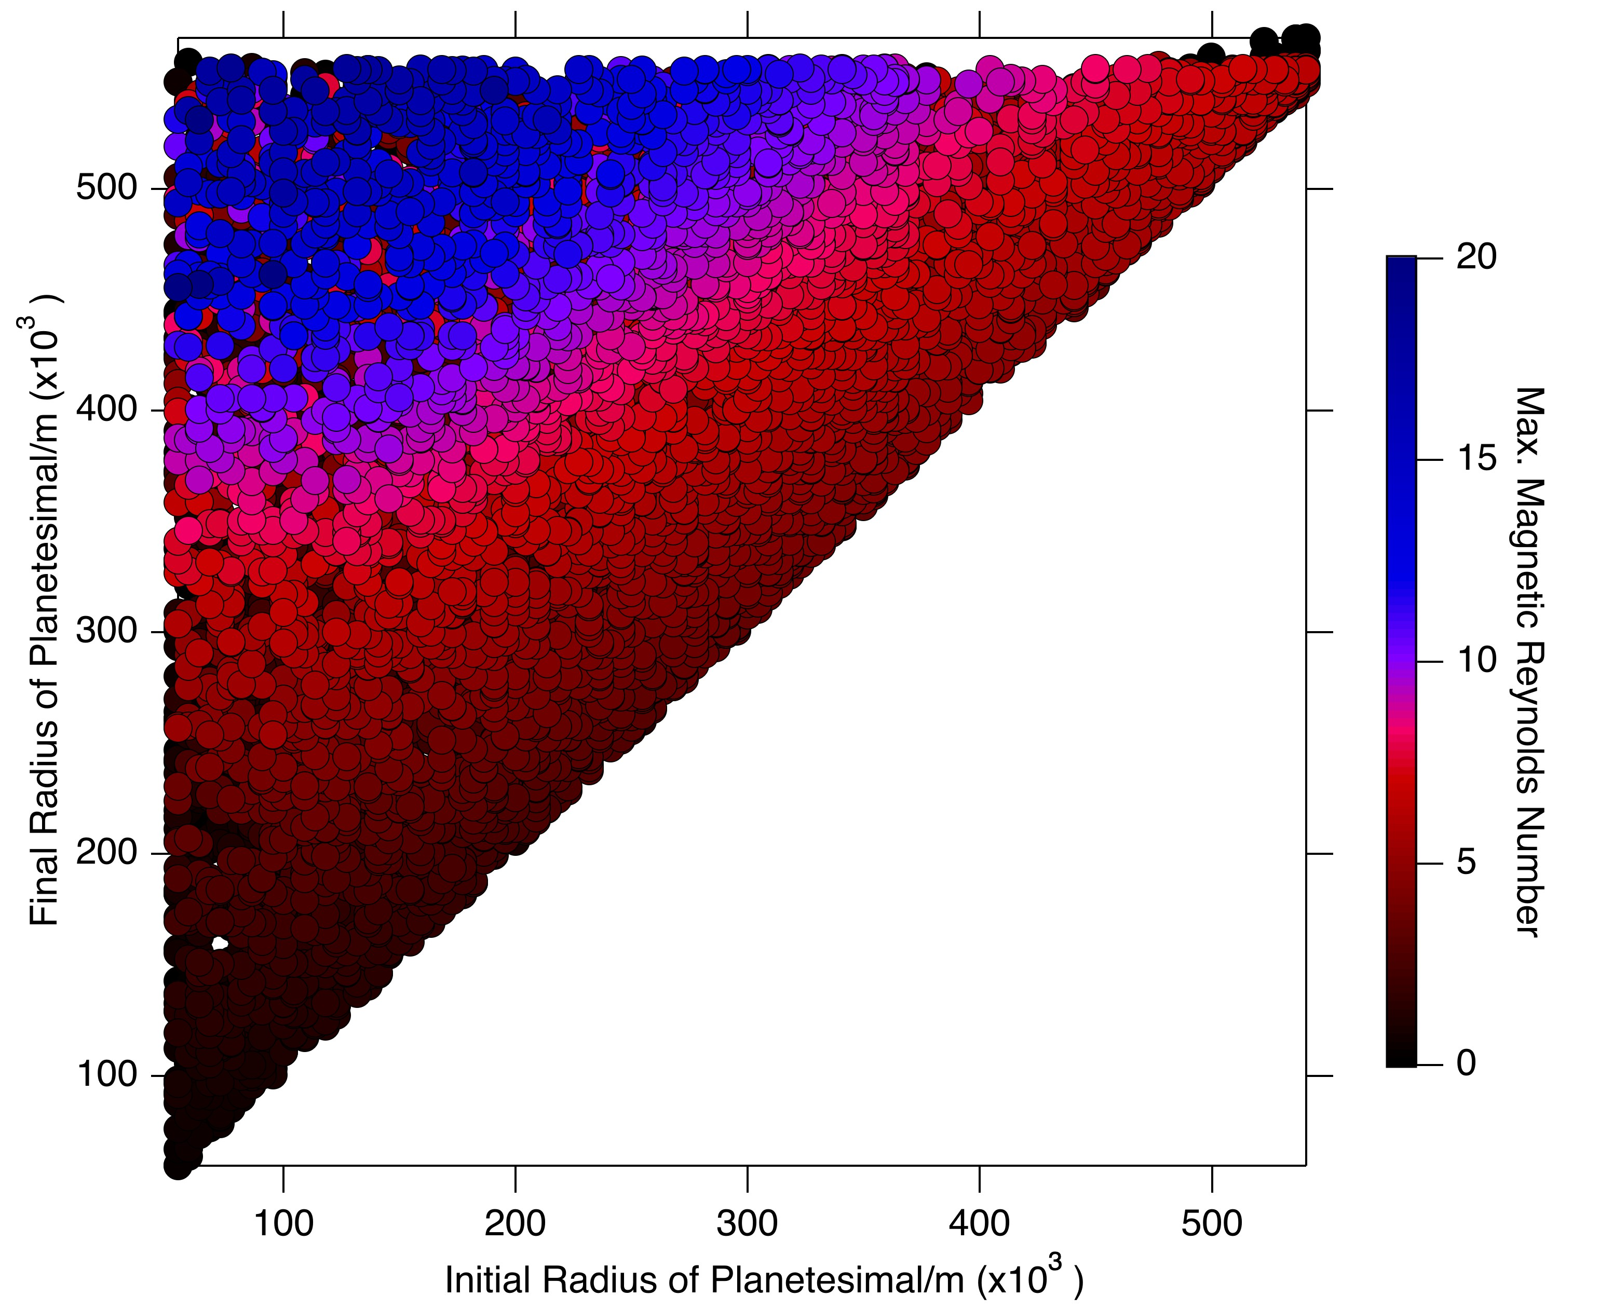
Thermal Dynamo Generation Requirements

Slide 19
Thermal Dynamo Generation Requirements
Dynamos

Slide 20
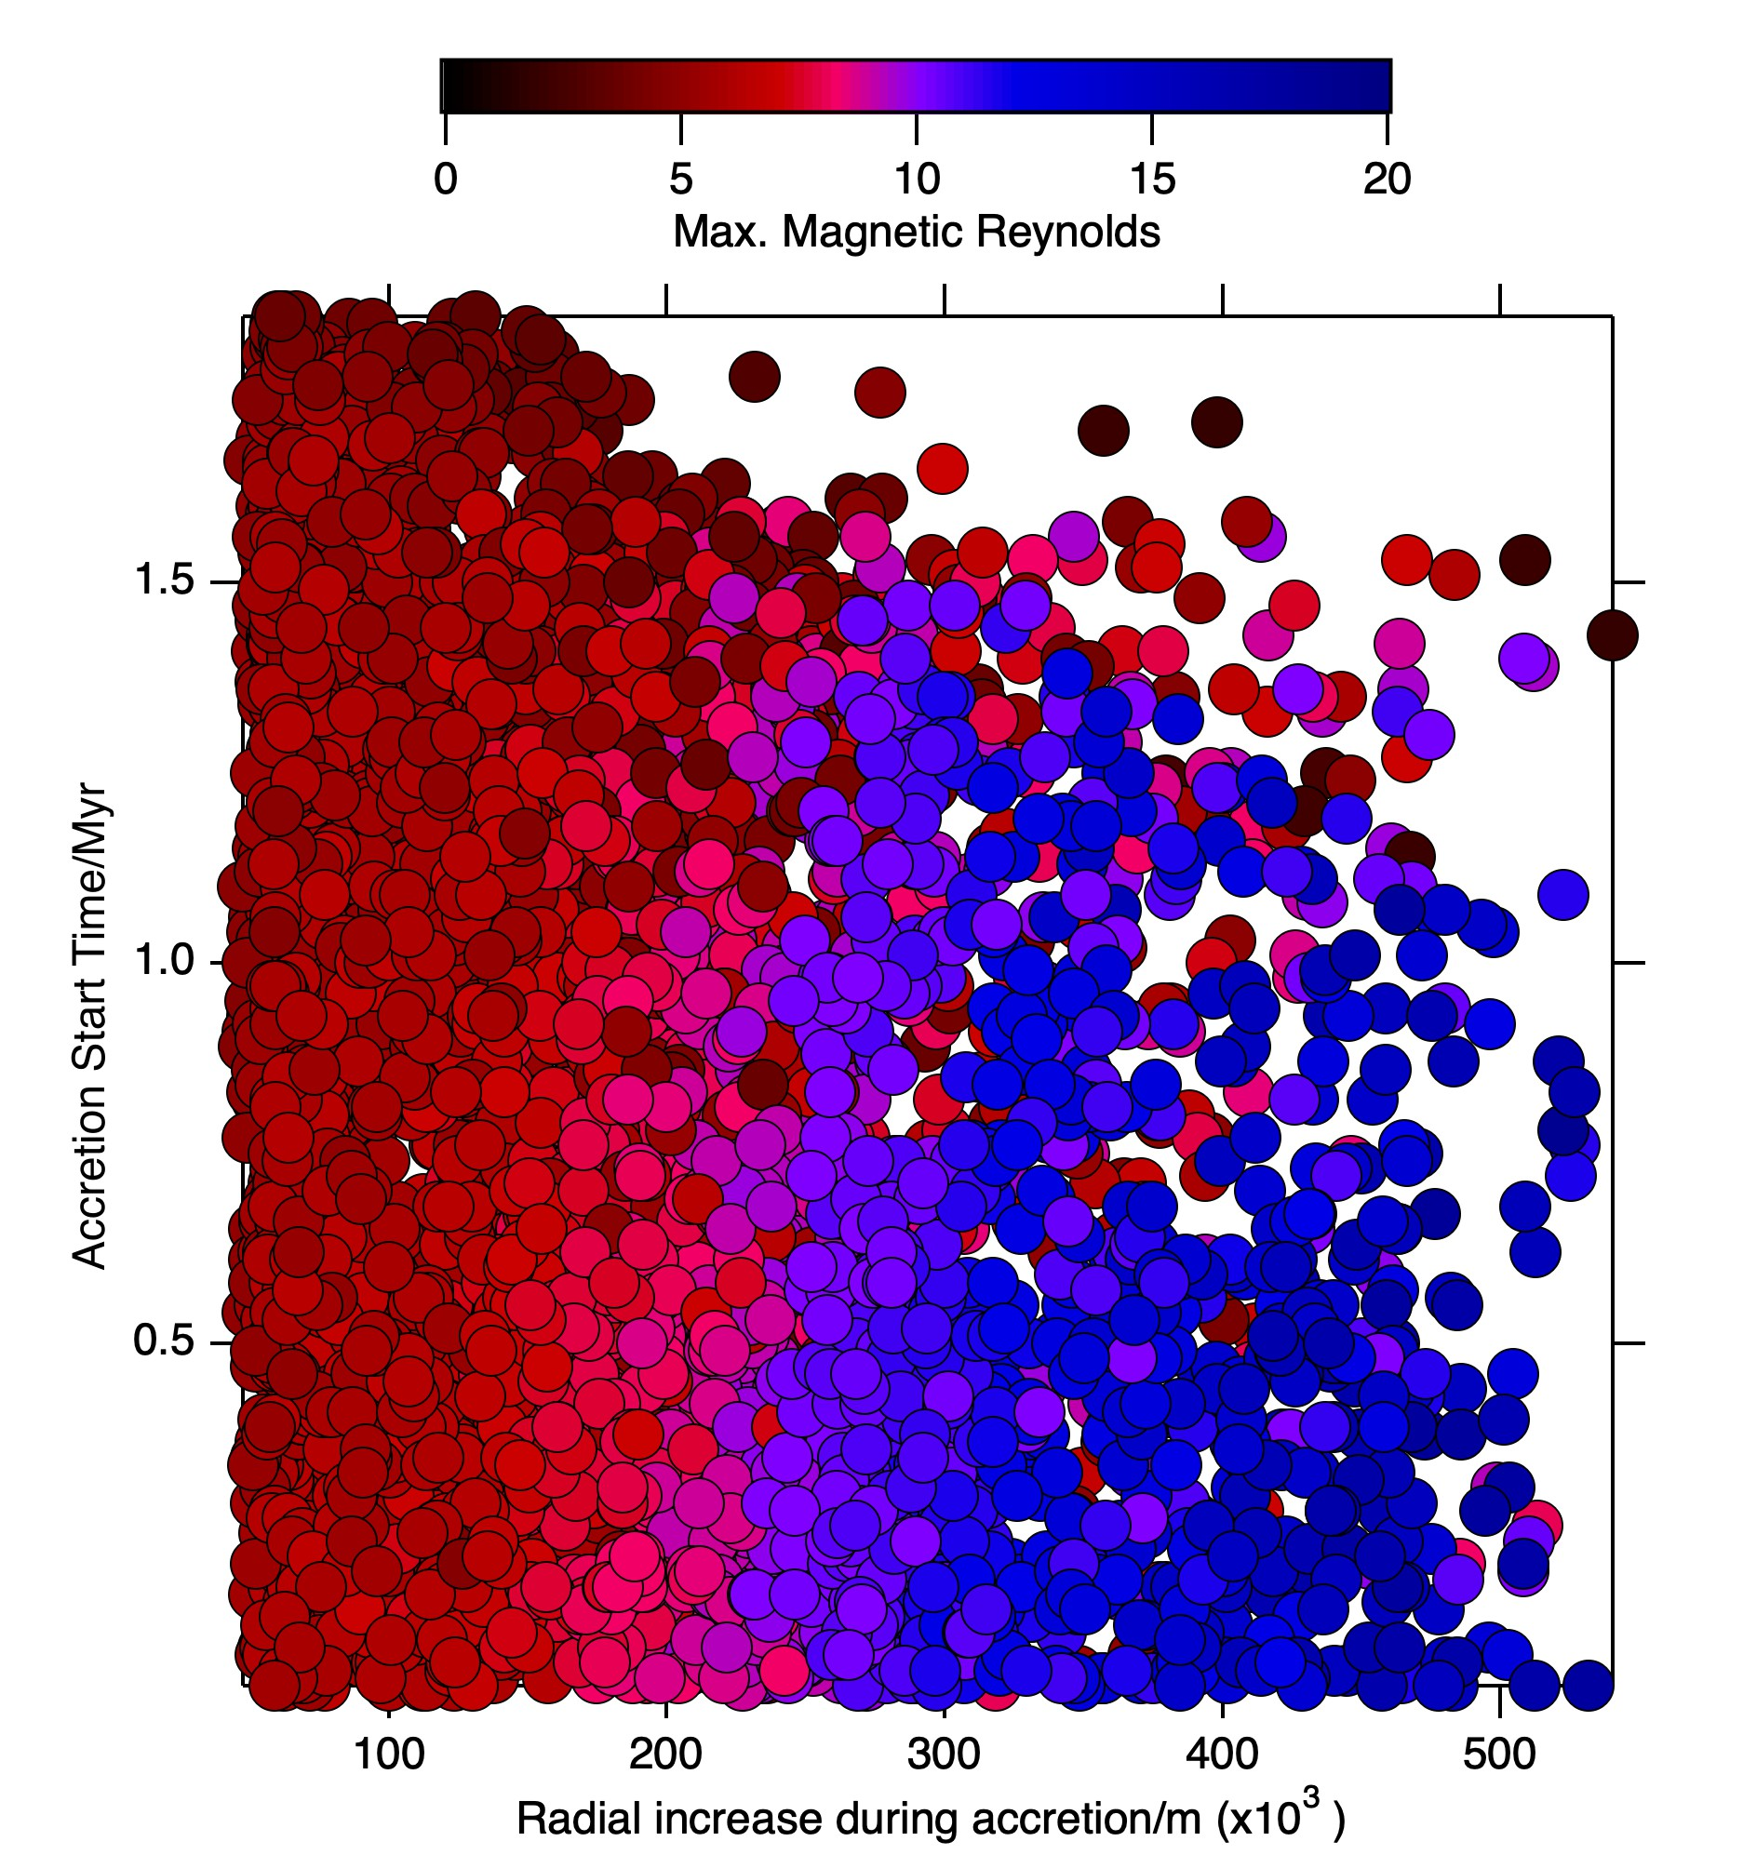
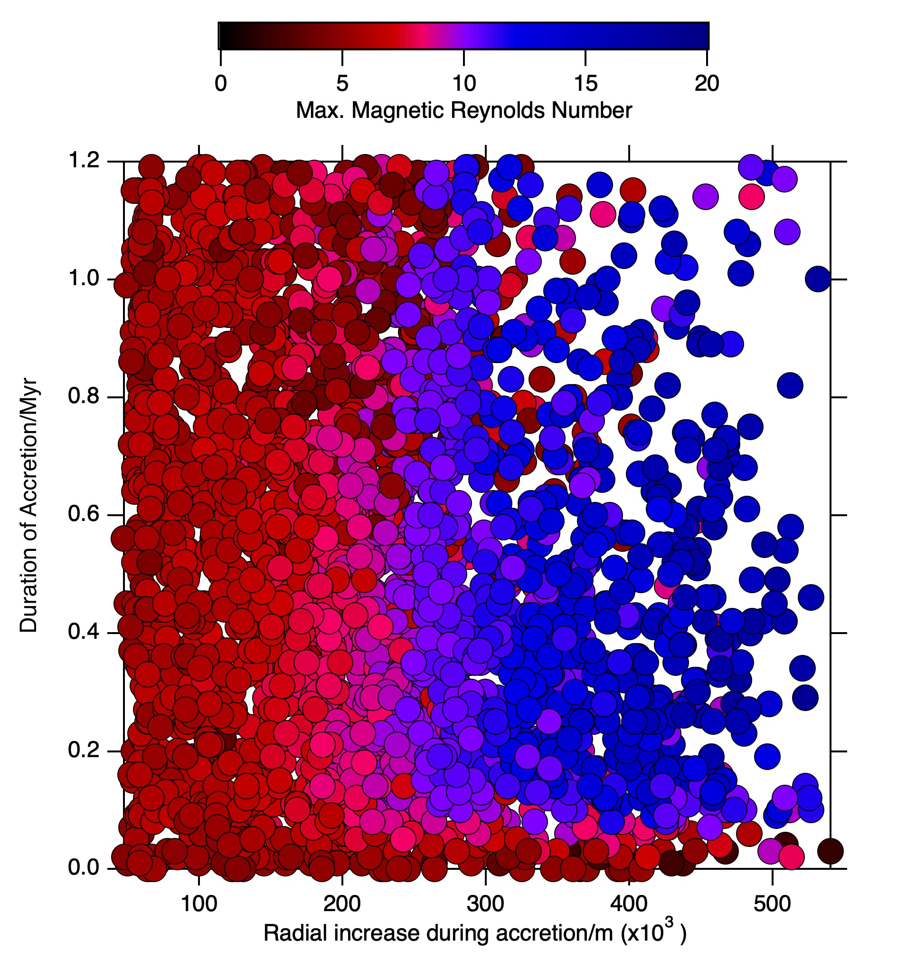
Effect of Accretion Start Time and Duration
Now only looking at bodies with core radius >200km

Slide 21
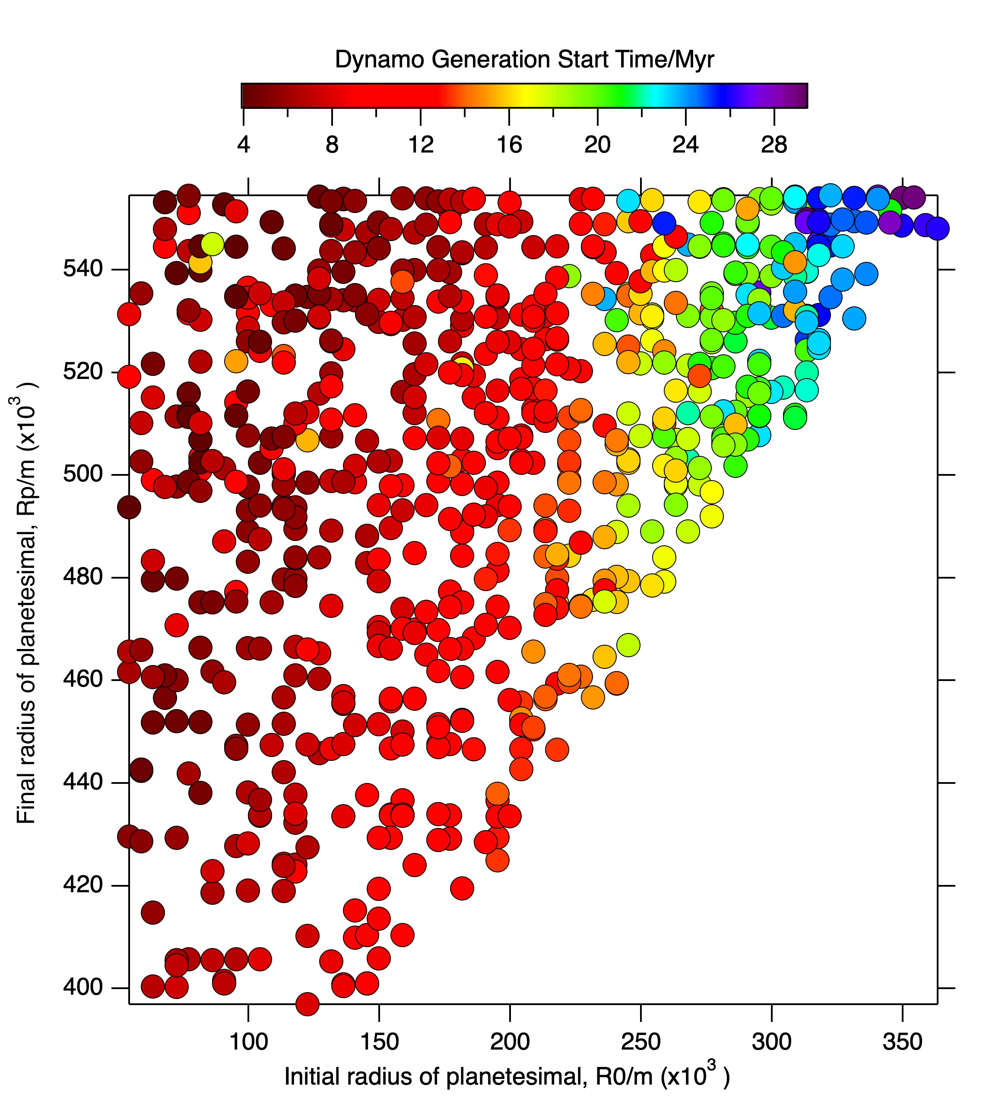
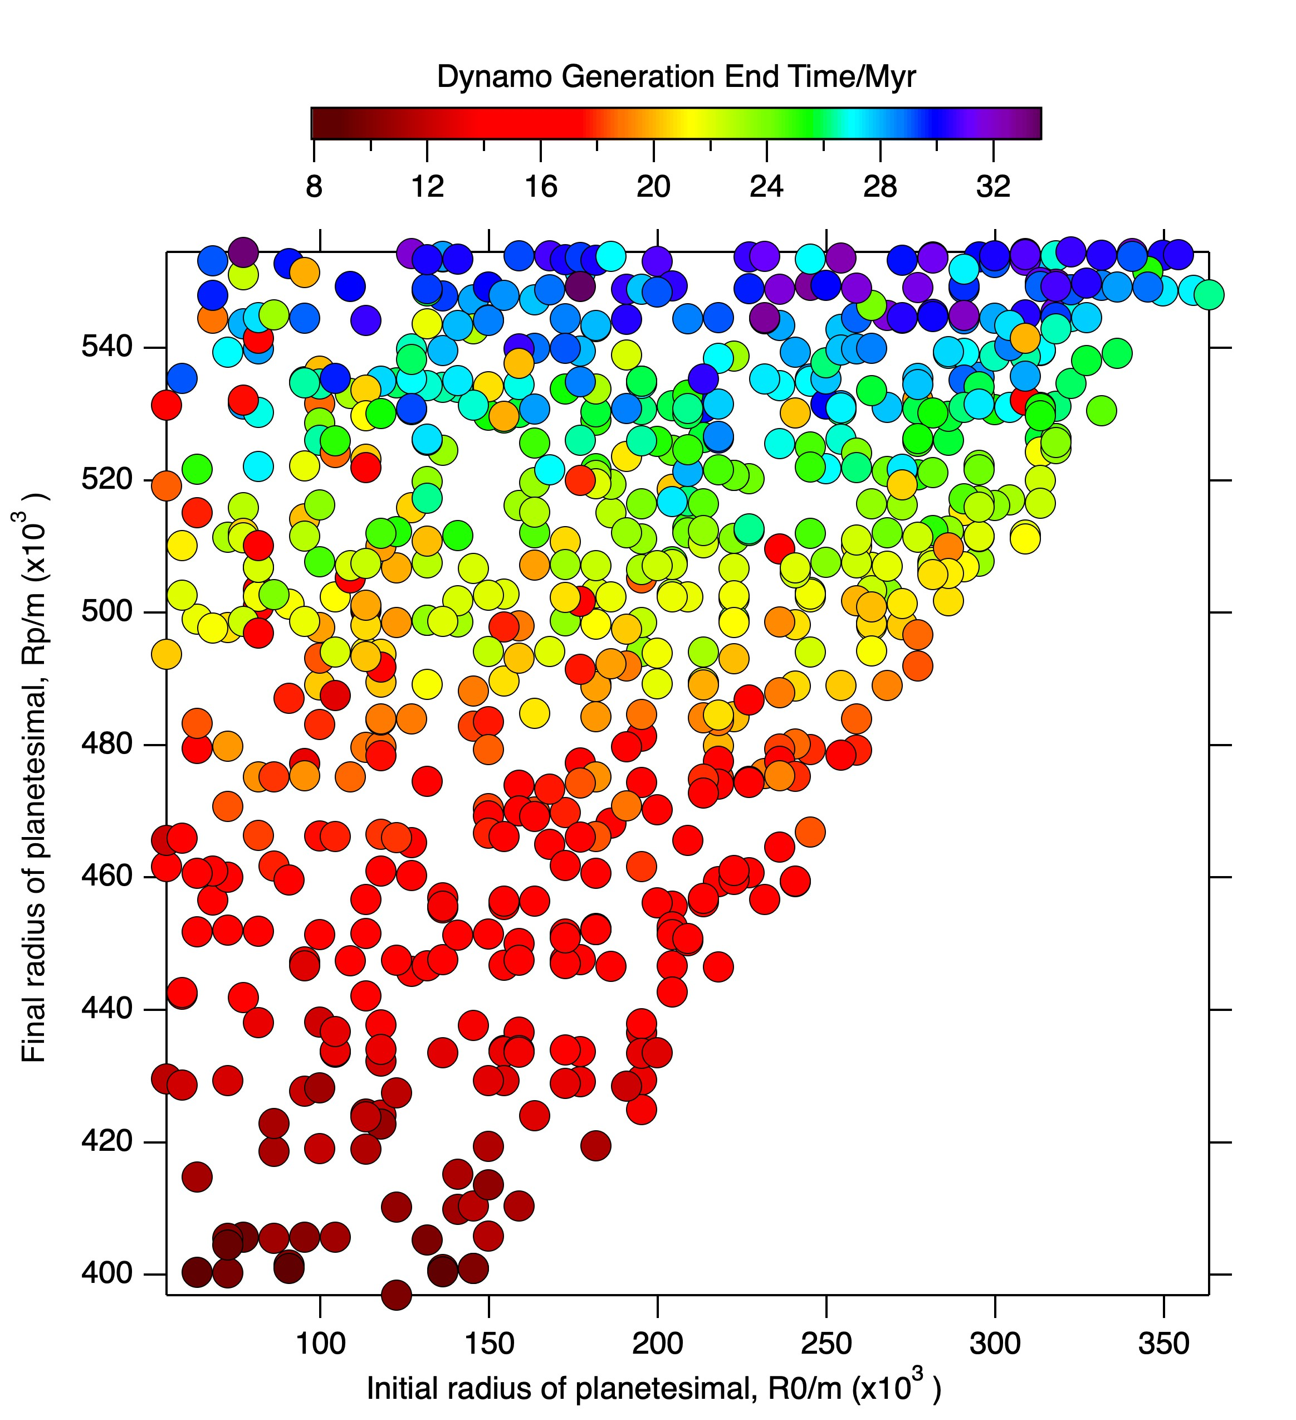
Dynamo Start and End Timing

Slide 22
Conclusions
Dynamo generation by thermal convection requires a core radius of >200km.
We also require accretion durations of >100kyr and addition of >250km of material during accretion.
These planetesimals avoid developing a thick, stable stratification at the top of their cores.
These early dynamo fields may allow us to directly constrain planetesimal accretion rates.
Further work: direct comparison to paleomagnetic record, look at different range of accretion laws, more detailed characterisation of dynamo fields.
Notes:
Make a graph of this

Slide 23
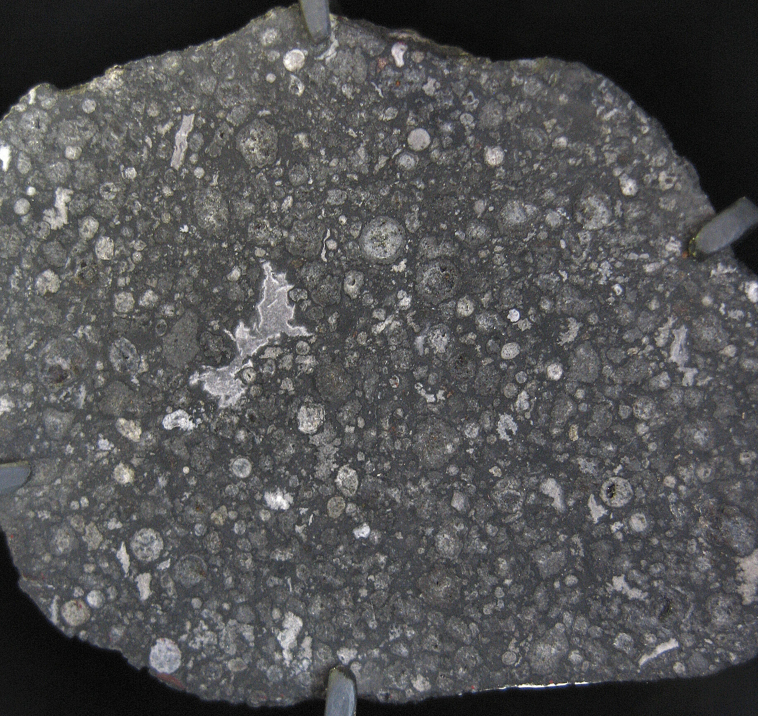
Chondrites
Allende, CV3
Notes:
These were originally rotating molten blobs of silicate material which have crystallised – exact mechanism for creating the molten material is unknown, but many different possibilities have been proposed. Formed somewhat continuously during the first 4Myr of the solar system.
Holding this all together is a fine grained matrix of dust. There are also grains of iron oxides, iron sulphides and another iron alloys within a chondrite. If we take a chondrite and start melting it, we will get immiscible silicate and iron melts which can then segregate under gravity and we create rocky achondrites from the silicate portion and iron meteorites from the metal portion.

Slide 24
Chondrites
CAIs
Formed 4567Myr BP
Formation age is t=0
for Solar System
Allende, CV3
Notes:
These were originally rotating molten blobs of silicate material which have crystallised – exact mechanism for creating the molten material is unknown, but many different possibilities have been proposed. Formed somewhat continuously during the first 4Myr of the solar system.
Holding this all together is a fine grained matrix of dust. There are also grains of iron oxides, iron sulphides and another iron alloys within a chondrite. If we take a chondrite and start melting it, we will get immiscible silicate and iron melts which can then segregate under gravity and we create rocky achondrites from the silicate portion and iron meteorites from the metal portion.

Slide 25
Chondrites
Chondrules
Formed between
t=0-4Myr
CAIs
Formed 4567Myr BP
Formation age is t=0
for Solar System
Allende, CV3
Notes:
These were originally rotating molten blobs of silicate material which have crystallised – exact mechanism for creating the molten material is unknown, but many different possibilities have been proposed. Formed somewhat continuously during the first 4Myr of the solar system.
Holding this all together is a fine grained matrix of dust. There are also grains of iron oxides, iron sulphides and another iron alloys within a chondrite. If we take a chondrite and start melting it, we will get immiscible silicate and iron melts which can then segregate under gravity and we create rocky achondrites from the silicate portion and iron meteorites from the metal portion.

Slide 26
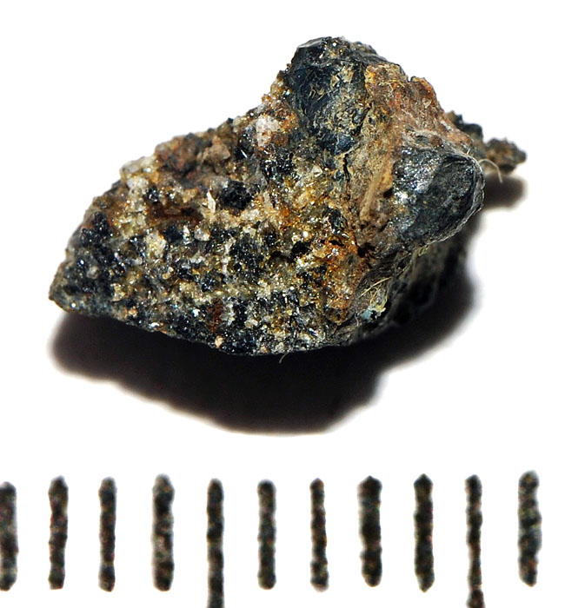
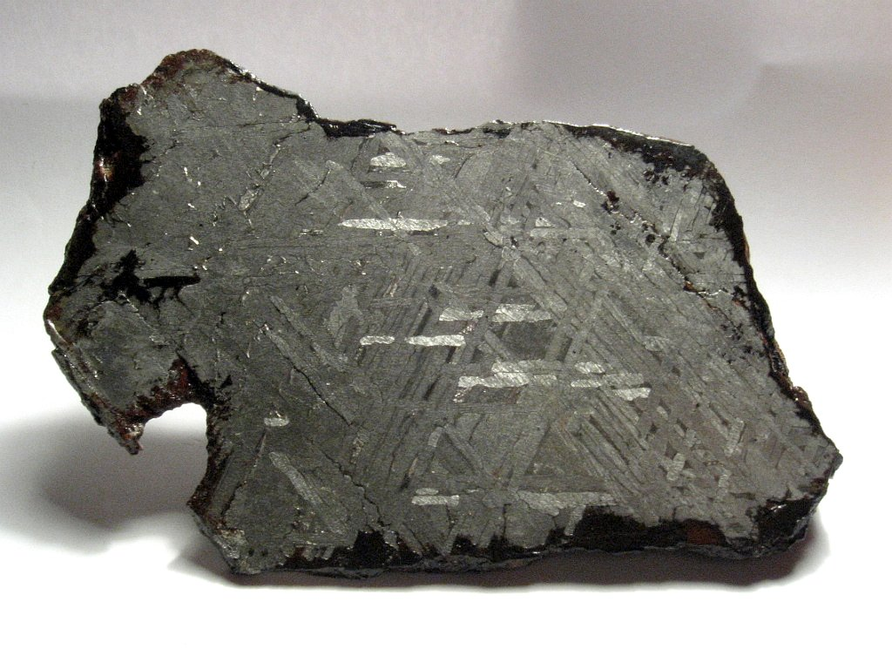
Achondrites
Rocky Achondrites; mantle material
D’Orbigny, Plutonic Angrite
Magmatic Irons; core material
Toluca, IAB
(Photo credit: G. Armstrong)
Toluca, IAB
Notes:
This is d’Orbigny which is an example of a rocky achondrite. Clearly crystalline texture, none of the original chondritic texture remains. Represent differentiated silicate portion of the angrite parent body.

