Slide 1
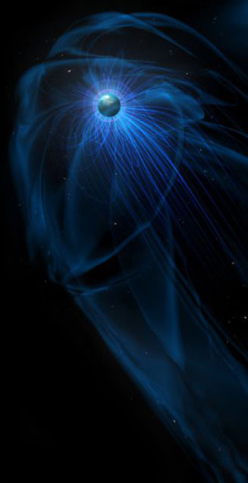
Planetary Magnetism as a Parameter in Exoplanet Habitability
Sarah R.N. McIntyre
Research School of Astronomy & Astrophysics
Australian National University
Rocky Worlds: from the Solar System to Exoplanets
Kavli Institute, Cambridge, 6 – 8 January 2020
(©NASA)
Notes:
Hi I’m Sarah McIntyre from the Australian National University and my research focuses on exploring a multi-parameter approach to habitability in order to optimise target selection for future biosignature observations.

Slide 2
Acknowledgments
A/Prof. Charles Lineweaver
A/Prof. Michael Ireland
Research School of Astronomy & Astrophysics
Australian National University
Support
Australian Government Research Training Program (RTP) Scholarship
Research School of Astronomy and Astrophysics Scholarship
RSAA Joan Duffield Scholarship
(©NASA)
Notes:
This particular project was completed with the help of 2 of my supervisors and money from the Australian government and research school of astronomy and astrophysics.

Slide 3
Near future telescopes will provide us with an
increasing number of exo-Earths
Target selection focused on ‘habitable worlds’-
rocky bodies (with enough surface gravity to
sustain an atmosphere) orbiting their host stars at a distance where stellar radiation is suitable
for the presence of surface liquid water.
Numerous planetary and astronomical factors
influence an exoplanet's ability to maintain
liquid water
(©ARIE WILSON PASSWATERS/RICE UNIVERSITY)
Notes:
Within the next decade, upcoming observations with…
To make the most of the observational resources available….
With the expected increase in the number of detected exoplanets from TESS and PLATO, we might end up with hundreds of planets that suit these criteria, therefore, it is imperative that we rethink our classification of what makes a planet habitable.

Slide 4

Multi-Parameter Approach to Habitability (M-PAtH)
Notes:
Numerous planetary and astronomical factors influence an exoplanet's ability to maintain liquid water. It is increasingly important to expand our considerations and include factors such as magnetic field, albedo, stellar type, planet chemical composition, orbital eccentricity, inclination, tidal locking, impact events, and plate tectonics.

Slide 5
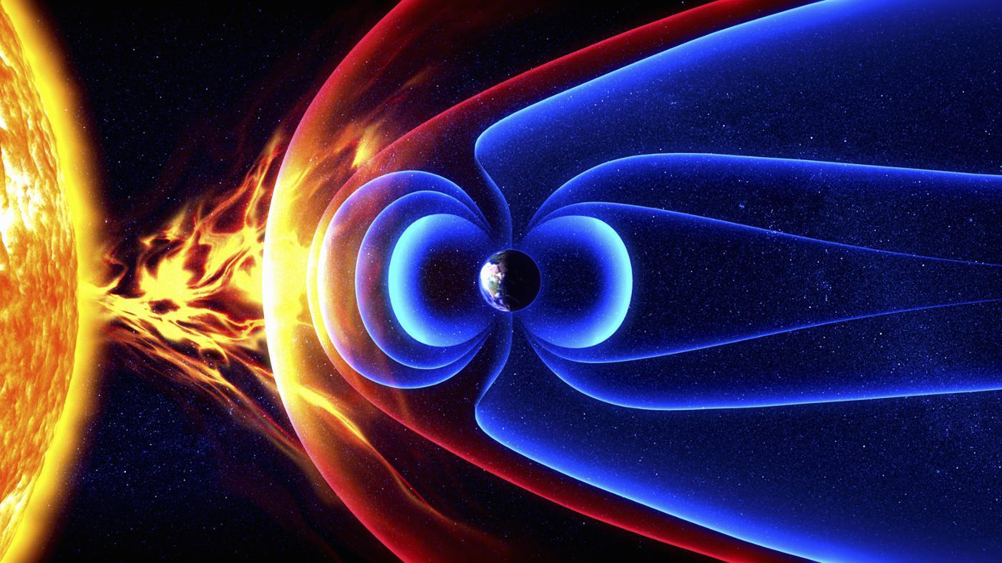
(Jaime Trosper/FQTQ)
Notes:
The majority of our assessments on habitability stems from what we have observed in our own solar system. One of the differences amongst the terrestrial planets in our solar system is the presence of a strong magnetic dipole moment on Earth that protects the surface and liquid water from solar winds and flares.

Slide 6
(Jaime Trosper/FQTQ)
Notes:
Venus, Earth and Mars likely began with similar amounts of water since they are all about the same size and formed at the same time (~4.5 billion years ago).

Slide 7
∼100 D/H of bulk Earth
∼5 D/H of Earth
(Jaime Trosper/FQTQ)
Notes:
This is corroborated by their deuterium to hydrogen ratios (D/H) which suggests that both Mars and Venus had more water early in their histories. Yet today, only Earth has retained liquid water.

Slide 8

Magnetic Moment Model
$$𝓜=4π{r_{0}}^{3}γ{\left(\frac{{\overline{ρ}}_{0}}{μ_{0}}\right)}^{1/2}{\left(FD\right)}^{1/3}$$
Olson & Christensen (2006)(2006)
Notes:
As a part of this project we focus on modelling the strengths of the magnetic dipole moments of rocky exoplanets to assess their ability to protect their atmospheres from hydrogen loss. In our calculations we use Olson & Christiensen’s magnetic moment scaling law…

Slide 9

Magnetic Moment Model
$$𝓜=4π{r_{0}}^{3}γ{\left(\frac{{\overline{ρ}}_{0}}{μ_{0}}\right)}^{1/2}{\left(FD\right)}^{1/3}$$
Olson & Christensen (2006)(2006)
$$r_{0}=R_{p}\sqrt{\frac{1}{0.21}\left[1.07−\left(\frac{R_{p}}{R_{⊕}}\right)/{\left(\frac{M_{p}}{M_{⊕}}\right)}^{0.27}\right]}$$
Zeng et al. (2016)
Zeng & Jacobsen (2017)2006)
Notes:
in combination with Zhang’s planetary core radius calculation…

Slide 10

Magnetic Moment Model
$$𝓜=4π{r_{0}}^{3}γ{\left(\frac{{\overline{ρ}}_{0}}{μ_{0}}\right)}^{1/2}{\left(FD\right)}^{1/3}$$
Olson & Christensen (2006)(2006)
$$r_{0}=R_{p}\sqrt{\frac{1}{0.21}\left[1.07−\left(\frac{R_{p}}{R_{⊕}}\right)/{\left(\frac{M_{p}}{M_{⊕}}\right)}^{0.27}\right]}$$
Zeng et al. (2016)
Zeng & Jacobsen (2017)2006)
$$\frac{F}{F_{⊕}}={\left(\frac{R_{O_{l}}}{R_{O_{l⊕}}}\right)}^{2}{\left(\frac{D}{D_{⊕}}\right)}^{2/3}{\left(\frac{Ω}{Ω_{⊕}}\right)}^{7/3}$$
Lopez-Morales et al. (2011))
Notes:
and Lopes-Morales’s convective buoyancy flux equation to estimate the magnetic moment of an exoplanet.

Slide 11

Magnetic Moment Model
$$𝓜=4π{r_{0}}^{3}γ{\left(\frac{{\overline{ρ}}_{0}}{μ_{0}}\right)}^{1/2}{\left(FD\right)}^{1/3}$$
Olson & Christensen (2006)(2006)
$$r_{0}=R_{p}\sqrt{\frac{1}{0.21}\left[1.07−\left(\frac{R_{p}}{R_{⊕}}\right)/{\left(\frac{M_{p}}{M_{⊕}}\right)}^{0.27}\right]}$$
Zeng et al. (2016)
Zeng & Jacobsen (2017)2006)
$$\frac{F}{F_{⊕}}={\left(\frac{R_{O_{l}}}{R_{O_{l⊕}}}\right)}^{2}{\left(\frac{D}{D_{⊕}}\right)}^{2/3}{\left(\frac{Ω}{Ω_{⊕}}\right)}^{7/3}$$
Lopez-Morales et al. (2011))
$R_{O_{l}}=0.1$2
Notes:
Additionally, as Olsen & Christiensen determined that the transition from dipole-dominant to multipolar dynamos occurs in a narrow interval around local Rossby number of 0.12 for base-heated dynamos, in our model, we have used this value to generate…

Slide 12


Magnetic Moment Model
$$𝓜=4π{r_{0}}^{3}γ{\left(\frac{{\overline{ρ}}_{0}}{μ_{0}}\right)}^{1/2}{\left(FD\right)}^{1/3}$$
Olson & Christensen (2006)(2006)
$$r_{0}=R_{p}\sqrt{\frac{1}{0.21}\left[1.07−\left(\frac{R_{p}}{R_{⊕}}\right)/{\left(\frac{M_{p}}{M_{⊕}}\right)}^{0.27}\right]}$$
Zeng et al. (2016)
Zeng & Jacobsen (2017)2006)
$$\frac{F_{max}}{F_{⊕}}={\left(\frac{R_{O_{l}}=0.12}{R_{O_{l⊕}}}\right)}^{2}{\left(\frac{D}{D_{⊕}}\right)}^{2/3}{\left(\frac{Ω}{Ω_{⊕}}\right)}^{7/3}$$
Lopez-Morales et al. (2011))
$R_{O_{l}}=0.1$2
Notes:
the maximum convective buoyancy flux…

Slide 13


Magnetic Moment Model
$$𝓜_{max}=4π{r_{0}}^{3}γ{\left(\frac{{\overline{ρ}}_{0}}{μ_{0}}\right)}^{1/2}{\left(F_{max}D\right)}^{1/3}$$
Olson & Christensen (2006)(2006)
$$r_{0}=R_{p}\sqrt{\frac{1}{0.21}\left[1.07−\left(\frac{R_{p}}{R_{⊕}}\right)/{\left(\frac{M_{p}}{M_{⊕}}\right)}^{0.27}\right]}$$
Zeng et al. (2016)
Zeng & Jacobsen (2017)2006)
$$\frac{F_{max}}{F_{⊕}}={\left(\frac{R_{O_{l}}=0.12}{R_{O_{l⊕}}}\right)}^{2}{\left(\frac{D}{D_{⊕}}\right)}^{2/3}{\left(\frac{Ω}{Ω_{⊕}}\right)}^{7/3}$$
Lopez-Morales et al. (2011))
$R_{O_{l}}=0.1$2
Notes:
allowing us to then estimate the maximum dipolar magnetic moment. Being really optimistic about our values… let’s just see if we give it our all will all planets show strong dipole moments?

Slide 14
Magnetic Moment Model
$$𝓜=4π{r_{0}}^{3}γ{\left(\frac{{\overline{ρ}}_{0}}{μ_{0}}\right)}^{1/2}{\left(FD\right)}^{1/3}$$
Olson & Christensen (2006)(2006)
$$r_{0}=R_{p}\sqrt{\frac{1}{0.21}\left[1.07−\left(\frac{R_{p}}{R_{⊕}}\right)/{\left(\frac{M_{p}}{M_{⊕}}\right)}^{0.27}\right]}$$
Zeng et al. (2016)
Zeng & Jacobsen (2017)2006)
$$\frac{F}{F_{⊕}}={\left(\frac{R_{O_{l}}}{R_{O_{l⊕}}}\right)}^{2}{\left(\frac{D}{D_{⊕}}\right)}^{2/3}{\left(\frac{Ω}{Ω_{⊕}}\right)}^{7/3}$$
Lopez-Morales et al. (2011))
Parameters:
Mass
Radius
Rotation rate
Notes:
All of the equations depend on the parameters of planetary mass, radius and rotation rate.

Slide 15
Magnetic Moment Model
$$𝓜=4π{r_{0}}^{3}γ{\left(\frac{{\overline{ρ}}_{0}}{μ_{0}}\right)}^{1/2}{\left(FD\right)}^{1/3}$$
Olson & Christensen (2006)(2006)
$$r_{0}=R_{p}\sqrt{\frac{1}{0.21}\left[1.07−\left(\frac{R_{p}}{R_{⊕}}\right)/{\left(\frac{M_{p}}{M_{⊕}}\right)}^{0.27}\right]}$$
Zeng et al. (2016)
Zeng & Jacobsen (2017)2006)
$$\frac{F}{F_{⊕}}={\left(\frac{R_{O_{l}}}{R_{O_{l⊕}}}\right)}^{2}{\left(\frac{D}{D_{⊕}}\right)}^{2/3}{\left(\frac{Ω}{Ω_{⊕}}\right)}^{7/3}$$
Lopez-Morales et al. (2011))
Parameters:
Mass – RV
Radius – transit
Rotation rate – tidally locked? non-tidally locked?
Notes:
While mass and radius can be determined using RV and transit observations, our estimates of rotation rate depend on whether an exoplanet is tidally locked or non-tidally locked.

Slide 16

Magnetic Moment Model
$$𝓜=4π{r_{0}}^{3}γ{\left(\frac{{\overline{ρ}}_{0}}{μ_{0}}\right)}^{1/2}{\left(FD\right)}^{1/3}$$
Olson & Christensen (2006)(2006)
$$r_{0}=R_{p}\sqrt{\frac{1}{0.21}\left[1.07−\left(\frac{R_{p}}{R_{⊕}}\right)/{\left(\frac{M_{p}}{M_{⊕}}\right)}^{0.27}\right]}$$
Zeng et al. (2016)
Zeng & Jacobsen (2017)2006)
$$\frac{F}{F_{⊕}}={\left(\frac{R_{O_{l}}}{R_{O_{l⊕}}}\right)}^{2}{\left(\frac{D}{D_{⊕}}\right)}^{2/3}{\left(\frac{Ω}{Ω_{⊕}}\right)}^{7/3}$$
Lopez-Morales et al. (2011))
$$τ_{sync}≈\frac{4}{9}αQ_{p}^{′}\left(\frac{{R_{p}}^{3}}{GM_{p}}\right)\left(ω_{i}−ω_{f}\right){\left(\frac{M_{p}}{M_{∗}}\right)}^{2}{\left(\frac{d}{R_{p}}\right)}^{6}$$
Grießmeier et al. (2009)
Notes:
Grießmeier’s formula was used to calculate the time taken to tidally lock an exoplanet and this value was then compared against the stellar age of the host stars to establish which planets were tidally locked. For the subset of tidally locked exoplanets we assume that the rotation period equals the orbital period.

Slide 17
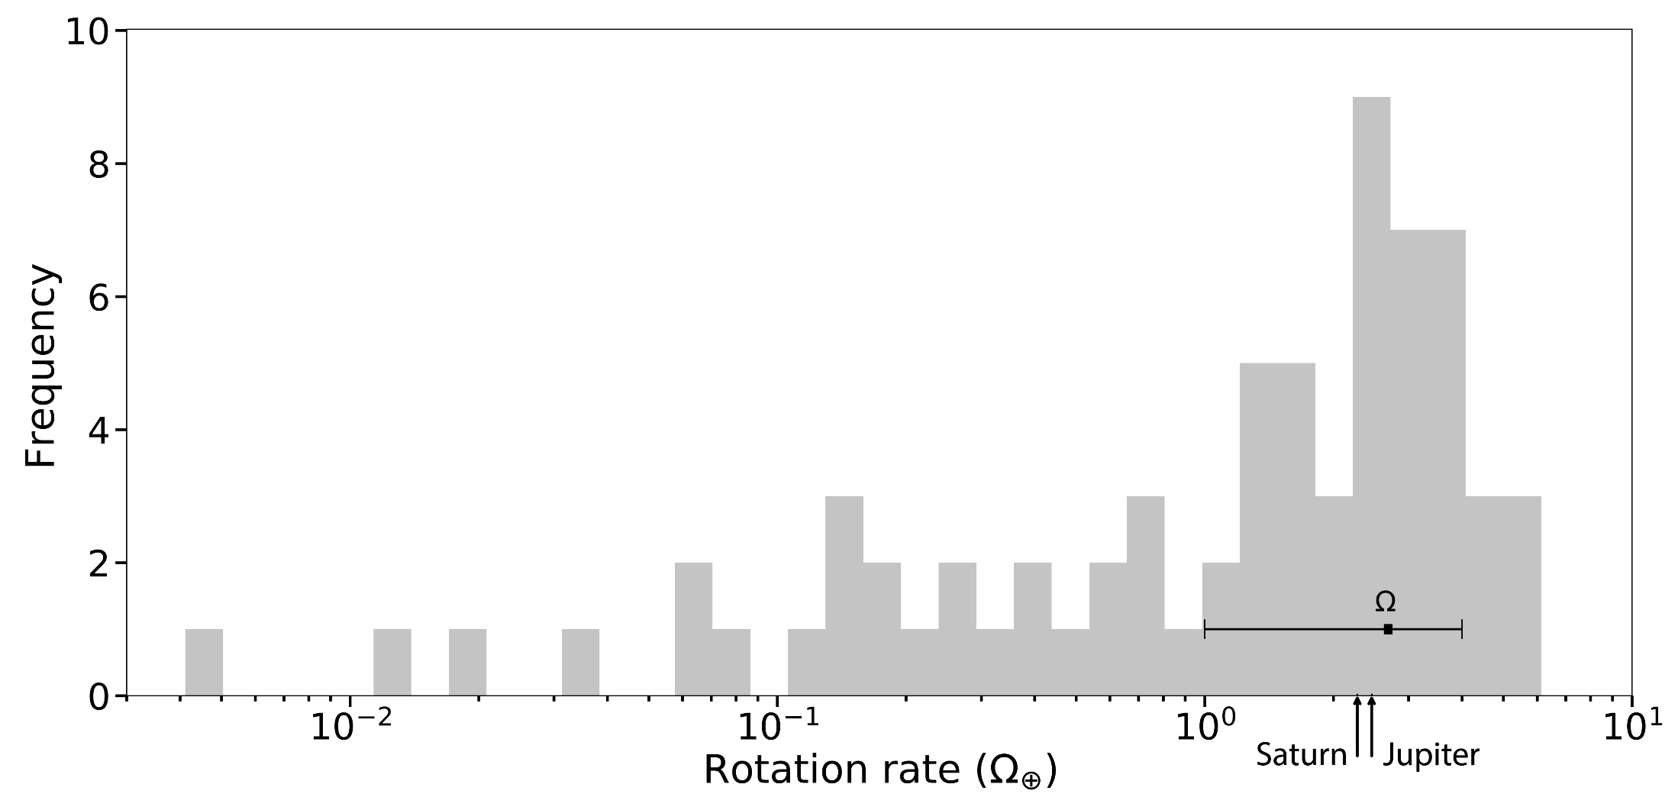
(McIntyre et al. 2018)
Notes:
Since we do not have the planetary rotation rates for non-tidally locked exoplanets, we examine the rotation rate of 43 solar system objects including planets, moons, dwarf planets, Kuiper belt objects and main-belt asteroids. Their distribution is characterised by an average rotation rate of 2.5 ± 1.5 Ω⊕.

Slide 18
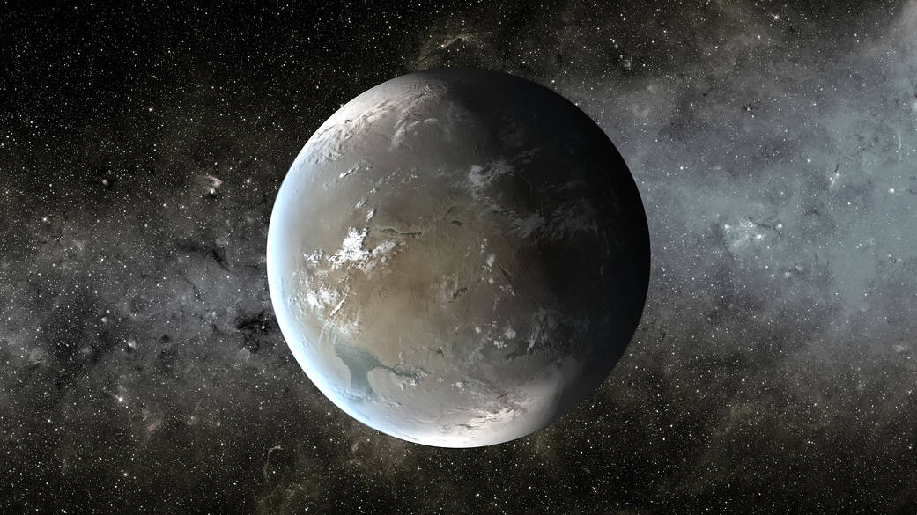
Terrestrial Planet Database
PRIMARY:
      NASA exoplanet archive composite database
SECONDARY:
      Fulton & Petigura (2018)
M-R RELATION:
      R ~ M^{0.279±0.009} Chen & Kipping (2016)
LIMITATIONS:
      R ≤ 1.23R⊕ ∼ 2 M⊕ Chen & Kipping (2016)
PREDICTIONS:
      M > 2.5 M⊕ = no inner core Gaidos et al. (2010)
(NASA Ames/JPL-Caltech/T. Pyle)
Notes:
Finally, before applying the model, we compile a database of rocky planets using the NASA composite exoplanet archive in conjunction with the higher precision radii of Kepler planets given in Fulton & Petigura. Unknown masses or radii and their associated uncertainties are estimated using Chen & Kipping M–R relationship for terrestrial planets. Following the Chen & Kipping definition of the boundary between terrestrial and Jovian planets, we restrict our sample to exoplanets with radii less than 1.23 R⊕, which corresponds to ∼ 2 M⊕ and agrees with the Gaidos’s prediction that rocky planets with mass > 2.5 M⊕ will not develop inner cores and hence will not be able to sustain a magnetic field.

Slide 19
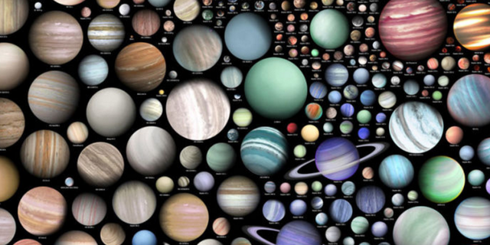
 | Total | Tidally locked
Rocky exoplanets | 496 | 490
CHZ exoplanets | 9 | 8
Notes:
Taking these constraints into account, our sample is compiled of 496 rocky exoplanets (490 tidally locked), including 9 exoplanets located in the CHZ (8 tidally locked).

Slide 20
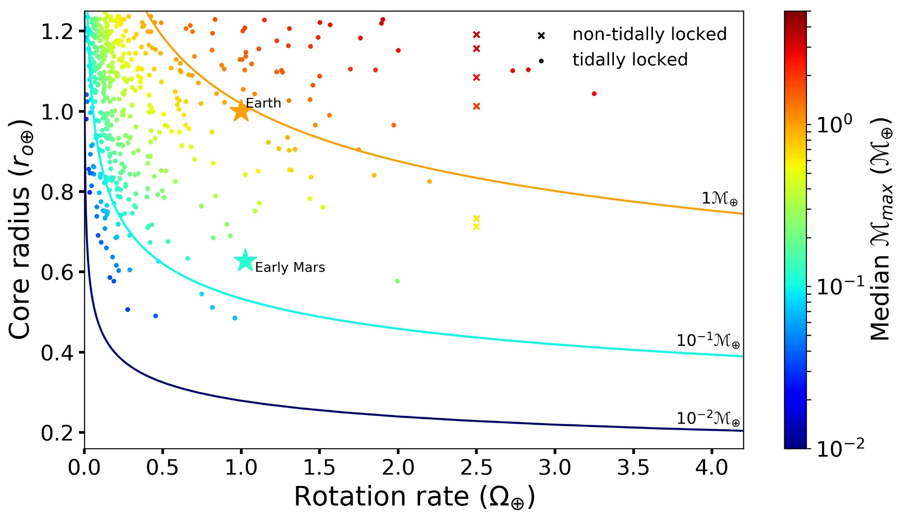
(McIntyre et al. 2019)
Notes:
The median maximum magnetic dipole moments for all confirmed rocky exoplanets from our sample are plotted in this figure. Broad observations we can see that exoplanets with larger core radii have larger Mmax. Additionally, the majority of the data is located on the left-hand side, indicating that the sample of currently detected exoplanets has an observational bias towards planets with short tidally-locked periods. In the future, a broader sample of exoplanet detections combined with better constrained rotation rate measurements, will hopefully contribute to the clarity of magnetic dipole moment trends.

Slide 21
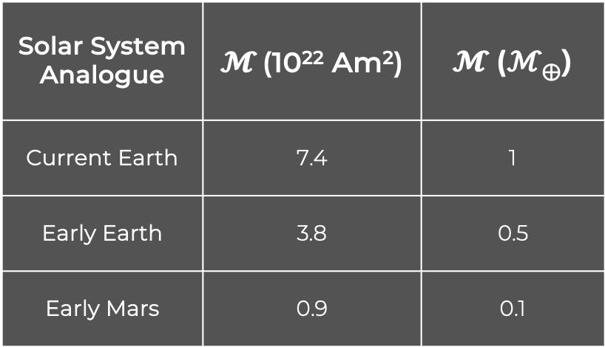
Comparison With Solar System Analogues
Solar System Analogue | $𝓜$ (10²² Am²) | $𝓜$ (ℳ⊕)
Current Earth | 7.4 | 1
Early Earth | 3.8 | 0.5
Early Mars | 0.9 | 0.1
(NASA/Jet Propulsion Laboratory-Caltech)
Notes:
Since there are no well-established conversions between magnetic moment strength and habitability, to help place our modelled Mmax values into a broader context, we compare our values to the those of three solar system scenarios involving the presence of liquid water on the surface of a planet - current Earth, early Earth and early Mars.

Slide 22
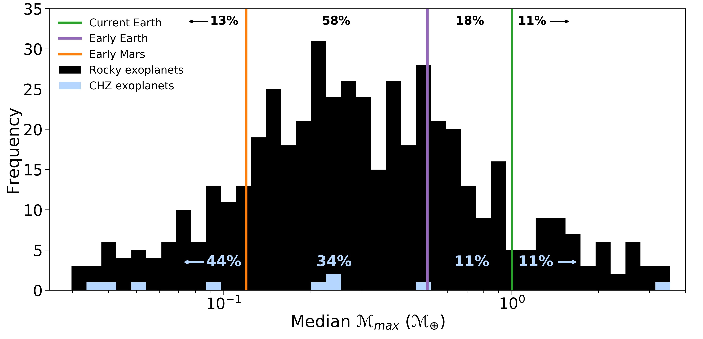
(McIntyre et al.2019)
Notes:
Here we have a frequency distribution of Mmax for all exoplanets within our sample when compared against the solar system analogues

Slide 23
(McIntyre et al.2019)
Notes:
In our sample, only 11% of all modelled exoplanets have Mmax larger than that of current Earth.

Slide 24
Hypothesis: larger
magnetic moments are
better able to protect a planet’s surface
(McIntyre et al.2019)
Notes:
Based on the postulate that larger magnetic moments are better able to protect a planet’s surface,

Slide 25
Hypothesis: larger
magnetic moments are
better able to protect a planet’s surface
Conclusion: higher
likelihood of sustaining
liquid water
(McIntyre et al.2019)
Notes:
this subset of planets has a higher likelihood of sustaining liquid water.

Slide 26
(McIntyre et al.2019)
Notes:
On the other hand, 13% of all modelled exoplanets have Mmax less than early Mars.

Slide 27
Hypothesis: No example in SS of ℳ < 0.1ℳ⊕
successfully shielding the planet’s liquid water
(McIntyre et al.2019)
Notes:
We do not have an example in our solar system of a magnetic dipole moment < 0.1ℳ⊕ successfully shielding the planet’s liquid water

Slide 28
Conclusion: unlikely to be able to conserve water
(McIntyre et al.2019)
Notes:
assume that it is unlikely these exoplanets would be able to conserve water.

Slide 29
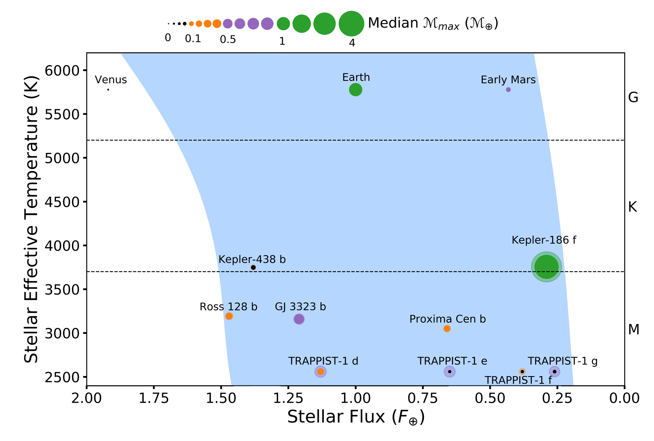
(McIntyre et al. 2019)
Notes:
Looking at the maximum magnetic moment strength in the context of the CHZ we find that only Kepler-186 f has a median ℳ_{𝑚𝑎𝑥} larger than Earth’s current dipole moment.

Slide 30
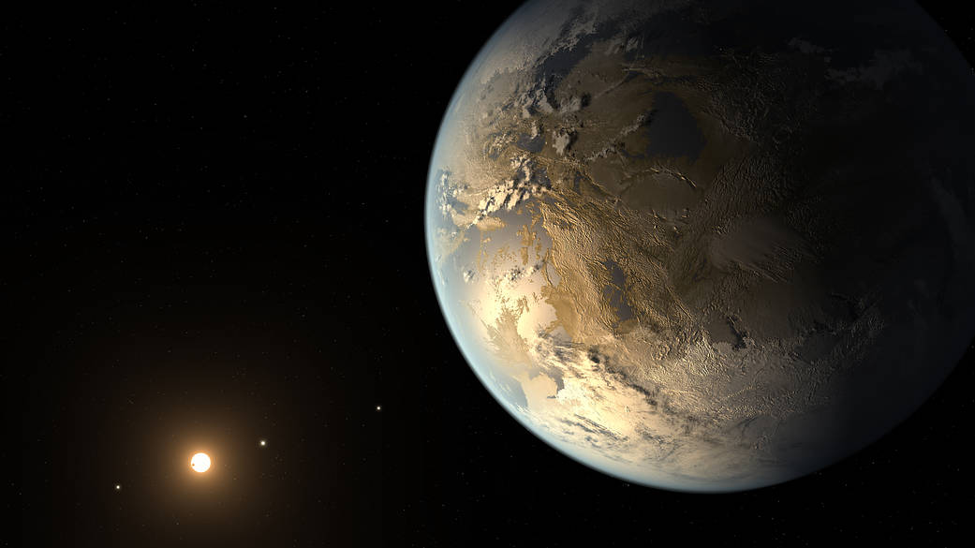

With a large magnetic moment
and temperate orbit, this planet
would be the most likely to
maintain the presence of surface
liquid water over prolonged
periods of time.
(NASA/Goddard)
Notes:
With a large magnetic moment and temperate orbit, this planet would be the most likely to maintain the presence of surface liquid water over prolonged periods of time.

Slide 31
(McIntyre et al. 2019)
Notes:
When the upper limits are taken into account, the purple planets, including Trappist-1 d, e, and g fall into the subgroup that has a median ℳ_{𝑚𝑎𝑥} larger than early Earth’s, but smaller than current Earth’s dipole moment.

Slide 32

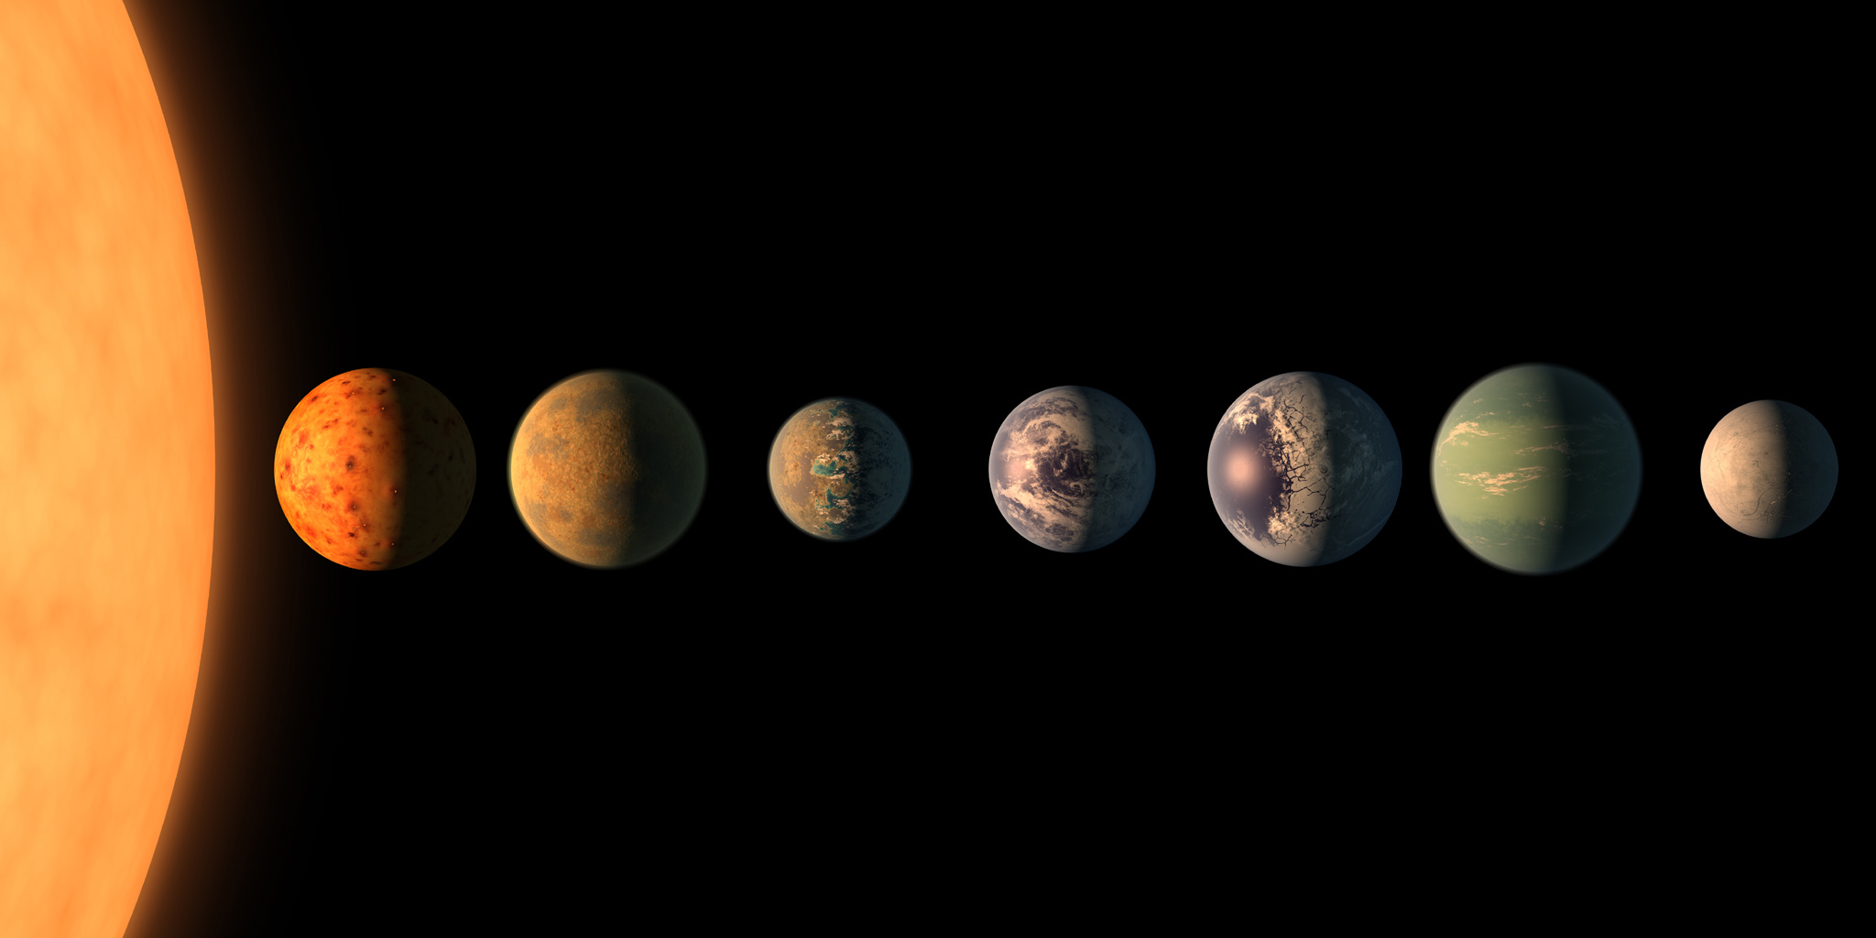
While there was life and liquid
water present on the surface of
Earth during the Paleoarchean,
there is the potential for an
increased rate of atmospheric and water loss during this period.
It is uncertain that this subset of
planets in would continue to
maintain water over time.
(NASA/Goddard)
Notes:
While we know there was life and liquid water present on the surface of Earth during the Paleoarchean, there is the potential for an increased rate of atmospheric and water loss during this period, so it is uncertain that the planets in this subsample would continue to maintain water over time.

Slide 33
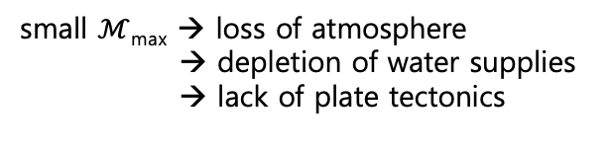
small $ℳ$_{max} → loss of atmosphere
→ depletion of water supplies
→ lack of plate tectonics
(McIntyre et al. 2019)
Notes:
Since a small magnetic moment has been connected with a loss of atmosphere, depletion of water supplies, and lack of plate tectonics, the orange planets which fall between Early mars and early Earth and the black planets with Mmax less than that of early Mars are unlikely to retain surface liquid water over prolonged periods of time

Slide 34
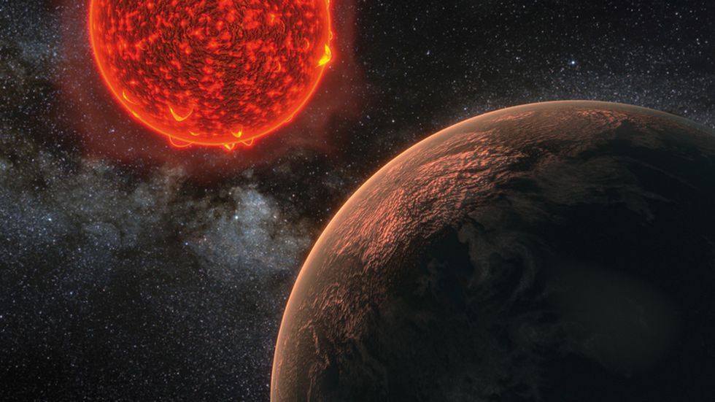

Circumstances that could counteract the effects of a lower magnetic moment:
Significant initial reservoir of water
High surface gravity
Low amount of incident stellar irradiation
(NASA/Goddard)
Notes:
… unless other circumstances were to counteract the effects of a lower magnetic moment, such as significant initial reservoir of water, high surface gravity, and/or a low amount of incident stellar irradiation.

Slide 35
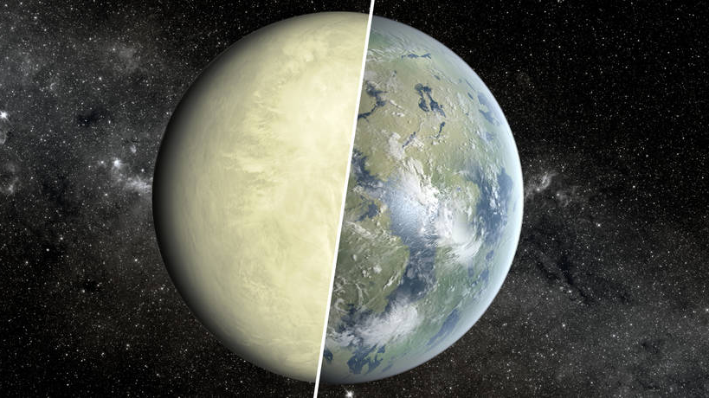

Conclusion
Even with the best-case scenario of modelling the maximum dipole
moment, 44% of rocky exoplanets located in the CHZ have a negligible magnetic dipole moment – no protection against stellar and cosmic
irradiation and unable to maintain liquid water over a prolonged period of time, despite residing within the CHZ.
Habitable Zone $≠$“liquid water zone”
Kepler-186 f is the only exoplanet that shows a strong magnetic dipole
moment, and is the only one that would be likely to maintain the
presence of surface liquid water over prolonged periods of time.
NASA/JPL-Caltech/Ames
Notes:
Our analysis suggests that…..
CHZ might not be “the liquid water zone”.
Ultimately…

Slide 36

Notes:
So it’s sounding like good news for Kepler 186 f….

Slide 37
Notes:
But wait!

Slide 38
Multi-Parameter Approach to Habitability (M-PAtH)
Notes:
Planetary magnetism is just one more parameter amongst many astrophysical and geophysical properties of exoplanets and their host stars that could affect the habitability of a planet.

Slide 39
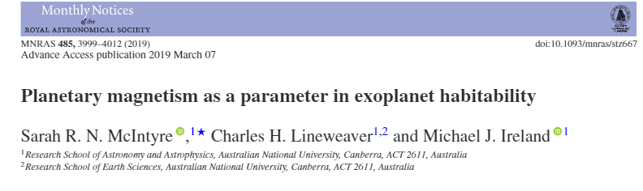
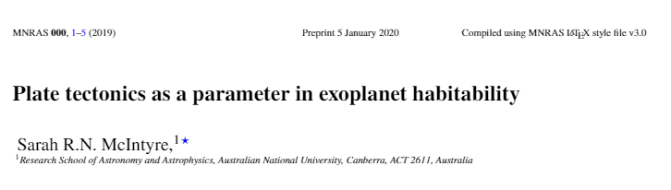
Next up…
Notes:
In the follow paper (in review) focus is on modelling the tidal evolution of currently observed rocky exoplanets to determine the impact on the internal heating required for long-lived plate tectonics.

Slide 40
Hope for the Future
TESS and PLATO missions, combined with ground-based radial velocities
from existing and new spectrographs, will increase the sample size and
improve the method used here.
Generate a flexible framework that involves multiple observable characteristics and features that influence continuous planetary habitability.
Expand strategies for future observations characterising rocky exoplanets.
NASA/JPL-Caltech/Ames
Notes:
Hopes for the future is that the exoplanet detections from the…
Expanding to a multi-parameter approach to habitability, and analysing, modelling and constraining how these factors interact on any given planetary body, we will be able to…
Based on the results, a revised model of planetary habitability should be constructed and strategies for future observations characterising rocky exoplanets expanded.

