Slide 1
HOW PLANETS GROW BY PEBBLE ACCRETION
Chris Ormel
Allona Vazan
Marc Brouwers

Slide 2
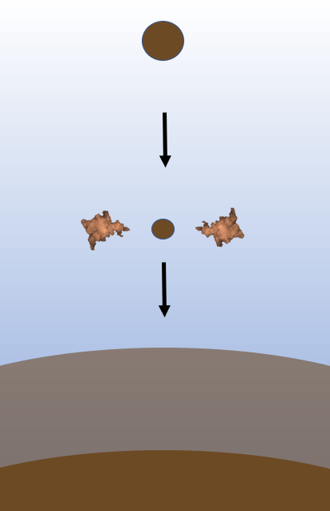
Goals & Findings
Goals:
Challenge the idea of continued core growth (Brouwers et al, 2018)
Sketch the effects on planetary evolution (Brouwers & Ormel 2020)
Findings:
Core growth during solids accretion is limited
Significant effects on planetary evolution such as:
- Runaway gas accretion occurs at smaller critical metal mass
- Nebular accretion during cooling is less efficient

Slide 3
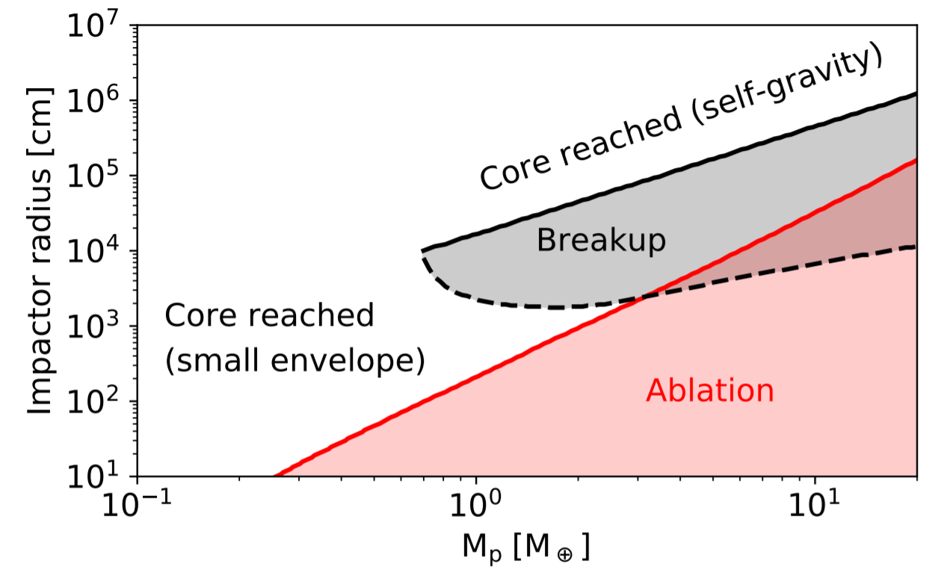
Fate of impactors
Impact code (SiO2, Thermal ablation, fragmentation)
Pebbles vaporize very easily
(small) planetesimals are susceptible to fragmentation
Brouwers et al (2018), Brouwers & Ormel (2020)
See also Iaroslavitz & Podolak (2007), Mordasini et al. (2015),
Pinhas et al. (2016), Valletta & Helled (2018)

Slide 4
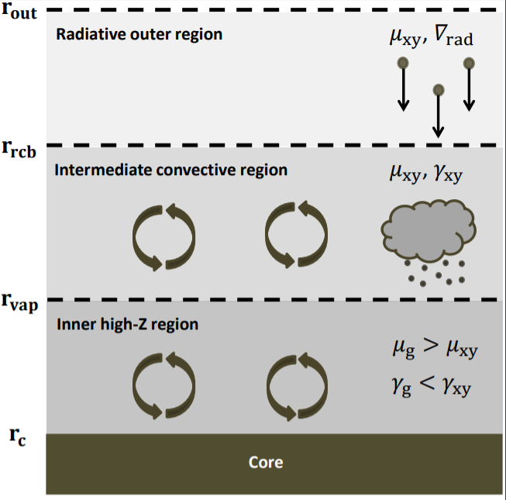
Analytical model vapor planet
Main simplifications:
Ideal gases
Analytical (grain-free) opacity
3 uniformly mixed layers
Density jump at
Brouwers & Ormel (2020)

Slide 5
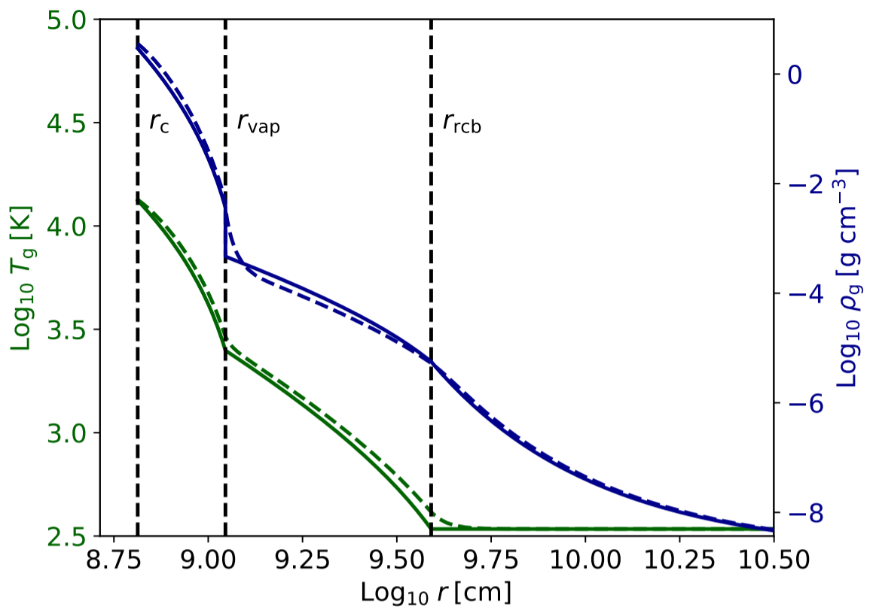
Vapor planet structure
Polluted (hot)
Metal-free (cold)
Brouwers & Ormel (2020)

Slide 6
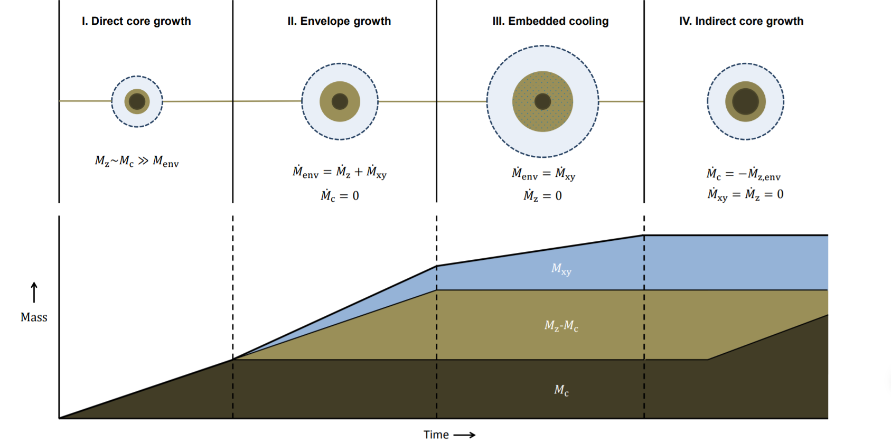
Making a vapor planet
Brouwers & Ormel (2020)

Slide 7
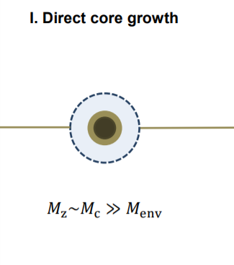
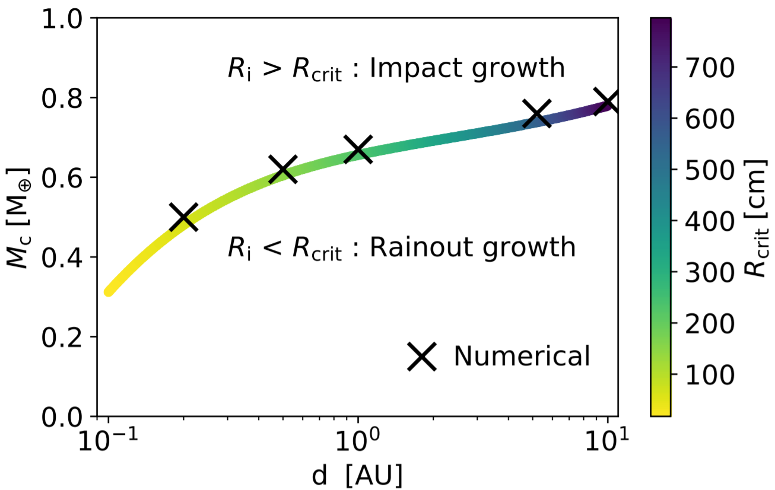
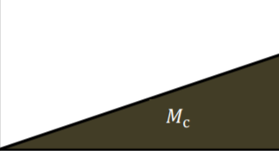
I. Direct core growth
Brouwers & Ormel (2020)
Direct core growth is limited to less than (with ideal gases)

Slide 8
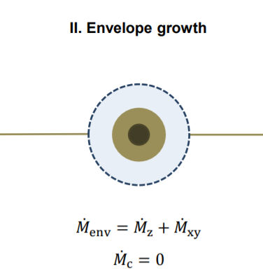
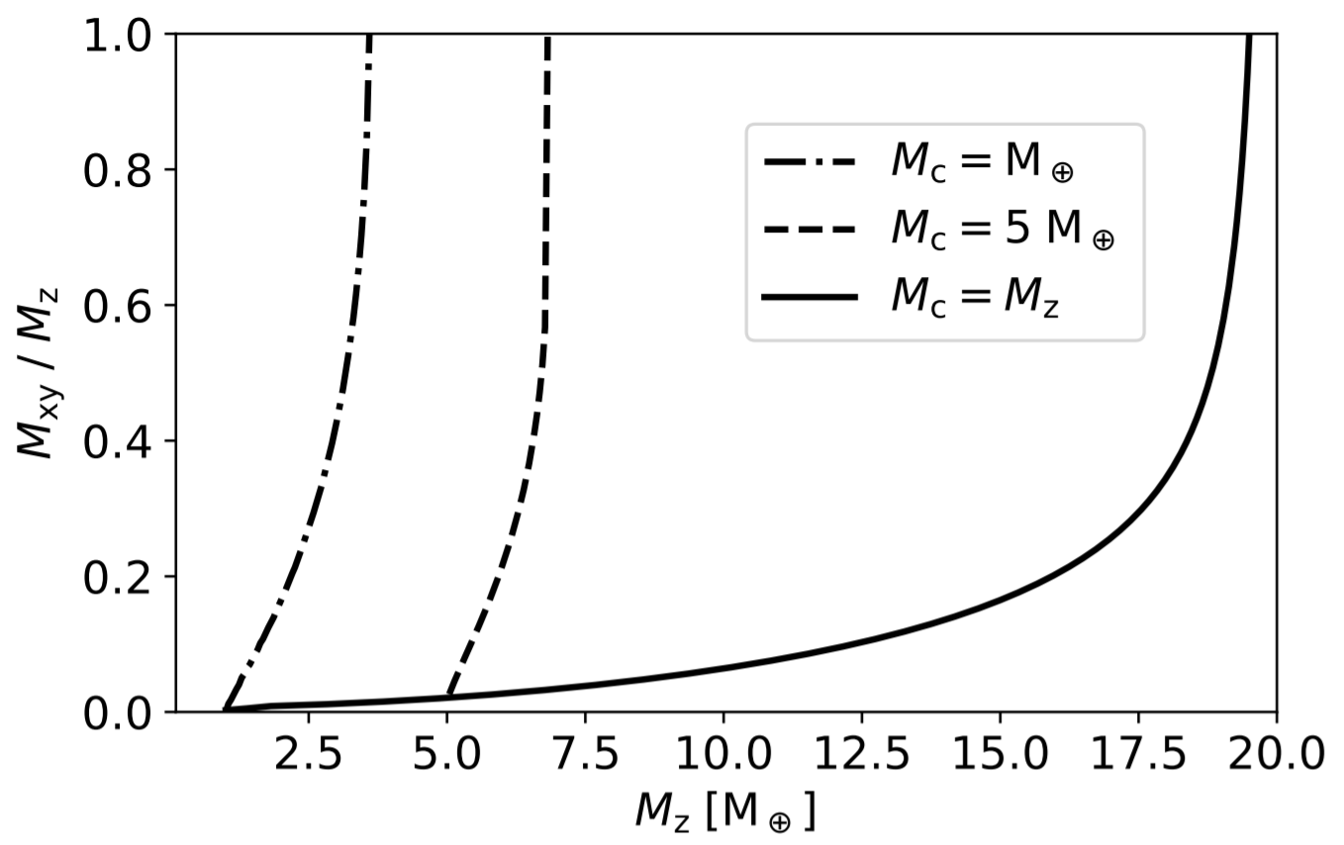
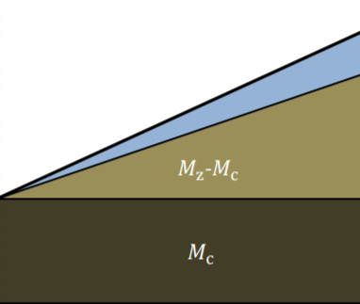
II. Envelope growth
Brouwers & Ormel (2020)
Runaway accretion when
Critical core mass
Critical metal mass

Slide 9
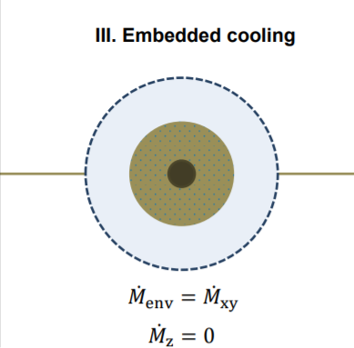
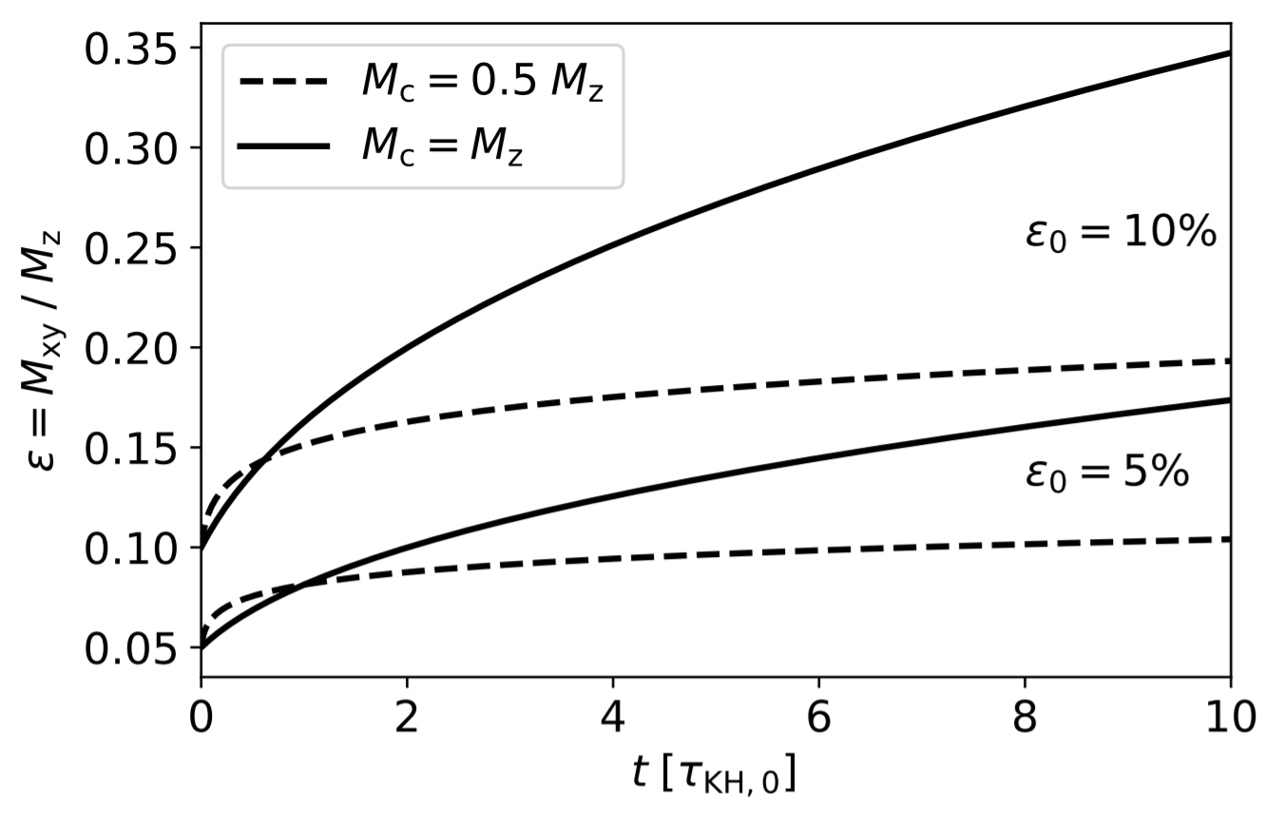
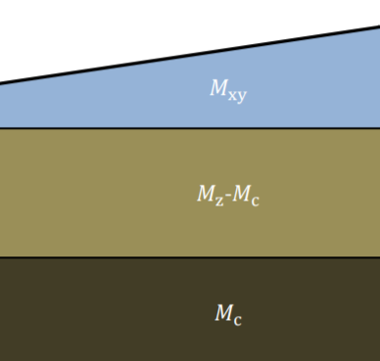
III. Embedded cooling
Brouwers & Ormel (2020)
Dilution limits nebular gas accretion during embedded cooling

Slide 10
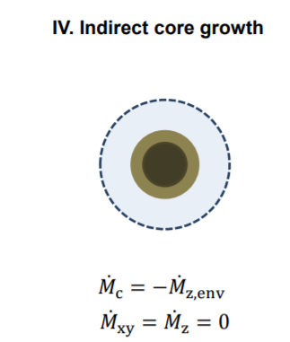
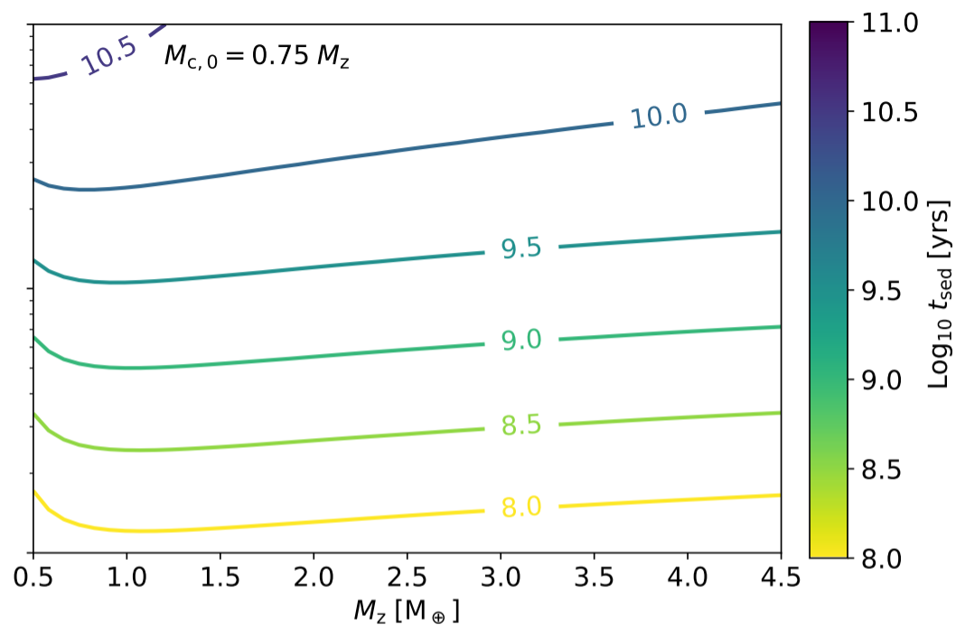
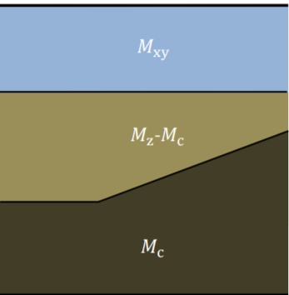
IV. Isolated cooling / Indirect core growth
Brouwers & Ormel (2020)
Energy release occurs late, when
Ineffective mass loss from internal energy release
Cooling time depends on the nebular mass fraction

Slide 11
Conclusions
Direct core growth is limited
Runaway occurs sooner, at the critical metal mass
Gas accretion during embedded cooling is less efficient
Isolated cooling does not inherently lead to mass-loss
Full numerical simulations are being developed (Ormel et al, in prep)

