Slide 1





Tracing the coupled evolution of water and oxygen on temperate rocky exoplanets
Robin Wordsworth
with collaborators: Kaitlyn Loftus, Feng Ding,
Caroline Morley, Laura Schaefer & Rebecca Fischer
Rocky Worlds 2020
Cambridge, UK
Notes:
Acknowledge coauthors. View from opportunity rover on Mars. Oxidized iron.
Wadi rum in Jordan. Talk is about processes that drive this kind of oxidation.

Slide 2
Talk Outline
Part I: Planetary oxidation and water loss
  Fundamentals, motivation and solar system trends
  A generalized approach to redox evolution modeling
  Abiotic O₂ predictions for terrestrial exoplanets
Part II: Detection of surface liquid water
  Why exoplanet surface liquid water detection is hard
  Using the sulfur cycle to constrain H₂O_{(l)} indirectly
Notes:
Atmospheres of gas giants: H₂-rich
Rocky planet atmospheres: heavier, more oxidized, and much more diverse
Also, focus on abiotic processes

Slide 3
Part I: Planetary oxidation and water loss
Notes:
Atmospheres of gas giants: H₂-rich
Rocky planet atmospheres: heavier, more oxidized, and much more diverse
Also, focus on abiotic processes

Slide 4
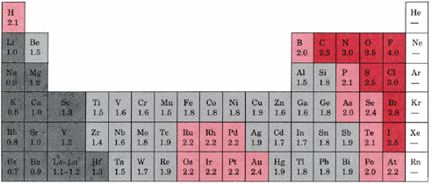
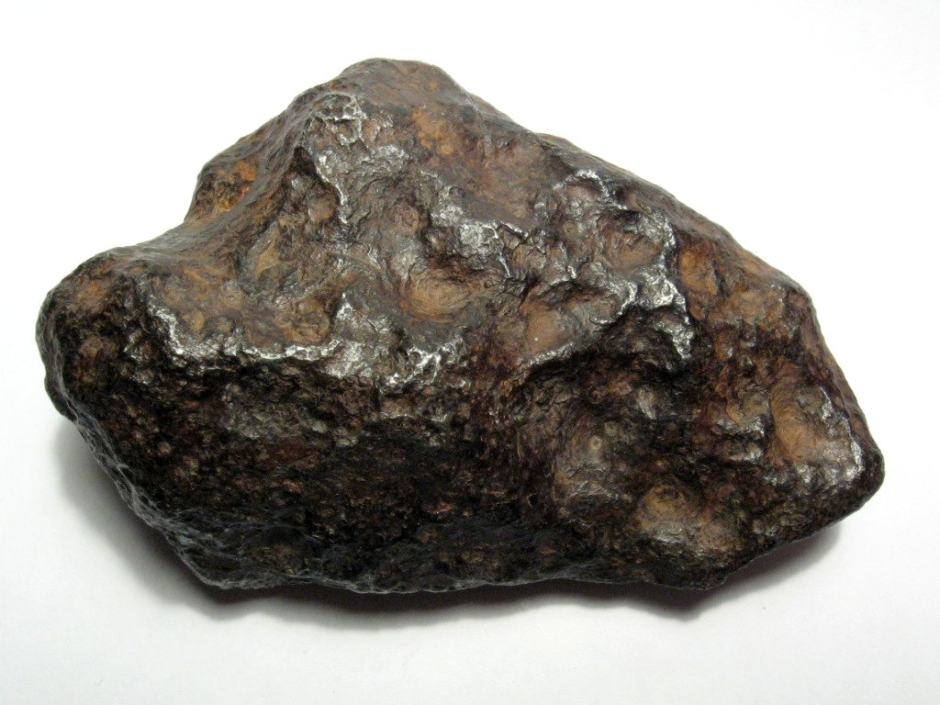
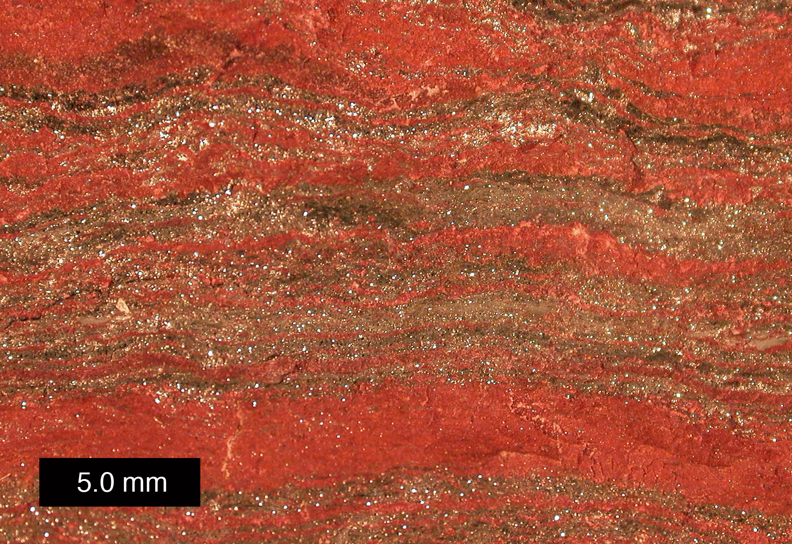
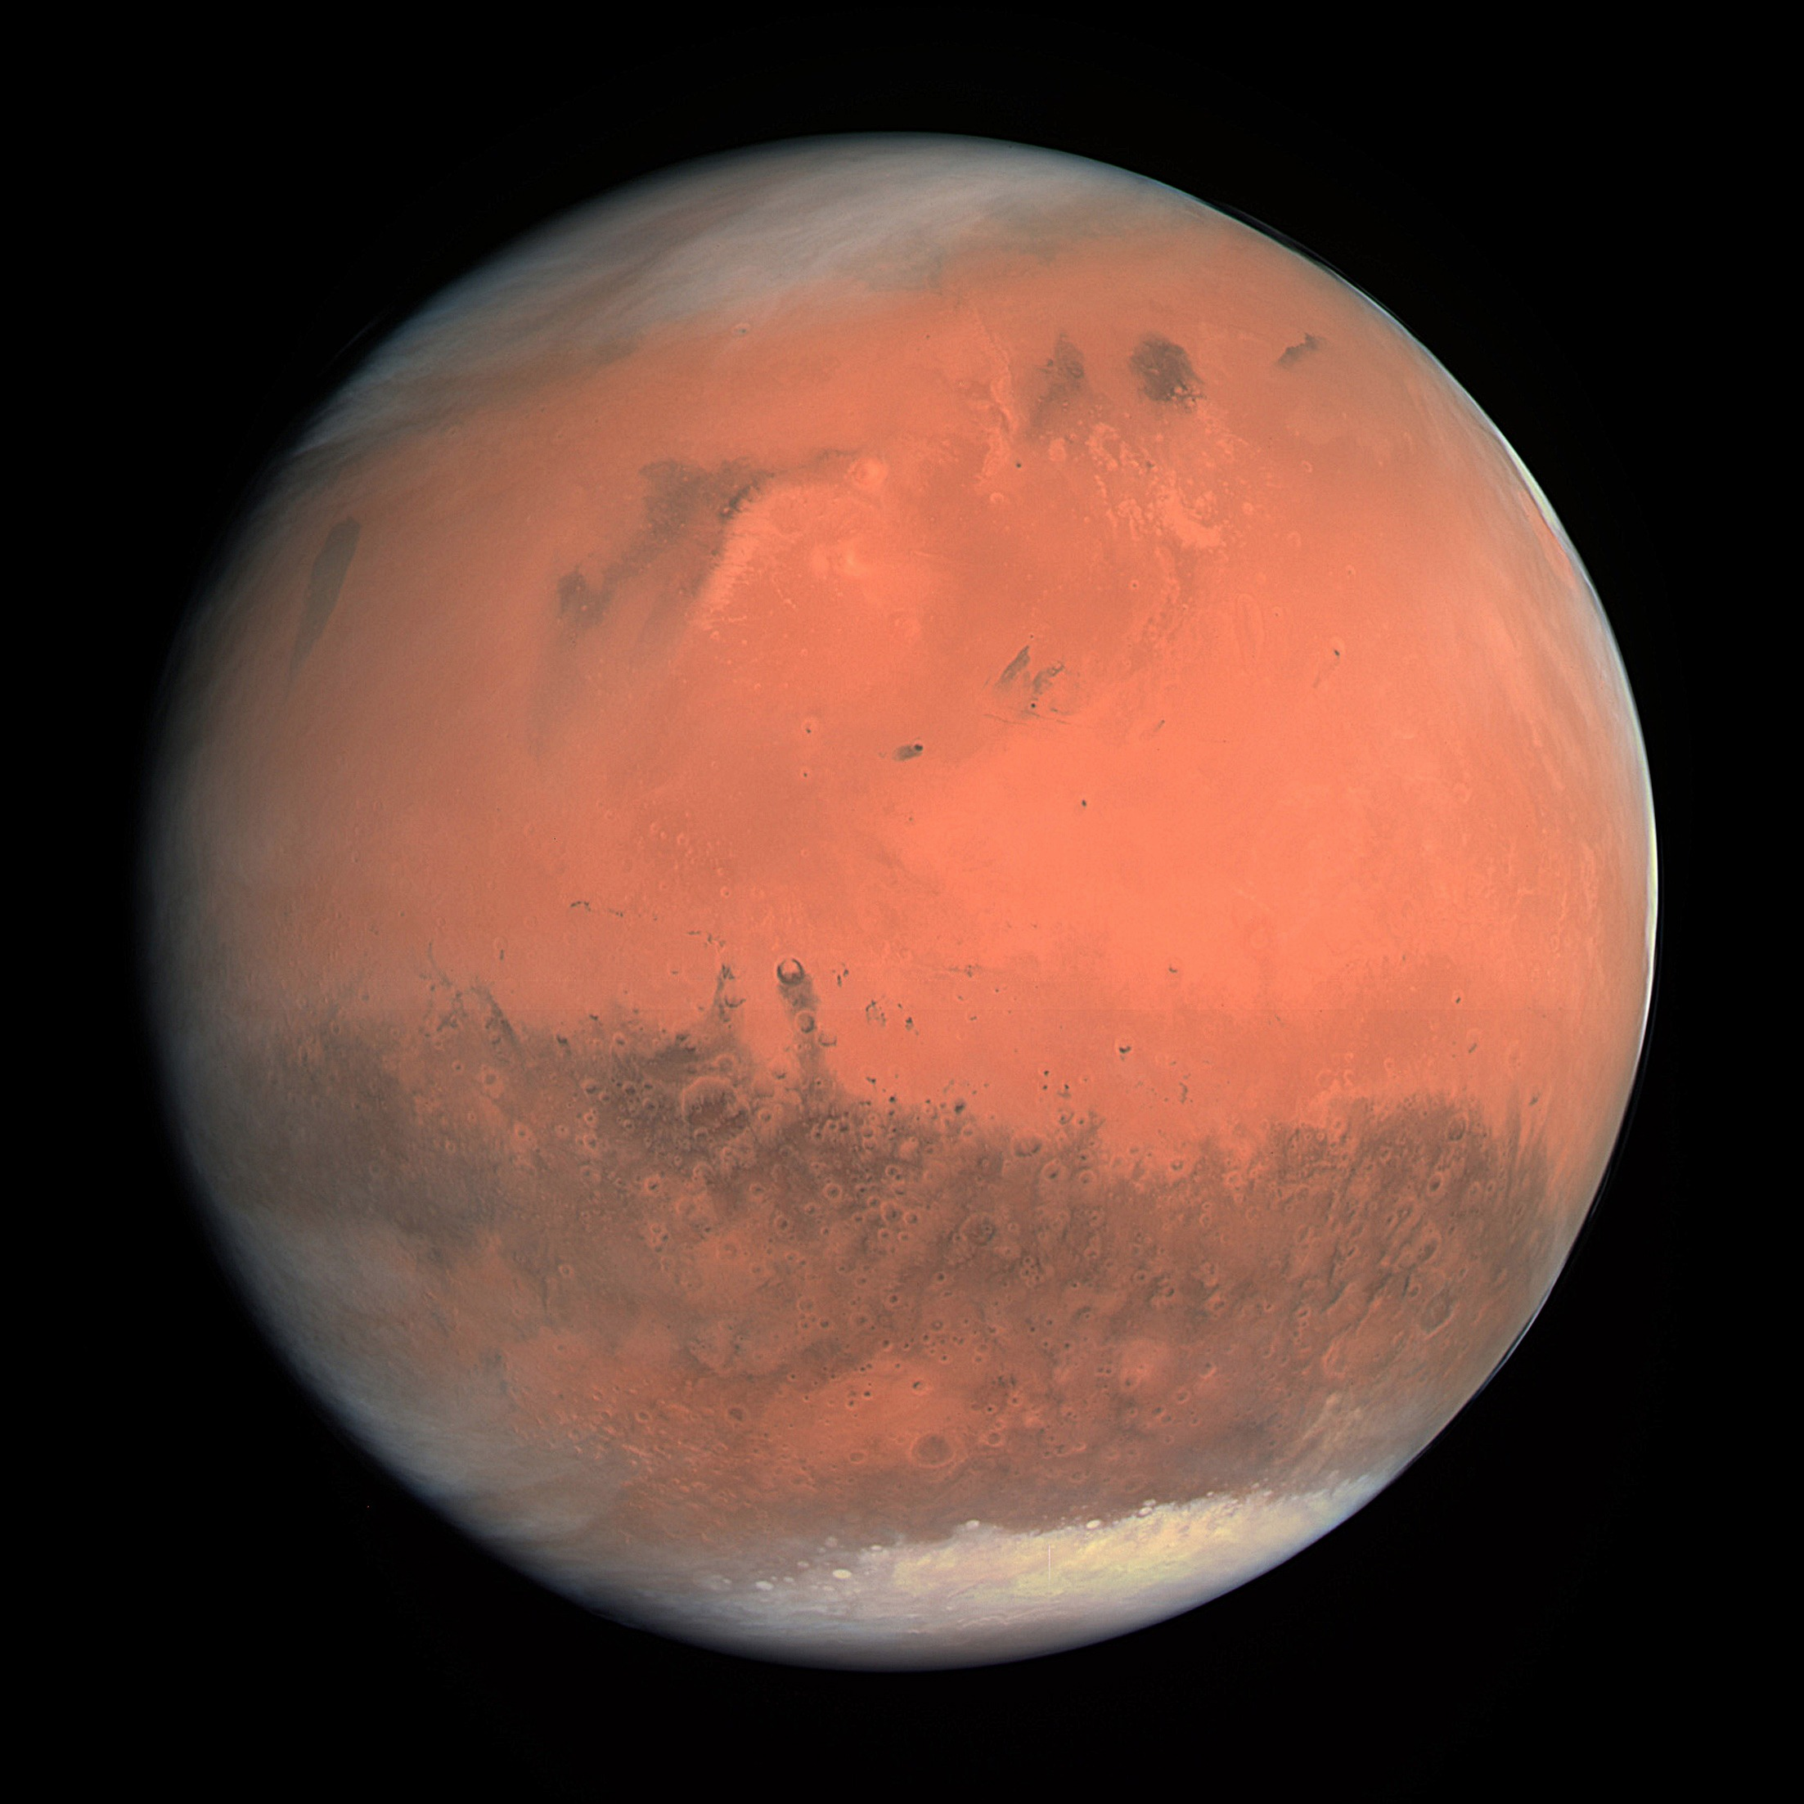
Oxidizing vs. Reducing Species
Data from Linus Pauling. “The Nature of the Chemical Bond,” 3d ed., Cornell University Press, Ithaca, N.Y., 1960.
reduced
iron (Fe⁰)
oxidized
iron (Fe³⁺)
Example redox reaction:
4Fe + 3O₂ → 2Fe₂O₃
Fe electronegativity ~ 1.8
O electronegativity ~ 3.5
reduced
surface (Titan)
oxidized
surface (Mars)
O oxidizes Fe from Fe⁰ to Fe³⁺
Notes:
[with apologies to chemists]
oxidation is loss of electrons, reduction is gain
In plan chem, more oxidizing really does usually mean more oxygen
This is a tale of 3 elems: H, O and Fe

Slide 5
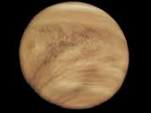
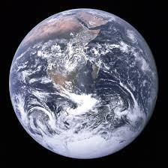
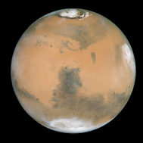
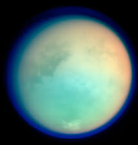
Motivation I: Solar System Oxidation Trends
VENUS
0.72 AU
CO₂-N₂-SO₂ atmosphere
EARTH
1 AU
N₂-O₂ atmosphere
MARS
1.5 AU
CO₂ atmosphere
TITAN
9.6 AU
N₂-H₂-CH₄ atmosphere

Slide 6
Motivation I: Solar System Bulk Oxidation
Trends (Atmosphere, Crust + Upper Mantle)
VENUS
0.72 AU
CO₂-N₂-SO₂ atmosphere
upper mantle f_{O2} near MH?
(Fegley et al. 1997, Wordsworth 2015)
EARTH
1 AU
N₂-O₂ atmosphere
upper mantle f_{O2} near QFM
(Frost et al. 2008)
MARS
1.5 AU
CO₂ atmosphere
upper mantle f_{O2} QFM to IW
(Wadhwa 2001)
TITAN
9.6 AU
N₂-H₂-CH₄ atmosphere
interior composition unknown

Slide 7
Motivation I: Solar System Bulk Oxidation
Trends (Atmosphere, Crust + Upper Mantle)
VENUS
0.72 AU
CO₂-N₂-SO₂ atmosphere
upper mantle f_{O2} near MH?
(Fegley et al. 1997, Wordsworth 2015)
Highly oxidized?
EARTH
1 AU
N₂-O₂ atmosphere
upper mantle f_{O2} near QFM
(Frost et al. 2008)
Moderately oxidized
MARS
1.5 AU
CO₂ atmosphere
upper mantle f_{O2} QFM to IW
(Wadhwa 2001)
Moderately reduced
TITAN
9.6 AU
N₂-H₂-CH₄ atmosphere
interior composition unknown
Highly reduced
What drives these bulk trends?
What is the role of orbital distance vs. planetary mass?
Notes:
UPDATE WRT JON WADE TALK

Slide 8
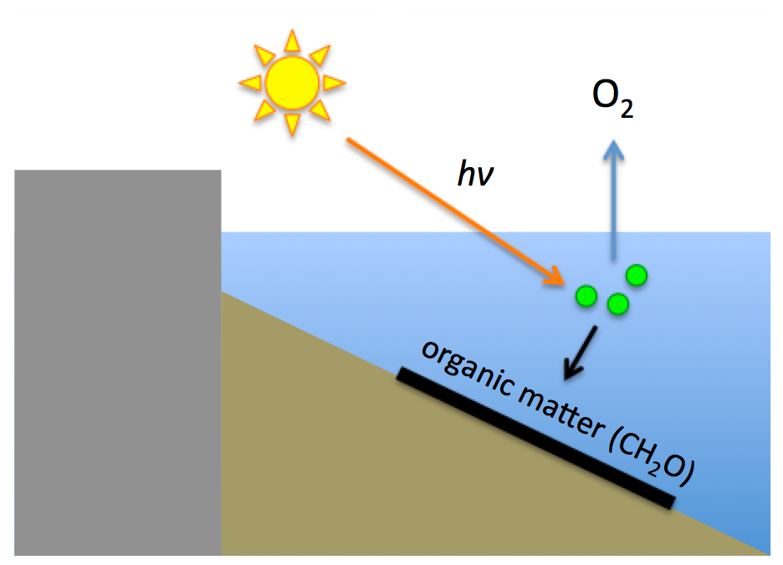
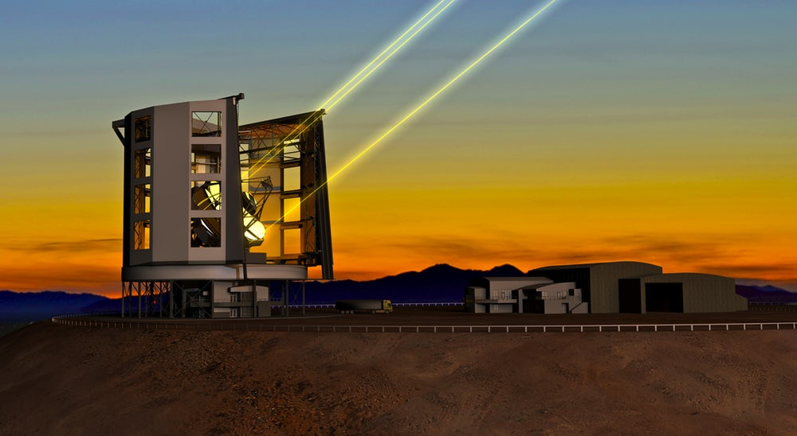
Motivation II: Terrestrial exoplanet oxidation
CO₂ + H₂O + hν → CH₂O + O₂
Earth’s oxygen atmosphere is produced by life
We’ll likely be able to observe O₂ in exoplanet atmospheres in the next this decade (e.g. Snellen et al., 2013; Rodler et al. 2014)
Great! We can detect life on exoplanets!
https://newatlas.com/giant-magellan-telescope/28852/#gallery

Slide 9
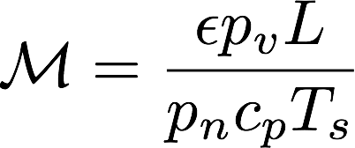
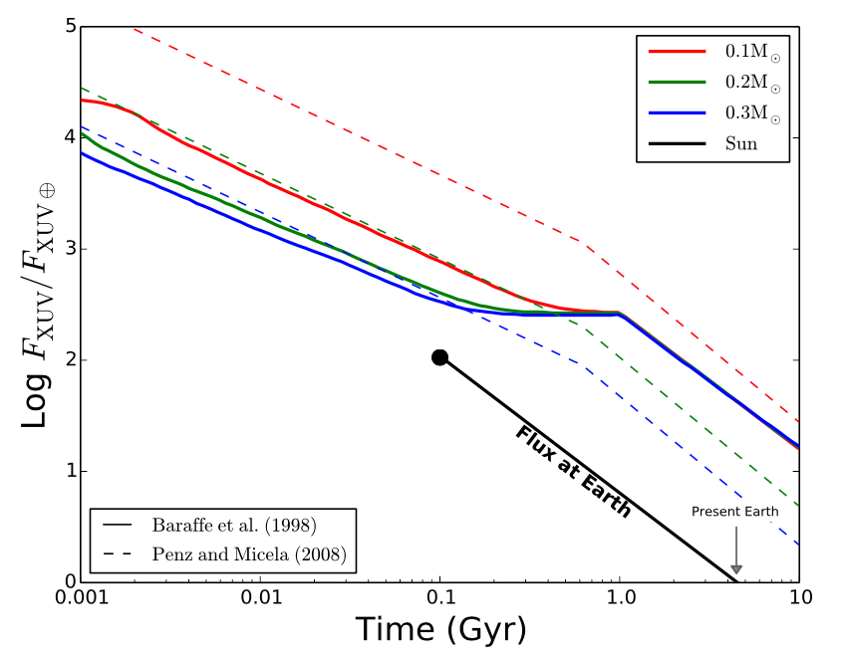
Motivation II: Terrestrial exoplanet oxidation
0.01 bar N₂
(moist stratosphere)
Loss of N₂ / Ar / CO₂ removes a planet’s cold-trap, leading to irreversible O₂ buildup via water loss
M-stars have high stellar activity + XUV levels → enhanced loss of these gases
M-stars also have an extended pre-main sequence phase → long period of water loss + potentially oxidation
Will M-star rocky planets develop abiotic O₂ atmospheres?
1 bar N₂
(dry stratosphere)
Wordsworth & Pierrehumbert (2014)
Luger & Barnes (2016)
Notes:
Fairly recent development
N2 pressure cooker effect

Slide 10
Motivation II: Terrestrial exoplanet oxidation
H loss to space
H₂O + hv → OH + H
Loss of N₂ / Ar / CO₂ removes a planet’s cold-trap, leading to irreversible O₂ buildup via water loss
M-stars have high stellar activity + XUV levels → enhanced loss of these gases
M-stars also have an extended pre-main sequence phase → long period of water loss + potentially oxidation
Will M-star rocky planets develop abiotic O₂ atmospheres?
steam atmosphere
magma ocean
’mush’ region
solid mantle
Luger & Barnes (2016)

Slide 11
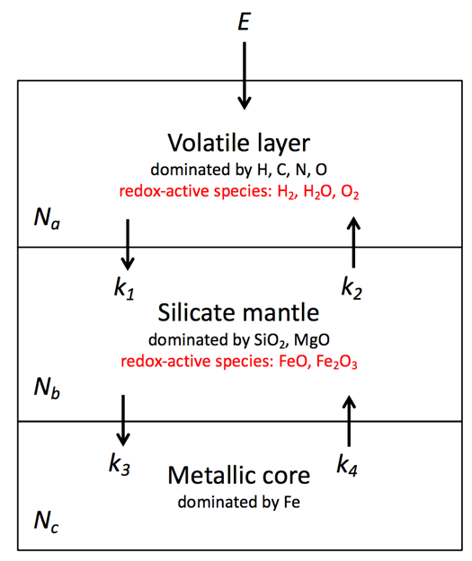
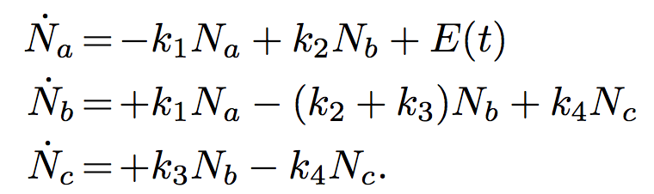
Our approach: A redox evolution model for planetary atmospheres
*
Stellar evolution
Atmospheric escape
Atmospheric chemistry
Radiative transfer + climate
Magma ocean / mantle outgassing
Schaefer, Wordsworth, Berta-Thompson & Sasselov (2016)
Wordsworth, Schaefer & Fischer (2018)
(*H loss = supply of oxidizing power N)
Notes:
Go quick here

Slide 12
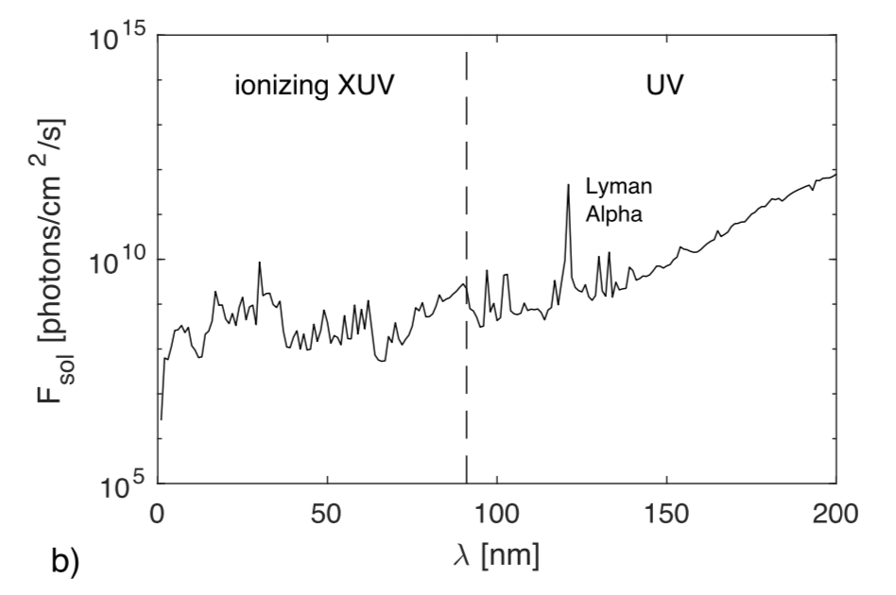
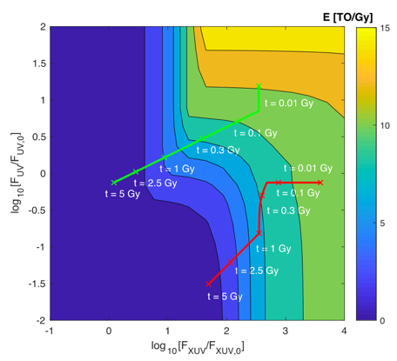
Stellar Evolution
Focus on XUV-driven hydrodynamic escape as dominant loss mechanism
Model stellar bolometric, UV and XUV evolution with time
Bolometric evolution curves from Baraffe et al. (2015)
G-star XUV/UV evolution based on Ribas et al. (2005); Claire et al. (2012)
M-star XUV/UV evolution bounded based on Loyd et al. (2016), Shkolnik & Barman (2014)
Notes:
Most important for H escape early on, CME etc. for heavier gases
M-stars have higher XUV, lower UV

Slide 13
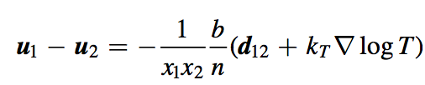
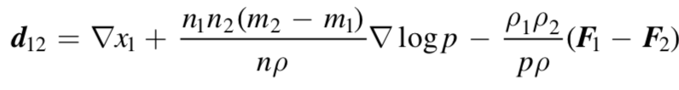
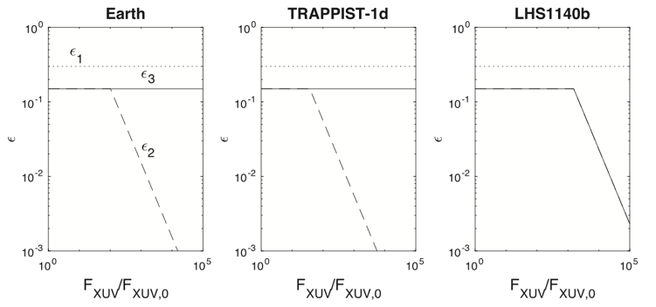
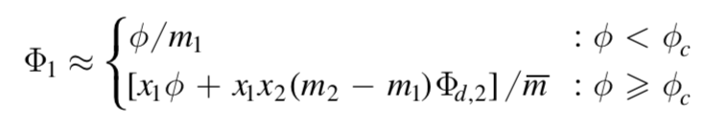
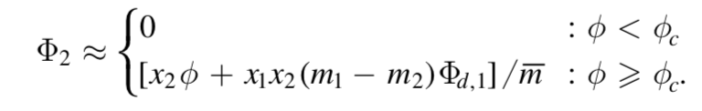
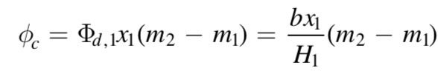
Atmospheric Escape
Dependence of escape efficiency on radiative processes bounded
Drag of O with H taken into account (derived from general diffusion equations)
Significantly simpler than using Hunten et al. formalism!
Energy-limited escape efficiency

Slide 14
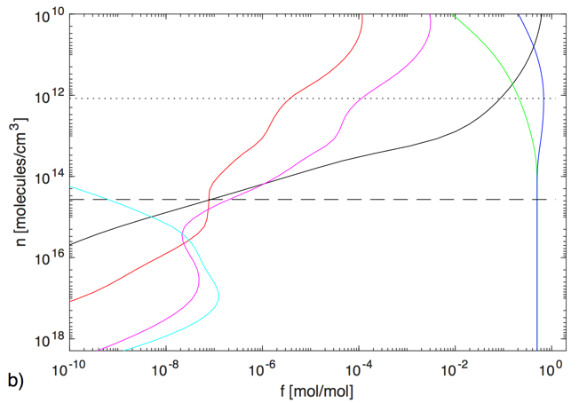
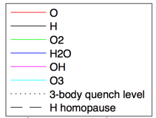
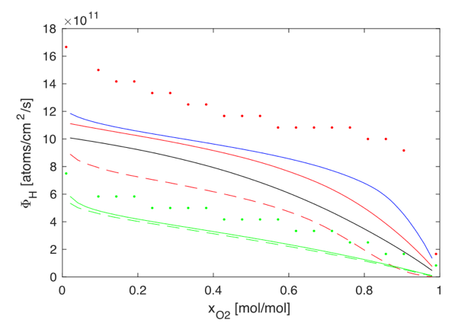



Atmospheric Chemistry
Key question: Can photochemical feedbacks involving O₂ buildup shut down H escape?
We used 1D model with 100 levels, backwards Euler, eddy + molecular diffusion
Result: No shutdown! Hydrogen loss rate has ~linear dependence on stellar UV flux and atmospheric O₂ concentration
Good agreement with results from Mars modeling (Chaffin et al. 2017)
Throttle mechanism:

Slide 15
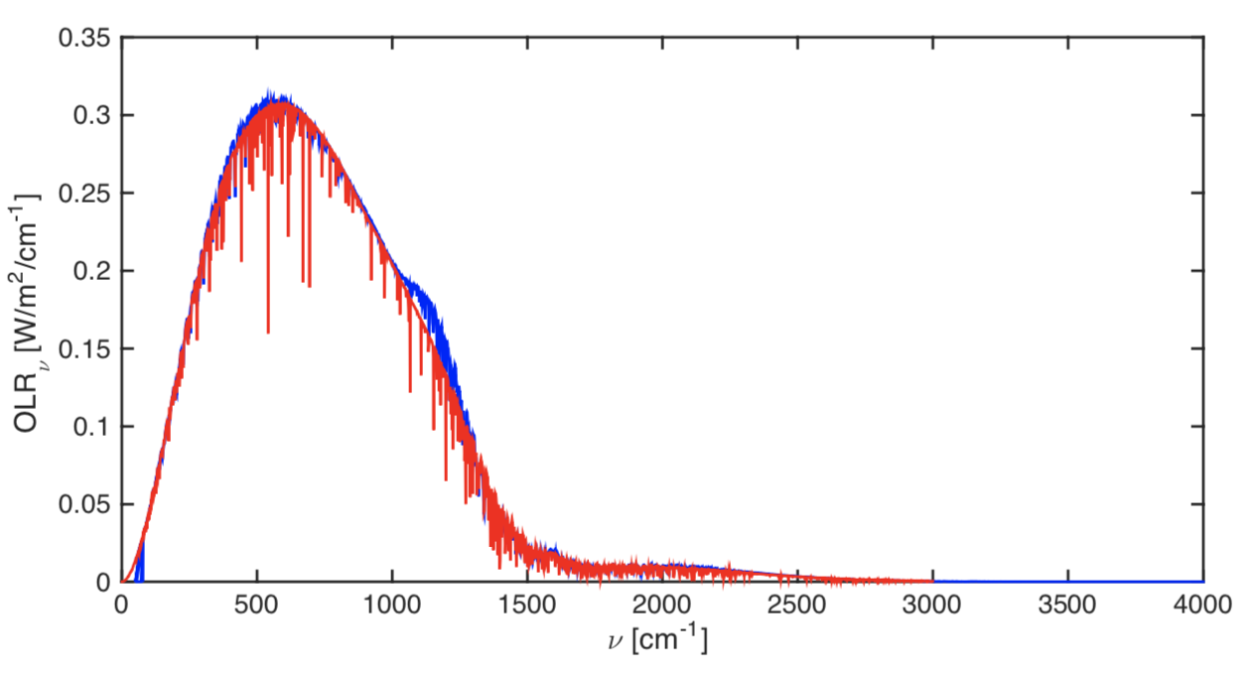
Radiative Transfer
Line-by-line radiative transfer used to calculate OLR under magma ocean conditions with H₂O, CO₂ atmosphere
100 levels, 8000 spectral intervals, MT-CKD continuum for H₂O
Albedo is treated as a free parameter, with default A = 0.3
Runaway greenhouse
model validation vs.
Goldblatt et al. 2013
Notes:
Skim over this

Slide 16
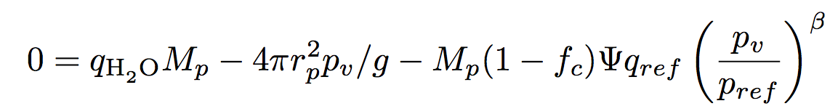
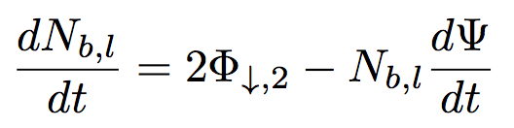
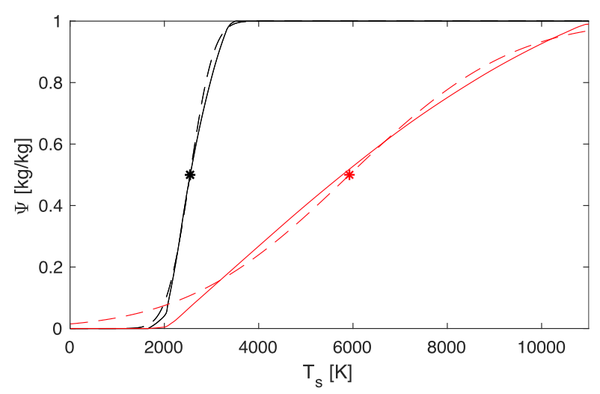

Magma ocean
H, O loss to space
H₂O / CO₂ equilibration
H₂O, CO₂, O₂ exchange
Oxygen partitioning
magma ocean
FeO, Fe₂O₃
’mush’ region
Variation of global melt fraction with T_{s}
solid mantle
Not included: Redox disproportionation
Notes:
You heard quite a bit from Laura about our MO modeling yesterday
Simplified in this treatment

Slide 17
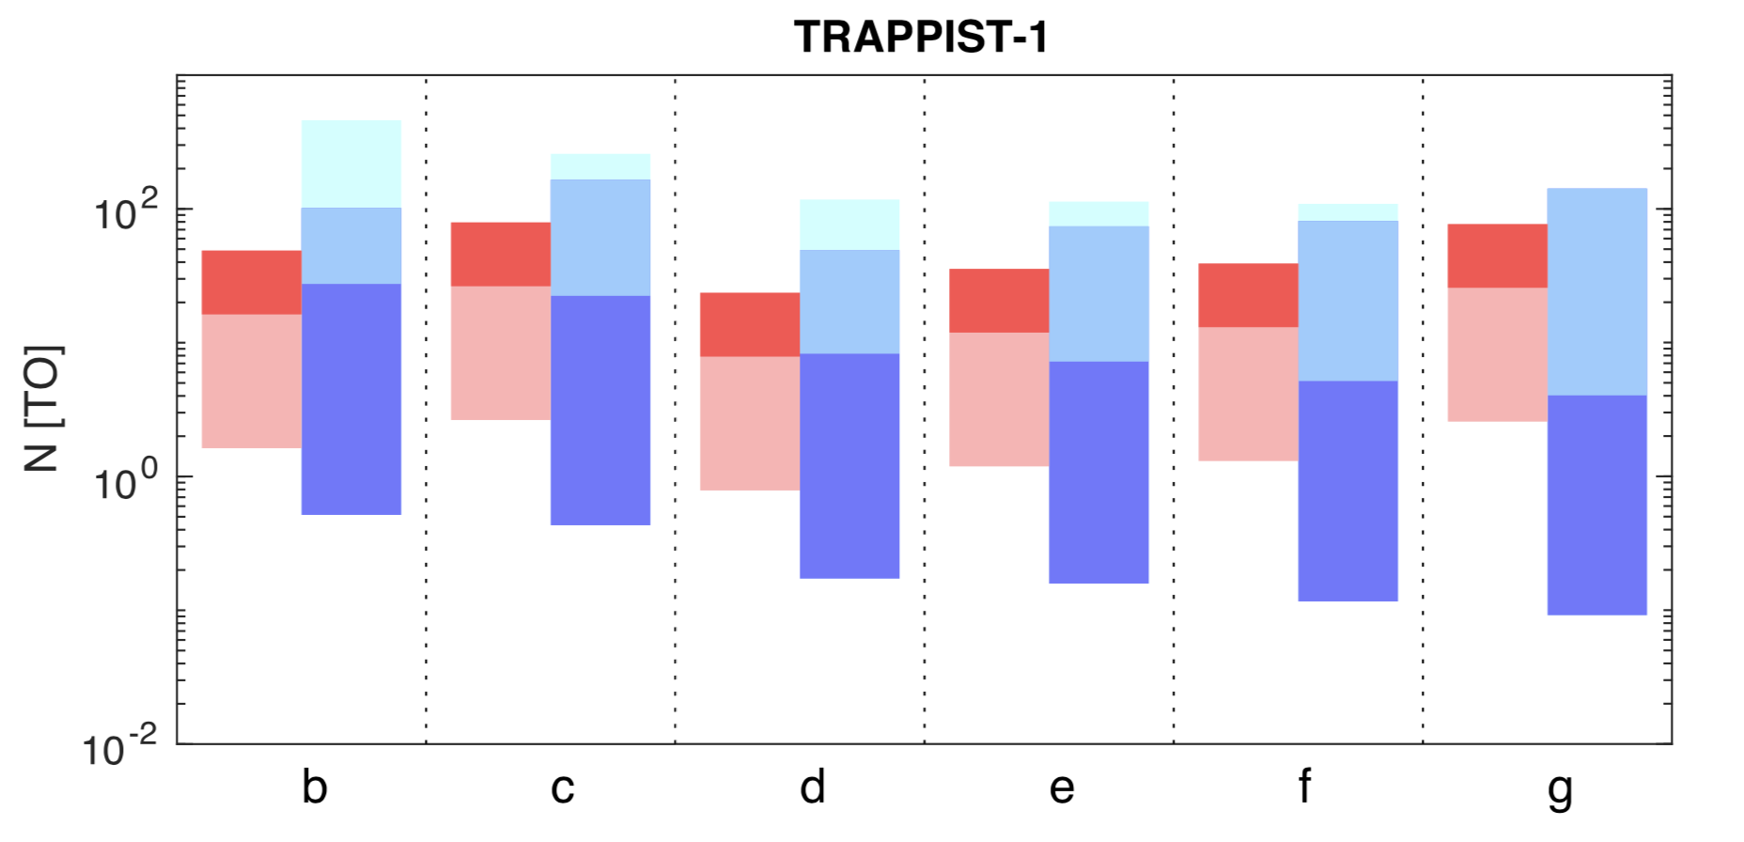
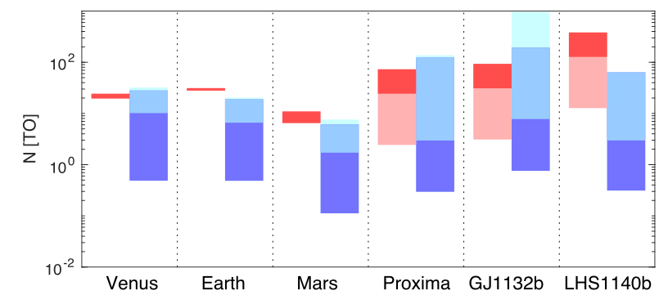
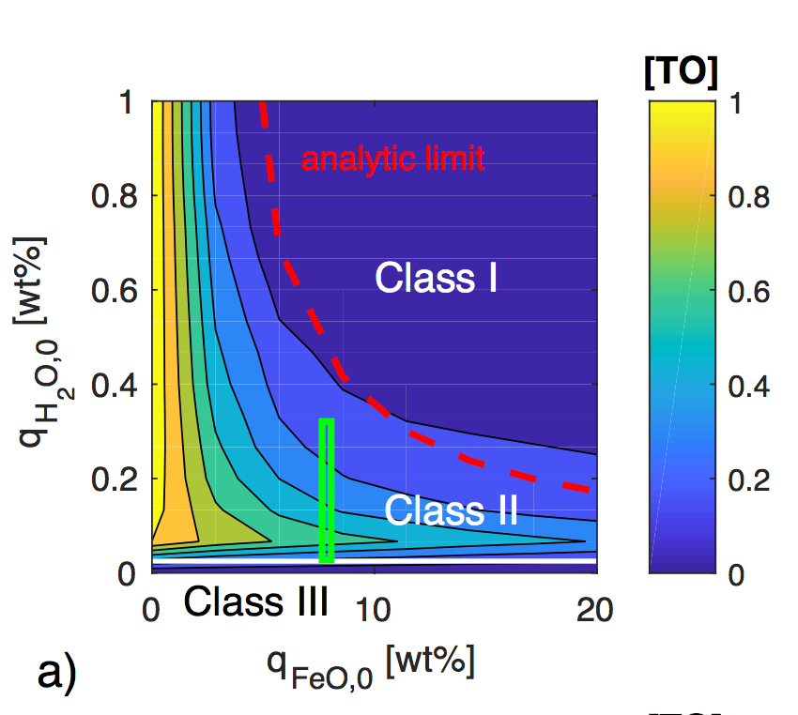
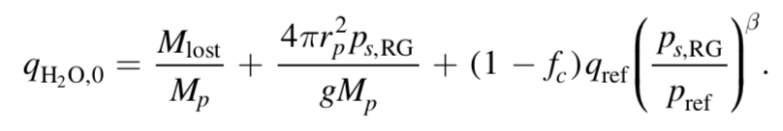
Model Results: Dependence on H₂O and mantle iron content
total potential oxidation
via water loss
plausible mantle FeO range
atmospheric O₂
Notes:
We start without H2, to be conservative

Slide 18
Model Results:
Dependence on orbital distance

Slide 19
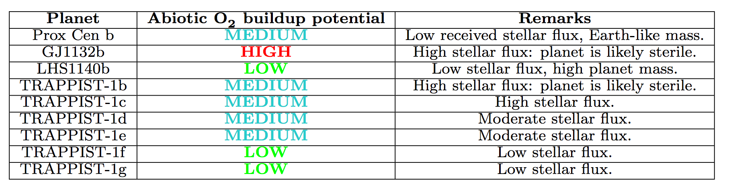
Executive Exoplanet Summary
(pre-TESS)
Hot, lifeless targets like GJ1132b are particularly exciting, as they are easier to observe, and provide a means to test our predictions independently of the possible presence of life
Notes:
Predictions for pot hab planets
But also validate models vs. obs for e.g. GJ1132b (as Laura disc yesterday)

Slide 20

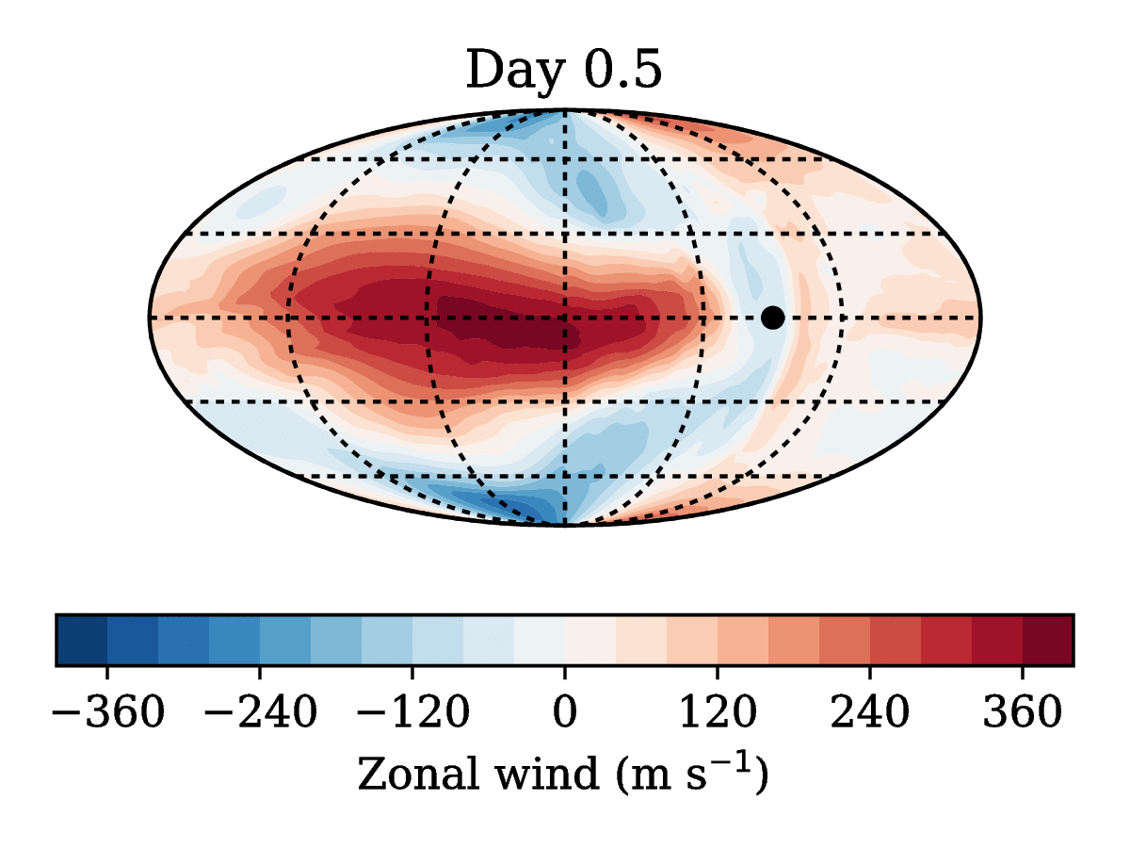
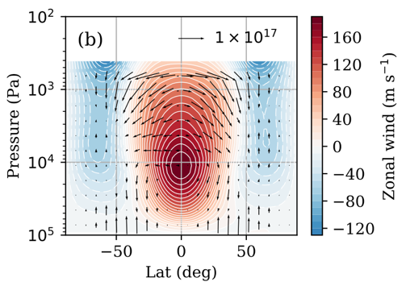
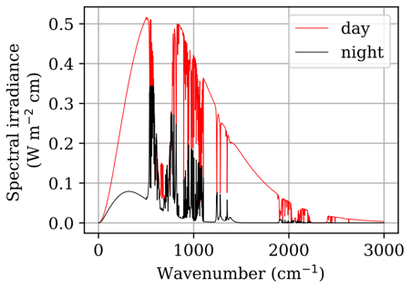
Line-by-line 3D GCM simulations of GJ1132b
To complement our atmospheric evolution studies, we have developed a new GCM that uses line-by-line radiative transfer
We have made climate and phase curve predictions for O₂-CO₂ atmospheres on the hot terrestrial exoplanet GJ1132b
Model extensions for future applications in exoplanet and solar system research are in progress
Ding & Wordsworth, ApJ, 2019
https://arxiv.org/abs/1905.04635
Notes:
Shout out for work by my v talented postdoc feng ding

Slide 21
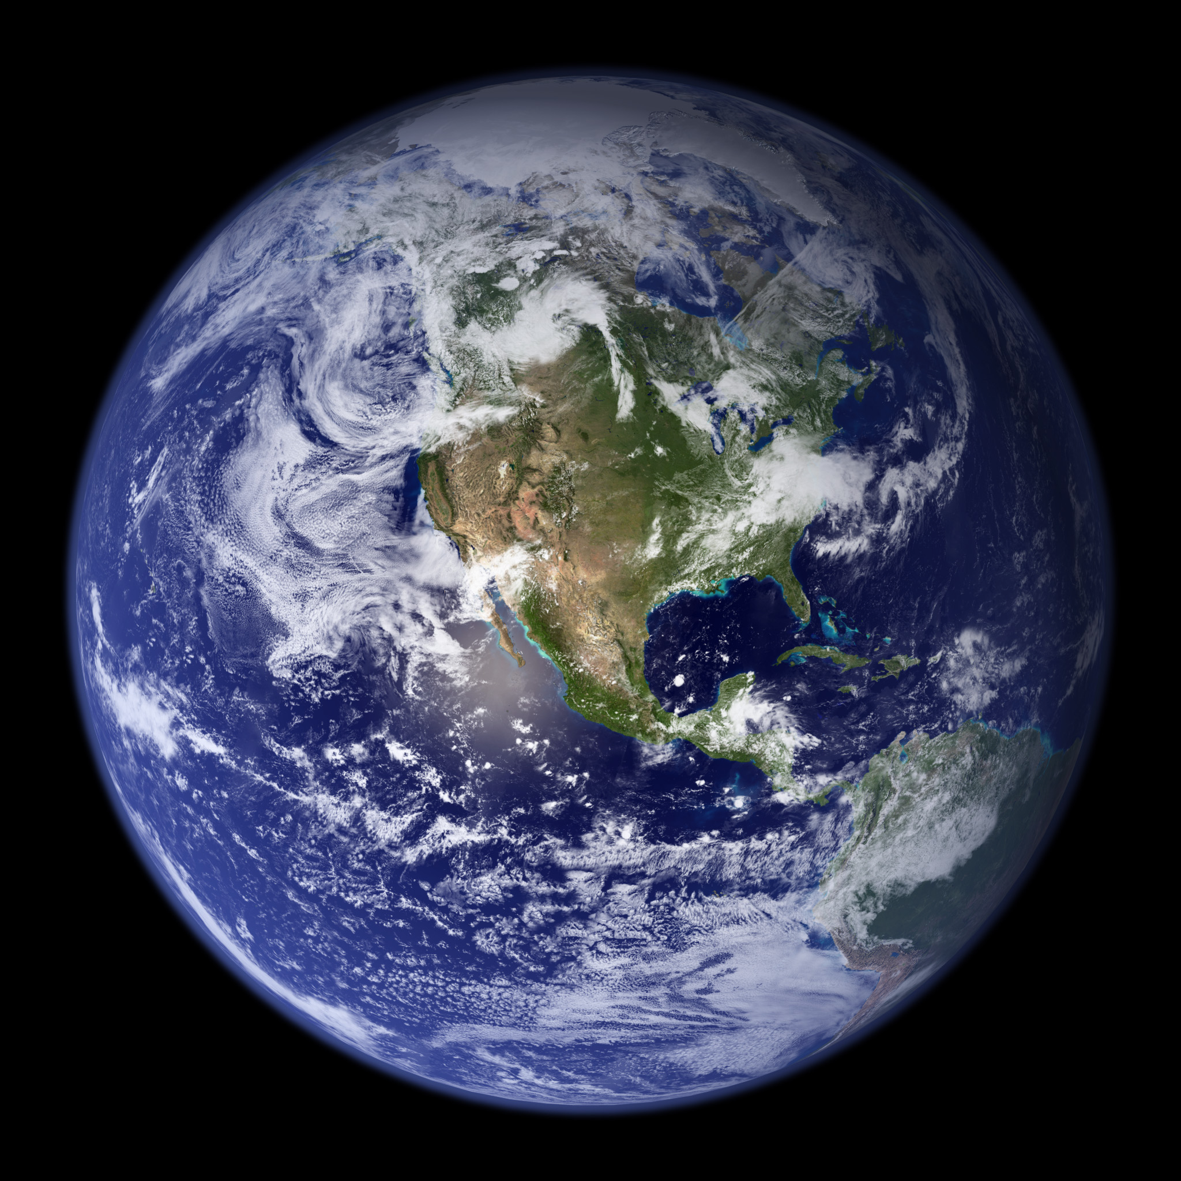
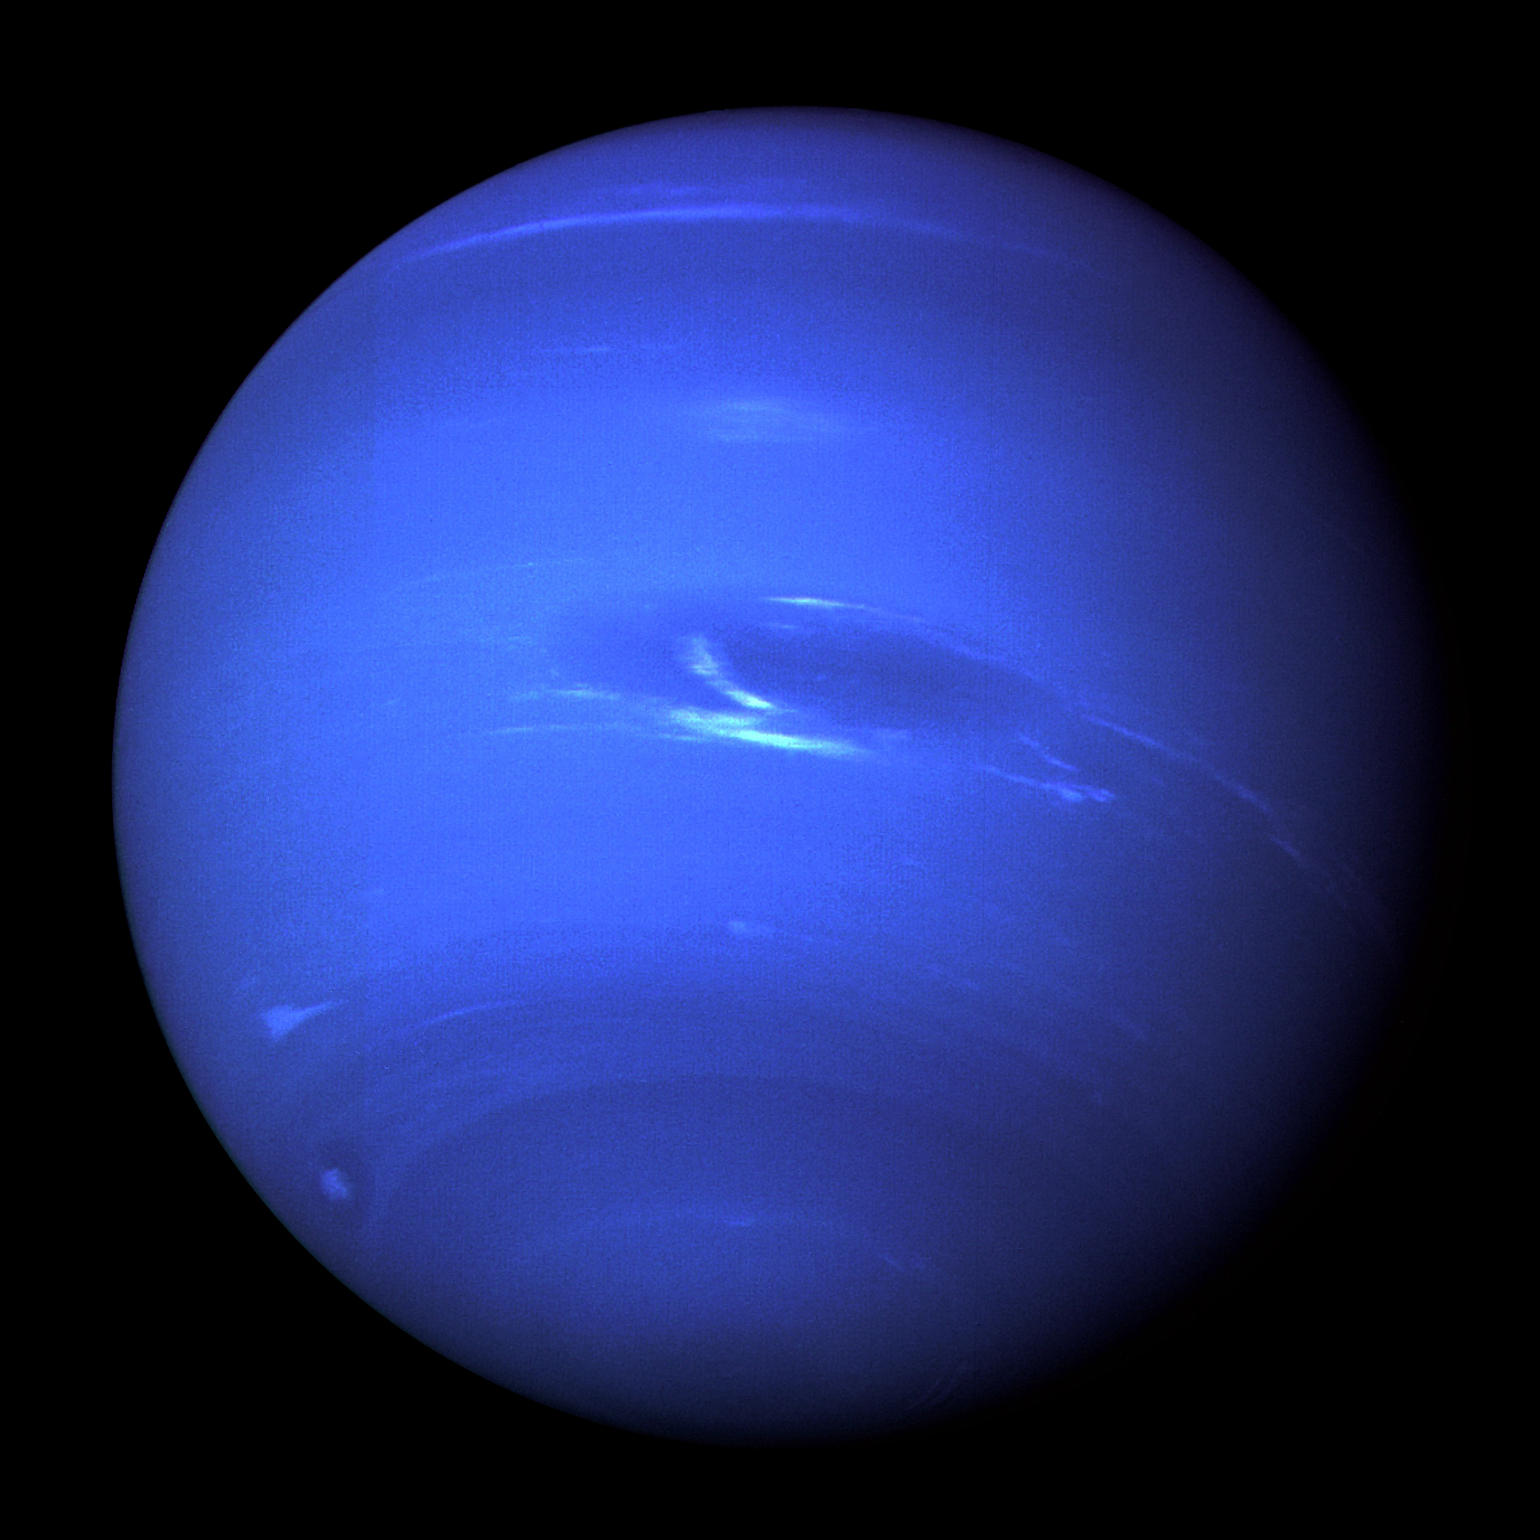
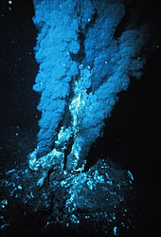
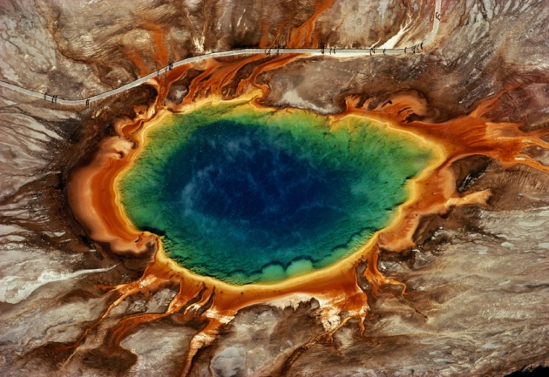
A Redox Goldilocks Zone?
OVER-OXIDIZED
Both oxidized and reduced
surface/atmosphere reservoirs
UNDER-OXIDIZED
Fertile conditions for biogenesis…
?
?
?
Notes:
Degree of oxidation should be considered as a habitability parameter
Need ways to assess remotely!

Slide 22
Future Steps
Extension of the model to include C, N, S species
Better experimental constraints on mantle redox disproportionation, magma solubility of various species under a wider range of conditions
Development of robust observational criteria for determining a planet’s atmospheric redox state
James Webb + GMT/E-ELT observations!

Slide 23
Part II: Detection of surface liquid water

Slide 24
Diagnosing the presence of surface oceans on exoplanets
Diagnosing the presence of surface oceans on exoplanets is going to be difficult
Previous studies have proposed e.g. ocean glint (Robinson et al. 2010); however this will be extremely challenging
What if we could use transit observations sensitive at cloud/aerosol height to interrogate the surface hydrology of a planet indirectly?

Slide 25
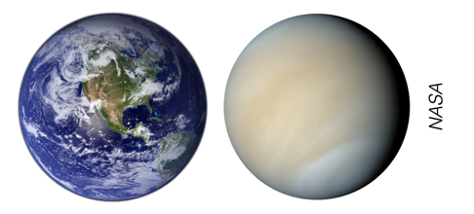
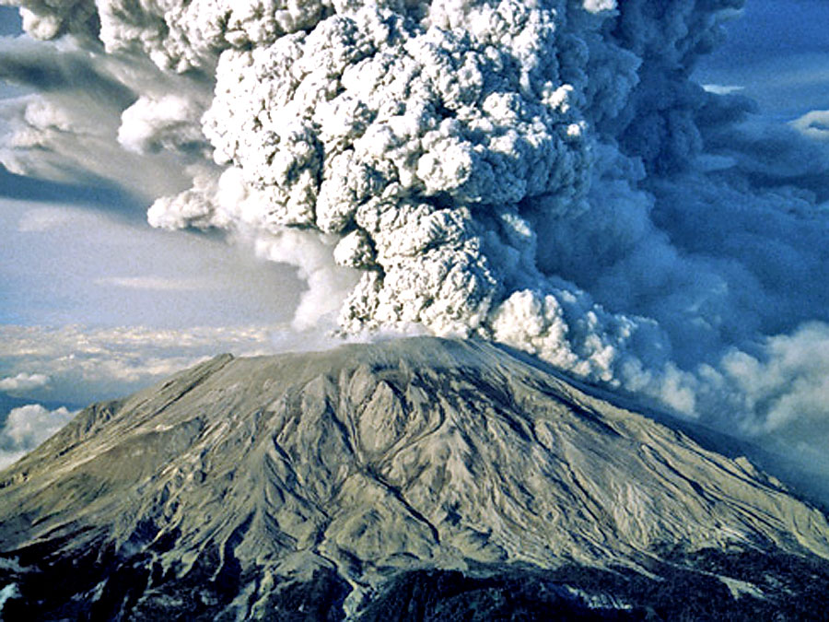
Using sulfur to constrain the presence of oceans on exoplanets
?
Under what circumstances could an Earth-like planet support a permanent Venus-like sulfate aerosol haze layer?
Loftus, Wordsworth & Morley, ApJ, 2020
https://arxiv.org/abs/1908.02769

Slide 26
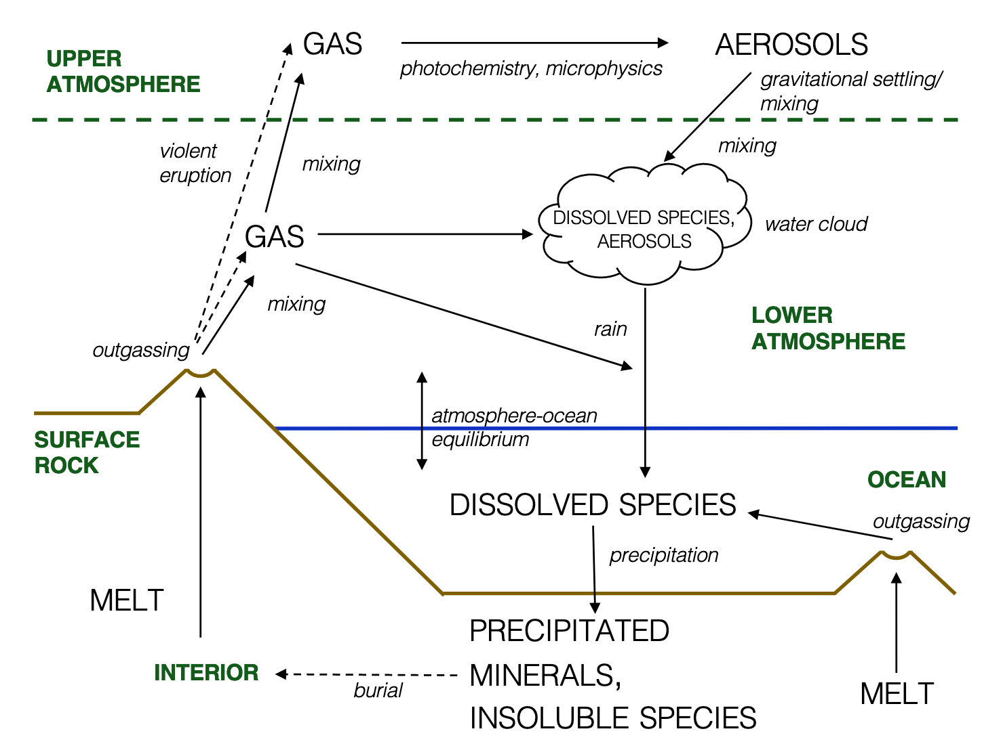
Loftus, Wordsworth & Morley, ApJ, 2020
Notes:
Highlights:

Slide 27
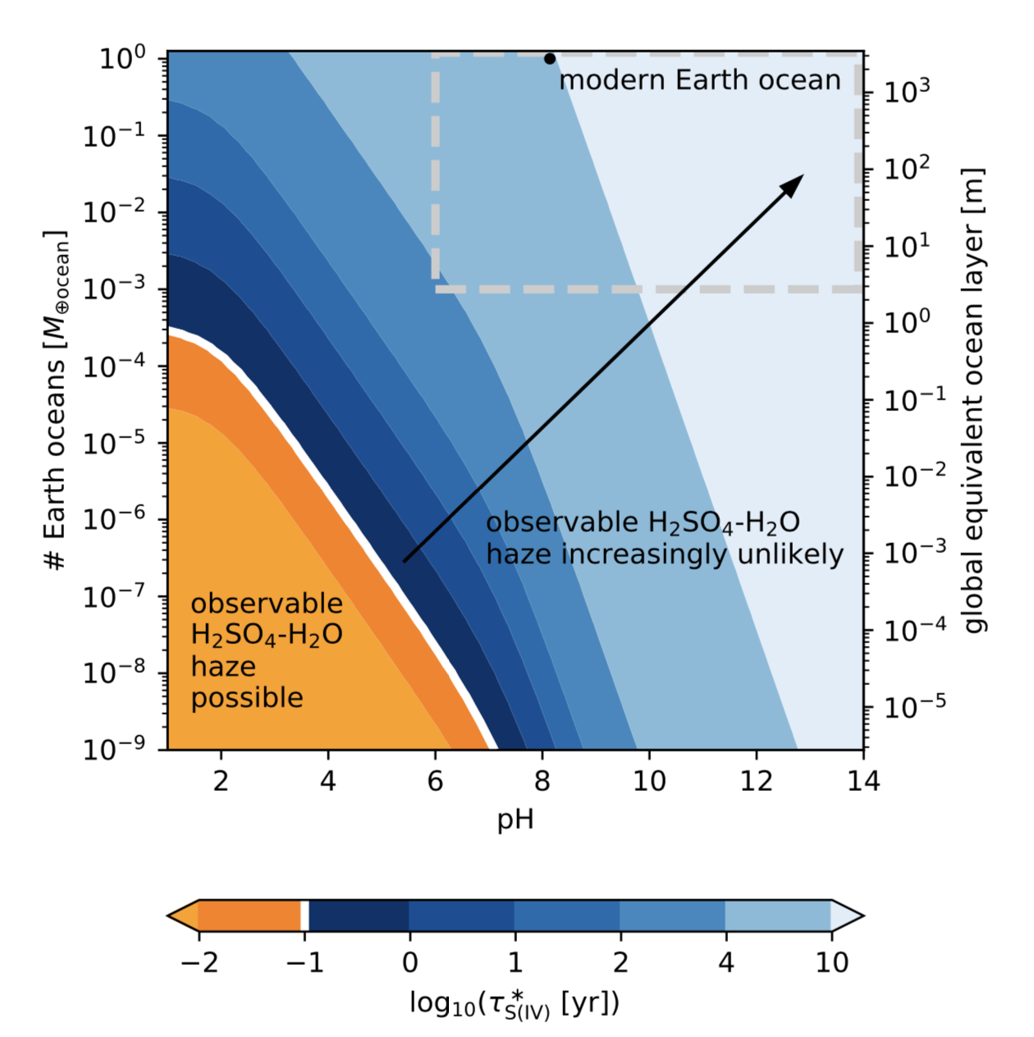
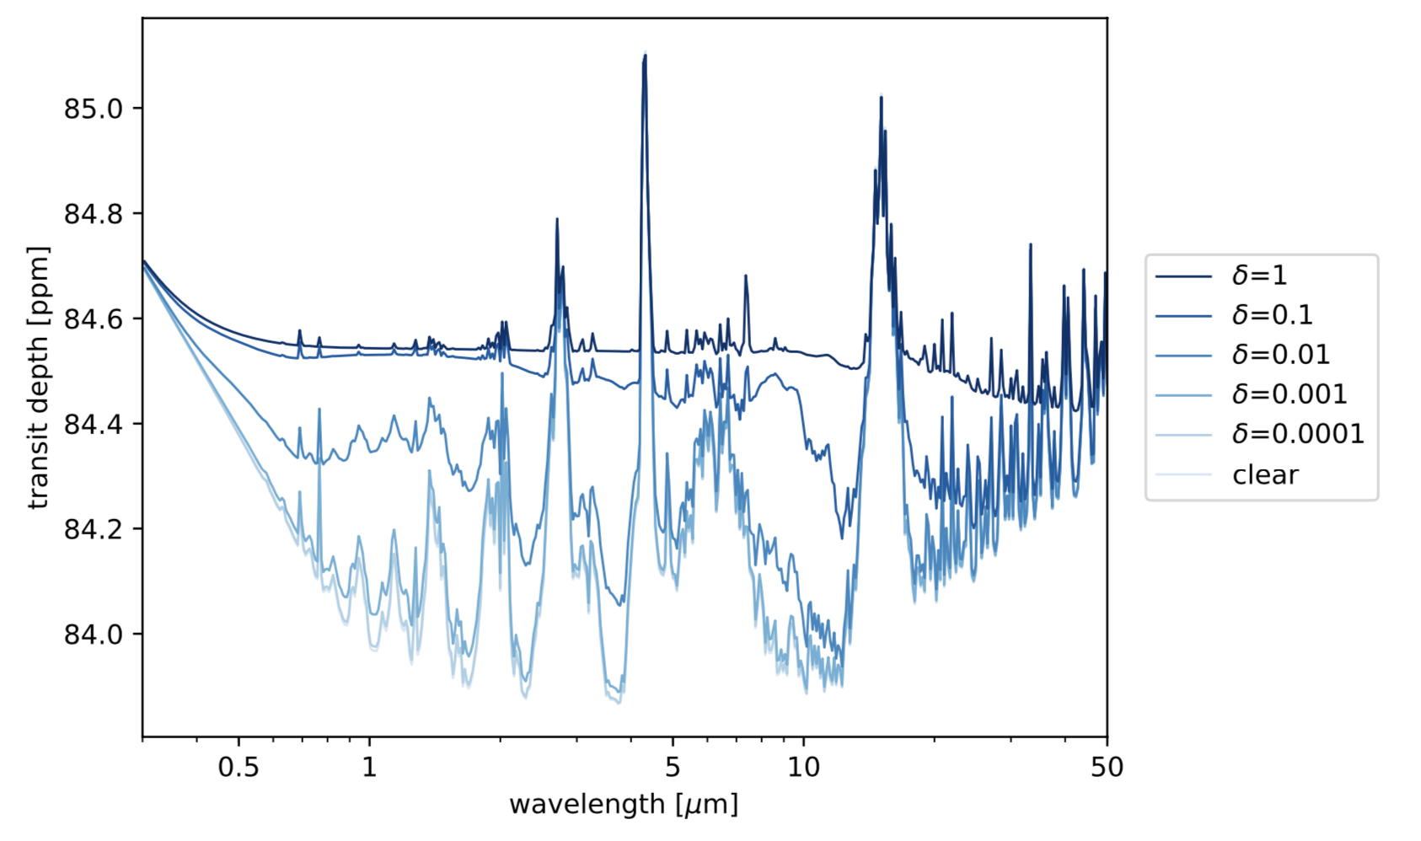
Using sulfur to constrain the presence of oceans on exoplanets
haze formation
inhibited
Loftus, Wordsworth & Morley, ApJ, 2020
Notes:
Delta=0.01 requires about 50 ppb; 0.04 ppb if well-mixed today, more anthropogenic emissions today
1/1250

Slide 28
Conclusions I
To understand planetary oxidation in a generalized way, we have constructed a model that couples chemistry, escape and mantle exchange processes.
Results indicate that wet planets and/or FeO-rich planets do not build up abiotic O₂ atmospheres during their magma ocean phase
Total planet surface oxidation rate strongly decreases with orbital distance. Dependence on mass is still hard to predict, with multiple competing effects.
Detection of O₂ (particularly combined with H₂O) in the atmosphere of LHS1140b, TRAPPIST-1f/g, or similar TESS planets would be a strong suggestion that life was present on those worlds
Notes:
Atmospheres of gas giants: H₂-rich
Rocky planet atmospheres: heavier, more oxidized, and much more diverse
Also, focus on abiotic processes

Slide 29
Conclusions II
Earth-like planets with even small surface oceans cannot sustain high SO₂ concentrations or sulfate aerosol layers that would be observable in transit
Hence if long-lived SO₂ or sulfate aerosols are detected in the upper atmosphere of a rocky planet, that planet does not possess appreciable surface liquid water
Notes:
However, the converse is not true: absence of haze does not imply water!

Slide 30
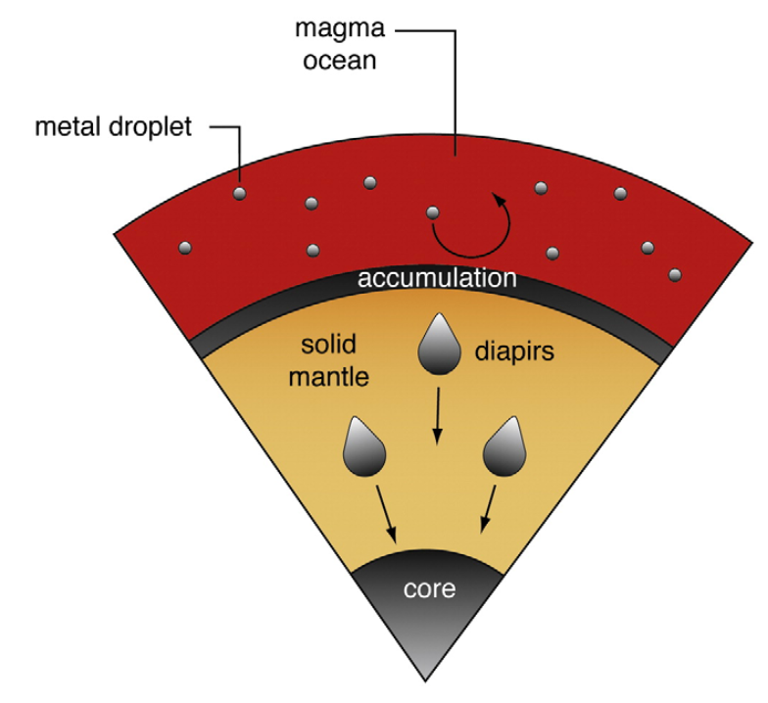
Initial conditions:
Temperature, FeO, H₂O and H₂
Initialize planet in a magma ocean state (accretion heat flux, pre-MS stellar luminosity)
Assume rapid early core formation → k₃ = k₄ = 0. Vary initial mantle FeO in the range 0-20 wt% (Fischer et al. 2017)
Vary H₂O in range 0–1 wt%.
Assume no initial H₂ envelope
Corgne et al, EPSL, 2009

Slide 31
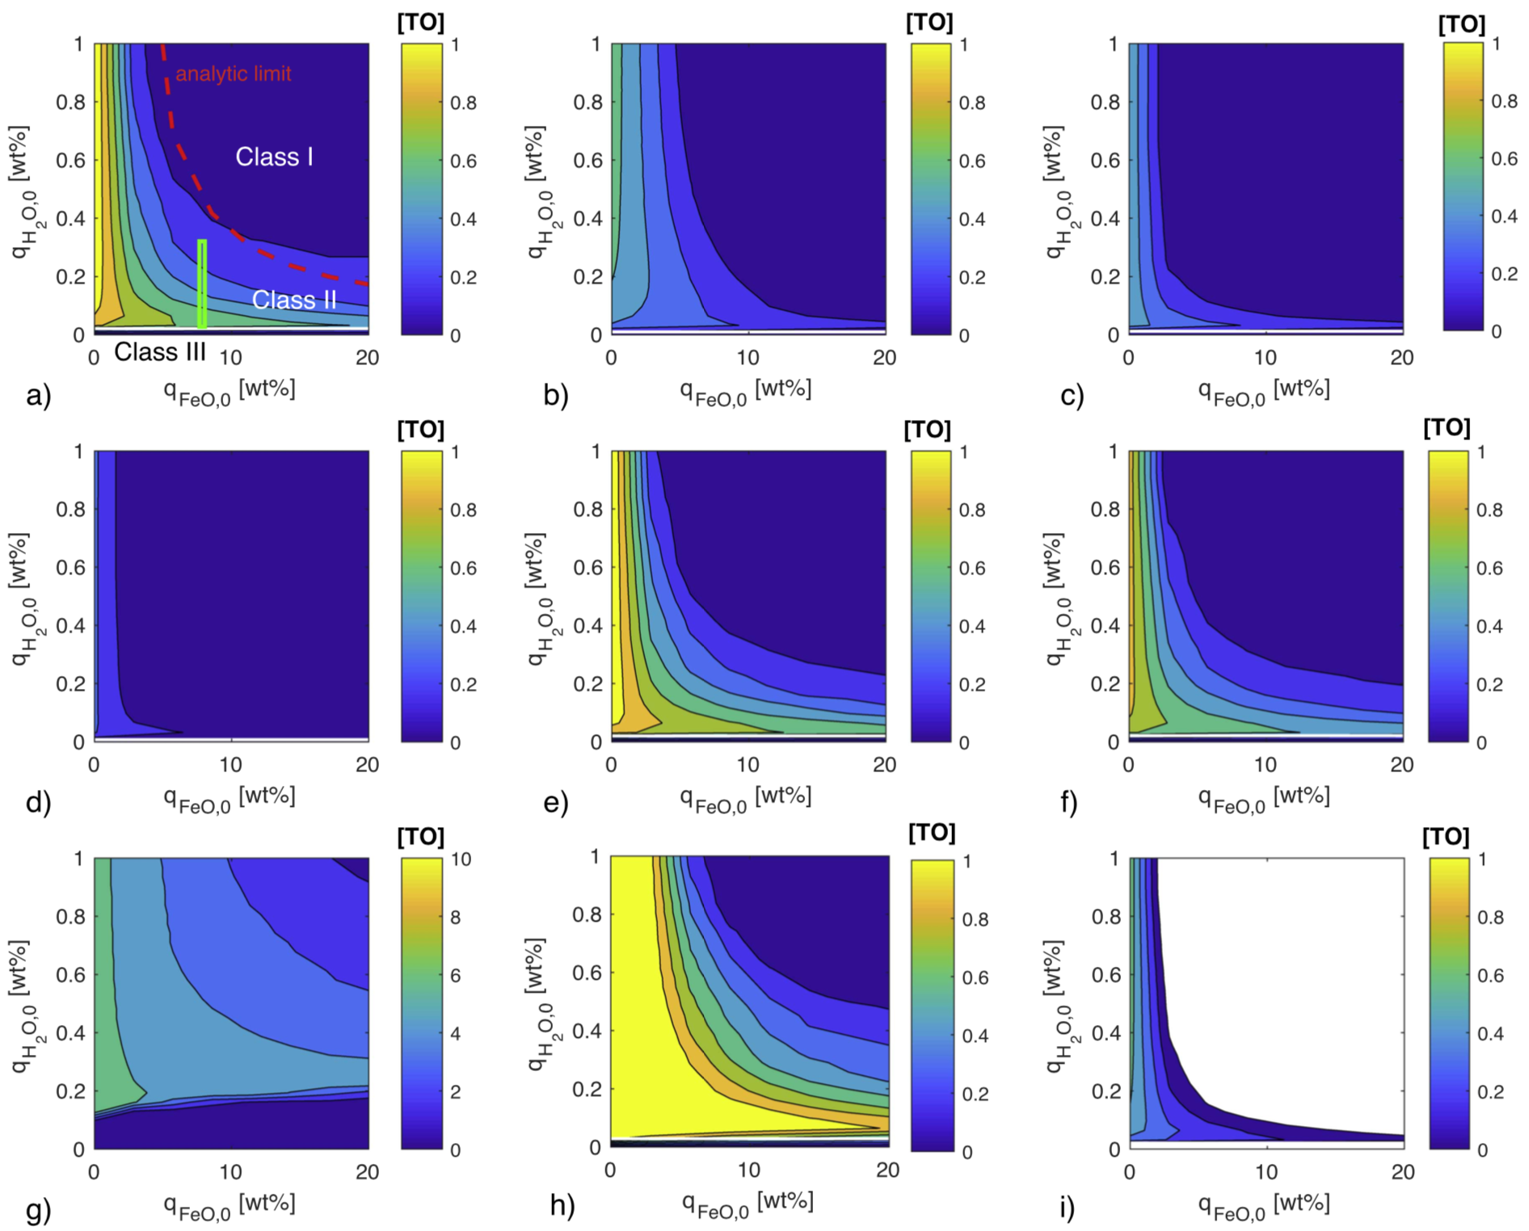
Sensitivity Tests
Notes:
SKIM

